Slide 1
Improving Pandemic Recovery Efforts in Education Agencies (ALN 84.305X)
Corinne Alfeld
James Benson
Allen Ruby
National Center for Education Research
Institute of Education Sciences

Slide 2
Agenda
IES and its Research Grant Programs
General requirements that apply to the Improving Pandemic Recovery Efforts in Education Agencies grant program
Improving Pandemic Recovery Efforts in Education Agencies (84.305X)
Prekindergarten through Grade 12 Recovery Research Network (1 Network Lead and 5 Research Teams)
Community College Recovery Research Network (1 Network Lead and 5 Research Teams)
Application, Submission, and Review
Notes:
Here is the agenda for the presentation.
This presentation provides an overview and you should read the Request for Applications and the IES Grant Submission Guide before writing and submitting your application for a grant.
.

Slide 3
Introduction to IES Research Grants

Slide 4
U.S. Department of Education Institute of Education Sciences (IES)
IES is the independent research arm of the U.S. Department of Education, authorized by the Education Sciences Reform Act in 2002. We are non-partisan. We are charged with providing rigorous evidence to inform education practice and policy, and sharing this information with educators, parents, policymakers, researchers, and the public.
The overall mission of IES is to:
Describe the condition and progress of education in the United States
Identify education practices that improve academic achievement and access to education opportunities
Evaluate the effectiveness of Federal and other education programs
Notes:
IES is the research arm of ED - Independent and non-partisan.
IES’ mission is to:
Describe the condition of education in the US
Evaluate the effectiveness of Federal ed programs
Identify practices to improve access and academic outcomes

Slide 5
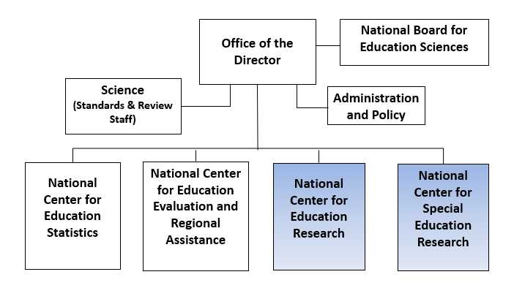
Organizational Structure of IES
Notes:
Director: Appointed by President, approved by Senate, advised by Board (appointed and approved as well)
NCES: Describe the condition and progress of education in the United States
NCEE - Contracts: Evaluate the effectiveness of Federal and other education programs
NCER and NCSER: Grants to Identify education practices that improve academic achievement and access to education opportunities as well as evaluate education programs
Office of Science – responsible for peer review

Slide 6
Objectives of IES Research Grant Programs
Identify the practices, processes, programs, and policies of students, teachers, schools, districts, and states that can be influenced by the education system that are linked to student education outcomes
Develop or identify education interventions (practices, programs, policies, and approaches) that enhance education outcomes and can be widely deployed
Understand the processes that underlie the effectiveness of education interventions and the variation in their effectiveness (what works for whom, where, and under what conditions; key components of interventions)
Develop measures of (e.g., processes, education outcomes, implementation) and validate them using student outcomes
Identify interventions and measures that do not work as expected
Develop research methods for use by education researchers
Notes:
Develop or identify education interventions (i.e., practices, programs, policies, and approaches) that enhance academic achievement and that can be widely deployed
Identify what does not work and thereby encourage innovation and further research
Understand the processes that underlie the effectiveness of education interventions and the variation in their effectiveness (what works for whom and under what conditions)

Slide 7
Intended Outcomes of IES Education Research Grants
Improved access to a high-quality education for all learners from early childhood through adulthood, particularly those at risk of failure
Improved academic achievement for all learners from early childhood through adulthood, particularly those at risk of failure
Reduced opportunity gaps and achievement gaps between high- and low-performing learners
Improved access to, persistence in, progress through, and successful completion of postsecondary education
Notes:
Outcomes set in the Education Sciences Reform Act of 2002 which established IES
Improve access and achievement for all students, particularly those at risk for failure

Slide 8
Projects Should Yield Meaningful Findings and Products
Contribute knowledge and theory of teaching, learning, and organizing education systems
Identify the benefits and effects that programs, policies, and practices have on relevant outcomes for learners
Identify costs and cost effectiveness of such programs, policies, and practices
Disseminate findings and products in a way useful to and accessible by educators, parents, policymakers, researchers, and the public
Notes:
Emphasize both the rigor of the research and the value of the research to practice
How to apply findings to education practice?
What are the links or impacts to student outcomes?
What are the costs?
How will findings be disseminated to a wide audience, not only researchers but to those involved in practice?

Slide 9
Focus on Student Education Outcomes
Projects must address student academic outcomes
Learning and achievement in the core academic content areas.
Student progression through the education system
Other student outcomes when appropriate as well
Social, behavioral, emotional, and mental health outcomes
Employment and labor market outcomes
Developmental and functional outcomes for students with or at risk for disabilities
Also include teacher outcomes if these are addressed by the recovery activities
Notes:
Research proposed must measure academic outcomes of learners. IES supports research on a diverse set of academic outcomes that reflect learning and achievement in academic content areas and learners’ successful progression through education systems.
Given the pandemic’s potential to reduce learners’ feelings of well-being, safety, and connectedness while increasing their disengagement from school, IES strongly recommends that applicants include learner social, behavioral, emotional, and mental health outcomes.
Other relevant outcomes may include learner reengagement in their education (such as student interest, motivation, and participation) or labor market outcomes (such as employment or earnings).
In addition, if the recovery activities being examined are expected to influence educators, applicants should also include educator outcomes (such as measures of educator knowledge, skills, beliefs, behaviors, and/or practices) in addition to learner outcomes.

Slide 10
Student Academic Outcomes by Age/Grade/Sector
Prekindergarten – school readiness outcomes, including pre-reading, language, vocabulary, early-STEM knowledge, English language proficiency, digital literacy, and social and behavioral competencies that prepare young children for school
K-12 – learning, achievement, and higher order thinking in the academic content areas of literacy, STEM, and social studies; English language proficiency; career and technical education (CTE) attainment; and progression through education systems as indicated by course and grade completion, retention, high school graduation, and dropout
Notes:
Another way to consider student academic outcomes is by grade range

Slide 11
Student Academic Outcomes by Age/Grade/Sector (cont.)
Postsecondary education – learning, achievement, and higher order thinking in postsecondary courses; and access to, persistence in, progress through, and completion of postsecondary education, which includes developmental education courses and bridge programs as well as programs that lead to occupational certificates, associate’s, or bachelor’s degrees
Adult education – achievement in literacy, English language proficiency, and numeracy, as well as access to, persistence in, progress through, and completion of adult education courses and programs provided at community colleges.

Slide 12
Importance of Examining Student Subgroups
The American Rescue Plan Act of 2021 identifies the following subgroups for IES to carry out research related to addressing learning loss caused by the coronavirus:
students experiencing homelessness
children and youth in foster care, and
subgroups identified in section 1111(b)(2)(B)(xi) of the Elementary and Secondary Education Act of 1965 which includes major racial and ethnic groups, economically disadvantaged students, children with disabilities, English proficiency status, gender, and migrant status
Notes:
Grant applications are to identify the student population (including subgroups) the project will focus on and the project team personnel who have experience working with populations of learners from student subgroups that have been disproportionately affected by COVID-19.

Slide 13
Education Settings
Proposed research must address education recovery activities implemented in
U.S. prekindergarten, elementary, and/or secondary education systems implemented by state and local agencies (including U.S. Territory and tribal agencies), or in
U.S. postsecondary and/or adult education programs implemented by state and city community college systems

Slide 14
Improving Pandemic Recovery Efforts in Education Agencies (ALN 305X)

Slide 15
Funding Opportunities
Notes:
This page shows a picture of the IES Funding webpage which is at ies.ed.gov/funding
This web page includes links to the Request for Applications – what to put in your application, Webinars, and Virtual Office Hours

Slide 16
To Better Understand the Improving Pandemic Recovery Grant Program
Read the Request for Applications (RFA)
Overview and eligibility
General requirements
Project Narrative – Requirements and Recommendations
Appendices and other narrative content
Award length and size
Take part in virtual office hours:
https://ies.ed.gov/funding/technicalassistance.asp
View the webinars for applicants: https://ies.ed.gov/funding/webinars/index.asp
Talk to the designated IES program officer (email for a meeting)
Notes:
Information Sources for applying for a grant include the Request for Application, Webinars and Virtual Office Hours, and the Program Officer.

Slide 17
Purpose of Improving Pandemic Recovery Grant Program
Support research to counteract instructional and learning loss encountered by many learners during the COVID-19 pandemic
Identify, explore, and evaluate state and local programs and policies designed to accelerate learning and recovery of those learners
Provide evidence to education agencies to improve learner engagement, reengagement and achievement through recovery activities.
Address these points for underrepresented student subgroups that were disproportionately affected by COVID-19
17
Notes:
The American Rescue Plan Act of 2021 identifies the following subgroups for IES to carry out research related to addressing learning loss caused by the coronavirus: students experiencing homelessness, children and youth in foster care, and subgroups identified in section 1111(b)(2)(B)(xi) of the Elementary and Secondary Education Act of 1965 which includes major racial and ethnic groups, economically disadvantaged students, and children with disabilities, English proficiency status, gender, and migrant status.

Slide 18
Examples of Research Questions to be Addressed
How have the disruptions in education due to COVID-19 been associated with changes in learners’ achievement and opportunities to learn during the disruptions?
How have achievement and opportunities to learn changed during the recovery from the disruptions?
Are recovery activities being implemented as planned and are they reaching the intended learners?
Which recovery activities (e.g., practices, programs and services, and policies) are reengaging learners in their education and help meet their current social, emotional, and mental health needs?
Which recovery activities increase student learning in academic subjects, support progress through the education system, and offset learning loss that occurred due to the disruptions?
Which recovery activities support educator practice and well-being thereby supporting student reengagement and learning?
18

Slide 19
Create a Research Infrastructure on Recovery
Establish Two Research Networks
Prekindergarten through Grade 12 Recovery Research Network
Community College Recovery Research Network
Composition of Each Research Network
One Network Lead to coordinate the Network, provide national leadership on learning acceleration and recovery, and share findings from the network with education agencies
Five Research Teams, each of which includes at least one education agency, carrying out research on learners being served by that agency and the recovery activities in which the learners are engaged.
19
Notes:
IES intends to establish two research networks with one examining recovery activities in prekindergarten through grade 12 and the other examining recovery activities in community colleges.
Each network will consist of one project that coordinates and leads the network (Network Lead) and several projects that carry out research on recovery (Research Teams). Each Research Team will include at least one education agency (defined as state and local agencies involved in PreK-12 education and community college systems), and its research will focus on learners being served by that agency(ies) and the recovery activities in which the learners are engaged. The Network Leads will provide national leadership on learning acceleration and recovery from pandemic-induced learning loss, sharing findings from the network with education agencies across the US.
Your application should be for either a Network Lead grant or a Research Team grant under one of the two Networks. Please note that the maximum length of the Research Narrative is 15 pages for the Network Lead and 22 pages for the Research Teams.
For information on other IES-supported networks, see https://ies.ed.gov/ncer/research/researchNetworks.asp.

Slide 20
Eligible Applicants
Institutions that have the ability and capacity to conduct rigorous research are eligible to apply.
Research Teams: One or more education agencies must be included as the primary applicant or a subaward on any Research Team application. Education agencies include:
State and local agencies (including U.S. Territory and tribal agencies) that oversee prekindergarten, elementary, and/or secondary education, and
State and city community college systems that provide postsecondary and/or adult education.
To be eligible, the education agency must be implementing the recovery program or policy being proposed for study.
20
Notes:
When an education agency applies with another organization, such as a research institution, IES does not have preference for whether the applicant is the education agency or the research institution but recommends that the applicant has the grant management expertise to fulfill the administrative, financial, and reporting requirements of the grant.

Slide 21
Prekindergarten through Grade 12 Recovery Research Network
The PreK – Grade 12 Recovery Research Network will:
produce research findings that identify and improve activities that support recovery,
work with state and local education agencies to improve their recovery activities,
train early career researchers, and
disseminate information to multiple stakeholders across the nation to help increase learner engagement and achievement.
21

Slide 22
PreK - Grade 12 Network: Research Teams
Carry out research that will help education agencies identify learners for whom recovery activities are needed to help them reengage and achieve in education and/or better understand and improve the recovery activities provided to these learners.
You may propose any type of research (e.g., descriptive, correlational, predictive, continuous improvement, and/or causal analyses) that will address the education agency’s research questions and provide findings that the agency can use in its decision making on recovery activities.
22
Notes:
Research Teams will work directly with state and local education agencies on their recovery efforts with the goal of providing evidence to help direct, improve, and select among potential recovery activities. Research Teams can address recovery activities broadly across prekindergarten to Grade 12 or focus more narrowly on recovery activities for a specific sample of grades or learners. These Research Team projects should examine short-term student academic and other outcomes, as well as longer-term ones, so that findings can be released quickly enough to inform agencies’ ongoing decisions on recovery activities.
Reminder: An application for a Research Team grant must include one or more education agencies as the primary applicant or a subaward. Eligible education agencies include state and local agencies (including U.S. Territory and tribal agencies) that oversee prekindergarten, elementary, and/or secondary education. To be eligible, the education agency must be implementing any recovery program or policy being proposed for study.
See the Recommendations for a Strong Application in the Request for Applications that describe what the peer reviewers will be looking for as they review your Research Team application.

Slide 23
PreK - Grade 12 Network: Network Lead
Coordinate network activities, holding network meetings, and promoting training of early career researchers across all teams
Organize network working groups on specific recovery issues
Carry out an ongoing scan of the recovery needs of student subgroups that were disproportionately affected by COVID-19 and the recovery activities states and districts are implementing to support these students
Connect the network to other stakeholders involved in recovery activities
Establish a forum for identifying recovery research needs
Provide national leadership and dissemination
23
Notes:
The Network Lead has responsibilities both within and external to the network. The Network Lead is responsible for coordinating network activities, organizing working groups on specific recovery issues composed of key personnel from the research teams, promoting and organizing cross-site training and/or mentoring of early career researchers in the Network, and ensuring communication among network members and IES. The Network Lead is responsible for providing national leadership and dissemination that includes carrying out a broader scan of recovery needs and activities across the U.S. , especially for students from subgroups disproportionately affected by the pandemic; connecting the network to other stakeholders involved in recovery; establishing a forum composed of practitioners, policymakers, and researchers for identifying ongoing recovery research needs; and synthesizing and disseminating what is being learned about PreK-12 recovery needs and activities by the network and through meetings with state and local agencies.
See the Recommendations for a Strong Application in the Request for Applications that describe what the peer reviewers will be looking for as they review your Network Lead application.

Slide 24
Collaboration of PreK-Grade 12 Network Lead and Research Teams
The Research Teams and Network Lead will collaborate with one another to
identify common measures,
discuss research plans,
offer cross-site training and/or mentoring of early career researchers (including agency personnel)
share emerging findings, and
give and receive constructive feedback.
24

Slide 25
Community College Recovery Research Network
The Community College Recovery Research Network will:
produce research findings that identify and improve activities that support recovery,
work with state and city community college systems to improve their recovery activities,
train early career researchers, and
disseminate information to multiple stakeholders across the nation to help increase learner engagement, achievement, and completion.
25

Slide 26
Community College Network: Research Teams
Carry out research that will help community colleges identify learners for whom recovery activities are needed to help them reengage and achieve in education and/or better understand and improve the recovery activities provided to these learners.
You may propose any type of research (e.g., descriptive, correlational, predictive, continuous improvement, and/or causal analyses) that will address the community college system’s research questions and provide findings that the system can use in its decision making on recovery activities.
26
Notes:
Research Teams will work directly with community college systems on their recovery efforts with the goal of providing evidence to help direct, improve, and select among potential recovery activities. These Research Team projects should examine short-term student academic and other outcomes, as well as longer- term ones, so that findings can be released quickly enough for systems to use them in their ongoing decisions on recovery activities.
Reminder: An application for a Research Team grant must include one or more state or city community college systems as the primary applicant or a subaward. To be eligible, the community college system must be implementing any recovery program or policy being proposed for study.
See the Recommendations for a Strong Application in the Request for Applications that describe what the peer reviewers will be looking for as they review your Research Team application.

Slide 27
Community College Network: Network Lead
Coordinate network activities, holding network meetings, and promoting training of early career researchers across all teams
Organize network working groups on specific recovery issues
Carry out an ongoing scan of the recovery needs of student subgroups that were disproportionately affected by COVID-19 and the recovery activities community colleges are implementing to support these students
Connect the network to other stakeholders involved in recovery activities
Establish a forum for identifying recovery research needs
Provide national leadership and dissemination
27
Notes:
The Network Lead has responsibilities both within and external to the network. The Network Lead is responsible for coordinating network activities, organizing working groups on specific recovery issues composed of key personnel from the research teams, promoting and organizing cross-site training and/or mentoring of early career researchers in the Network, and ensuring communication among network members and IES. The Network Lead is responsible for providing national leadership and dissemination that includes carrying out a broader scan of recovery needs and activities across the U.S., especially for students from subgroups disproportionately affected by the pandemic; connecting the network to other stakeholders involved in recovery; establishing a forum composed of community college practitioners, policymakers, and researchers for identifying ongoing recovery research needs; and synthesizing and disseminating what is being learned about community college recovery needs and activities by the network and through meetings with community college systems.
See the Recommendations for a Strong Application in the Request for Applications that describe what the peer reviewers will be looking for as they review your Network Lead application.

Slide 28
Collaboration of Community College Network Lead and Research Teams
The Research Teams and Network Lead will collaborate with one another to
identify common measures,
discuss research plans,
offer cross-site training and/or mentoring of early career researchers (including agency personnel)
share emerging findings, and
give and receive constructive feedback.
28

Slide 29
For all Applications: Dissemination Plans and History
Present a plan to disseminate project findings and resources so that they make meaningful contributions to education policy and practice
Describe your dissemination history to demonstrate your ability and capacity to disseminate research findings to a range of audiences
Research Team applications provide this in Appendix A
Network Lead applications provide this under the Network Lead Activities section of the Research Narrative
29

Slide 30
Maximums
Network Role | Maximum Number of Awards per Network | Maximum Grant Duration | Maximum Grant Award
Network Lead | 1 | 3 years | $3,000,000
Research Team | 5 | 3 years | $3,000,000 per team
Network Role | Maximum Number of Awards per Network | Maximum Grant Duration | Maximum Grant Award
Research Team | 5 | 3 years | $3,000,000 per team
Network Lead | 1 | 3 years | $3,000,000

Slide 31
Application Submission, Review, and Resubmission
Notes:
Check for questions on last part

Slide 32
Important Dates
Letter of Intent Due: 1/13/2022
https://iesreview.ed.gov/LOI/LOISubmit
Application Package Available: 12/16/2021
https://www.grants.gov
Application Deadline: 3/10/2022 11:59 pm Eastern
https://www.grants.gov
Start Date: 9/1/2022
Notes:
A letter of intent is requested but not required in order to submit an application.
If you submit a letter of intent (LOI) at https://iesreview.ed.gov/, a program officer will contact you regarding your proposed project.
IES does not accept applications for review received after the Application Deadline.

Slide 33
IES Application Submission Guide and Webinar
IES Application Submission Guide
Instructions for obtaining the application package from grants.gov, completing the application package including the attachments and accompanying forms, and submitting the application
Follow the guide to help make sure your application is complete and received on time without errors through the Grants.gov website
IES Webinar: IES Application Process at https://ies.ed.gov/funding/webinars/index.asp
Notes:
The IES Application Submission Guide describes how to submit your application on Grants.gov. In addition to the guide, you may want to view the IES Application Process webinar. Grants.gov also has a Help Line to address questions about submission.

Slide 34
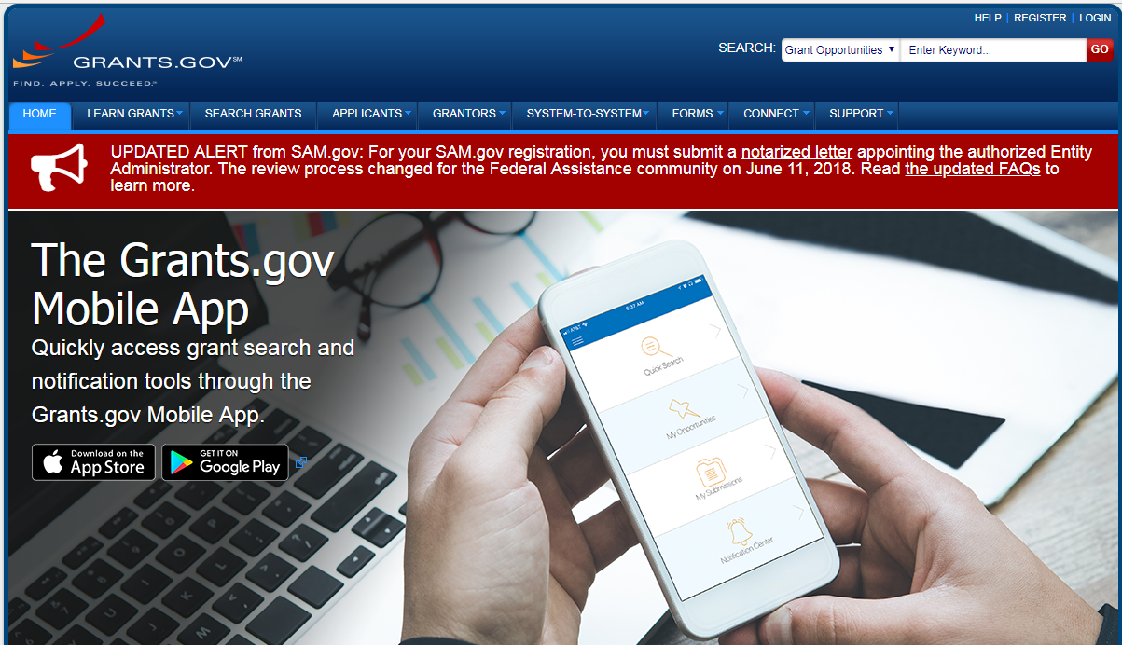
Grant Application Package
Notes:
Application is submitted as part of an application package that is completed within Grants.gov
IES submissions guide helps explain how to use the package.

Slide 35
Peer Review Process
Overseen by the IES Office of Science
Applications are reviewed for compliance and responsiveness to the RFA (e.g., submitted on time with acceptable formatting, meet Requirements) before being accepted for peer review
Accepted applications are assigned to panel according to the match between the overall expertise of reviewers on each panel and the content and methodological approach proposed in each application.
See the Procedures for Peer Review of Grant Applications (https://ies.ed.gov/director/sro/application_review.asp)
Notes:
An initial review is done by 2-3 members of the panel.
The highest scoring applications go to full panel for discussion and receive primary reviewer comments, panel average score, and a summary of panel discussion.
Applications that do not go to full review receive primary reviewer comments
If interested, you can apply to be a peer reviewer on iesresearch.ed..gov – Interested in Reviewing?

Slide 36
Funding Decisions
The following are considered in making award decisions for responsive and compliant applications:
Scientific merit as determined by scientific peer review
Performance and use of funds under a previous federal award
Contribution to the overall program of research described in this request for applications
Ability to carry out the proposed research within the maximum award and duration requirements
Availability of funds
Notes:
Peer review panel’s score is primary in decision to fund an application regarding scientific merit
Applicants may receive clarification and budget questions regarding issues 2-4

Slide 37
Notification
All applicants will receive email notification that the following information is available via the Applicant Notification System:
Status of award
Reviews
Notes:
After submitting an application, you will receive an email on how to set up an account on the Applicant Notification System if you don’t already have one.

Slide 38
Program Officers are a Resource
Discuss your research idea with a program officer
Email a synopsis and schedule a time for a call
Email short questions
You will hear from us if you submit a letter of intent
We will review draft applications, given we receive drafts within sufficient time
We are available for discussion after you receive your reviews

Slide 39
Program Officers
Prekindergarten through Grade 12 Recovery Research Network
Dr. Corinne Alfeld: Corinne.Alfeld@ed.gov
Dr. Allen Ruby: Allen.Ruby@ed.gov
Community College Recovery Research Network
Dr. James Benson: James.Benson@ed.gov

