Slide 1
IES FY 2016 Funding Opportunities: Application Submission Process
Emily Doolittle, Ph.D.
National Center for Education
Kimberley Sprague, Ed.M.
National Center for Special Education Research
Notes:
During today’s webinar, Institute of Education Sciences (IES) staff will provide information regarding the grant submission process. The webinar will focus on information included in all Requests for Applications for NCER and NCSER competitions on content and formatting requirements, human subjects clearance, and the application forms. This information will apply to all current FY16 competitions.

Slide 2
Today you’ll learn…
…how to find application materials
…how to use Grants.gov
…what goes in an application
…how to format your application
…program-specific information
Notes:
Today we are going to talk about how to apply for an IES grant, and you will learn about the application process in terms of finding the forms and materials you need, using grants.gov to download the application package and submit your application, and completing and formatting your application.

Slide 3
FY 2016 Research Grant Programs
Education Research Programs (84.305A)
Cognition and Student Learning
Early Learning Programs and Policies
Education Technology
Effective Teachers and Effective Teaching
English Learners
Improving Education Systems: Policies, Organization, Management, and Leadership
Mathematics and Science Education
Postsecondary and Adult Education
Reading and Writing
Social and Behavioral Context for Academic Learning
Special Education Research Programs (84.324A)
Autism Spectrum Disorders
Cognition and Student Learning in Special Education
Early Intervention and Early Learning in Special Education
Families of Children with Disabilities
Mathematics and Science Education
Professional Development for Teachers and Related Services Providers
Reading, Writing, and Language Development
Social and Behavioral Outcomes to Support Learning
Special Education Policy, Finance, and Systems
Technology for Special Education
Transition Outcomes for Secondary Students with Disabilities
Notes:
The information contained in today’s webinar applies to all of the fiscal year 2016 research and research training program grants. You will need to download a separate application package for each program, so pay special attention to the CFDA number. That is the one that starts with 84.305 (or 84.324). The letter at the end is what distinguishes your competition from the others, so you want to pay special attention to that CFDA number and the letter at the end.

Slide 4
FY 2016 Research Grant Programs
Education Research & Development Center (84.305C)
Virtual Learning
Statistical & Research Methodology in Education (84.305D)
Early Career Statistical & Research Methodology Grants
Partnerships & Collaborations Focused on Problems of Practice or Policy (84.305H)
Researcher-Practitioner Partnerships in Education Research
Research Networks Focused on Critical Problems of Education Policy & Practice (84.305N)
Supporting Early Learning from Preschool through Elementary Grades
Scalable Strategies to Support College Completion

Slide 5
FY 2016 Research Training Grant Programs
Research Training Programs in the Education Sciences (84.305B)
Pathways to the Education Sciences Research Training Program
Research Training Programs in Special Education (84.324B)
Postdoctoral Research Training Program
Early Career Development and Mentoring
Methods Training Using Single-Case Design

Slide 6
Finding Application Materials
Notes:
The first topic we will cover today is how to find the application materials that you need.

Slide 7
How to Start
Find the Request for Applications for the competition you want to apply to:
Requirements for an application
Information for writing your Project Narrative
Information about submitting your application through Grants.gov
Find the Application Package for the competition you want to apply to
Notes:
You need two things to apply. First you need the Request for Applications or RFA, which contains information for writing your Project Narrative as well as information about submitting your application using grants.gov and you need to find the correct application package itself.

Slide 8
RFAs
The Requests for Applications (RFAs) for all current competitions are available at:
http://ies.ed.gov/funding/
http://www.grants.gov/ (under “Application Instructions”)

Slide 9
Notes:
This is the main IES page (shown on slide). To find the RFAs, choose the Funding Opportunities link on the main ies.ed.gov webpage.

Slide 10
On the IES Website
Sign up for the IES Newsflash:
http://ies.ed.gov/newsflash/
Notes:
While you are on the IES page, you should sign up for the IES Newsflash (http://ies.ed.gov/newsflash), which will tell you automatically when RFAs and application materials, upcoming webinars, etc. are available.

Slide 11
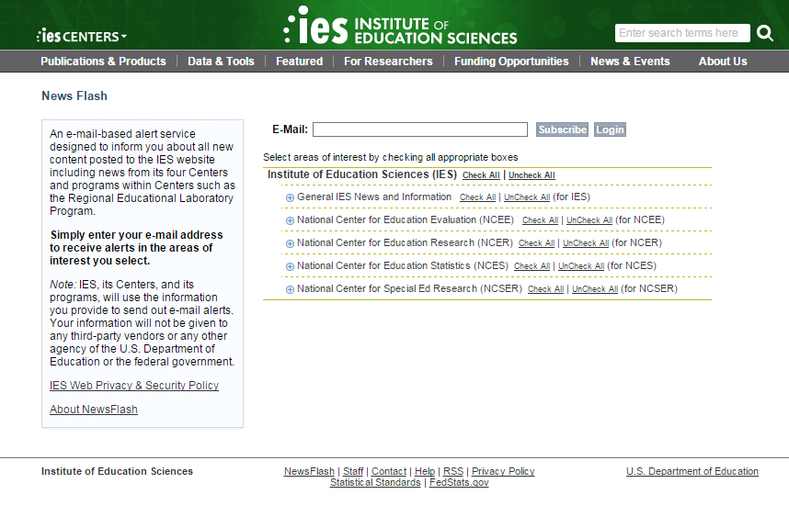
Notes:
To sign up for the Newsflash, hover your mouse over the News and Events on the main IES webpage, and choose Newsflash from the dropdown list to get to this page.

Slide 12
Notes:
When you go to ies.ed.gov/funding, this is what you will see (shown on slide). You will see I circled in red the link for the RFAs. When you click on that link you will find a list of all the RFAs for FY2016, and then you want to make sure you choose the correct one, again paying attention to the letter at the end of the CFDA number.

Slide 13
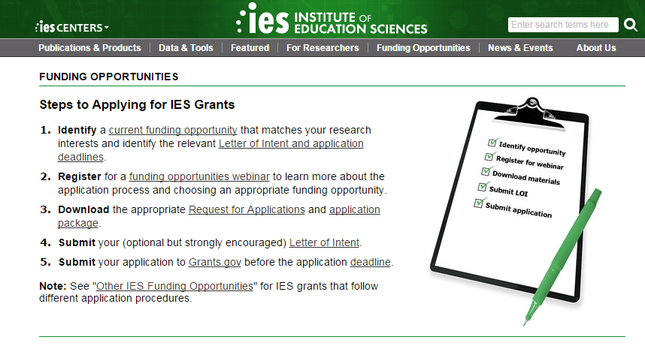
IES has two deadline dates this year – pay attention!
Notes:
Each competition has a single deadline, but there are two different deadline dates – pay attention!

Slide 14
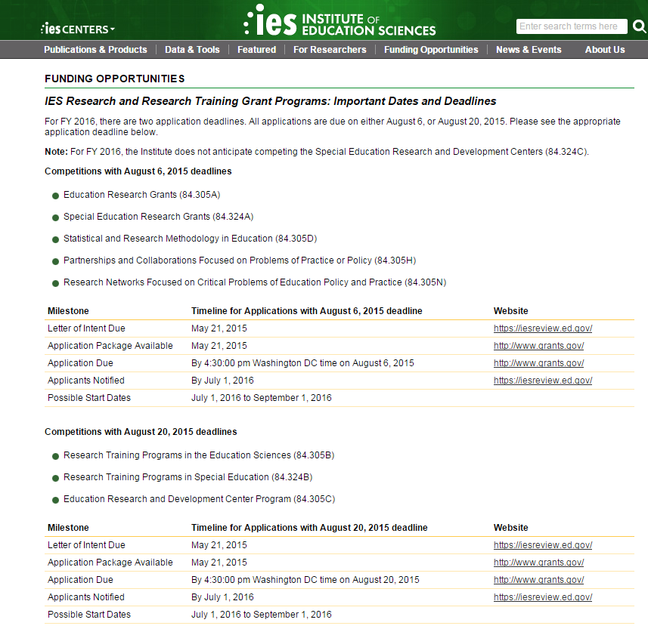
Notes:
84.305A, 84.324A, 84.305D, 84.305H, 84.305N are due August 6th
84.305B, 84.324B, 84.305C are due August 20th

Slide 15
Applications due August 6, 2015
National Center for Education Research (NCER)
Education Research Grants (84.305A)
Statistical & Research Methodology in Education (84.305D)
Partnerships & Collaborations Focused on Problems of Practice & Policy (84.305H)
Research Networks Focused on Critical Problems of Education Policy & Practice (84.305N)
National Center for Special Education Research (NCSER)
Special Education Research Grants (84.324A)
Notes:
The application will list the correct due date for the competition as well –use this as a reminder!

Slide 16
Applications due August 20, 2015
National Center for Education Research (NCER)
Research Training Programs in the Education Sciences (84.305B)
Education Research & Development Centers (84.305C)
National Center for Special Education Research (NCSER)
Research Training Programs in Special Education (84.324B)
Notes:
The application will list the correct due date for the competition as well –use this as a reminder!
Research Training Programs in the Education Sciences (84.305B)
Pathways to the Education Sciences Research Training Program NEW
Research Training Programs in Special Education (84.324B)
Postdoctoral Research Training Program
Early Career Development and Mentoring
Methods Training Using Single-Case Designs NEW

Slide 17
Finding Application Packages and Application Instructions
FY 2016 application packages and instructions available now on http://www.grants.gov/
Notes:
You need the application package for the competition you are applying to; the packages are available on grants.gov. Now I am going to show you how to navigate the grants.gov website to find the information that you need.

Slide 18
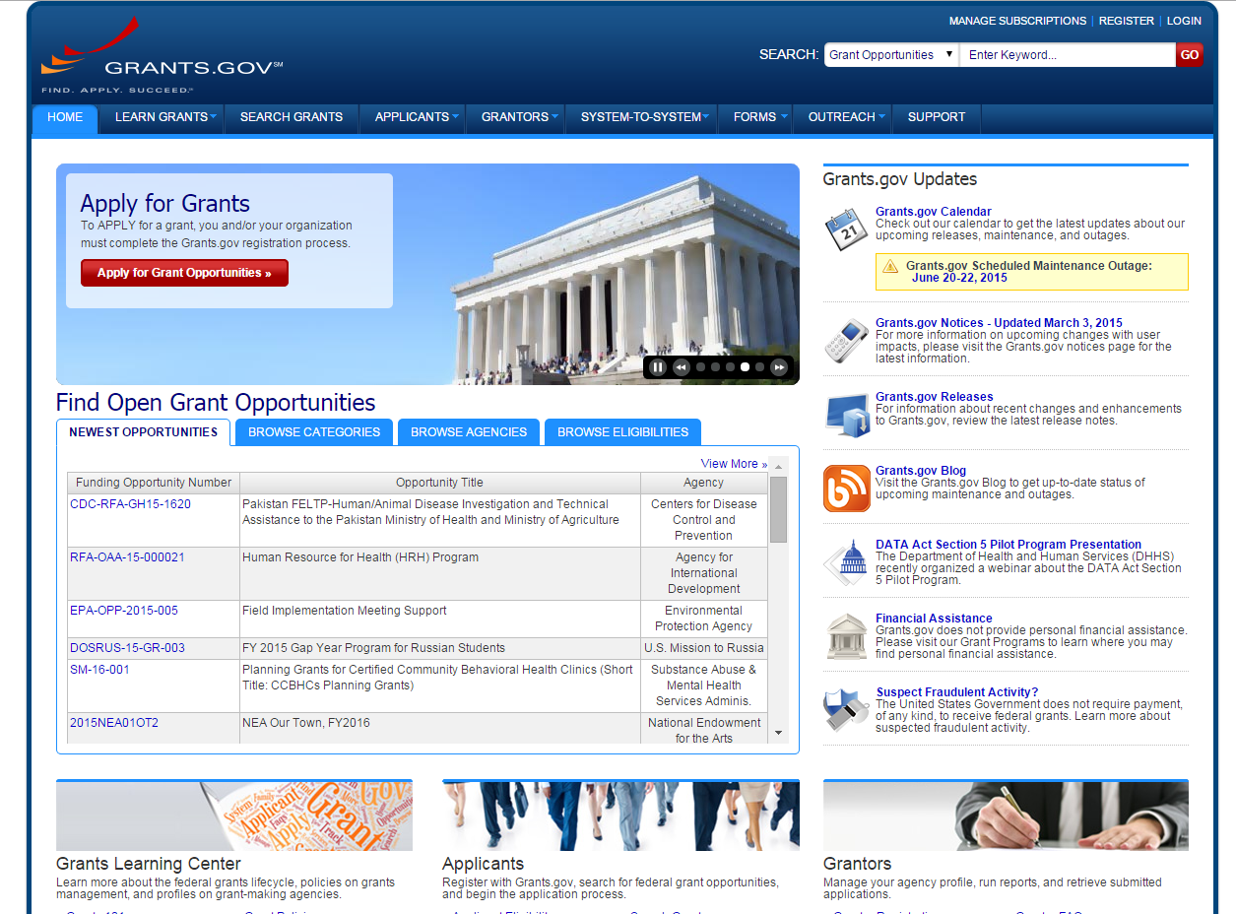
Notes:
I am going to go to grants.gov (the full address will automatically load). Across the top of the page, there are a number of menus, and you want to click on Search Grants.

Slide 19
Downloading the Correct Application Package
Search by CFDA number
All Education Research (NCER) competitions: 84.305
All Special Education Research (NCSER) competitions: 84.324
Notes:
The easiest way to find the application package is to search by the CFDA number, using the third search term box in the upper left of the page (SHOWN ON THE NEXT SLIDE). Enter “84.305” in the box and click Search.

Slide 20
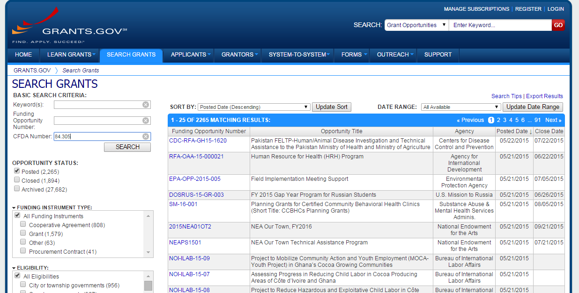
Notes:
The easiest way to find the application package is to search by the CFDA number, using the third search term box in the upper left of the page. For example, enter “84.305” in the box and click Search.

Slide 21
Grants.gov search yields more than one application package
Download the application package designated for your competition
Look at the Opportunity Title and the CFDA number

Slide 22
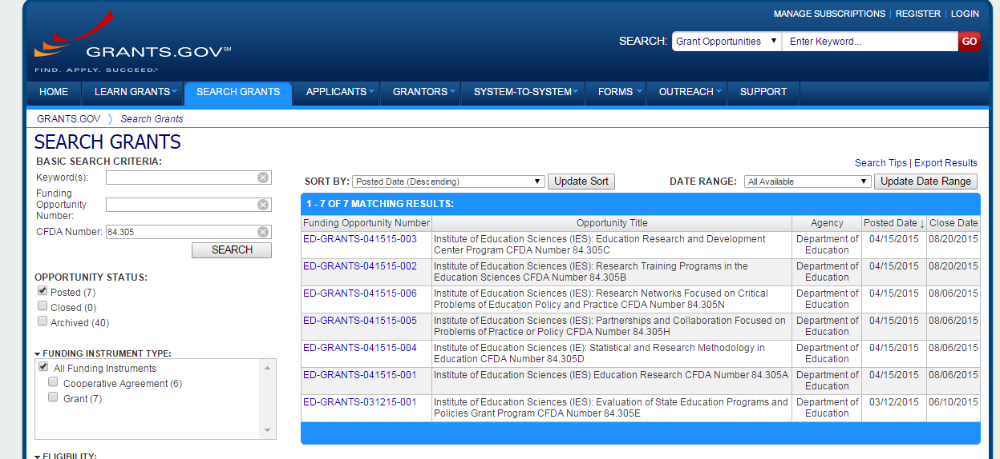
Notes:
You will see here that this search returns multiple results because these are all of the current IES NCER grant competition packages. You want to make sure that you are downloading the application package for your competition, so pay attention to the opportunity title and to the CFDA numbers at the end of the opportunity title. The second to last one on the list is 84.305A, for example.

Slide 23
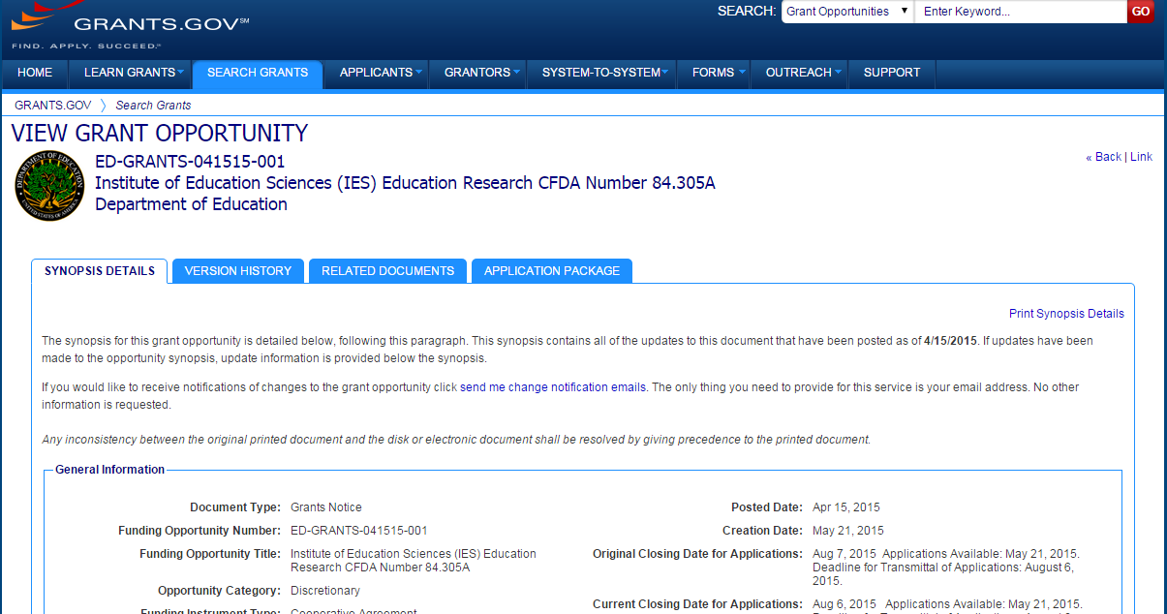
Notes:
Again, you want make sure that the CFDA number is correct. If you scroll down, you will see all of the appropriate information here. Again, this tells you the deadline. You now know that you have chosen the correct package, in this case, if you want to apply to the IES Education Research competition 84.305A

Slide 24
Application Packages
Title of program
e.g., Education Research
CFDA number
e.g., 84.305A

Slide 25
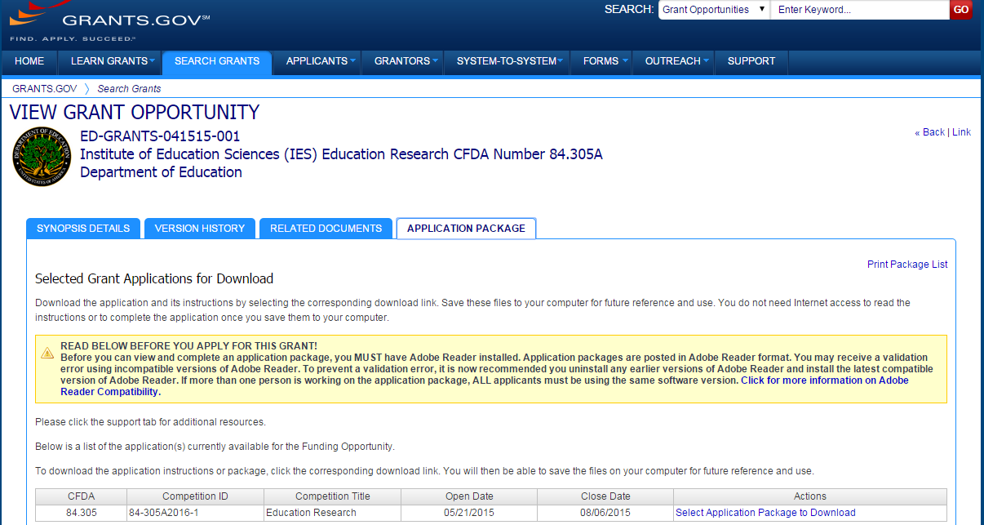
Notes:
When you are ready, you can click on the Application Package tab just under the grant opportunity title at the top. Again you have a chance here to confirm that you are downloading the correct package. Again, it says 84.305A. That is the correct package. Then we will click Select Application Package to Download.

Slide 26
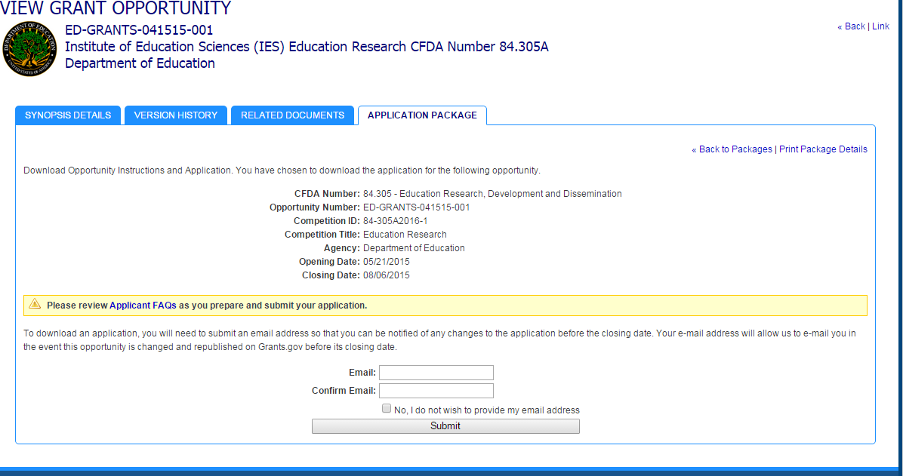
Notes:
On this page, you have the opportunity to enter your e-mail address, which you can choose to do if you want to be alerted to changes in the package. If you don’t want to enter it, you can click No. Then click Submit.

Slide 27
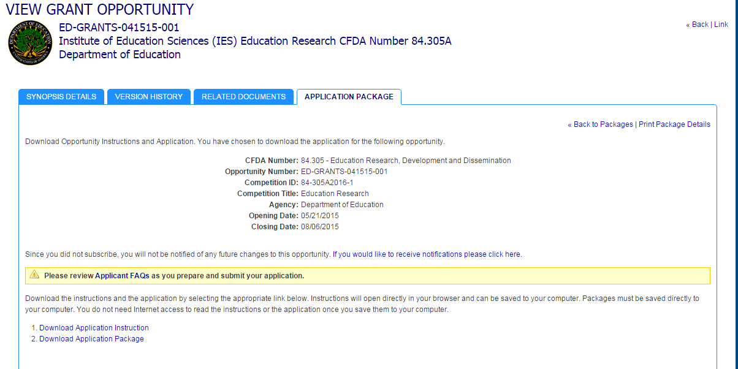
Notes:
Now you can download the application instructions and/or the application package. The application instructions document is the Request for Applications; that is the same document that was on the IES website, so you can download it from here also. I’m going to download the application package.

Slide 28
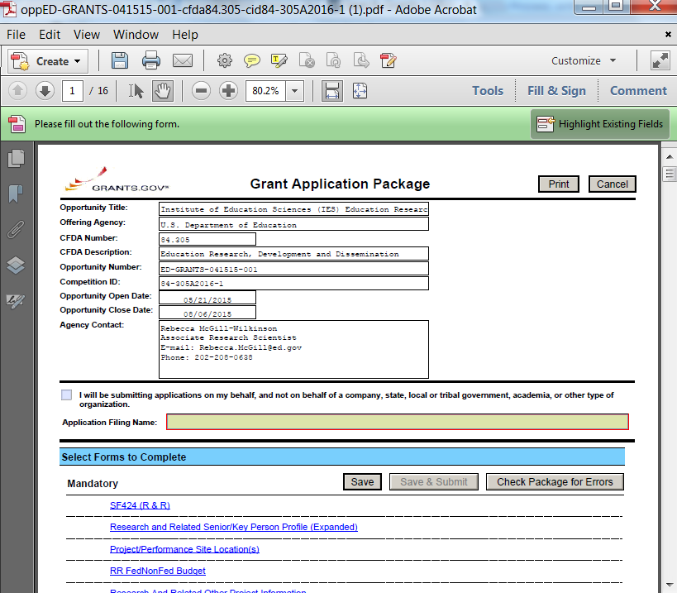
Notes:
The application package is in Adobe; it is a PDF form. Again, at the very top, you just want to check here to make sure that you have the right package. Notice how this is outlined in red and highlighted in yellow? That is how you are alerted to the fact that this is a required field. You need to fill out that field. (FILING NAME)

Slide 29
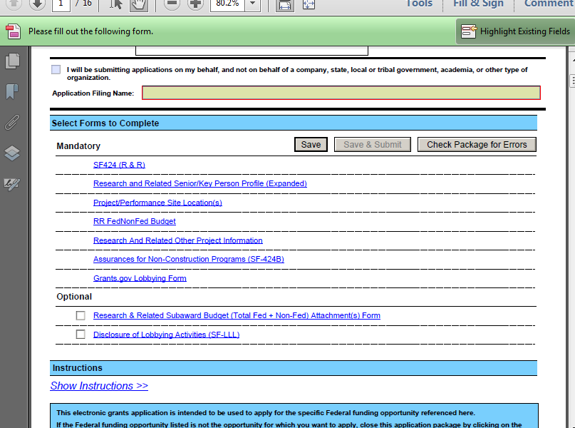
Notes:
Below you will see there is a list of mandatory forms and a list of optional forms. If you click on any of these links, then it will take you to that form.
The Check Package for Errors button at the top of the form is an important button for you to use (when forms are completed) because that is how you are going to check to make sure that you didn’t leave any required fields empty.

Slide 30
More on Grants.gov
Notes:
Now we are going to talk a little bit more about some tips for using grants.gov.

Slide 31
Grants.gov Registration
START EARLY!
Initial registration may take 5 or more business days to complete
Grants.gov recommends allowing 4 weeks
Annual update may take more than 3 days to complete
Notes:
In terms of registration for grants.gov, the first tip, and perhaps the most important tip, is to start early. Initial registration in grants.gov can take more than 5 business days, and grants.gov recommends allowing 4 weeks to register. Even if you are already registered on grants.gov, the annual update that you must complete could take more than 3 days. One thing to note here is that it is actually your institution that needs to register on grants.gov, not you as an individual. For most institutions, especially universities, the sponsored projects office will likely take care of the grants.gov registration if it hasn’t already been done, but you may want to check with them just to make sure that it has been completed.

Slide 32
Grants.gov Software Requirements
Adobe software
To read and complete the application forms
To convert Word, Excel, or other documents to PDF documents
Grants.gov can help with checking software and downloading the version you need
http://www.grants.gov/web/grants/applicants/adobe-software-compatibility.html
Notes:
In terms of software requirements, you need Adobe software in order to read and complete the application forms. You can use the Adobe software to convert your documents to PDFs. All of the documents that you are going to upload to your application need to be uploaded as PDFs, so you need to have the capability of converting your files to PDF. Grants.gov supports Adobe Reader version 9.0.0 and later; grants.gov can help you check the version you have and download the version you need if you don’t have the correct version.
Note: If you can see the application package, you are able to complete and submit grant applications on Grants.gov

Slide 33
Application Submission
Must be submitted electronically using http://www.grants.gov/
Do NOT e-mail an electronic copy to Program Officers
This is NOT an official application, and it will NOT be sent forward for peer review
Notes:
You must submit your application through grants.gov. You cannot e-mail your application to the Program Officer. If you do that, your application will not be sent forward for peer review.

Slide 34
Grants.gov Submission
Applications received by Grants.gov are date- and time-stamped
Your application must be…
Fully uploaded and submitted
Date- and time-stamped by the Grants.gov system
Submitted no later than 4:30:00 p.m. Washington, DC time on the application deadline date
Late applications will not be considered!
Notes:
Applications received by grants.gov are date and time stamped and the time is stamped to the second. Your application must be fully uploaded and submitted, and the date and time must be stamped no later than 4:30:00 p.m. Washington, DC time on August 6, 2015 (or August 20, 2015 depending upon the competition). Late applications will not be reviewed.

Slide 35
Grants.gov Submission
Your application will be rejected if you submit it in paper format unless you qualify for one of the following exceptions:
You do not have access to the Internet
You do not have the capacity to upload large documents to the Grants.gov system
Notes:
You cannot submit your application on paper. Your application will be rejected unless you meet one of the following requirements. If you do not have access to the Internet or you do not have the capacity to upload large documents to the grants.gov system, then you can qualify for an exception to the online submission.

Slide 36
If You Qualify for a Grants.gov Submission Exception
You MUST…
Submit a written statement that you qualify no later than 2 weeks before the application deadline
Notes:
If you qualify for a grants.gov submission exception, you must submit a written statement that you qualify at least 2 weeks before the application deadline. (Select the SUPPORT tab to contact the grants.gov support desk for more information.)

Slide 37
Grants.gov Submission Problems
If you experience technical problems submitting an application through Grants.gov
Contact Grants.gov Support Desk
1-800-518-4726 or support@grants.gov
http://www.grants.gov/web/grants/support.html
Obtain a Grants.gov Support Desk Case Number and keep a record of it
Contact your Program Officer and provide explanation of technical problem
Notes:
If you experience technical problems with grants.gov, your first step should be to contact the grants.gov support desk. They will give you a case number, which you need to keep. After this, you should contact your Program Officer and let them know about the problem and the steps that you have already taken to remedy the problem.

Slide 38
Grants.gov Submission Problems
We will accept your application if we can confirm that a technical problem occurred with the Grants.gov system and that the problem affected your ability to submit your application by 4:30:00 p.m. Washington, DC time on the application deadline date.
Notes:
If we can confirm that a technical problem occurred with the grants.gov system, and that the problem with the system affected your ability to submit your application on time, we will accept your application.
The vast majority of the time, there is not a technical problem with Grants.gov; instead, it is a common error that leads to problems and might make your application late!

Slide 39
Track your application on Grants.gov
Use the Grants.gov “Track My Application” link to verify on-time, valid submissions
Use your assigned Grants.gov Tracking Number (e.g.,GRANT00234567)
Notes:
You can track your application on grants.gov using the Track My Application link to verify that your submission was on time and valid. You can track the application this way from the time you begin the upload process until the Department receives the application and assigns the PR/Award number.

Slide 40
Notes:
You access the Track My Application page by selecting Applicants from the menu bar at the top of the main grants.gov page, and then select Track My Application.

Slide 41
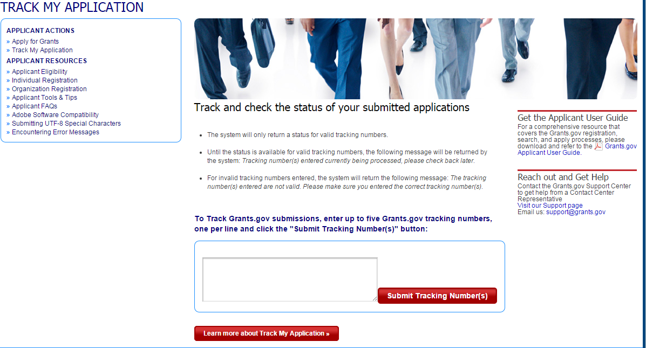

Slide 42
Grants.gov Submission Confirmation
Comes by e-mail
3 e-mails from Grants.gov
Followed by a 4th e-mail from the U.S. Department of Education
Notes:
You will get a submission confirmation from grants.gov, and it will come in the form of multiple e-mails. You are going to get four different e-mails. The first three e-mails come from grants.gov, and the fourth e-mail comes from the U.S. Department of Education (ED).

Slide 43
From Grants.gov
First e-mail confirms that you have attempted to upload an application into the Grants.gov system
Application tracking number assigned (e.g.,GRANT00234567)
Second e-mail indicates…
EITHER application successfully validated by Grants.gov
OR application has been rejected due to errors
Third e-mail indicates…
U.S. Department of Education has retrieved application from Grants.gov.
Notes:
The first e-mail confirms that you have attempted to upload your application to grants.gov. At this point, your application will be assigned a tracking number that starts with G–R–A–N–T, grant. The second e-mail you receive will indicate either that your application has been validated by grants.gov or that your application has been rejected due to errors. If it has been rejected, you will need to go back and fix the errors. This is yet another reason that you should submit your application early, because you want to make sure you have enough time to fix any problems if your application is rejected. The third e-mail you receive from grants.gov indicates that the ED has retrieved your application.

Slide 44
Department of Education Confirmation
You will receive a 4th e-mail from the U.S. Department of Education with a PR/Award number unique to your application (e.g., R305X16XXXX or R324X16XXXX).
Use this number to track your application from this point forward.
If your application is late (as determined by Grants.gov), this e-mail will state that it was late and your application will not be given further consideration.
Notes:
Then you will get a fourth e-mail from ED, which will contain a PR award number unique to your application. It will start with R305, and then the letter of the competition. From then on you should use this R305 or R324 number to track your application. If your application was submitted late, this e-mail will state that it was late and that it will not be given further consideration.

Slide 45
What’s included in an application?
Notes:
Question: Do IES grants allow a fee-for-profit; are for-profit agencies allowed to charge a standard fee?
Answer: That is an excellent question. I don’t believe that for-profit agencies are allowed to charge a standard fee. For-profit agencies can apply for grants, absolutely.
My understanding is that they are not allowed to charge a standard fee. This would be a good question about which to contact your Program Officer.
Our last topic will be application format requirements.

Slide 46
Application Contents
Forms
Research & Related (R&R) Forms (SF 424 form family)
Assurances
PDF File Attachments
Project Summary/Abstract
Project Narrative
Appendices A, B, C, D, and/or E
Bibliography & References Cited
Human Subjects Narrative
Narrative Budget Justification
Biographical Sketches of Key Personnel
Lists of Current and Pending Funding
Notes:
Now we will discuss what is included in the application.
First is the Research and Related, or R&R form. This is the SF424 family. You will have a project summary or abstract. You will have the Project Narrative. You will have appendices A, B, C, D, and/or E; bibliography and references cited; the Human Subjects Narrative; biographical sketches of key personnel; Narrative Budget Justification; and lists of current and pending funding.
Question: What about the Letter of Intent (LOI)?
Answer: The Letter of Intent deadline has passed, but that doesn’t mean that you cannot submit an application. The LOI is not required, so if you didn’t manage to send one in, or you sent one in and you have now changed your mind about the project you want to do, you can still submit an application. You should contact the Program Officer listed in the RFA to let them know that you didn’t submit an LOI but that you would like to submit an application. The best way to contact your Program Officer the first time is through e-mail, and the Program Officer may request a brief written summary of your idea for your project, or they may request a phone call to discuss it, but definitely, if you have not submitted an LOI, you can still submit an application and you should contact your Program Officer.

Slide 47
Research and Related (R&R) Forms
Required fields are highlighted in yellow and outlined in red
Use the “Check Package for Errors” button
Complete SF 424 Cover Sheet first
Pre-populates other forms
Notes:
The first set of forms you need to fill out are the Research and Related, or R&R, forms. Again, the required fields are highlighted in yellow, and are outlined in red. Again, you want to use the Check Package for Errors button. You should start with the SF424 cover sheet because it pre-populates all the other forms.

Slide 48
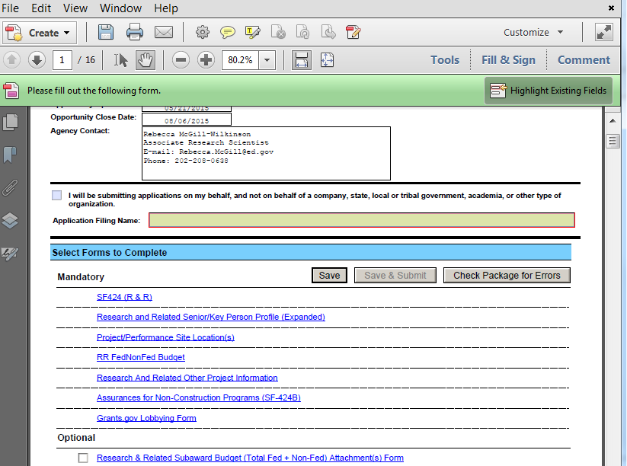
Notes:
This is a screenshot of the webpage that I have already shown you, and notice the circle around the Check Package for Errors button.

Slide 49
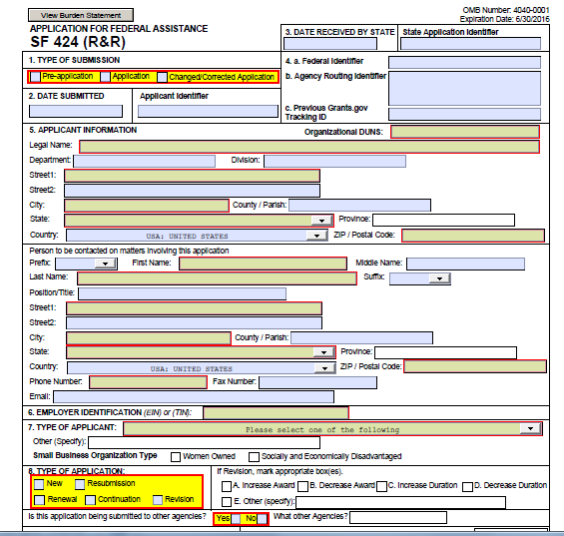
SF 424 (Cover Sheet)
Notes:
This is the SF424 cover sheet. Again, here you will notice the required fields are pretty well highlighted. IES uses Item 4B, which is circled in red on the slide, toward the upper right corner of the screen in front of you. We use Item 4B to correctly route your application, so even though it is not red and yellow, you must complete this item.

Slide 50
Item 4b “Agency Routing Identifier”
This item is used to…
Screen applications for responsiveness to the competition requirements
Assign applications to the appropriate scientific peer review panel
Your application may be rejected as non-responsive or assigned inaccurately for scientific review of merit if this field is not completed using the correct topic and goal codes (see Request for Applications for codes)
Notes:
The Agency Routing Identifier, Item 4B, is used to screen applications for responsiveness and to assign applications to the appropriate scientific review panel. If your application doesn’t include an agency routing identifier or if it is incorrect, your application may be rejected as nonresponsive or assigned inaccurately for scientific review.

Slide 51
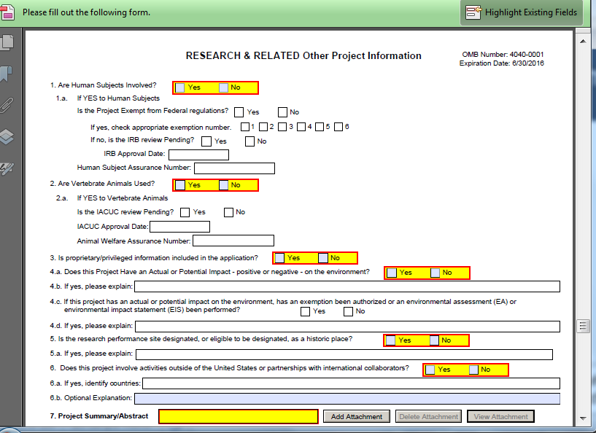
Other Project Information Form
Notes:
This is the Other Project Information form (shown on slide), which is where you will attach (upload) your abstract and your narrative. You will also attach other materials here like your bibliography. All attachments must be PDF files.

Slide 52
Important Tips for PDF Files
Read-only, non-modifiable format
Individual files (attachments that contain files within a file, such as PDF Portfolio files, or an interactive or fillable PDF file will not be read)
Not password protected
Uniquely named - Grants.gov cannot process an application that includes two or more file attachments that have the same name.
No more than 50 characters
No special characters (e.g., &,–,*,%,/,#), blank spaces, periods, or accent marks in the file name (an underscore to indicate word separation in file names is ok e.g., “my_Attached_File.pdf”)
Notes:
The forms included in the application package provide the means for you to attach Adobe Portable Document Format (PDF) files. You must attach read-only, non-modifiable PDF files; any other file attachment will cause your application to be rejected by Grants.gov.
Grants.gov provides help for converting files to a PDF format: http://www.grants.gov/web/grants/support/technical-support/software/pdf-conversion-software.html.

Slide 53
Formatting Requirements
All PDF files must adhere to margin, format, and font size requirements (discussed later)
All PDF files must be attached to the appropriate form in the Application Package

Slide 54
Project Summary/Abstract
Page limit: 1 page, single-spaced
Attach at #7 on the “Other Project Information” form
***Include the research topic (and goal for 305A and 324A) in the Abstract and make sure this information agrees with Item 4b of SF 424 (R&R) Application for Federal Assistance.
Notes:
The Project Summary or Abstract has a page limit of one page single-spaced. You should add it as a PDF file attachment under number seven on the Other Project Information form. Make sure that you adhere to margins and formatting requirements, which we are going to go over later. You should include your research topic and goal in the Project Summary or Abstract if you are applying to 84.305A. This information should match the information provided in Item 4B of the SF424 form.

Slide 55
Project Narrative
Page limit: see the relevant RFA
Attach at #8 on the “Other Project Information” form
Notes:
Project Narratives have varying page limits and it depends on the competition to which you are applying, so make sure that you check the RFA to determine your page limit for your Project Narrative. The Project Narrative should be added as an attachment under Item number eight on the Other Project Information form.

Slide 56
Project Narrative
Four (or five) sections (see relevant RFA):
Significance
Research Plan
Personnel
Resources
Information for each section is detailed in the RFA:
Part II: Topic Requirements
Part III: Goal Requirements (for 305A and 324A)
Notes:
The Project Narrative has four or five sections depending on the competition to which you are applying, so you should read the relevant RFA. Most of the applications will have Project Narratives that include Significance, Research Plan, Personnel, and Resources sections. Information for each of these sections is detailed in the RFA.

Slide 57
Project Narrative
Concise
Easy to read
Pages are numbered consecutively
Use footnotes only sparingly, or not at all
Notes:
We recommend that your Project Narrative be concise and easy to read and that you number your pages consecutively. This helps the reviewers to find the information that they need during the review process. You also must adhere to type, font size, and format specifications for the entire Project Narrative, including any footnotes.

Slide 58
Appendix A
Page limit: 3 pages, single-spaced
Include at end of the Project Narrative and submit as part of the same PDF file attachment
This is Required for Resubmissions only
Describe how revised proposal is responsive to prior reviewer feedback
Indicate prior application number
Notes:
Appendix A has a page limits of 3 pages single-spaced. This appendix is required for resubmissions only. For resubmissions, you must use up to three pages to describe how your revised proposal is responsive to prior feedback from the reviewers. Make sure you indicate your prior application number in those three pages in Appendix A. It should be included at the end of the Project Narrative and submitted as part of the same PDF file attachment. In other words, the same file as your Project Narrative should also include Appendix A at the end. Make sure you adhere to margin, format, and font size requirements.

Slide 59
Appendix B
Page limit: 15 pages, single-spaced
Include at the end of Appendix A and submit as part of the same PDF file attachment
Notes:
Appendix B has a page limit of 15 pages single-spaced. It should be included at the end of Appendix A and submitted as part of the same PDF file attachment. Make sure you adhere to margin, format, and font size requirements.

Slide 60
Appendix B
Include…
Figures, charts, or tables that supplement research text
Examples of measures to be used in the project
Notes:
Appendix B should include figures, charts, or tables that supplement the text of your Project Narrative, and can include examples of measures to be used in the project.

Slide 61
Appendix C
Page limit: 10 pages, single-spaced
Include after Appendix B and submit as part of same PDF file attachment
Notes:
Appendix C has a page limit of 10 pages single-spaced. It should be included at the end of Appendix B and submitted as part of the same PDF file attachment. Make sure you adhere to margin, format, and font size requirements.

Slide 62
Appendix C
Include…
Curriculum materials
Computer screenshots
Test items you will develop
Other materials used in the intervention or assessment
Notes:
Appendix C should include curriculum materials, computer screenshots, test items of measures you will be developing, or other materials used in the intervention or assessment.

Slide 63
Appendix D
Page limit: None
Include at end of Appendix C and submit as part of same PDF file attachment
Notes:
Appendix D has no page limit. It should be included at the end of Appendix C and submitted as part of the same PDF file attachment. Make sure you adhere to margin, format, and font size requirements.

Slide 64
Appendix D
Include letters of agreement from research partners
E.g., schools, districts, consultants
Letters should clearly indicate understanding of time, space, and resources that will be required if the application is funded
Notes:
Appendix D should include letters of agreement from your research partners; that may be schools or districts, it may also be consultants who will work on your project. Do not reduce the size of the letters. Make sure they are full-size. The letters should clearly indicate an understanding of the time, space, and resources that will be required of the partner if the application is funded.
If you include scanned documents as part of a PDF file (e.g., Letters of Agreement in Appendix D), scan them at the lowest resolution to minimize the size of the file and expedite the upload process. PDF files that contain graphics and/or scanned material can greatly increase the size of the file attachments and can result in difficulties opening the files. The average discretionary grant application package totals 1 to 2 MB; therefore, check the total size of your application package before you attempt to submit it. Very large application packages can take a long time to upload, putting the application at risk of being received late and therefore not accepted by the Institute.

Slide 65
Appendix D
Do not reduce the size of the letters
But, scanned documents can increase the size of your application, which may take longer to upload – make sure you don’t miss the 4:30:00pm Washington DC time deadline!

Slide 66
Appendix E
Required only for Efficacy and Replication and Effectiveness Goal applications
Page limit: 5 pages, single-spaced
Include at end of Appendix D and submit as part of same PDF file attachment
Notes:
Appendix E is required only for the Efficacy and Replication and Effectiveness Goal applications, under 305A. There is a page limit of five pages single-spaced. Appendix E should be included at the end of Appendix D and submitted as part of the same PDF attachment. Make sure you adhere to margin, format, and font size requirements.

Slide 67
Appendix E
Required only for Efficacy and Replication and Effectiveness Goal applications
Include data-sharing plan
Notes:
Again, Appendix E is only for the Efficacy and Replication and Effectiveness Goal applications, and it should include your data sharing plans.

Slide 68
Bibliography & References Cited
Page limit: None
Use APA style
Attach at #9 on the “Other Project Information” form
Include complete citations
Notes:
For your bibliography and references cited, there is no page limit. You should use APA style; that is the American Psychological Association. You should add it as a PDF file under number nine on the Other Project Information form. Make sure you adhere to margin, format, and font size requirements and that your citations are complete.

Slide 69
Human Subjects Narrative
Page limit: None
Attach at #12 (“Other Attachments”) on the “Other Project Information” form
Submit exempt research narrative or nonexempt research narrative
Notes:
The Human Subjects Narrative has no page limit, and again, it should be added as an attachment, a PDF file, on number 12 on the Other Project Information form. Note that Item 12 on that form says Other Attachments, it does not specifically say Human Subjects Narrative, but that is where you want to upload your file. So you either need to submit an exempt Project Narrative or a nonexempt Project Narrative.

Slide 70
Human Subjects Narrative: Exempt
6 exemptions (see Department’s website http://www2.ed.gov/policy/fund/guid/humansub/overview.html)
Include information on involvement of human subjects to determine whether exemptions are appropriate
Notes:
There are six exemptions listed in the IES grants.gov Application Submission Guide. Include information on the involvement of human subjects to determine whether your exemption is appropriate.

Slide 71
Human Subjects Narrative: Nonexempt
Include…
Human subjects involvement and characteristics
Sources of materials
Recruitment and informed consent
Potential risks
Protection against risk
Importance of the knowledge to be gained
Collaborating sites
Notes:
If you are conducting nonexempt human subject work, then your narrative should include the involvement in characteristics of the human subjects, the sources of materials and data, the recruitment and informed consent, discussion of potential risks and protection against those risks, the importance of the knowledge to be gained, and collaborating sites.

Slide 72
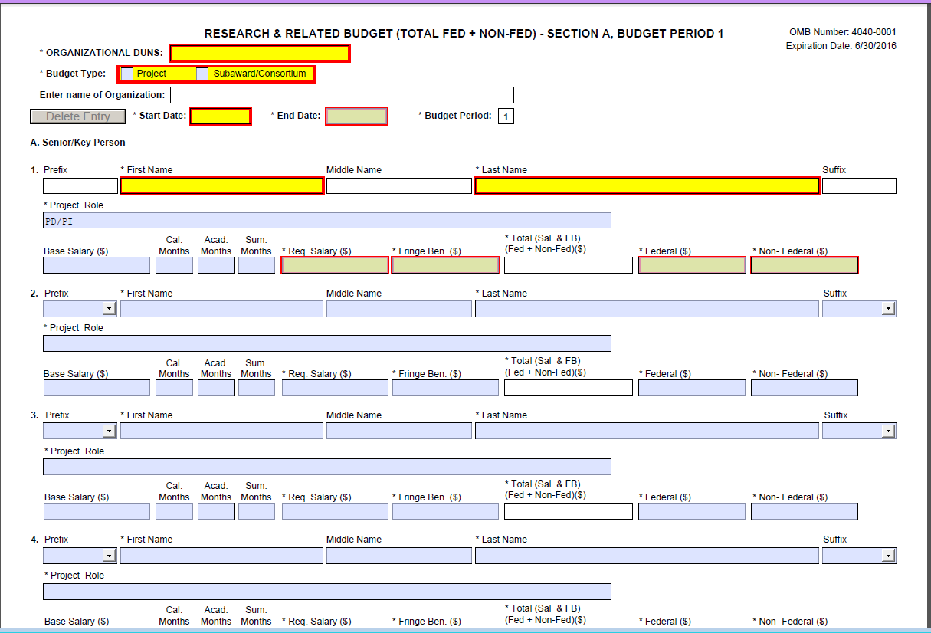
Research & Related Budget (Total Fed+Non-Fed) Form
Notes:
Next we are going to talk about the Research and Related form. This is the budget form. This is the total federal plus non-federal form. Again, notice the red and the yellow and asterisks that are highlighting the required fields.

Slide 73
Common Mistakes Applicants Make When Filling Out the Budget Form
Notes:
Here are a few common mistakes that applicants make when filling out the budget form. We are going to go through them just so that you don’t make the same mistakes.

Slide 74
Participant/Trainee Support Costs
Notes:
On this form you will notice, circled in red, there is a category called Participant/Trainee Support Costs.

Slide 75
Participant/Trainee Support Costs
Only use the Participant/Trainee Support Costs category on a training grant application: 84.305B or 84.324B
Notes:
Only use the Participant/Trainee Support Costs category on a training grant application 84.305B or 84.324B. Otherwise you shouldn’t be using that category at all.

Slide 76
Time Commitment of Senior/Key Personnel
Fill in the Calendar months or the Academic and Summer Months that each key person will be working in each project year.
IES wants to know level of effort over the calendar year (include percentage of 12-month period for each key person in narrative budget justification)
Notes:
The next common mistake we see is the Time Commitment of Senior and Key Personnel. Under the Senior Key Person Profile is where you enter the information for your key personnel, including the current and pending support as an attachment.
For the time commitment of each person, on the SF424 budget form, make sure you fill in the calendar months or the academic plus summer months that they will be devoting to the project.

Slide 77
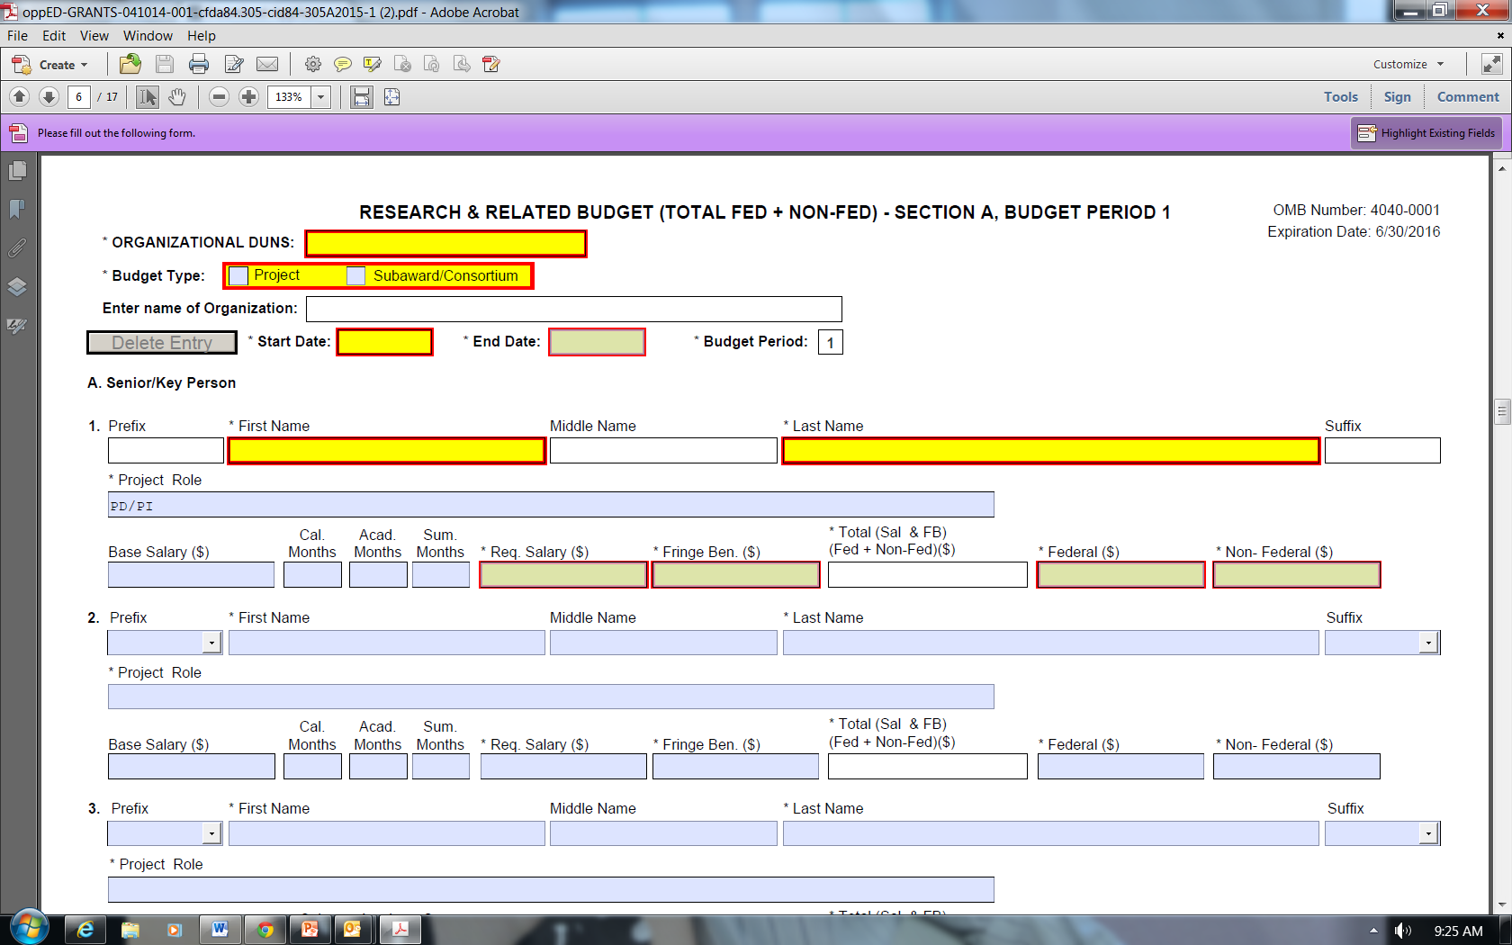
Time Commitment of Senior/Key Personnel
Notes:
You will see that months is circled in red.

Slide 78
Narrative Budget Justification
Page limit: None
Create a single document with budget justification for all years of the entire project
Attach to the R&R Budget (Total Federal + Non-Federal) form at Section K of the first budget period
Notes:
You also, for the budget, need to include a Narrative Budget Justification. The Narrative Budget Justification has no page limit, and you should add it as an attachment, a PDF file, to the R&R Budget form. Adhere to margin, format, and font size requirements. This should be a single document with all of the budget justification for all years of the entire project in one file. You are going to attach that at Section K of the first budget period.

Slide 79
Research & Related Budget (Total Fed+Non-Fed) Form
Notes:
This is what the form looks like (on the slide), and you can see that toward the bottom there in red I have circled where you add the Narrative Budget Justification. Notice also the circle in the upper right corner, which has two highlighted buttons that say, “Next Period.” That is how you move between periods for multiple year projects.

Slide 80
Narrative Budget Justification
Provide sufficient detail to allow reviewers and IES to judge whether costs are reasonable
Make sure narrative justification aligns with budget
To allow for easy cross-checking, organize narrative justification
EITHER within year by category
OR within category by year
Notes:
Your Narrative Budget Justification should provide sufficient detail to allow reviewers and IES to judge whether your costs are reasonable. Make sure your Narrative Budget Justification aligns with the budget. In other words, make sure that the numbers in your narrative match the numbers on your form. We recommend that, in order to allow for easy cross-checking, you organize either within year by category or within category by year.

Slide 81
More on the Narrative Budget Justification
Subawards should not duplicate costs in main award
Include time commitments (calendar year % effort) and descriptions of responsibilities of PI and other key personnel
Clearly indicate cost-shares
Donation of personnel time, lab space, etc.
Notes:
Sub-awards, if you have them, should not duplicate the costs in the main award. Include the time commitment and descriptions of responsibilities for the principal investigator and other key personnel. You need to clearly indicate cost shares in your Narrative Budget Justification.
Question: Please provide further explanation by what is meant by calendar versus academic or summer months.
Answer: What we mean by this is that the calendar year is out of the full 12 months, versus academic and summer months, which a lot of professors use. They will refer to the 9 months that they are in their academic year in their institution as a certain percentage of time and what their summer months time will be, and generally that is only done by people in universities; whereas people who are in the nonprofit/for-profit world will generally use calendar months.

Slide 82
The Indirect Cost Rate
Use institution’s negotiated federal indirect cost rate
Use off-campus indirect cost rate when appropriate following the terms of your institution’s negotiated agreement
Don't include as direct costs things that are really indirect costs (as defined by your negotiated agreement)
Indirect cost rate agreement must be in place at the time of the award to claim indirect costs
Notes:
For the Indirect Cost Rate you need to use your institution’s negotiated federal indirect cost rate. You should use the off-campus indirect cost rate when appropriate following the terms of your institution’s negotiated agreement. Do not include as direct costs things that are really indirect costs. You need to check your negotiated agreement and make sure that you are only including indirect costs in indirect costs. The Indirect Cost Rate Agreement must be in place at the time of award in order for you to claim indirect costs.

Slide 83
Subaward Budget
Use R&R Subaward Budget (Fed/Non-Fed) Attachment(s) Form
Listed under Optional Documents
Extract and attach a budget form (PDF document) for each institution that will hold a subaward on the grant
Separate budgets are required only for subawardee/collaborating organizations that perform a substantial portion of the project
Notes:
Use the R&R Sub-Award Budget Attachment forms if you have sub-awards. This is listed under Optional Documents. If you don’t have any sub-awards, you don’t need to complete this optional document, but if you do, then you need to complete this form, extracting and attaching budgets for as many sub-awards as you are including. You need to extract and attach a budget form for each institution that will hold a sub-award. Separate budgets are required only for those sub-awardee and collaborating organizations that perform a substantial portion of the work.
Question: How do you define indirect costs versus direct costs?
Answer: Indirect costs are generally negotiated; there should be a negotiated document that is between some federal agency—it does not have to be with the U.S. Department of Education—and your institution. I would reference your institution’s indirect cost to find out more on what that covers.
Question: Are DUNS numbers required from each sub-awardee?
Answer: Yes.
Question: Do you need a sub-award budget for collaborators?
Answer: It depends. I believe, in the Application Submission Guide, it is recommended that a sub-award only be included for a collaborator or a partner who is doing a substantive amount of work, and substantive is really up to you to decide. IES doesn’t have a preference. If you don’t create a sub-award for a collaborator you can include the collaborator as a consultant within the main budget. There is a place in the Other Direct Costs category, I believe, where you could do that.
Question: For the partnership grant, which is 305H, if your partner is a school district, would you necessarily create a sub-award budget for the school district?
Answer: Yes, you would make a sub-award. How that sub-award would be designed would depend on the school district, in terms of paying for personnel and information related to that. They would be either the sub-awardee, or they would be the primary. So, yes, in the partnership, you would need to have them in one of the roles, either as the primary or as the sub-awardee.

Slide 84
R&R Subaward Budget (Fed/Non-Fed) Attachment(s) Form
Notes:
This is what the R&R Sub-Award Budget Form looks like (shown on slide). You will notice the big red circle is where you click to extract the form. The small red circle shows you where you would attach the form once it is complete. You need a separate form for each sub-award. If you have three sub-awards, you need to extract the form three times, fill in each one, save each with a unique name following Grants.gov instructions for naming these PDF files, and then attach each to this form under one, two, and three.

Slide 85
Biographical Sketches of Key Personnel
Attach as a single PDF file for each key person
Page limit: Each biographical sketch is limited to 4 pages (i.e., an abbreviated c.v.)
Attach this PDF at “Attach Biographical Sketch” field of Research & Related Senior Key/Person Profile (Expanded)
Notes:
I am going to pause for a moment to answer a couple questions.
Question: Is cost sharing required?
Answer: No, it is not required. Cost sharing is not required under any of these grants.
Question: Does the proposed research need to be approved by our institutional review board prior to submission to IES?
Answer: No, you don’t need to have IRB approval before you submit your application. You do need to have IRB approval before you can collect any data. So if your grant is awarded, then IES and ED will work with you to make sure that you have IRB approval, and that is the point at which you would go through the IRB at your institution and you would need to send that information to IES. You don’t need to worry about that in order to apply. You only need to worry about that if your grant is funded.
Question: Please clarify what a collaborating site is in the Human Subjects Narrative. Is that a district that is permitting access to its teachers of students? What is the difference between a collaborating site and being engaged in the research?
Answer: Collaborating sites for the Human Subjects Narrative are any sites where you will be collecting data. If you are working with a district and you are getting access to the teachers and the students, then that is considered a collaborating site. There isn’t really a difference between a collaborating site and being engaged in the research. It is just different terminology depending on whether we are talking about the Human Subjects Narrative. There is more information and more detail about the Human Subjects Narrative in the Application Submission Guide, so you can also look there if you have further questions.
We are going to talk about the biographical sketches for key personnel. You should attach a single PDF file for each person. Each biographical sketch is limited to four pages. For example, many people submit an abbreviated curriculum vitae (CV). Each biographical sketch needs to adhere to margin, format, and font size requirements. It should be attached as a PDF at the Attach Biographical Sketch field of the Research and Related Senior Key Person Profile.

Slide 86
Notes:
This is where, circled in red at the bottom (shown on slide), you would attach the biographical sketch, and you need to do it separately for each key person.
Question: Can biographical sketches be in National Institutes of Health (NIH) format?
Answer: We have no requirements for the format of your biographical sketch except that it needs to be four pages or less and it needs to adhere to our margin, format, and font size requirements. Other than that you can use any format that you would like.

Slide 87
Lists of Current & Pending Support
Attach a list as a single PDF file for each key person
Page limit: 1 page, single-spaced
Attach this PDF at “Attach Current & Pending Support” field of Research & Related Senior Key/Person Profile (Expanded)
Notes:
For each key person you need to attach a list of current and pending support as a single PDF file, so a separate file for each person. This list must be a maximum of one page single-spaced. This should be attached as a PDF at the Attach Current and Pending Support field of the Research and Related Senior Key Person Profile. We recommend, also, that you include the date of each project on your list of current and pending support so that reviewers and IES can see which of the projects will overlap with your application.

Slide 88
Notes:
This is where the Attach Current and Pending Support (shown on slide) field is; this is where you would attach that list.
Question: Is there a standard form or format for the biographical sketch?
Answer: There isn’t a standard form or format for the biographical sketch. I think most people submit abbreviated CVs, but there is no form or format for that; so whatever you think is the best or most appropriate is fine.

Slide 89
Other Mandatory Forms
Project/Performance Site Location(s) Form
Allows for 8 sites
Assurances - Non-Construction Programs (SF 424B)
Grants.gov Lobbying Form
Notes:
There are a few other mandatory forms that you need to fill out for your application.
The first is the Project Performance Site Location form. The second is the Assurances for Non-Construction Programs, and the third is the Grants.gov Lobbying Form (formerly the ED Combined Assurances form). I am going to show you what they look like (on the slides).
Question: To clarify, we have four partners, and we consider them equal partners, but their budget amounts differ. Some are much smaller than others. Are you saying that we can choose not to submit sub-award budgets from them, but add them under the principal investigator (PI) budget as a collaborator?”
Answer: This, again, is up to you. Things to consider are both the budget and the time—the amount of the budget that is given to that individual or to that sub-awardee, and then the time commitment listed. You want to be able to show they can have a small budget, but can also have a significant amount of time on the project. That is one way of showing that they are in some way an equal partner in the application. The decision of whether they are actually treated as a sub-awardee or a consultant really depends on you. I would recommend, if you have questions about your specific circumstance, that you contact your Program Officer to discuss that further, since they may be able to give you additional guidance.

Slide 90
Notes:
This is the Project Performance Site Location form (shown on slide).

Slide 91
Notes:
This is the Assurances for Non-Construction Projects form (shown on slide).

Slide 92
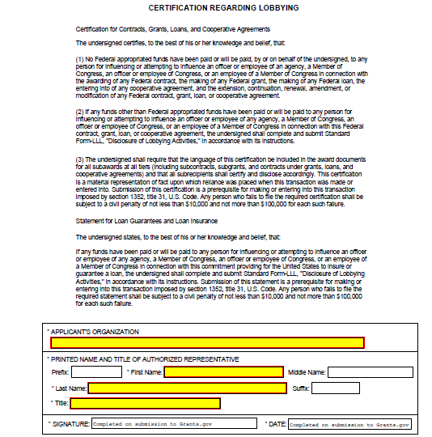
Notes:
This is the Grants.gov Lobbying Form (formerly the ED Combined Assurance form) (shown on slide). There is more information about those forms on each of the forms and also in the Application Submission Guide.

Slide 93
Application Format Requirements
Notes:
FROM PRIOR SLIDE
Question: Do IES grants allow a fee-for-profit; are for-profit agencies allowed to charge a standard fee?
Answer: That is an excellent question. I don’t believe that for-profit agencies are allowed to charge a standard fee. For-profit agencies can apply for grants, absolutely.
My understanding is that they are not allowed to charge a standard fee. This would be a good question about which to contact your Program Officer.
Our last topic will be application format requirements.

Slide 94
Format Requirements for PDF Files
Page
8.5-inch X 11-inch
On one side only
1-inch margins at top, bottom, and both sides
Notes:
The same format requirements are used for the Abstract, the Project Narrative, the appendices, the bibliography, the Human Subject Narrative, Narrative Budget Justification, biographical sketches, and list of current and pending support—in other words, everything that you need to create on your own as opposed to just filling out a form. A page is defined as 8-1/2 by 11 inches and one side. You should have 1-inch margins at the top, bottom, and both sides of the page.

Slide 95
Format Requirements for PDF Files
Type size/font size
Height of letters must not be smaller than 12-point
Type density, including characters and spaces, must be no more than 15 characters per inch (cpi)
No more than 6 lines of type within a vertical inch
Spacing
Text must be single-spaced
Notes:
The height of your letters must not be smaller than 12-point, and your type density, including both characters and spaces, must be no more than 15 characters per inch. You also have to make sure you have no more than six lines of type within a vertical inch. In general, if you use a 12-point Times New Roman font and single-spacing, you should be fine on all of these type size and font size requirements. We have these requirements for two reasons: first, so that we make sure that your text is legible for all of our reviewers, but also to ensure that everyone has the same amount of space for their Project Narrative, etc.
Question: Is there a standard form or format for the current and pending funding information that gets uploaded for each person?
Answer: There is not a standard form and format for that information either. I think, most commonly, people make a small table that includes the start and end dates of each project, the percent effort on each project, and whether the project is pending or already funded. I think that is sort of the minimal amount that you probably want to include, but again, we don’t have a form or format for that, so it is up to you.
Question: Is there a particular font that you prefer?
Answer: There isn’t necessarily a particular font that we prefer. Please choose one that is easy to read for the reviewers. As I said a moment ago, I think that if you choose Times New Roman in a 12-point, then you should be fine in terms of your type size and font size, so that is probably a safe bet, but we don’t really have a preference for any font.
Question: Please confirm if the page numbers and footnotes are within the 1-inch margin or if they can be outside the 1-inch margin.
Answer: They can be outside the 1-inch margin if you need them to be. I would be especially careful about footnotes because you don’t want to run the risk of your footnote being cut off. If you can move the footnote outside of the 1-inch margin, I think that that would be a safer bet, but you can go in the 1-inch margin if necessary.
Question: If we have key personnel that are included under sub-awards, do we include that person under the main personnel section or the sub-award section?
Answer: If they are being paid through the sub-award, they should be included in the sub-award budget and budget narrative justification. You don’t want to duplicate the cost of the funds devoted to that person, so if they will be paid through the sub-award, then they should be in the sub-award.

Slide 96
Format Requirements for PDF Files
Graphs, Diagrams, Tables, and Charts
Graphs, diagrams, tables, and charts must reproduce well in black and white
Conform to same type size requirements
Figures, charts, tables, and figure legends may be smaller in size but must be readily legible
Notes:
If you have graphs, diagrams, and tables, which you are allowed to have, you should make sure that they reproduce well in black and white. So make sure, for instance, if you have some kind of pie chart or bar graph, that in black and white you can tell the difference between the different sections of the pie or different bars. Your graphs, diagrams, tables, and charts should conform to the same type size requirements as the rest of the materials with your application. Figures, charts, and table legends may be smaller in size but should still be readily legible.

Slide 97
Reminders about Page Limits
Project summary/abstract: 1 page
Project narrative: See relevant RFA
Appendix A: 3 pages
Appendix B: 15 pages
Appendix C: 10 pages
Appendix E: 5 pages
Each biographical sketch: 4 pages
Each list of current and pending funding: 1 page
Notes:
Some reminders about page limit. The Project Summary/Abstract has a limit of one page. The Project Narrative has a page limit, and you need to check your RFA to see what the page limit is. Appendix A has a limit of 3 pages. Appendix B has a limit of 15 pages. Appendix C has a limit of 10 pages. Appendix E has a limit of five pages. Each biographical sketch has a limit of 4 pages and each list of current and pending funding has a limit of one page.

Slide 98
No page limits for…
Appendix D
Bibliography & References Cited
Human Subjects Narrative
Narrative Budget Justification
Notes:
There are no page limits for Appendix D, the bibliography and references cited, the Human Subjects Narrative, and the Narrative Budget Justification.
Question: Is there any way to see a completed application sample, especially of the attached documents?
Answer: There is. You can make a request through the Freedom of Information Act, FOIA, and if you Google that you can find the FOIA information on the ed.gov website, and it tells you the process that you need to go through. That is the formal avenue for seeing a completed application. No one at IES can send you an application. We don’t have any samples. So if you would like to see an application, you would need to put in a FOIA request. If you put that request in, then you will get all of the information that is not personally identifying information, including all of the attachments.
We will go over some general program information.

Slide 99
General Program Information

Slide 100
Eligibility Information
Applicants must have the ability and capacity to conduct scientifically valid research
Cost sharing or matching is not required
Notes:
In terms of eligibility, applicants must have the ability and capacity to conduct scientifically-valid research. I have already said this, but here it is again: cost sharing or matching is not a requirement.
Question: Are footnotes in 12-point font?
Answer: The answer is yes, but I will add a little bit to that. You are allowed to put in footnotes, and I know that programs like Microsoft Word will automatically format footnotes in a smaller font size, which is okay. I think the idea here is that we are trying to create equity in these applications, which is why we have all these requirements about font sizes. So I would strongly recommend that you either avoid footnotes altogether or use them very, very sparingly, and don’t use them as a way to include a lot of additional information. You can use footnotes. They can be smaller font size, but I wouldn’t use them excessively. I hope that helps.
Question: Should the narrative be single-spaced?
Answer: Yes.

Slide 101
Award Information
Awards depend on
availability of funds
quality of applications received (peer review)
scope of project proposed (i.e., Goal in 305A or 324A, Topic in other RFAs)
Notes:
Awards will depend on the availability of funds. Also, the number of awards will depend on the quality of the applications that we receive, and the size of the awards depends on the scope of the projects that are being proposed.
Question: You mentioned that sub-award budget dollars shouldn’t be duplicated in the prime budget but at Other Direct Costs there is an item number five which says Sub-Awards Consortium Contractual Costs. Does the sub-award budget dollars go in here?
Answer: Yes. You want to do your sub-award budget separately. So fill out a separate form for each sub-award. Once you do that, you take that number you come up with at the end and put it into number five for Sub-Awards Consortium Contractual Costs on the main budget form. So yes, that is absolutely correct. What I meant when I said they shouldn’t be duplicated is that you don’t want to, for instance, pay the same person under key personnel for the main award and pay them again through the sub-award. You don’t want to buy two computers when you really only need one, once through the main award and once through the sub-award. So that is what I meant by duplicating. You are right that that number itself does need to go into the main form. That is a great question.

Slide 102
Award Information
Maximum dollar amount for total funding
See relevant request for applications
IMPORTANT:
NCER (84.305 RFAs) - lower budget maximums this year!!
Notes:
There is a maximum dollar amount for total funding for each grant. You should refer to the RFA to see what the maximum dollar amount for total funding is for the competition to which you are applying.

Slide 103
Final Reminders
Notes:
Here are a couple final reminders.

Slide 104
Application Checklist
Use Application Checklist provided in the relevant Request for Applications to determine that you have…
Provided required information for each mandatory form in Grants.gov electronic application package
Attached correct PDF files to proper form
Completed certifications and assurances
Notes:
Use the application checklist in the Request for Applications for the competition you are submitting to in order to determine that you have provided all of the required information for each form, that you have attached the correct PDF files to the proper form, and that you have completed all of the certifications and assurances.
Question: A question came in earlier about where key personnel should be listed. Let’s say you have a key person on a sub-award. I think you also want to make sure you list them, for example, on the Key Personnel form. The question here is about whether a key person who is being paid through a sub-award should be included in that Section A, and the answer is yes.
Answer: Yes, and have the biographical sketch for them and a current and pending funding.
That means that you put their contact information in, you upload their bio, and you include a list of current and pending funding. So your key personnel, whether they are on your sub-award or your main award, should be included on that form, should have a bio, and should have a current and pending funding list. In terms of budget, they go on a different form, but in terms of the key personnel form, you do want to include them there also.

Slide 105
Application Checklist
Use “Check Package for Errors” button on application package
Upload application and confirm validation by Grants.gov before 4:30:00 p.m., Washington, DC time on 8/6/2015 or 8/20/2015 (pay attention to the deadline for your competition!)
Use “Track My Application” on Grants.gov
Pay attention to e-mail (4 in total) – look for PR/Award number and date/time stamp
Notes:
You should use the Check Package for Errors button on the application package in order to make sure that you have completed all of the required forms.
You need to upload your application and confirm that it is validated by grants.gov before 4:30:00 p.m. Washington, DC time; that is Eastern Daylight Time, on August 6, 2015 (or August 20, 2015). You can use the Track My Application function on grants.gov to make sure that your application has been uploaded and validated.
Pay attention to your e-mails; you should get four in total. Look for the PR award number and the date/time stamp in one of the e-mails to ensure that your application was received in time.

Slide 106
Remember
Register for Grants.gov early
Review application submission information at the end of the RFA for the relevant competition for information on filling out forms and uploading applications
http://ies.ed.gov/funding/
Download the application package designated for your competition and deadline
Notes:
Remember to register for grants.gov early. If you aren’t sure if your institution is registered for grants.gov, you should do it as soon as this webinar is over just to make sure.
Review the application submission information at the end of the RFA for the relevant competition for information about filling out the forms and uploading the application. The RFA for the competition you are applying to is also available through grants.gov.
Make sure that you download the application package designated for your competition and your deadline.
Question: Appendix C—should you conform to the font and format requirements? What if you have letters coming from many different institutions?
Answer: You probably will have letters coming from many different institutions. I would say that it is not very strictly enforced, in terms of the formatting of the letters. The most important thing is that you make sure that they are legible, that is what we mean when we say you shouldn’t shrink down the letters, what we mean is don’t make them smaller and put multiple ones on a page or something like that. This really is just so reviewers can read the letter. So you want to make sure that the letter is legible and that nothing gets cut off in the margins. You don’t need to contact all of your schools and force them into certain formatting requirements as long as their letter is legible.

Slide 107
Remember
Submit your application early
Three or four days in advance
Verify submission is OK using “Track My Application”
http://www.grants.gov/web/grants/applicants/track-my-application.html
Notes:
Also, remember to submit your application early, we would recommend 3 or 4 days in advance. This is so that you can verify your submission is okay. Again, use the Track My Application function on grants.gov to make sure that your application is validated.
Question: What do you recommend in terms of running heads on any or all parts of the application documents?
Answer: I am not sure that I have a recommendation for that. I would say don’t waste your space. The other thing people ask about a lot is a table of contents. In theory, tables of contents are really nice, but they take up a page, and if you include a table of contents it is going to count toward your page limit for the narrative. Running heads take up space, so I would recommend, unless you are sure you have space for them, not including a running head. One of the things to keep in mind is that when all of your PDFs and forms are put together, there is a footer that is added on every page that has your unique assigned number. You don’t need to identify each page of your application because that is done automatically through the system.
Question: Is it too late to contact a Program Officer to discuss a proposal?
Answer: The answer is absolutely not. It is never too late to contact a Program Officer. How should we contact the Program Officer? Should we e-mail for a phone conference with a brief description of the project? That sounds great. Program Officers are more than happy to talk with you on the phone, but I think your best bet is to e-mail them ahead of time and request a time to speak with them. If you can include a brief description of your project that will help them a lot too, so that they can have an idea of your project before they speak to you on the phone.

Slide 108
And last but not least…
Contact relevant Program Officer
To learn more about substantive requirements for a proposal
For help with completing forms in application package
Notes:
Last but not least, I have said this before but I will say it again, contact your Program Officer if you have any questions. They can help you with the substantive requirements for your proposal, and they can also help you with completing forms in the application package. So make sure you reach out to your Program Officer.

Slide 109
http://ies.ed.gov/funding/
http://www.grants.gov/
Notes:
Here is the website for grants.gov and our funding page.
Question: In terms of budget, how specific in detail should the Budget Narrative Justification be?
Answer: It needs to be pretty specific. You need to talk about each key person, talk about the role that they play on the project, the jobs that they are going to do on the project, and be clear about their percent effort. In terms of other items, if you are talking about travel, for example, make sure you indicate how many trips per year and how many people are going to be on each trip. You also need to itemize cost estimates for airfare, hotel stays, and meals and incidentals. You need to estimate all of that. Your sponsored projects office will have guidance on the per diem that you are allowed to use for your hotel, etc. When we are talking about materials or equipment, you need to itemize that also. You need to say, “I need to purchase five computers at $1,000.00 each for a total of $5,000.00.” All that needs to be itemized in your Budget Narrative Justification. I would say you want to err on the side of being overly detailed. It is better to have more information and to be more specific than to be too general.
Question: Can the budget be an estimate or does it need to be precise?
Answer: You should be as precise as you can. We recognize that the cost of things change sometimes between the time that you have submitted your application and the time that your grant is awarded. For instance, if you look up airfare to a conference, that is just an estimate. Do the best you can with your estimates. Price out the costs of all the assessments you need, the cost of the equipment and the computers and the materials you need, and just do the best you can.
Question: Does IES have any limitations with regard to including non-American citizens as collaborators or consultants on applications? What about post-doctoral fellows?
Answer: I don’t believe we have any limitations on including non-American citizens as collaborators. You can also include institutions outside of the United States. They can be included as sub-awards. An important thing to note, though, is that those institutions outside of the United States cannot charge indirect costs. Otherwise, we don’t have any limitations on non-American citizens or post-doctoral fellows.
Question: Which e-mail confirms on-time submission?
Answer: The fourth e-mail you receive, from the U.S. Department of Education, confirms that your application was on time. The first e-mail tells you that you have uploaded it into the system. The second e-mail tells you that it has been validated. The third tells you that the U.S. Department of Education has retrieved it. It is the fourth e-mail that tells you that it is on time. You do not need to receive that e-mail from the U.S. Department of Education before the deadline. However, I would recommend that you submit your application early. That way you don’t need to be concerned about whether your submission was on time. So the earlier you can do it, the better.

