Slide 1
IES Application Submission Process
Emily Doolittle, PhD
National Center for Education Research
Sarah Brasiel, PhD
National Center for Special Education Research
Notes:
Welcome to the IES Application Submission Process webinar. My name is Emily Doolittle, and I am a program officer in the National Center for Education Research. I am joined by my colleague Sarah Brasiel who is a program officer in the National Center for Special Education Research.
In the webinar today, we will provide an overview of how to submit a grant application to IES for the current fiscal year 2022 funding opportunities.

Slide 2
What You Will Learn Today
How to prepare for an IES grant competition
How to find application materials
How to use Grants.gov
What to include in an application
How to format your application
Notes:
Today you will learn how to apply for an IES grant, with a focus on how to find the materials you need, how to use grants.gov to complete and submit your application, and some general information about what to include in your application and how to format important components of your application.

Slide 3
The IES Research Centers
NCER - National Center for Education Research
ALN 84.305
NCSER - National Center for Special Education Research
ALN 84.324
Notes:
IES has two research centers, each of which offers funding opportunities. The research centers’ grant competitions are identified using an Assistance Listing Number (ALN). All National Center for Education Research (also known as NCER) competitions are identified with the ALN number 84.305, and all National Center for Special Education Research (also known as “nik-ser”) competitions are identified with the ALN number 84.324. Individual grant programs within each center are identified using an alpha character (A, B, C, etc.). More on that later.

Slide 4
What are the Research Centers Competing this Fiscal Year?
Go to https://ies.ed.gov/funding/ to see the current fiscal year research and research training opportunities from NCER and NCSER
Notes:
Go to the IES Funding Opportunities page to see what the centers are competing in the current fiscal year.

Slide 5
Application Due Dates Vary by Competition
The due date for each competition can be found on the cover of the current fiscal year request for applications (RFA)
See https://ies.ed.gov/funding/futureComp.asp for important dates and deadlines
Notes:
Pay attention to due dates. For FY 2022, the research centers are accepting applications on three different due dates – know the due date for your competition. IES does not accept late applications. More on that later.
NCSER’s Research to Accelerate Pandemic Recovery in Special Education has two separate deadlines designated 324X-1 and 324X-2. The first deadline (324X-1) is August 2nd, and the second deadline (324X-2) is September 9th.
Applications to NCER’s Stats and Methods program and the Longitudinal Data to Support Recovery Policymaking are due on August 12th.
Finally, applications to NCER’s Education Research, Research Training, and Systematic Replication competitions are due on September 9th.

Slide 6
Stay Informed with the IES NewsFlash
Sign up for the IES NewsFlash (https://ies.ed.gov/newsflash/) to receive email alerts about funding opportunities
Notes:
Stay informed about current funding opportunities by signing up for the IES news flash

Slide 7
How to Find Application Materials
Notes:
Now, let’s review how to find the materials you will need to submit an application to one of the research or research training grant competitions at IES.

Slide 8
RFAs
https://ies.ed.gov/funding/22rfas.asp
Find the Request for Applications for the competition you want to apply to
Requirements to get to peer review
Recommendations for a strong application
Notes:
You need three things to apply. First you need the Request for Applications, or RFA, which contains information for writing your Project Narrative including requirements that must be met to advance to peer review and recommendations for a strong application. The RFAs are located on the IES website.

Slide 9
Application Submission Guide
https://ies.ed.gov/funding/pdf/submissionguide.pdf
How to submit your application through Grants.gov
What to expect after you submit your application
Notes:
Second, you will need the Application Submission Guide which contains information about submitting your application using grants.gov.

Slide 10
Application Packages
https://www.grants.gov/
Forms needed for a complete application
Notes:
You also need to find the correct application package, which contains the forms that you will need to complete – that is located on the Grants.gov website.

Slide 11
How to Use Grants.gov
Notes:
Now let’s turn to Grants.gov, where you will find the application package for your competition.

Slide 12
Where to Start on Grants.gov
Notes:
I recommend that you start on the “For Applicants” page on Grants.gov. Here you will find links to Get Registered and Apply for Grants – both circled in red. Start with registration to ensure your organization is registered in time to submit your application well in advance of the deadline date. More on that later.

Slide 13
Registration Overview
Organizations need these before using Grants.gov to apply for federal grants:
Data Universal Numbering System (DUNS) Number
Active System for Award Management (SAM) registration
Grants.gov Account: You only need one. Uses unique email, username & password.
Profile(s): Can have multiple within one Grants.gov account.
Notes:
Before you can register your organization on Grants.gov, you need a DUNS Number and an active System for Award Management, or SAM registration. Each organization only needs one Grants.gov account. Within each account, you can have multiple User Profiles to allow more than one person to work on a single grant application.

Slide 14
Get Registered
Notes:
Registration (and annual renewal) on Grants.gov involves multiple steps that can take several weeks depending on a variety of factors. Your Organization Registration in Grants.gov must be active in order to submit an application to IES. Make sure your organization registration is complete in plenty of time to meet the application deadline for your competition.

Slide 15
Apply for Grants
Notes:
Once you have attended to your organization’s registration status in Grants.gov, you will need to find the application package for your competition. Go to Apply for Grants and select “Apply for a Grant Opportunity Today.”
If you are not familiar with Workspace, you can read an overview of how to apply using Workspace here as well (circled in red).

Slide 16
Workspace Overview
Notes:
Workspace is the standard way for organizations to apply for federal grants in Grants.gov.

Slide 17
Apply for a Grant Opportunity
Notes:
Now let’s go to “Apply for a Grant Opportunity Today” and I’ll show you how to find the application materials for your competition.

Slide 18
Use the Search Function
Notes:
The easiest way to find the application package for your competition is to use the Search function in Grants.gov (circled in red)

Slide 19
CFDA (or ALN) Number
Search by CFDA (or ALN) number without the alpha character
All NCER competitions use 84.305
All NCSER competitions use 84.324
Notes:
Search by CFDA or ALN number for the competition you wish to apply to, without the alpha character. As a reminder, all grant competitions offered by NCER use 84.305, and all those offered by NCSER use 84.324.

Slide 20
CFDA (or ALN) Search Results
Grants.gov search yields more than one application package if there are multiple competitions offered by either center in a given fiscal year
Download the application package designated for your competition
Look at the Opportunity Title and the CFDA/ALN number
Notes:
When you search by CFDA or ALN number (without the alpha character), you will get a list of all of the competitions offered. Make sure you select the Opportunity Title and CFDA number for your competition to get the correct package.

Slide 21
Mandatory and Optional Forms
Notes:
Once you find the application package for your competition, open the Grant Opportunity and click Preview to see the mandatory and optional forms for the competition. If you click on any of these links it will take you to a preview of that form.

Slide 22
Applying with Workspace
Notes:
Now I’ll show you how to apply using Workspace.

Slide 23
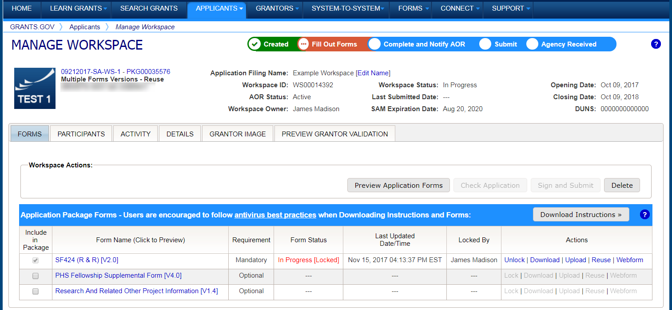
Example Workspace
Notes:
Workspace is a shared, online environment where you work on your grant application.
Multiple people may simultaneously access and fill out the mandatory and optional forms within an application. This is an example Workspace from Grants.gov to show you what the environment looks like. Now I’ll show you some features of the Workspace.
The Participants tab lists the members of a workspace who work as a team to complete the required forms for a federal grant.

Slide 24
Completing Workspace Forms
Notes:
Under Actions (bottom right of the screen shot) you have several options.
Click Webforms to fill out the forms online
Click Download to complete PDF forms
Click Upload to submit completed PDF forms
Click Lock/Unlock forms to prevent other Workspace members from editing a form as needed
Click Reuse if you want to use a form from another workspace

Slide 25
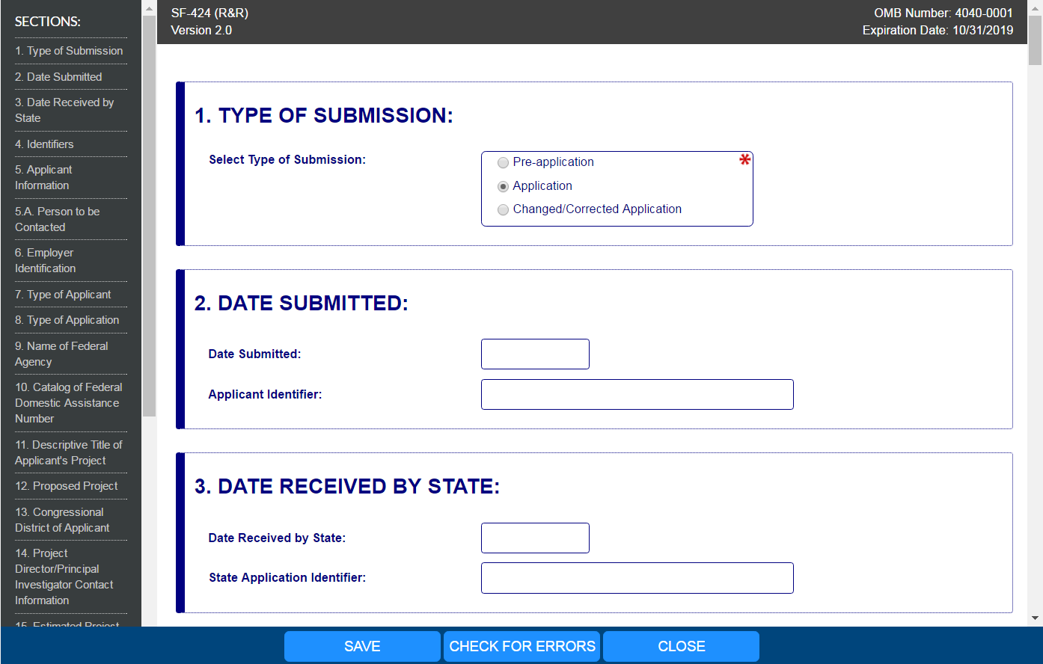
Completing Webforms
Notes:
Let’s review some basic features of the webforms.
Complete the form in your web browser
Navigate by clicking Sections (see left-hand side)
Use the “Tab” key to move through the form fields
Required fields are marked by a red asterisk

Slide 26
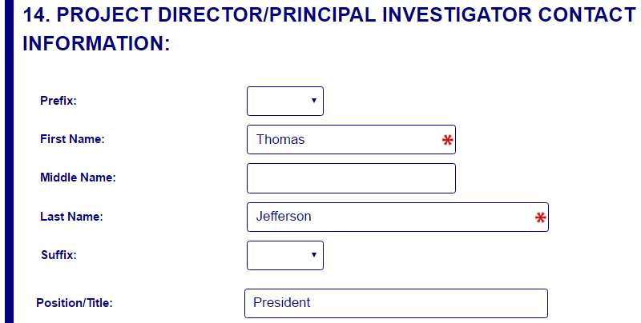
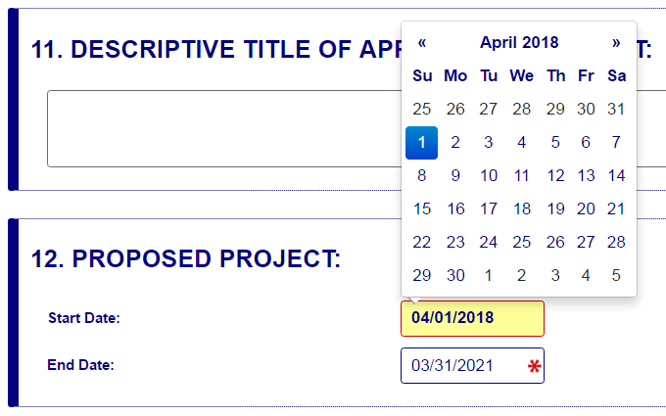
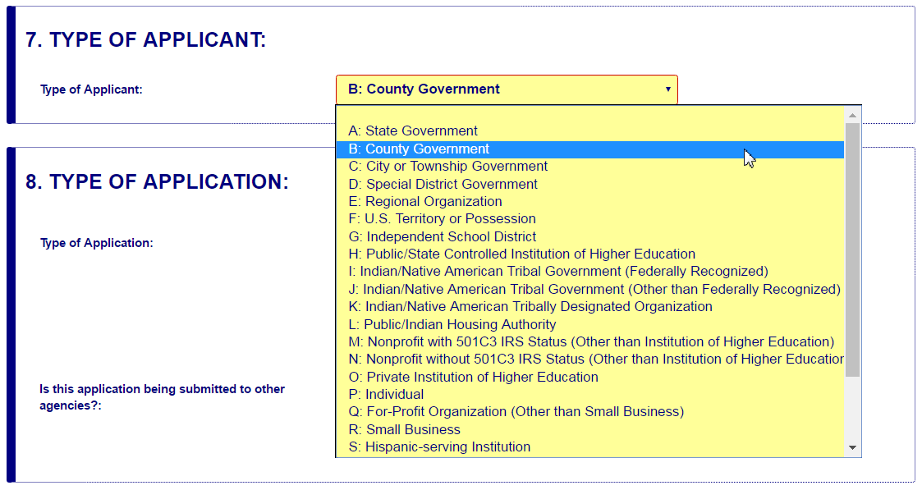
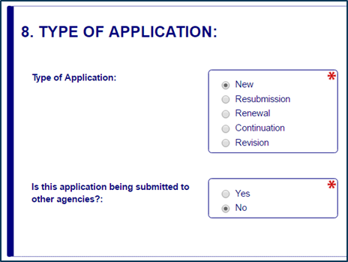
Enter Data
Dates/calendar
Open text entry
Drop-down menu
Radio buttons (multiple choice)
Notes:
You will enter information into the webform in a variety of ways, including entering your own text, using a drop-down menu or using a pop-up calendar that allows you to choose dates, and selecting radio buttons for multiple choice fields

Slide 27
Completing Webforms (1 of 3)
Hover mouse over form fields for help
Pop-up messages explain how to fill out form fields
Notes:
If you need help while working on the webform, hover your mouse over the field where you will see a pop-up message that explains what is needed.

Slide 28
Completing Webforms (2 of 3)
Forms will auto save every 5 minutes
Complete the SF-424 Application for Federal Assistance form first to pre-populate fields in other forms in the application package
Notes:
Other features to note in webforms: they will autosave every 5 minutes. Also, you should complete the SF-424 Application for Federal Assistance form first because it will pre-populate other forms in the application package

Slide 29
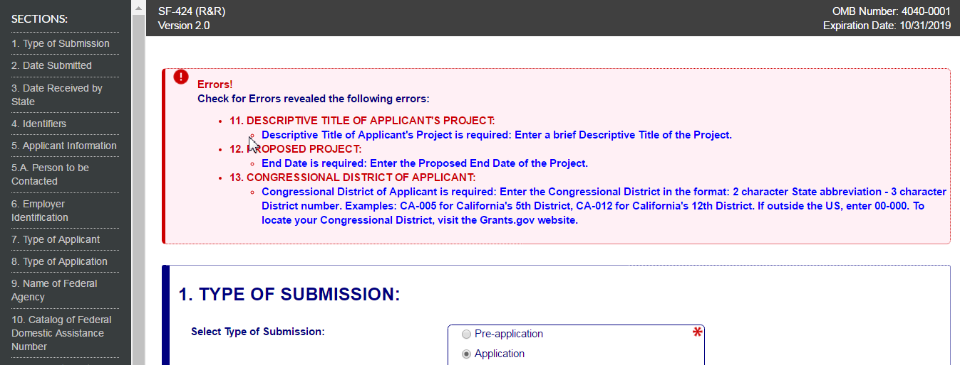
Completing Webforms(3 of 3)
Check for Errors: Form validation & field-level errors
Notes:
At the bottom of each webform, there is a tab “Check for Errors” that will tell you if there are any errors in the form. For example, if you haven’t filled in a field that is required, when you click the Check Package for Errors button you will get a message telling you what is needed.

Slide 30
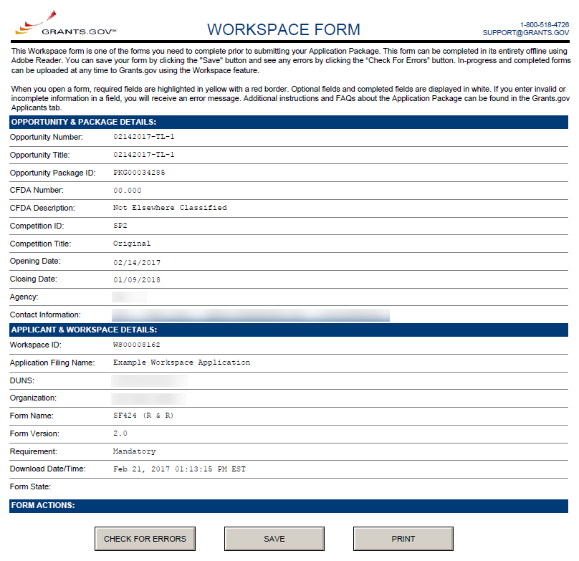
Completing PDF Forms (1 of 2)
PDF Form Basics:
Option to download PDF forms to complete in Adobe software
Upload PDF forms to Workspace
Notes:
If you don’t want to use the webform option, you can download the forms and complete them using Adobe software. Once completed, you then upload them to workspace. Note that the PDF forms also have a Check for Errors button.

Slide 31
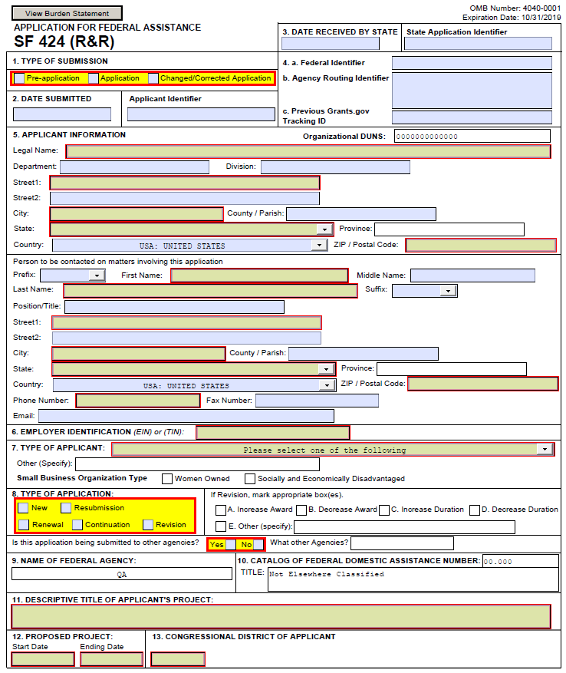
Completing PDF Forms (2 of 2)mpleting PDF Forms (2 of 2)
PDF Form Basics:
Tab through form fields
Required fields are flagged
Hover mouse over form fields for help
Error messages explain how to fill out form fields
Notes:
If using PDF forms, you can move through the form using the Tab key. Note that required fields are flagged. As with the webforms, you can hover your mouse over form fields if you need help.

Slide 32
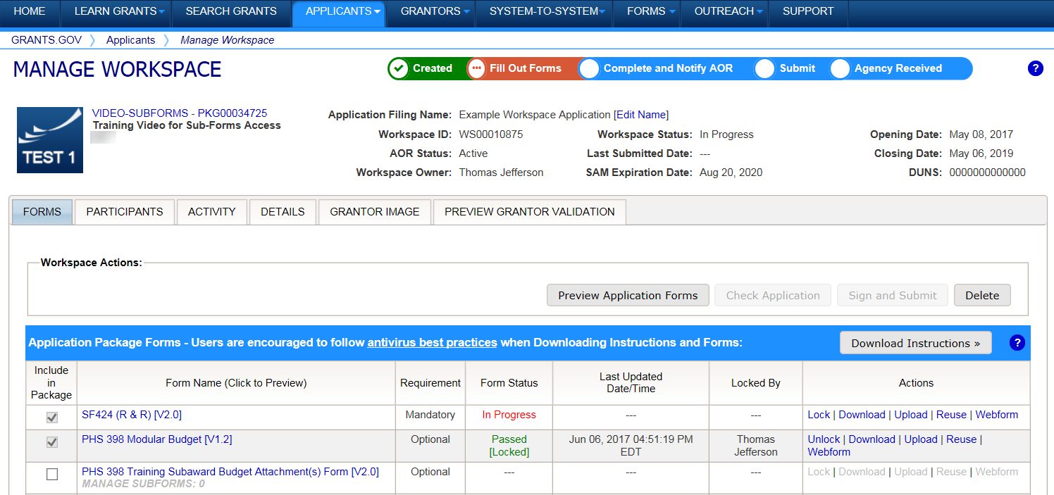
Reusing Workspace Forms
Workspace Features
Reuse past forms
Data retained for three years
Notes:
Whether using webforms or PDF forms, you always have the option of reusing a form. Grants.gov will keep your forms for three years.

Slide 33
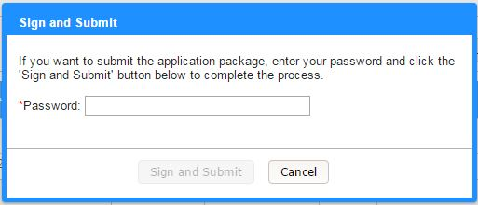
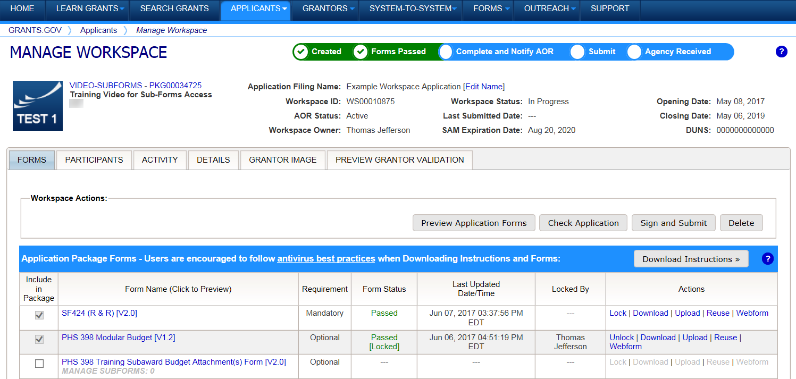
Workspace: Submit Application
Process:
Workspace Owner notifies users with AOR role to submit
Note you need your Grants.gov password to submit
Notes:
When you’re ready to submit your application, the Workspace Owner (the participant with that assigned role) must notify the Authorized Organization Representative (AOR) that it is ready to submit. The AOR is the Workspace participant with the authority to submit the application.
Also, please note that you need your Grants.gov password in order to submit the application.

Slide 34
More on Grants.gov
Notes:
Now, we’ll go over more features of Grants.gov to help you complete and submit your application successfully and on-time.

Slide 35
Grants.gov Software Requirements
Adobe software
To read and complete the application forms
To convert Word, Excel, or other documents to PDF documents
Grants.gov can help with checking software and downloading the version you need
Notes:
As noted earlier, you need Adobe software to read and complete the application forms. In addition, you will attach documents to the application forms that contain the substance of your application (more on that later). IES recommends that you use PDF files. If you need help converting your files to PDF, grants.gov has resources to check the version you have and download the version you need if you don’t have the correct version.
Note: If you can see the application package, you are able to complete and submit grant applications on Grants.gov.

Slide 36
Adobe Resources on Grants.gov
Notes:
Back on the For Applicants page, there is a section on Adobe Compatibility (circled in red) that you can use to ensure you have the right version of Adobe to submit your application.

Slide 37
Grants.gov Submission
Applications received by Grants.gov are date- and time-stamped
Your application must be…
Fully uploaded and submitted
Date- and time-stamped by the Grants.gov system
Submitted no later than 11:59:59 p.m. Eastern Time on the application deadline date – different dates for different competitions
Late applications will not be reviewed!
Notes:
Applications received by grants.gov are date and time stamped and the time is stamped to the second. Your application must be fully uploaded and submitted, and the date and time stamp must be no later than 11:59:59 p.m. Eastern Time on THE DUE DATE in order for IES to review your application.
Late applications will not be reviewed.

Slide 38
Grants.gov Submission Problems
If you have trouble completing the forms or submitting your application through Grants.gov
Contact Grants.gov First!
1-800-518-4726
support@grants.gov
Use Grants.gov’s Applicant FAQs
Notes:
If you have any trouble completing the forms in the application package or submitting your application through grants.gov, your first step should be to contact grants.gov. You can call their 800 number or send an email. When you contact Grants.gov for help, they will give you a case number that you need to keep. Once you have your case number, contact your IES Program Officer and let them know about the problem and the steps that you have already taken to remedy the problem.

Slide 39
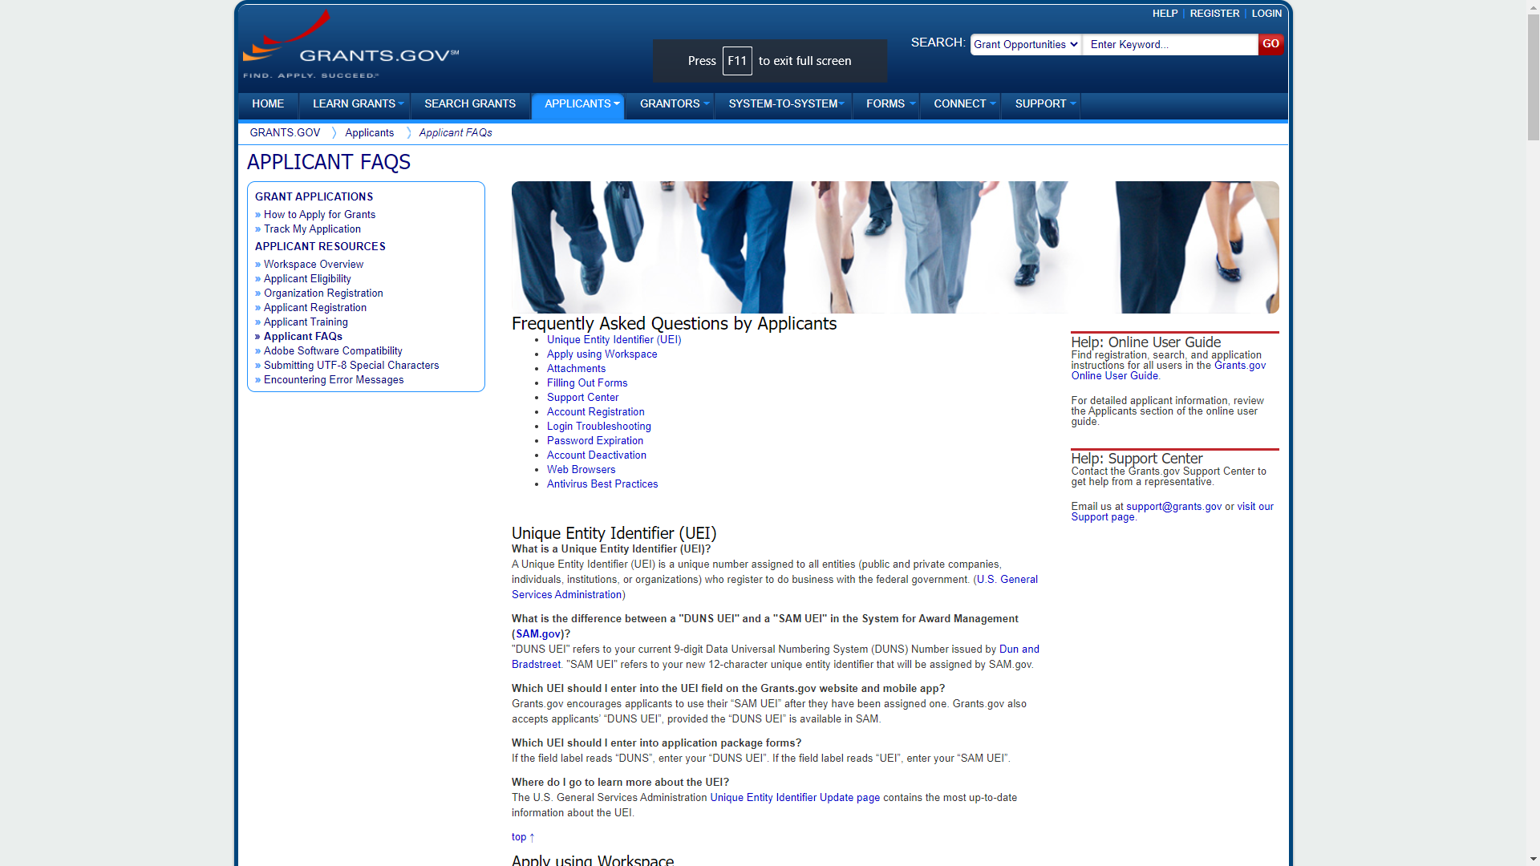
Applicant FAQs
Notes:
On the Applicant FAQ page, Grants.gov provides several resources that may help if you are experiencing any difficulties with your application.

Slide 40
Late Applications
If Grants.gov determines there was a technical problem with their system, and that the problem caused the application to be late, you may email the relevant IES program officer to petition your case
However, IES will not accept an application that was late due to failure to follow Grants.gov’s submission guidelines
Notes:
IES does not accept late applications. If Grants.gov determines that there was a technical problem with the grants.gov system, and that the problem with the system affected your ability to submit your application on time, we will accept your application. If that is the case, email the IES program officer with your Grants.gov Case Number.
Please note, though, that the vast majority of the time, there is not a technical problem with Grants.gov; instead, it is a common error that leads to problems that slow you down and that could make your application late! IES will not accept an application that was late because the Grants.gov submission guidelines weren’t followed.

Slide 41
Track your application on Grants.gov
Use the Grants.gov “Track My Application” link to verify on-time, valid submissions
Use your assigned Grants.gov Tracking Number (e.g.,GRANT00234567)
Notes:
You can track your application on grants.gov using the Track My Application link to verify that your submission was on time and valid. You can track the application this way from the time you begin the upload process until IES receives the application and assigns a unique identifier.

Slide 42
Track Your Application
Notes:
You access the Track My Application page from the For Applicants page where you can select Track Your Application.

Slide 43
Track and Check the Status of Your Application
Notes:
Enter the Grants.gov tracking number for your submission to follow your application’s progress through the Grants.gov system.

Slide 44
Grants.gov Submission Confirmation
Comes by email
3 emails from Grants.gov
Followed by a 4th email from the U.S. Department of Education
Notes:
You will get confirmation of your submission from grants.gov and IES in the form of four e-mails. The first three e-mails come from grants.gov, and the fourth e-mail comes from IES, U.S. Department of Education.

Slide 45
From Grants.gov
First e-mail confirms that you have attempted to upload an application into the Grants.gov system
Application tracking number assigned (e.g.,GRANT00234567)
Second e-mail indicates…
EITHER application successfully validated by Grants.gov
OR application has been rejected due to errors
Third e-mail indicates…
U.S. Department of Education has retrieved application from Grants.gov.
Notes:
The first e-mail confirms that you have attempted to upload your application to grants.gov. At this point, your application will be assigned a tracking number that starts with G–R–A–N–T, grant. The second e-mail you receive will indicate either that your application has been validated by grants.gov or that your application has been rejected due to errors. If it has been rejected, you will need to go back and fix the errors. This is yet another reason that you should submit your application early, because you want to make sure you have enough time to fix any problems if your application is rejected. The third e-mail you receive from grants.gov indicates that the Department of Education has retrieved your application.

Slide 46
Department of Education Confirmation
You will receive a 4th e-mail from the U.S. Department of Education with an 11-digit PR/Award number unique to your application beginning with R305 (NCER) or R324 (NCSER).
Use this number to track your application from this point forward.
If your application is late (as determined by Grants.gov), this email will state that it was late and your application will not be given further consideration.
Notes:
This final email contains an identified, called a PR/Award number, that is unique to your application. It will start with R, then 305 or 324 depending on which center you submitted your application to, and then the letter of the competition and a series of digits. Once you get this PR/Award number, use this R305 or R324 number to track your application on the IES Peer Review Website, which I will describe next. If your application was submitted late, this e-mail will state that it was late and that it will not be given further consideration.

Slide 47
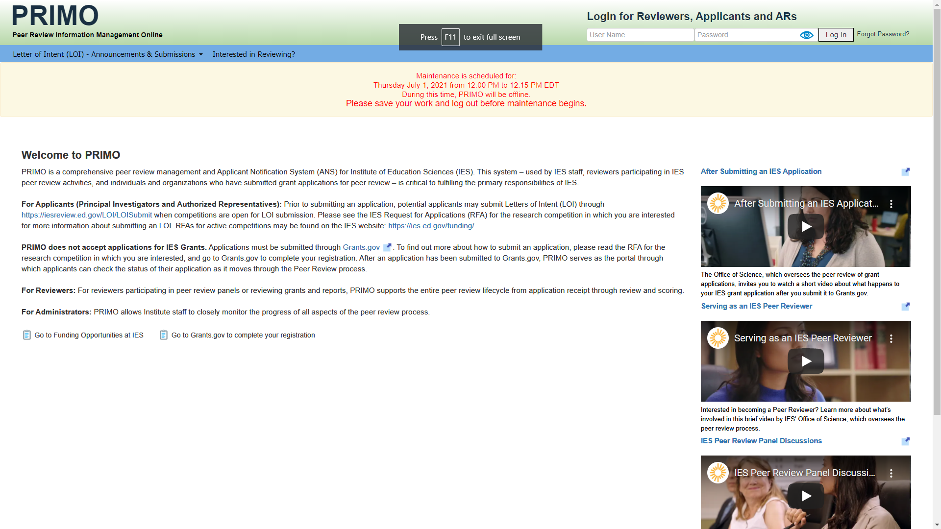
Peer Review Information Management Online (PRIMO)
Notes:
IES has a peer review website called PRIMO – Peer Review Information Management Online. After submitting your application, you will be invited to set up your PRIMO applicant account to keep track of the status of your application as it is reviewed.

Slide 48
IES Peer Review Website
PRIMO: Peer Review Information Management Online
A few weeks after the application deadline, look for up to 3 emails from IESHelp@prsmhosting.com
1st email: Subject line “IES – PRIMO Applicant Notification System (ANS) – Status of Application (Part 1 of 2)” provides login information
2nd email: Subject line “IES-PRIMO Applicant Notification System (ANS) – Status of Application (Part 2 of 2)” provides password
3rd email (or 1st email if you already have an ANS Account): Subject line “FY Application Status Update – Institute of Education Sciences – PRIMO ANS” tells you to login to PRIMO to see the status of your application.
Contact the relevant program officer if you do not receive these emails
Notes:
A few weeks after the application deadline you will receive up to 3 emails about PRIMO’s Applicant Notification System (ANS). From this point forward, all communication about the status of your grant application will come from this system.
The 1st email has the subject line “IES – PRIMO Applicant Notification System (ANS) – Status of Application (Part 1 of 2)“ and provides login information
The 2nd email has the subject line “IES-PRIMO Applicant Notification System (ANS) – Status of Application (Part 2 of 2) “ and provides password
The 3rd e-mail (or 1st email if you already have an ANS Account) has the subject line “[Fiscal Year} Application Status Update – Institute of Education Sciences – PRIMO ANS” and tells you to login to PRIMO to see the status of your application.
If you do not receive these emails, please contact your IES program officer so we can help you get set up.

Slide 49
What’s Included in an Application?
Notes:
Hello, this is Sarah Brasiel from the National Center for Special Education Research. I will be reviewing what is included in an application.

Slide 50
Application Contents
Forms
Research & Related (R&R) Forms (SF 424 form family)
Assurances
PDF File Attachments
Project Summary/Abstract
Project Narrative
Appendices (SOME ARE REQUIRED, SOME ARE NOT)
Bibliography & References Cited
Human Subjects Narrative
Narrative Budget Justification
Biographical Sketches of Key Personnel (including Current and Pending Funding)
Notes:
An application consists of forms – the SF-424 Research and Related, or R&R, form family – and PDF files with the substantive content of your application that are attached to the forms. This substantive content includes a project abstract, a Project Narrative, several appendices (some of which are required, some optional), a reference list, a human subjects narrative, and bio sketches for key personnel.

Slide 51
SF 424 (Cover Sheet)
Notes:
This is the SF424 cover sheet. As mentioned earlier, you should fill this form out first because it will pre-populate the other forms in the application package.
Please note Item 4B, the Agency Routing Identifier. This is not a required form field according to Grants.gov, but IES would like you to enter information into this field to help us make sure your application is routed appropriately.
Please see the request for applications for your competition to find the appropriate Agency Routing information.

Slide 52
Item 4b “Agency Routing Identifier”
This item is used to…
Screen applications for responsiveness to the competition requirements
Assign applications to the appropriate scientific peer review panel
Your application may be rejected as nonresponsive or assigned inaccurately for scientific review of merit if this field is not completed using the correct codes
See the RFA for your competition to find the codes you need to use
Notes:
The Agency Routing Identifier, Item 4B, is used to screen applications for responsiveness and to assign applications to the appropriate scientific peer review panel. If your application doesn’t include an agency routing identifier or if it is incorrectly identified, your application may be rejected as nonresponsive or assigned inaccurately for scientific review.

Slide 53
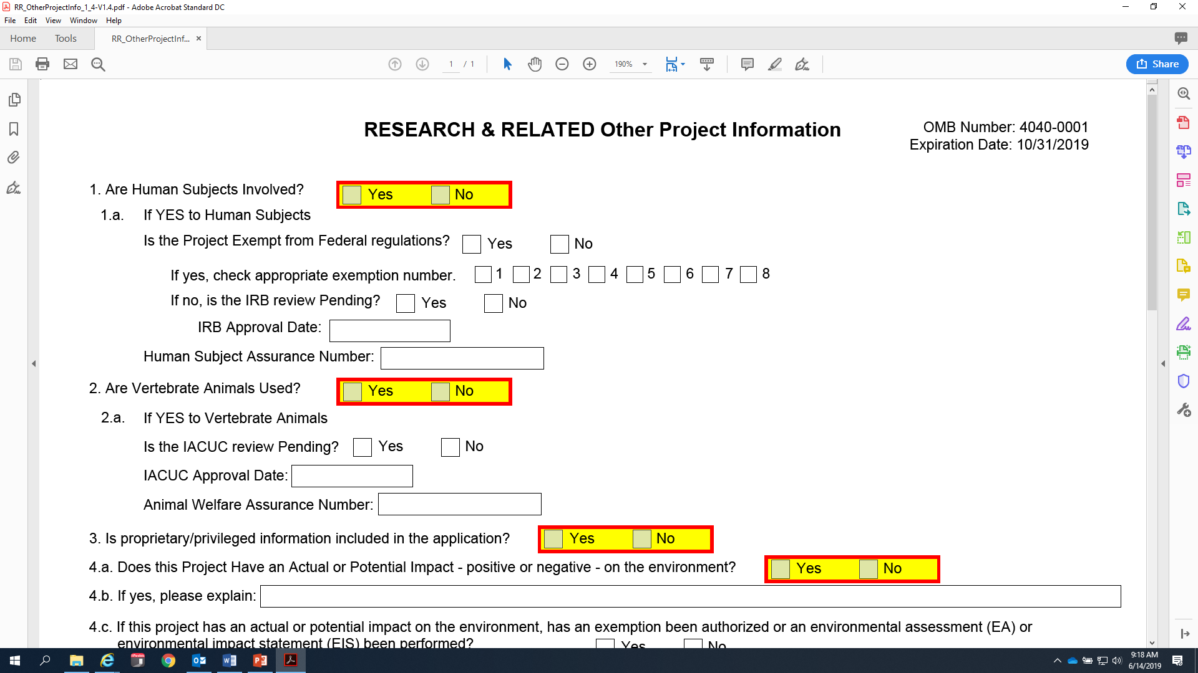
Other Project Information Form
Notes:
This is the Other Project Information form (shown on slide), which is where you will attach the substantive portions of your application, like your project abstract and narrative. All attachments must be PDF files.

Slide 54
Important Tips for PDF Files
PDF files are the recommended file type
PDF files must be:
in a read-only, non-modifiable, “flattened” format
given a unique file name
no more than 50 characters
avoid special characters
individual files (no PDF Portfolio, interactive, or fillable files)
not password protected
Notes:
The forms included in the application package provide the means for you to attach Adobe Portable Document Format (PDF) files. You must attach read-only, non-modifiable, “flattened” PDF files; any other file attachment will not be accepted by the Department. Grants.gov has additional requirements for PDFs, including a unique name for each file, names that are no more than 50 characters and that avoid special characters. Finally, you must use individual files that are non-fillable and not password protected. See Grants.gov’s Applicant FAQs for more information about PDF files.

Slide 55
PDF Attachments
The Substantive Content of Your Application
Notes:
Now we will discuss the PDF Attachments which are the substantive content of your application.

Slide 56
General Formatting Requirements
Do not exceed page limit maximums (see RFA)
Follow formatting guidelines for readability and fairness
Notes:
Each RFA specifies a maximum page limit. Any pages exceeding the maximum will be removed before the application is forwarded for scientific peer review.
We provide formatting recommendations to ensure applications are readable and that applicants are able to submit the same amount of information in an application.

Slide 57
Project Summary/Abstract
Recommended Page Length: no more than 2 pages, single-spaced
Recommended Format: the IES online abstract https://ies.ed.gov/funding/grantsearch/
Attach at #7 on the “Other Project Information” form
Include codes as required in Item 4b of SF 424 (R&R) Application for Federal Assistance (see RFA)
Notes:
The Project Summary or Abstract should be no more than two pages, single-spaced, and follow the IES online abstract format. Add this abstract as a PDF file attachment under number seven on the Other Project Information form. Make sure that you adhere to margin and formatting recommendations, which we are going to go over later. Include required codes in Item 4B of the SF424 form.

Slide 58
Project Narrative (1 of 2)
Maximum Page Length: see the relevant RFA, typically no more than 22 pages
Attach at #8 on the “Other Project Information” form
Notes:
Project Narratives have varying page limits and it depends on the competition to which you are applying, so make sure that you check the RFA to determine your page limit for your Project Narrative. The Project Narrative should be added as an attachment under Item number eight on the Other Project Information form.

Slide 59
Project Narrative (2 of 2)
Four (or five) sections (see relevant RFA):
Significance
Research Plan
Personnel
Resources
Notes:
The Project Narrative has four or five sections depending on the competition to which you are applying, so you should read the relevant RFA. Most of the applications will have Project Narratives that include Significance, Research Plan, Personnel, and Resources sections. Information for each of these sections is detailed in the RFA.

Slide 60
Appendices
See relevant RFA for information about appendices
Appendices and alpha codes (A-F) vary by competition
Some are required, some are not
Notes:
See relevant RFA for information about appendices. Appendices and alpha codes (A-F) vary by competition. Some are required; some are not. Appendices must be included at the end of the Project Narrative and submitted as part of the same PDF file attachment. Make sure you adhere to margin, format, and font size requirements.

Slide 61
Bibliography & References Cited
Recommended Page Length: None
Use author-date style for citations
Attach at #9 on the “Other Project Information” form
Notes:
For your bibliography and references cited, there is no page recommendation. You should use the author-date style for your citations. You should add the bibliography and references cited as a PDF file under number nine on the Other Project Information form. Make sure you adhere to margin, format, and font size recommendations.

Slide 62
Human Subjects Narrative
Recommended Page Length: None
Attach at #12 (“Other Attachments”) on the “Other Project Information” form
Submit exempt research narrative or nonexempt research narrative
Notes:
The Human Subjects Narrative has no page limit, and again, it should be added as an attachment, a PDF file, on number 12 on the Other Project Information form. Note that Item 12 on that form says Other Attachments, it does not specifically say Human Subjects Narrative, but that is where you want to upload your file. So you either need to submit an exempt human subjects narrative or a nonexempt human subjects narrative.

Slide 63
Human Subjects Narrative: Exempt
6 exemptions (see Department’s website)
Include information on involvement of human subjects to determine whether exemptions are appropriate
Notes:
You can learn more about exemptions on the Department’s website – provide enough detail to determine whether the exemption is appropriate or not.

Slide 64
Human Subjects Narrative: Nonexempt
Include…
Human subjects' involvement and characteristics
Sources of materials
Recruitment and informed consent
Potential risks
Protection against risk
Importance of the knowledge to be gained
Collaborating sites
Notes:
If you are conducting nonexempt human subject work, your narrative should include the involvement and characteristics of the human subjects, the sources of materials and data, the recruitment and informed consent process, discussion of potential risks and protection against those risks, the importance of the knowledge to be gained, and collaborating sites.

Slide 65
Research & Related Budget (Total Fed+Non-Fed) Form
Notes:
Next we are going to talk about the budget form.

Slide 66
Common Mistakes Applicants Make When Filling Out the Budget Form
Notes:
Here I’ll review some of the common mistakes that we see in budget forms.

Slide 67
Participant/Trainee Support Costs
Notes:
Section E. Participant/Trainee Support Costs (circled in red) should only be used for training grant applications (305B).

Slide 68
Time Commitment of Senior/Key Personnel
Fill in the Calendar months that each key person will be working in each project year.
IES wants to know level of effort over the calendar year (include percentage of 12-month period for each key person in narrative budget justification)
Notes:
The next common mistake we see is the Time Commitment of Senior and Key Personnel. IES wants to know level of effort over the calendar year (include percentage of 12-month period for each key person in narrative budget justification)
Under the Senior Key Person Profile is where you enter the information for your key personnel, including the current and pending support as an attachment.

Slide 69
Time Commitment of Senior/Key Personnel
Notes:
For the time commitment of each person, on the SF424 budget form, make sure you fill in the calendar months that they will be devoting to the project. For people at Universities calendar months would be the same as academic plus summer months. Do not fill in anything under Academic Months or Summer Months. Only fill in the Calendar Months box. You will see that Calendar months is circled in red.

Slide 70
Budget Maximums
IES sets budget maximums for grants
Budget maximums vary across and within RFAs
Make sure that your budget does not exceed the maximum allowed
Notes:
IES sets budget maximums for grants. Budget maximums vary across and within RFAs. Make sure that your budget does not exceed the maximum allowed.

Slide 71
Narrative Budget Justification
Recommended Page Length : None
Create a single document with budget justification for all years of the entire project
Attach to the R&R Budget (Total Federal + Non-Federal) form at Section K of the first budget period
Notes:
For the budget, you also need to include a Narrative Budget Justification. The Narrative Budget Justification has no page limit, and you should add it as an attachment, a PDF file, to the R&R Budget form. Adhere to margin, format, and font size recommendations. This should be a single document with all of the budget justification for all years of the entire project in one file. Attach this file at Section K of the first budget period.

Slide 72
Research & Related Budget (Total Fed+Non-Fed) Form.
Notes:
This is what the form looks like (on the slide), and you can see that toward the bottom there in red I have circled where you add the Narrative Budget Justification. Notice also the circle at the bottom right corner, that says, “Add Period.” That is how you add another period for multiple year projects.

Slide 73
Narrative Budget Justification
Provide sufficient detail to allow reviewers and IES to judge whether costs are reasonable
Make sure narrative justification aligns with budget
To allow for easy cross-checking, organize narrative justification
EITHER within year by category
OR within category by year
Notes:
Your Narrative Budget Justification should provide sufficient detail to allow reviewers and IES to judge whether your costs are reasonable. Make sure the Narrative Budget Justification aligns with the budget. In other words, make sure that the numbers in your narrative match the numbers on your form. We recommend that, in order to allow for easy cross-checking, you organize either within year by category or within category by year.

Slide 74
More on the Narrative Budget Justification
Subawards should not duplicate costs in main award
Include time commitments (calendar year % effort) and descriptions of responsibilities of PI and other key personnel
Clearly indicate cost-shares
Donation of personnel time, lab space, etc.
Notes:
Sub-awards, if you have them, should not duplicate the costs in the main award. Include the time commitment and descriptions of responsibilities for the principal investigator and other key personnel. You need to clearly indicate cost shares in your Narrative Budget Justification, if you have them.

Slide 75
The Indirect Cost Rate
Use your institution’s negotiated federal indirect cost rate.
Use off-campus indirect cost rate when appropriate following the terms of your institution’s negotiated agreement.
Institutions, both primary grantees and subawardees, not located in the territorial United States cannot charge indirect costs.
The 10% de minimis rate may be used if no other rate is in place.
Notes:
For the Indirect Cost Rate you need to use your institution’s negotiated federal indirect cost rate. You should use the off-campus indirect cost rate when appropriate following the terms of your institution’s negotiated agreement. Do not include as direct costs things that are really indirect costs. You need to check your negotiated agreement and make sure that you are only including indirect costs in this category. The 10% de minimis rate may be used if your institution does not have a current negotiated indirect cost rate agreement.

Slide 76
Subaward Budget
Use R&R Subaward Budget (Fed/Non-Fed) Attachment(s) Form
Listed under Optional Documents
Extract and attach a budget form (PDF document) for each institution that will hold a subaward on the grant
Separate budgets are required only for subawardee/collaborating organizations that perform a substantial portion of the project
Notes:
Use the R&R Sub-Award Budget Attachment forms if you have sub-awards. This is listed under Optional Documents. If you don’t have any sub-awards, you don’t need to complete this optional document, but if you do, then you need to complete this form, extracting and attaching budgets for as many sub-awards as you are including. You need to extract and attach a budget form for each institution that will hold a sub-award. Separate budgets are required only for those sub-awardee and collaborating organizations that perform a substantial portion of the work.

Slide 77
R&R Subaward Budget (Fed/Non-Fed) Attachment(s) Form
The subaward budget form is a “parent” form within the workspace environment because multiple subforms can be created within this form
Each institution that will hold a subaward to perform a substantive portion of the project must complete one of these subforms and save it as a PDF file with a unique name for inclusion in this parent form
Notes:
The subaward budget form is a “parent” form within the workspace environment because multiple subforms can be created within this form. Each institution that will hold a subaward to perform a substantive portion of the project must complete one of these subforms and save it as a PDF file with a unique name for inclusion in this parent form.

Slide 78
Biographical Sketches of Key Personnel
Attach as a single PDF file for each key person
Maximum Page Length: 5 pages (a 4-page abbreviated c.v. and a 5th page listing grant support)
Attach this PDF at “Attach Biographical Sketch” field of Research & Related Senior Key/Person Profile (Expanded)
IES encourages you to use the IES Biosketch available through SciENcv even though it does not meet general formatting requirements
Notes:
Next, we are going to talk about the biographical sketches for key personnel. You should attach a single PDF file for each person. Each biographical sketch is limited to four pages. For example, many people submit an abbreviated curriculum vita (CV). Each biographical sketch needs to adhere to margin, format, and font size recommendations. It should be attached as a PDF at the Attach Biographical Sketch field of the Research and Related Senior Key Person Profile. The Institute encourages you to use the IES Biosketch available through SciENcv or you may develop your own biosketch format.

Slide 79
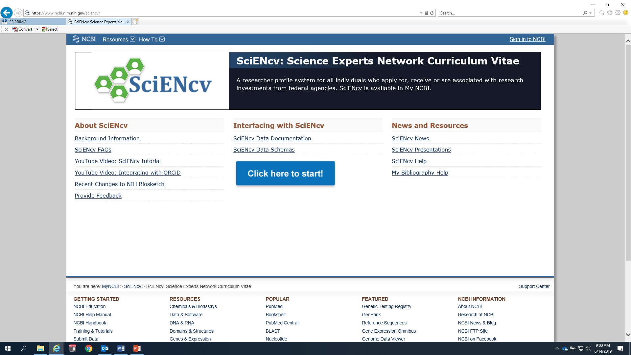
IES Biosketch
Notes:
You can find the IES Biosketch here

Slide 80
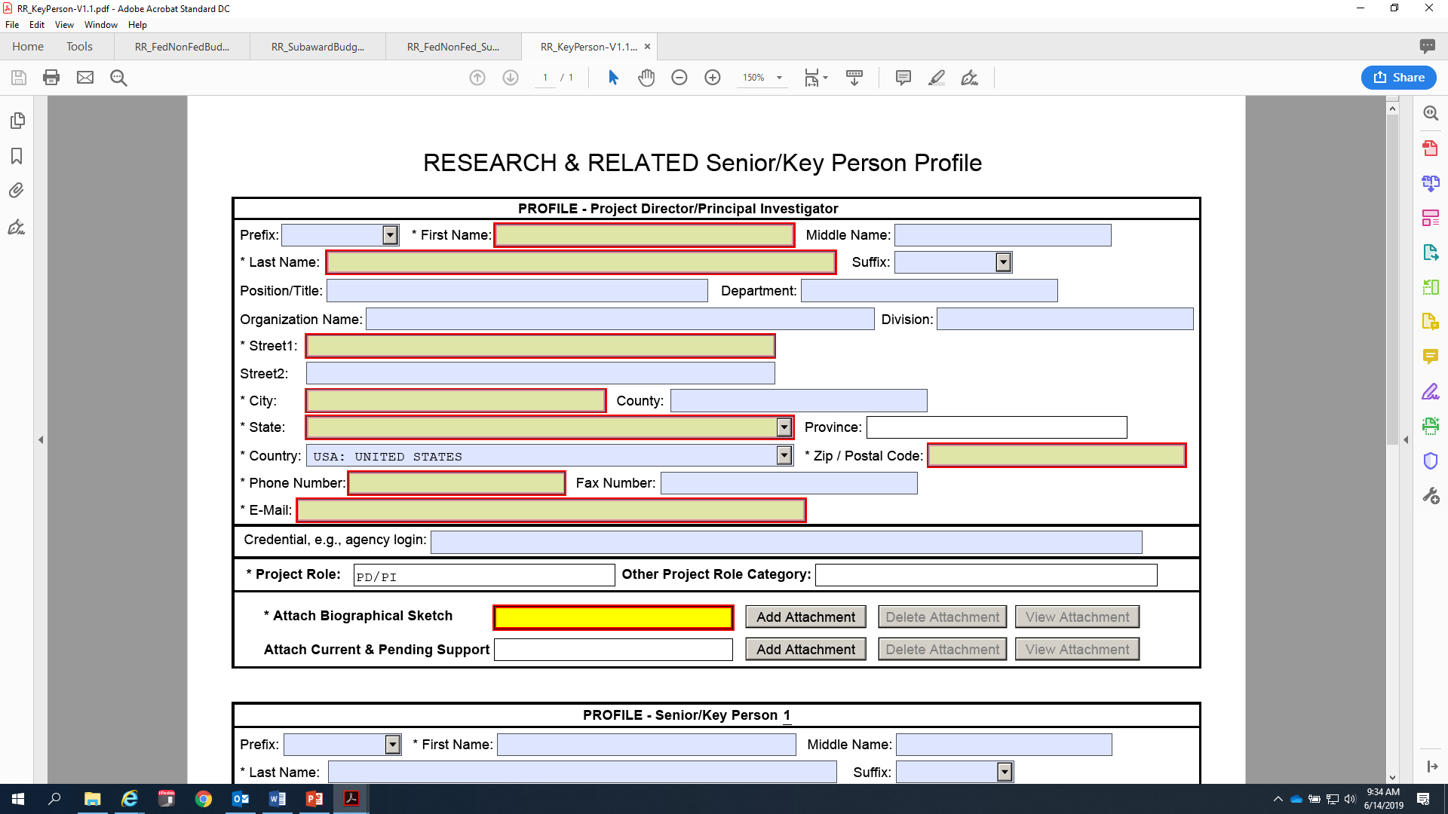
Attach Biosketch to the Senior/Key Person Profile form
Notes:
This is where, circled in red at the bottom (shown on the slide), you would attach the biographical sketch, and you need to do it separately for each key person.

Slide 81
Other Mandatory Forms
Notes:
There are a few other mandatory forms that you need to fill out for your application.

Slide 82
Project Performance Site Location Form
Notes:
You will need to fill out the Project Performance Site Location form (shown on slide).

Slide 83
Certification Regarding Lobbying Form
Notes:
You also need to complete the Grants.gov Lobbying Form (formerly the ED Combined Assurance form) (shown on slide).

Slide 84
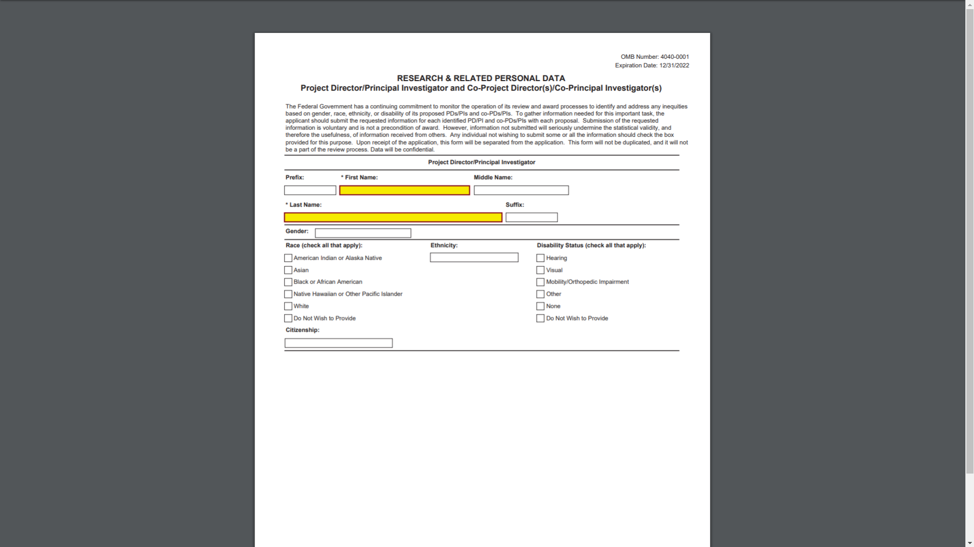
Research and Related Personal Data Form
Notes:
IES is committed to monitoring its review and award processes to identify and address any inequities based on gender, race, ethnicity, or disability of key personnel. To help IES gather information for this important task, we encourage you to submit the requested information for the PI and each identified co-PI and co-Investigator. IES will separate this form from the application upon receipt as it is not a part of the review process, and the data provided will be kept confidential. We encourage you to provide this information as it will help us in our efforts to ensure an equitable review and award process for all applicants. Providing the requested information is voluntary and is not a precondition of award.

Slide 85
Formatting Requirements
Notes:
Our last topic will be application format requirements.

Slide 86
Formatting PDF Files (1 of 3)
Page
8.5-inch X 11-inch
On one side only
1-inch margins at top, bottom, and both sides
Notes:
A page is defined as 8-1/2 by 11 inches and one side with 1-inch margins at the top, bottom, and both sides of the page.

Slide 87
Formatting PDF Files (2 of 3)
Type size/font size
12-point font
Type density, including characters and spaces, no more than 15 characters per inch (cpi)
No more than 6 lines of type within a vertical inch
Spacing
Text single-spaced
Notes:
The height of your letters must not be smaller than 12-point, and your type density, including both characters and spaces, must be no more than 15 characters per inch. We suggest making sure you have no more than six lines of type within a vertical inch. In general, if you use a 12-point Times New Roman font and single-spacing, you should be fine on all of these type size and font size recommendations. We recommend these things for two reasons: first, so that we make sure that your text is legible for all of our reviewers, but also to ensure that everyone has the same amount of space for their Project Narrative and all the other components of your application.

Slide 88
Formatting PDF Files (3 of 3)
Graphs, Diagrams, Tables, and Charts
Graphs, diagrams, tables, and charts should reproduce well in black and white
Figures, charts, tables, and figure legends may be smaller in size but must be readily legible
Notes:
If you have graphs, diagrams, and tables, which you are allowed to have, you should make sure that they reproduce well in black and white. So make sure, for instance, if you have some kind of pie chart or bar graph, that in black and white you can tell the difference between the different sections of the pie or different bars. We recommend that your graphs, diagrams, tables, and charts conform to the same type size as the rest of the materials with your application. Figures, charts, and table legends may be smaller in size but should still be readily legible.

Slide 89
Final Reminders
Notes:
Here are a couple final reminders.

Slide 90
Application Checklist
Each RFA has an Application Checklist at the end that you can use to determine whether you have…
Provided required information for each mandatory form in Grants.gov electronic application package
Attached correct PDF files to proper form
Completed certifications and assurances
Notes:
Use the application checklist in the Request for Applications for the competition you are submitting to in order to determine that you have provided all of the required information for each form, that you have attached the correct PDF files to the proper form, and that you have completed all of the certifications and assurances.

Slide 91
Grants.gov Reminders
Use “Check Package for Errors” button on application package
Upload application and confirm validation by Grants.gov before 11:59:59 p.m., Eastern Time on due date
Due Dates Vary by Competition!
Use “Track My Application” in Grants.gov
Pay attention to Email (4 in total) – look for PR/Award number and date/time stamp
Notes:
You should use the Check Package for Errors button in the application package in order to make sure that you have completed all of the required forms. You need to upload your application and confirm that it is validated by grants.gov before 11:59:59 p.m. Eastern time; You can use the Track My Application function on grants.gov to make sure that your application has been uploaded and validated. Pay attention to your e-mails; you will get four in total. Look for the PR award number and the date/time stamp in the final email to verify that your application was received on time.

Slide 92
More Grants.gov Reminders
Register in Grants.gov early
Download the application package designated for your competition and deadline
Submit your application early
Three or four days in advance
Notes:
Remember to register for grants.gov early. If you aren’t sure if your institution is registered for grants.gov, you should do it as soon as this webinar is over just to make sure. Make sure that you download the application package designated for your competition and your deadline. I recommend you submit your application early if at all possible, at least 3 or 4 days in advance of the deadline so that you have enough time to correct any errors and try to submit again before the deadline.

Slide 93
And last but not least…
Contact the IES Program Officer for your Competition!
To learn more about substantive requirements for an application
For help with completing forms in application package
Notes:
Last but not least, I have said this before but I will say it again, contact your Program Officer if you have any questions. They can help you with the substantive requirements for your proposal, and they can also help you with completing forms in the application package. So make sure you reach out to your Program Officer.

Slide 94
Important Links
IES Funding Opportunities
Grants.gov
Notes:
Here is the link for the IES funding page and the grants.gov website.

