Slide 1
Funding Opportunities for
Minority Serving Institutions
Katina Stapleton, Ph.D.
Program Officer
National Center for Education Research
Amy Sussman, Ph.D.
Program Officer
National Center for Special Education Research

Slide 2
Purpose of this Presentation
Increase awareness of researchers at Minority Serving Institutions (MSIs) of education research and training funding opportunities at the Institute of Education Sciences (IES)
  General Overview
  Pathways to the Education Sciences Research Training

Slide 3
Submitting Questions
You can submit questions during the webinar.
We will respond during presentation as appropriate and during the final Q&A period.

Slide 4


A Quick Overview of MSIs
Alaska Native-Serving Institutions
American Indian Tribally Controlled Colleges and Universities
Asian American and Native American Pacific Islander-Serving Institutions (AANAPISIs)
Hispanic-Serving Institutions (HSIs)
Historically Black Colleges and Universities (HBCUs)
Native American-Serving, Nontribal Institutions
Native Hawaiian-Serving Institutions
Predominantly Black Institutions (PBIs)

Slide 5
IES Funding Opportunities for MSIs
There is one targeted funding opportunity for MSIs (and their partners): Pathways to the Education Sciences Research Training Program
We also encourage MSIs to apply for Education Research and Special Education Research grants and training grants.
We encourage MSIs to take advantage of the technical assistance IES provides.

Slide 6


Quick Overview of IES

Slide 7
Legislative Mission of IES
Describe the condition and progress of education in the United States
Identify education practices that improve academic achievement and access to education opportunities
Evaluate the effectiveness of Federal and other education programs

Slide 8
Organizational Structure of IES
Office of the Director
National Board for Education Sciences
Standards & Review Office
National Center for Education Evaluation
National Center for Education Statistics
National Center for Education Research
National Center for Special Education Research

Slide 9
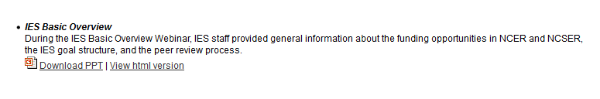
FY 17 Research Funding
Opportunities
ies.ed.gov/funding

Slide 10
Identifying the Appropriate
Research Funding Opportunity
Identify your own research interests and strengths and see if they overlap with current funding priorities
Read the separate Requests for Applications (RFAs), which describe the application requirements
Contact the relevant IES Program Officer to discuss your ideas (e-mail first)

Slide 11
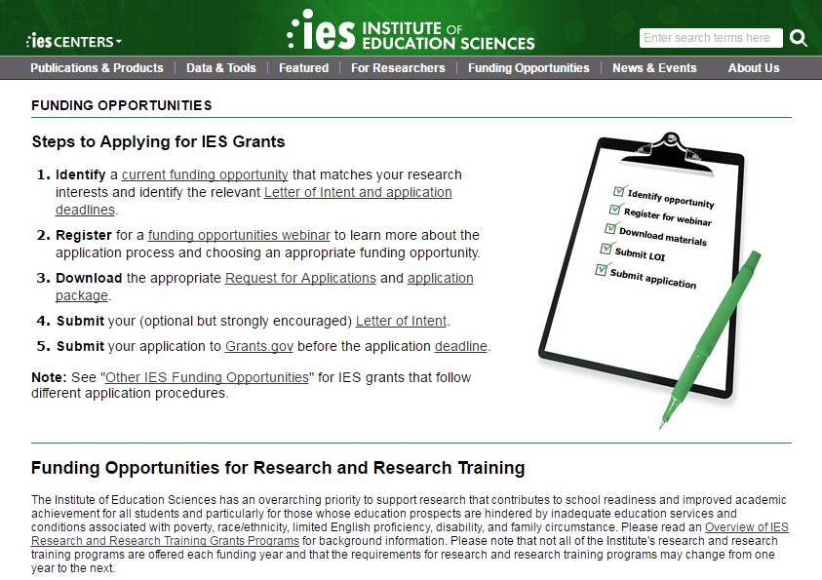
IES.ED.GOV/Funding

Slide 12
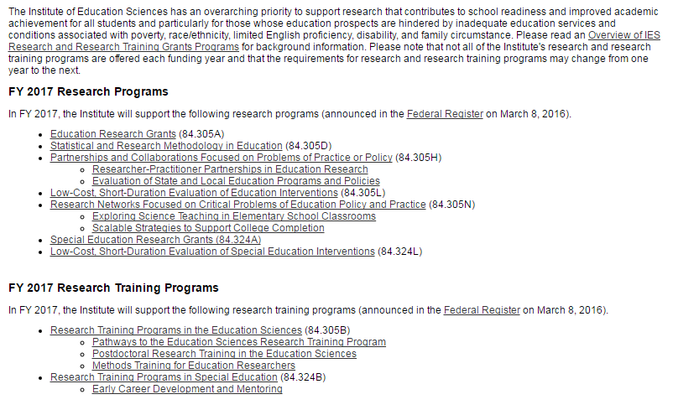
FY 17 Funding Opportunities at IES
Dig Deep: Opportunities aren’t always obvious

Slide 13
84.305A Education Research Grants
84.324A Special Education Research Grants
Primary Grant Programs
Apply to a Research Topic and a Research Goal
  Topic: Field you’ll be working in
    84.305A: 11 topics (including new “Special Topics”)
    84.324A: 11 topics
  Goal: Type of work you’ll be doing

Slide 14
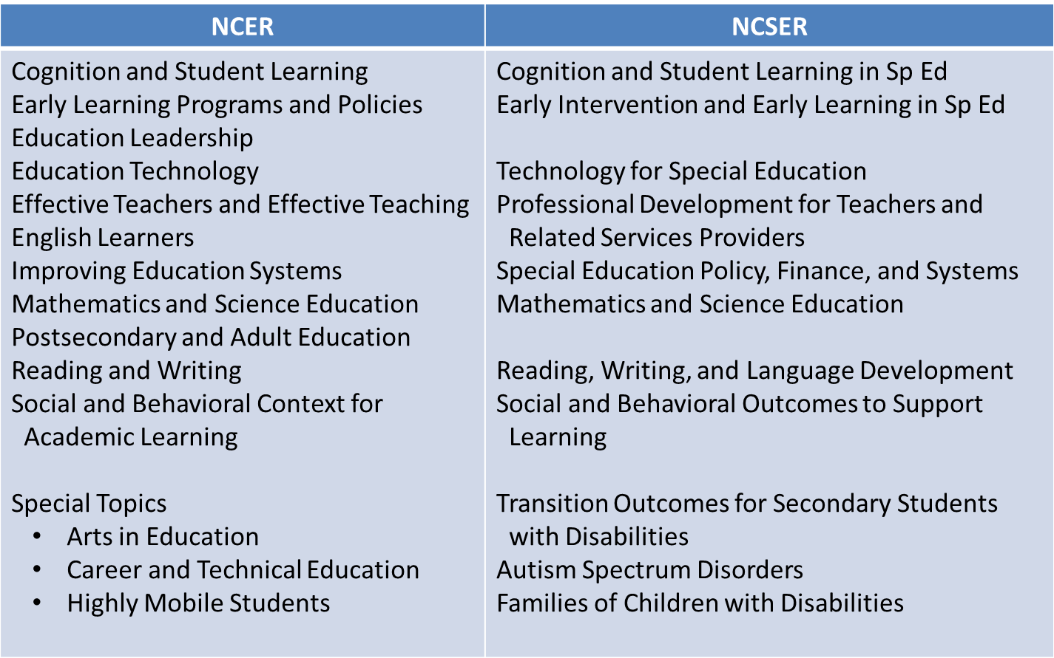
FY 17 Research Topics

Slide 15
FY2017 Research Goals
Exploration
Development & Innovation
Efficacy & Replication
Effectiveness
Measurement

Slide 16
Other Research Opportunities
Statistical & Research Methodology in Education (84.305D)
Researcher and Practitioner Partnerships in Education Research (84.305H)
Low-Cost, Short-Duration Evaluation of Education Interventions (84.305L)
Low-Cost, Short-Duration Evaluation of Special Education Interventions (84.324L)
Research Networks Focused on Critical Problems of Education Policy and Practice (84.305N)
  Exploring Science Teaching in Elementary School Classrooms
  Scalable Strategies to Support College Completion

Slide 17
Important Dates and Deadlines
Application Deadline | Letter of Intent Due Dates (varies) | Application Packages Posted (varies) | Start Dates
August 4, 2016 4:30:00 PM DC Time | May 5, 2016 May 19, 2016 | May 5, 2016 May 19, 2016 | July 1, 2017 to Sept 1, 2017

Slide 18
FY 16 Research Training
Opportunities
ies.ed.gov/funding

Slide 19
IES Training Programs
Overall Purpose
The training programs aim to prepare individuals to conduct rigorous and relevant education and special education research that advances knowledge within the field and addresses issues important to education policymakers and practitioners.

Slide 20
Research Training Grant Programs
84.305B: Research Training Grant Programs in the Education Sciences
  Pathways to the Education Sciences Research Training
  Postdoctoral Research Training in the Education Sciences
  Methods Training for Education Researchers
84.324B: Research Training Program in Special Education
  Early Career Development and Mentoring

Slide 21
Award Parameters
(84.305B & 84.324B)
Program | Maximum Number of Years | Maximum Award (direct + indirect)
305B Pathways Training Postdoctoral Training Methods Training | 5 years 5 years 3 years | $1,200,000 $715,000 $800,000
324B Early Career Development | 4 years | $400,000

Slide 22
Important Dates for
Training Grants Programs
Application Deadline | Letter of Intent Due Date | Application Package Posted | Start Dates
August 4, 2016 4:30:00 PM DC Time | May 19, 2016 | May 19, 2016 | July 1, 2017 to Sept 1, 2017

Slide 23
Upcoming Webinar:
Research Training Program in Special Education
IES/NCSER Special Education Research Training for Early Career Development and Mentoring (CFDA 84.324B)
Tuesday, June 7th, 2016
3:00 PM - 4:00 PM ET
Register: http://ies.ed.gov/funding/webinars/

Slide 24

A Closer Look . . .
Pathways to the Education Sciences Research Training Program (84.305B)

Slide 25
Pathways Training Program (84.305B)
Overall Purpose
to fund innovative training programs that
  promote diversity and
  prepare underrepresented students for doctoral study in education research.
to provide students, especially underrepresented students, with
  an introduction to education research and scientific methods,
  meaningful opportunities to participate in education research studies, and
  professional development and mentoring that leads to doctoral study.

Slide 26
FY 2016 Pathways Training Grant Awards
Maximum of 4 FY 2017 Awards
Awards structured as Cooperative Agreements
Maximum award is 5 Years
Maximum award amount is $1.2 million (indirect + direct)
  $630,000 for fellows (up to 1 year of support per fellow)
  $570,000 for program costs (including indirect costs)

Slide 27
Eligible Applicants for Pathways Program
Minority-serving institutions (MSIs) in the United States and its territories that grant bachelor’s degrees or graduate degrees in fields relevant to education.
Academic institutions in the United States and its territories that grant bachelor’s degrees or graduate degrees in fields relevant to education and that partner with an eligible MSI.

Slide 28
Is My Institution an Eligible MSI?
Does it award bachelor’s or graduate degrees?
Do you think it fits within one of the MSI categories?
IF BOTH YES, then check the lists
  WH-HBCU list of accredited HBCUs
  WH-American Indian list of Tribal Colleges and Universities
  OPE list of FY16 or FY15 Title III/IV eligible institutions

Slide 29
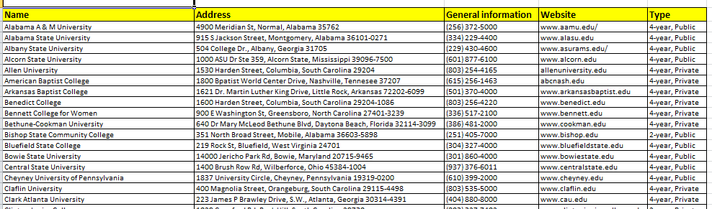
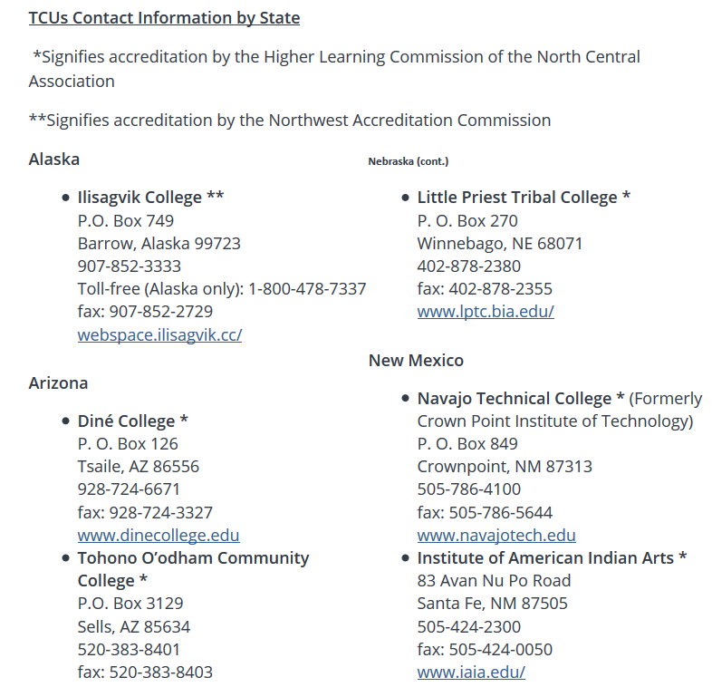
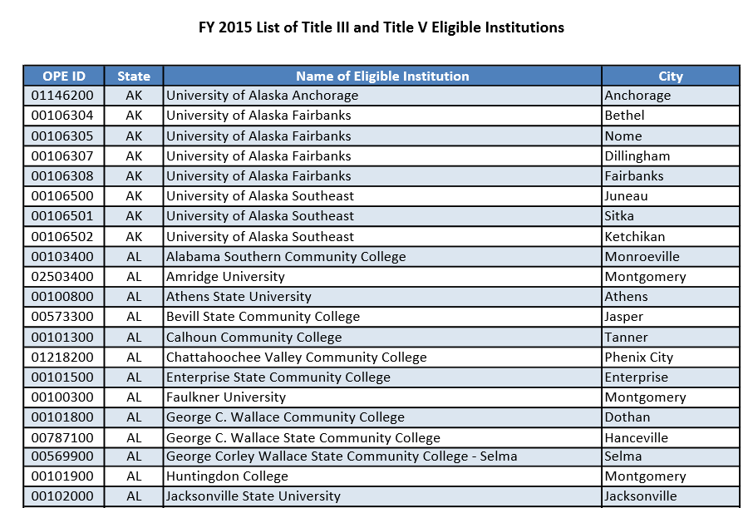

Slide 30
Eligibility Requirements for
Institutions on one of the MSI Lists
Eligible Alone
Eligible With Partners
Minority Serving Institutions
in the U.S. and its territories that grant bachelors or graduate degrees in fields relevant to education.

Slide 31
Eligibility Requirements for Institutions
That are Not on the MSI Lists
Eligible only with Eligible MSI Partner
NOT Eligible Alone
Academic Institutions
in the U.S. and its territories that grant bachelors or graduate degrees in fields relevant to education.

Slide 32

Institutions may only receive
ONE Pathways Training Grant
FY 16 Pathways grantees and their partners are ineligible for
FY 17 Pathways awards.
Check the IES website for list of FY16 awards (now available).
Check with sponsored programs offices of all partners.
* This restriction does not include collaborating institutions, please see RFA for definitions of partners vs. collaborating institutions.

Slide 33
Institutions may only receive
ONE Pathways Training Grant
Should an academic institution be included in more than one application that is recommended for funding,
IES will determine which application is eligible for funding.
* This includes partners, so check with sponsored programs offices

Slide 34
Eligibility Requirements:
Training Program Director
One Principal Investigator (AKA Training Director)
  Has overall responsibility of the award
  Interacts with IES
PI may be from any field, but must be able to provide intensive training in education research and statistics.
Is a Co-PI allowed? Yes, but ultimately the PI is responsible for the training grant, not the co-PI.
When is a Co-PI required? Each Partner Institution must designate a Co-PI.

Slide 35
Requirements vs. Recommendations
Requirements: Criteria that must be met in order for your application to be responsive & sent forward for review (each section discusses requirements first).
Recommendations: Criteria that make for a strong application and that are used by the peer reviewers

Slide 36
To be Responsive . . .
Your Training Program must…
Focus on education research
Provide research training to undergraduate, post-baccalaureate, or masters students.
Have required research apprenticeship
Your Application must …
Include all required information (see each RFA section for details)
Be complete and in the proper format
Be submitted on time
Fall within budget and project length maximums
Requirements & Recommendations for Training Program
(RFA pgs. 9-23)
Application Submission Requirements & Procedures
(RFA pgs. 45-86)

Slide 37
The Heart of Your Application is the
Research Training Narrative
It should . . . .
Establish a need (Significance)
Propose and clearly describe a compelling solution to that need (Significance)
Propose a specific, well designed plan to implement the solution (Training Plan)
Show reviewers you have the means to implement the solution successfully (Personnel, Resources)

Slide 38
While Writing Your Research Narrative,
Keep these Expectations in Mind
At the end of the grant, IES expects not only trained fellows but also…
A description of the training program as realized over the course of the grant, including descriptions of all key components discussed in the original application (e.g., required seminars or courses, workshops, research opportunities, mentoring, academic counseling, and presentation and writing opportunities)
A description of the fellows accepted to the program, identification of completers and non-completers, and their research products (presentations, publications, and other work)
A fully specified description of the measures used to track the progress of fellows through the training program as well as data demonstrating the program’s level of success in recruiting, training, and placing fellows in doctoral programs
An assessment of the program’s contributions to preparing fellows with the appropriate skills and knowledge to successfully apply to and enroll in doctoral programs in which they can pursue careers in education research

Slide 39
Research Narrative: Significance

Slide 40

What is the Purpose of your Training Program?
General Purpose
Specific Purpose
to fund innovative training programs that promote diversity and prepare underrepresented students for doctoral study in education research.
to provide students, especially underrepresented students, with an introduction to education research and scientific methods, meaningful opportunities to participate in education research studies, and professional development and mentoring that leads to doctoral study.
Applicants should identify the specific education research theme the program will address and the student population of interest.

Slide 41
What is an Education Research Theme?
Unifying idea that guides the training program.
Must be related to education research
Can be broad: “Using Research to Improve Urban Schools”
Can be narrow: “Quantitative Methods to Assess School Performance”

Slide 42
While Determining the Purpose & Theme…..
Consider the . . .
Type of fellow you hope to train
Type of research s/he will conduct
Think of the types of training experiences necessary for this type of fellow:
  Background knowledge (e.g., theoretical, methodological)
  Practical research experience (e.g., working in schools, participating in research studies)
  Other professional skills (e.g., presentation and writing skills; skills needed to pass graduate entrance exams)

Slide 43
What Skill-sets & Knowledge Will Your Training Program Provide?
Fellow
Training
First Year Doctoral Student
Fellows’ backgrounds, pre-existing skills/knowledge, home departments, etc. | What students will learn/do over course of their fellowship | A person with sufficient knowledge, skills, and abilities to be accepted into a doctoral program related to education research

Slide 44
How Will Your Training Program be Structured?
The designs of training programs will vary
  Eight weeks (min) to one year (max)
  Purpose, target populations, inclusion of partners will determine your training program structure.
Restrictions:
  Minimum number of Fellows: 40
  No Maximum number of Fellows (but max 60 possible at full stipend of $10,500)
  Minimum number of Cohorts: 4

Slide 45
Any Questions?

Slide 46
Research Narrative:
Training Plan

Slide 47
Research Training Plan
In this section, you should detail your proposed training program. This includes everything from describing how you will identify fellows to how you will help them transition to doctoral programs related to education research.
Required:
Recruitment
Training Activities
Research Apprenticeship
Financial Support
Evaluation

Slide 48

Who is Eligible for Your Program?
Eligible Participants
Targeted Population for Your Program
Upper level undergraduates (juniors & seniors)
Post-baccalaureate students (within 5 years of receiving bachelors degree)
Masters students
First, identify which type(s) of eligible participants your program will serve (undergrad vs post-bac vs. masters).
Next, determine what geographic population will you recruit from (campus only, regional, national, etc.)
Anyone who meets that criteria is then eligible to participate in the program.
Can I train teachers?
What about students in MA-PhD programs?

Slide 49
How will you encourage diversity?
Keep in Mind……
Keep it Legal ……
The Pathways Training Programs, while open to all students, seeks to increase the number of fellows from groups underrepresented in doctoral study, including racial and ethnic minorities, first-generation college students, economically disadvantaged students, veterans, and students with disabilities.
See the U.S. Department of Education, Office for Civil Right’s Guidance on the Voluntary Use of Race to Achieve Diversity in Postsecondary Education
http://www2.ed.gov/about/offices/list/ocr/docs/guidance-pse-201111.html
This guidance addresses the degree of flexibility that postsecondary institutions have to take proactive steps, in a manner consistent with principles articulated in Supreme Court opinions, to meet this compelling interest.

Slide 50

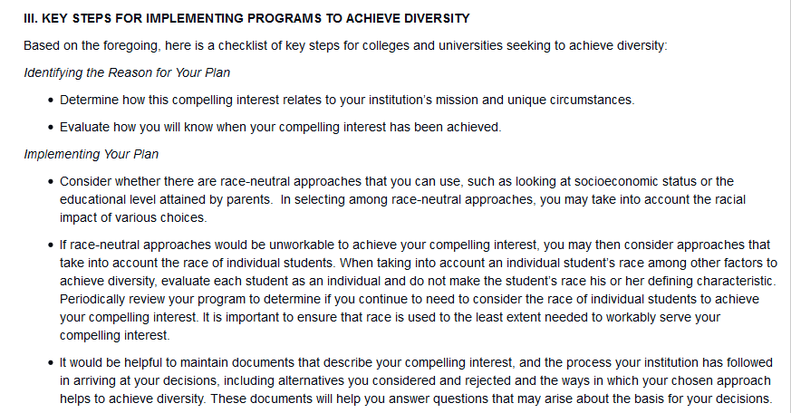
EXCERPT

Slide 51
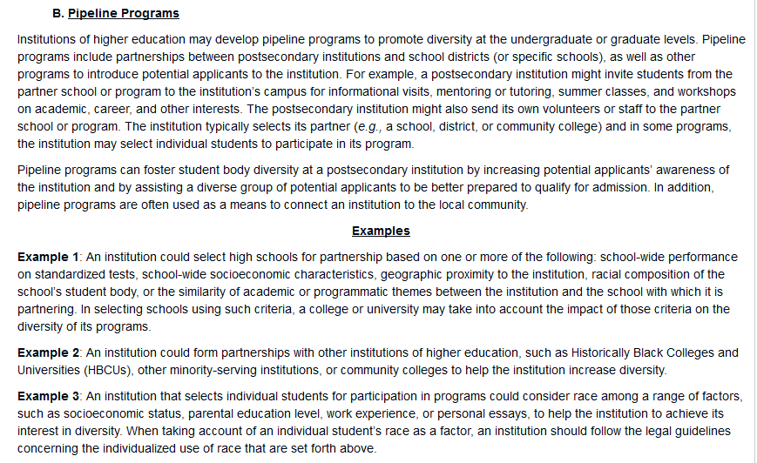
Pathways ≈ Pipeline Programs

Slide 52
Overview of Recruitment
You should detail your recruitment plan, strategies, and timeline.
Specifically describe:
the types of fellows you wish to train and how you will recruit them
your explicit strategies for recruiting members of groups underrepresented in doctoral programs
your selection criteria

Slide 53
Timing of Recruitment
Your recruitment timeline should reflect:
The type of fellowships your program will offer (8 weeks – 1 year)
Recruiting fellows for the first vs. second year of the grant.
The earliest fellows can start the training program is the 2017-18 academic year.

Slide 54
Special Requirements for Fellows
As part of the recruitment process, students must be made aware of IES requirements for predoctoral fellows:
Each fellow:
  Must be U.S. citizen or permanent resident of the United States
  Must be an upper level undergraduate, post-baccalaureate, or masters student to receive fellowship support
  Must conduct research that is relevant to practical issues in U.S. education
  Must make peer-reviewed scholarly research publically available
  Is expected to respond to an annual fellows survey

Slide 55
Direct Financial Support for Fellows
The training grant can directly support up to $10,500 per fellow, per year, including:
  Participant Stipends (est. $3000-$5000)
  Housing & Sustenance (est. $4000)
  Travel & Research (est. $1000)
  Normal Fees
  The maximum direct support costs for fellows is $630,000. Within the guidelines (pg. 20-23) you have wide latitude in allocating these funds.

Slide 56

Frequently Asked Financial Support Questions
Can we charge students fees? No. You may also pay for “normal” fees out of the $10,500.
Can we charge students tuition? No. However, you may include an option for students to earn credit for participation.
Can we pay for tuition? Not out of the grant. This training program is not meant to support fellows’ tuition. Your fellows are welcome (but not required) to use some of their stipends to pay tuition. Your University can pay for tuition out of other funds.
What about fees for graduate exams or submitting graduate school applications etc.? Yes. As long as these activities take place during the fellowship year, you can set-aside part of the fellow allocation to specifically be used for this purpose.

Slide 57
Alternative Arrangements for Direct Support of Fellows
Can we offer fellowships less than the maximum of $10,500? Yes. This will allow you to support more fellows.
Can we supplement the fellowship with other funds? Yes, the IES-portion of the fellowship is capped at $10,500, but you can use other funds to increase the fellowship. Caveat: This is considered cost-sharing which must be reflected in the budget and this must be made clear in the Letter of Agreement with fellows.

Slide 58
Research: Training Program Activities
In the Research Plan, detail the specific training activities that will help fellows develop their knowledge, skills, and abilities you identified in the Significance Section.
Other
Mentoring
Lecture Series or Curriculum
Research Apprenticeship (Required)

Slide 59
Specific Knowledge, Skills, and Abilities (KSAs) your Training Activities Should Address
Subject-matter and methodological knowledge and skills
Research experience and collaboration with education practitioners and/or policymakers
Communication skills
Career Development
It is helpful for reviewers if you use headings to identify the KSAs being addressed.
In Appendix A, you may include a table to show how these KSAs are being addressed.
Fundamental Skills

Slide 60
Describing Required
Research Apprenticeships
You should describe:
Requirements for research apprenticeships
Specific research projects fellows can work on and the type of work fellows will be expected to do
The link between these activities and fellows’ preparation for doctoral study
Opportunities for fellows to do independent research and/or collaborative research with other fellows (if applicable).
You must include a summary table of apprenticeship opportunities (other than faculty research projects) in Appendix B

Slide 61
Describing Specific Research Projects
When describing the specific research projects that fellows will have access to…
Discuss what fellows will learn from their work on the research projects
Elaborate both the topical and methodological focus of each research project and how these support the focus of the training program

Slide 62
Describing Other Training Activities
You should also describe:
Mentorship-related activities
Ongoing lecture/proseminar series
Activities to prepare fellows transition to doctoral study
Activities to develop fellows’ communication skills
Any other activities as appropriate
How these activities will develop the KSAs
How the program will monitor the activities’ contribution to the fellows’ professional development

Slide 63
Tracking Fellows’ Progress
In the Training plan, you must include a description of how you will measure fellow’s progress toward meeting the program’s and his/her own goals.
You should describe how the program will identify fellows’ strengths and weaknesses (and how to address them)

Slide 64
Evaluating the
Pathways Training Program
You should include a plan to evaluate the success of the program itself.
Basic measures
Did you recruit the type of fellows you intended to?
Did they complete their training? Apply to doctoral programs? Get accepted into doctoral programs?
More complex measures
Analysis of cost per fellow training year including recruitment efforts
Assessments of how well fellows have learned the skills that were taught and how well they progressed toward being prepared for graduate study?
Other potential measures
Self-defined measures that you value as signs of a program’s success (should be aligned to the program goals mentioned in the Significance section)

Slide 65
Research Narrative:
Personnel & Resources

Slide 66
Personnel
After discussing training program plan, describe who will deliver the training:
Identify all key personnel, including PI, Co-PI (if applicable), and the core faculty (required)
Include summary table of key personnel’s completed or ongoing research projects (required)
Describe relevant expertise of key personnel, their responsibilities, and time commitments to the program
Elaborate on how their expertise aligns with goals of the program, specific responsibilities, and reflects content and methodological foci of the training program.

Slide 67
Describing Core Faculty Members
You should demonstrate that the core faculty have the ability and commitment to conduct research of the type funded by NCER. In the narrative you should describe the “collective expertise” of the faculty.
You must also include a Summary Table in Appendix B that describes the Core Faculty’s ongoing and completed research projects. See RFA pg. 54-55 for details.

Slide 68
Describing Resources
Finally, describe institutional resources you have access to and how these resources will support the program (Required):
Institutional resources (overall, participating departments, subawardees)
Specific resources fellows will have for conducting research.
You must include Letters of Agreement from each source in Appendix D

Slide 69
Training Program Support Costs - 1
When developing your training program, keep in mind that you may request up to $570,000 total for training program support, including
Indirect Costs
Travel to Annual PI meeting in DC (required – includes PI at MSI, if applicable)
PI Salary (2 months maximum per year, can be split)
Program Coordinator Salary (6 months per year typical)
Stipends for research mentors

Slide 70
Training Program Support Costs - 2
Program support can also include funds for:
Short Term Visiting Faculty
Guest Speakers or Trainers
Workshops, Colloquia, and Seminars
Fellow Recruitment
Tracking of Fellows Progress & Program Success
Training program websit

Slide 71


General Restrictions on Use of Funds
Grant funds may not be used to support:
Faculty research
Faculty salaries outside allowable expenses
Facility construction, renovation, or maintenance
Food (unless approved by IES in advance or as allowable travel costs)

Slide 72
Other Required
Application Components

Slide 73
What Else Should be in the Application?
Appendix A (required for resubmissions)
Appendix B (required)
Appendix D (required)
Appendix E (optional
Bibliography
Budget and Budget Narrative

Slide 74
Appendix A (required for resubmissions)
LIMIT: 3 pages
You must describe how the revised application is responsive to prior reviewer comments.

Slide 75
Appendix B (required)
LIMIT: 15 pages
You must include a summary table of ongoing education research projects being conducted by the PI and other core faculty involved in the proposed program.
You must include a summary table of apprenticeship opportunities (not captured by the previous summary table).

Slide 76
Appendix D (required)
Unlimited pages
You must include Letters of Agreement from:
The Applying Institution indicating the nature of commitment
The Minority Serving Institution(s) serving as partner (if applicable) indicating the nature of the commitment
Participating departments/colleges/schools/institutes indicating the nature of the commitment.
Other institutions from outside the university that are partnering with the program to provide additional training opportunities (including research and collaborations with policymakers and practitioners)

Slide 77
Appendix E
15 pages
You may include any figures, charts, or tables that supplement the training program narrative.

Slide 78
Bibliography (as appropriate)
Unlimited pages
You should include complete citations for literature cited in the Training Program Narrative.

Slide 79
Budget and Budget Narrative (required)
Your Budget must meet the following criteria:
Maximum amount of award is $1.2 million over 5 years (direct and indirect costs)
IDC: Limited to 8% on allowed costs (see RFA pg. 19).
For fellow support ($630,000 maximum = 40 to 60+ fellows)
8 weeks to one year support per fellow (up to $10,500 per year)
  Stipend support
  Housing and Sustenance
  Funds for fellow research, travel, and conference attendance
  Normal Fees
Minimum of 40 fellows (maximum determined by amount of fellow support: 60 at $10,500 each)
See RFA pgs. 20-22 for allowable fellow costs
For program support ($570,000 maximum)
See RFA pgs. 22-23 for allowable program costs.

Slide 80
Fellow training costs (per fellow per year of fellowship) |  | SF 424 section |  | MAXIMUM | $10,500
Stipend |  | E | Fellow | 4500
Normal Fees |  | E | Fellow | 500
Housing & Sustenance |  | E | Fellow | 4000
Fellow software (including licenses) |  | E | Fellow | 500
Fellow travel/research |  | E | Fellow | 1000
 |  |  |  | $10,500.00
 |  |  |  | Total Fellow Costs $630,000
Program costs (for the entire grant)
Indirect Costs |  | H | Program
Principal Investigator |  | A | Program
Co-Principal Investigator (if applicable) |  | A | Program
Program Coordinator |  | A | Program
Recruitment travel |  | D | Program
Recruitment advertising |  | F | Program
Speaker honorarium |  | F | Program
Speaker travel |  | D | Program
PI travel (to PI meeting) |  | D | Program
Software/hardware for program use |  | F | Program
Workshop Events |  | F | Program
Program Evaluation / Fellow Progress Monitioring |  | F | Program
Training Program Website |  | F | Program
 |  |  |  | Total Program Costs $570,000
 |  |  |  | Total Grant Costs
 |  |  |  | $1,200,000
BUDGET FORM
All funds spent on the individual fellows should be in Section E of the SF 424.
Check your university’s IDC agreement to determine what should go into indirect cost calculations.

Slide 81
Preparing and Submitting
Pathways Application

Slide 82
Important Dates for
Training Grants Programs
Application Deadline | Letter of Intent Due Date | Application Package Posted | Start Dates
August 4, 2016 4:30:00 PM DC Time | May 19, 2016 | May 19, 2016 | July 1, 2017 to Sept 1, 2017

Slide 83
Submitting Your Application
To learn more about submitting your application, sign up for the Application Process webinar or download the slides/transcripts.
http://ies.ed.gov/funding/webinars/

Slide 84
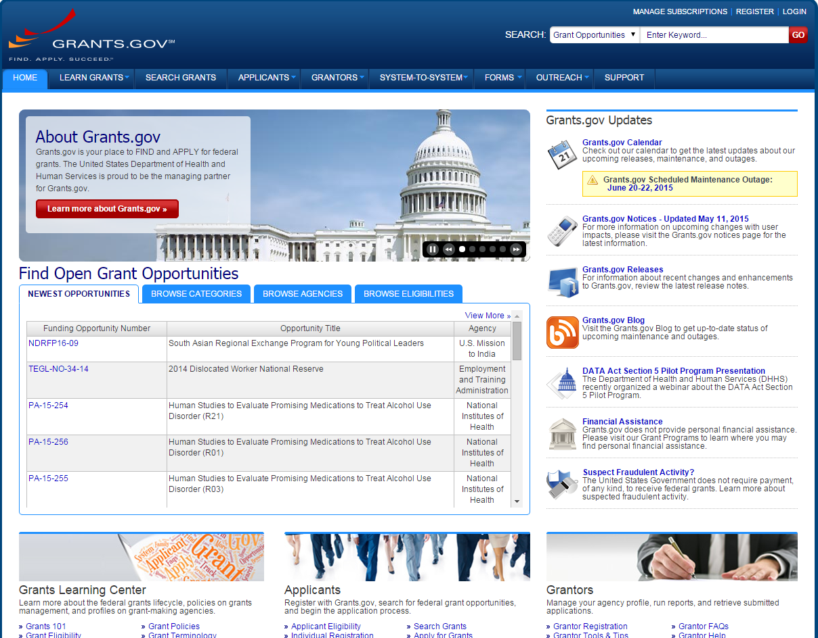
84

Slide 85
Review Application Requirements
Request for Applications
  Currently available at http://ies.ed.gov/funding
Application Package
  Currently available at Grants.gov

Slide 86
Peer Review Process
Applications are reviewed for compliance and responsiveness to the RFA
Applications that are compliant and responsive are assigned to a review panel
Two or three panel members conduct a primary review of each application
At panel meeting, the most competitive applications are reviewed by full panel

Slide 87
Notification Process
All applicants will receive e-mail notification that the following information is available via the Applicant Notification System (ANS):
  Status of award
  Reviewer summary statements
If you are not granted an award the first time, plan on resubmitting, and talk to your Program Officer

Slide 88
Help Us Help You
Read the Request for Applications carefully
Call or e-mail IES Program Officers early in the process
As time permits, IES program staff can review draft proposals and provide feedback
  Don’t be afraid to contact us!

Slide 89
For More Information
http://ies.ed.gov/funding
Katina Stapleton
Katina.Stapleton@ed.gov
Amy Sussman
Amy.Sussman@ed.gov

