Slide 1
Basic Overview of Funding Opportunities at the Institute of Education Sciences
Erin Higgins, Ph.D.
Program Officer
National Center for Education Research
Katie Taylor, Ph.D.
Program Officer
National Center for Special Education Research

Slide 2
Legislative Mission of IES
Describe the condition and progress of education in the United States
Identify education practices that improve academic achievement and access to education opportunities
Evaluate the effectiveness of Federal and other education programs

Slide 3
Organizational Structure of IES
Office of the Director
National Board for Education Sciences
Standards & Review Office
National Center for Education Evaluation
National Center for Education Statistics
National Center for Education Research (NCER)
National Center for Special Education Research (NCSER)

Slide 4
Missions of the Research Centers
NCER
Supports rigorous research that addresses the nation’s most pressing education needs, from early childhood to adult education
NCSER
Sponsors a rigorous and comprehensive program of special education research designed to expand the knowledge and understanding of infants, toddlers, and students with or at risk for disabilities from birth through high school

Slide 5
Objectives of the Research Grant Programs
Develop or identify education interventions (practices, programs, policies, and approaches)
that enhance academic achievement
that can be widely deployed
Identify what does not work and thereby encourage innovation and further research
Understand the processes that underlie the effectiveness of education interventions and the variation in their effectiveness

Slide 6
Focus on Student Outcomes
IES funds research to improve the quality of education for all students through advancing the understanding of and practices for teaching, learning, and organizing education systems
Research must address student education outcomes
Academic outcomes
Social and behavioral competencies that support student success in school
Note: In 2017, applications to the Special Education Research Grants program must focus on teachers and/or other instructional personnel and must address (a) teacher and/or other instructional personnel outcomes, and (b) student education outcomes

Slide 7
How do I identify the FY 2017 Funding Opportunities?

Slide 8
How to Identify Funding Opportunities
Begin at the IES website (http://ies.ed.gov/funding)
Sign up for the IES Newsflash
Funding opportunities are announced in The Federal Register
Review current Requests for Applications (RFAs)
Contact relevant Program Officer(s) for the topic(s) of interest in the relevant Center

Slide 10
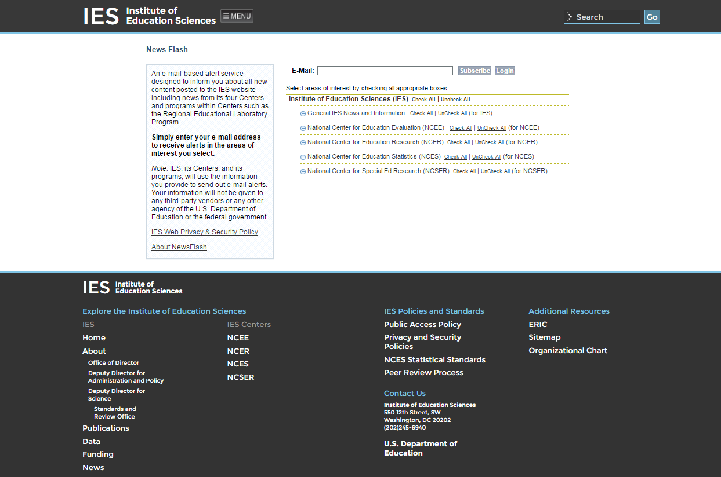
10

Slide 11
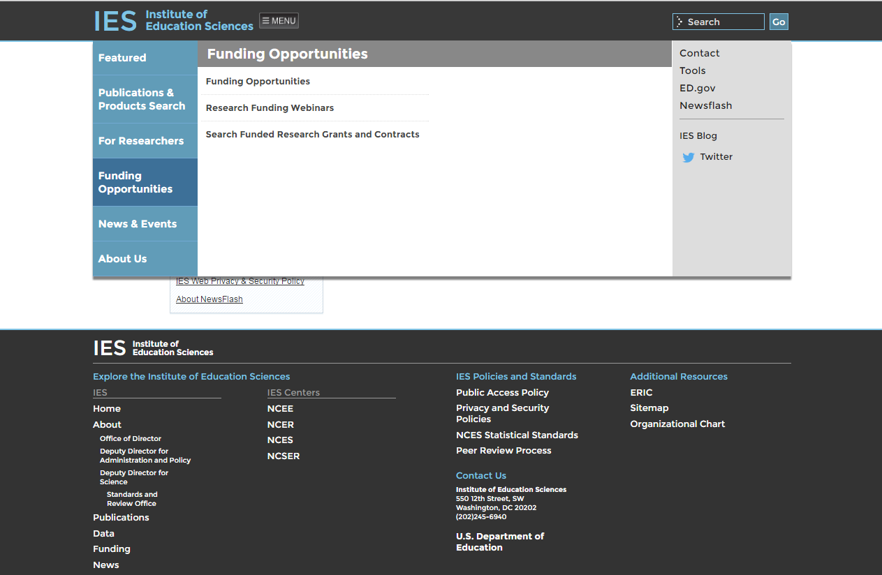
11

Slide 12
12

Slide 13
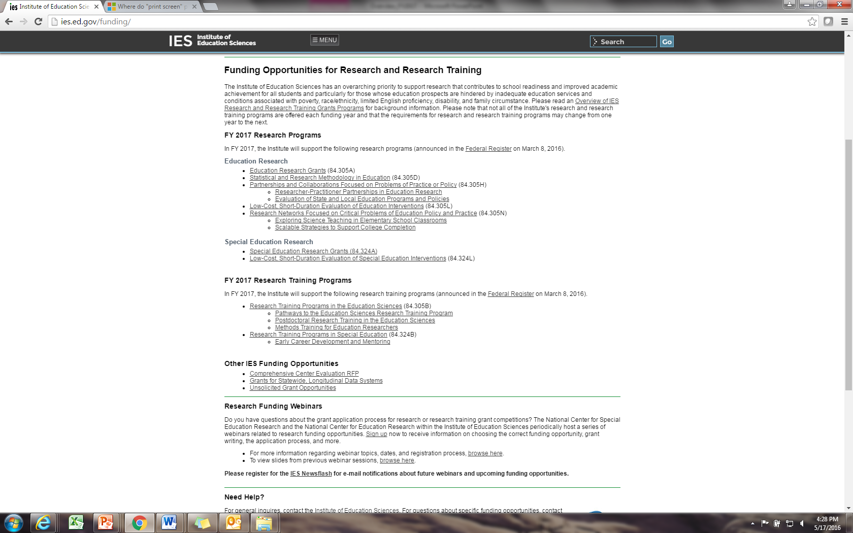
13

Slide 14
How to Identify Appropriate Grant Programs
Read the Request for Applications
Review announced topics and methodological requirements
Look at abstracts of projects funded under a research topic or program
http://ies.ed.gov/ncer/projects
http://ies.ed.gov/ncser/projects

Slide 15
What Are the FY 2017 Funding Opportunities?

Slide 16
Primary Grant Programs
Primary Grant Programs
84.305A Education Research Grants
84.324A Special Education Research Grants
Apply to a Research Topic and a Research Goal
Topic: field you will be working in
Goal: type of work you will be doing

Slide 17
84.324A: 2017 Focus on Teachers and Other Instructional Personnel
In 2017, the Special Education Research Grants Competition will focus specifically on teachers and other instructional personnel responsible for educating students with or at risk for disabilities.
NCSER is focusing this particular competition due to:
A limited budget for FY 2017
A critical need for additional research in this area

Slide 18
84.305A & 84.324A Research Topics
305A Education Research | 324A Special Education Research
Cognition & Student Learning | Cognition & Student Learning in Special Education
Early Learning Programs & Policies | Early Intervention & Early Learning in Special Education
Education Technology | Technology for Special Education
Effective Teachers & Effective Teaching | Professional Development for Teachers & Other Instructional Personnel
Improving Education Systems | Special Education Policy, Finance, & Systems
Mathematics & Science Education | Mathematics & Science Education
Reading & Writing | Reading, Writing, & Language Development
Social and Behavioral Context for Academic Learning | Social and Behavioral Outcomes to Support Learning
English Learners | Autism Spectrum Disorders
Postsecondary and Adult Education | Families of Children with Disabilities
Education Leadership | Transition Outcomes for Secondary Students with Disabilities
*Special Topics

Slide 19
84.305A: 2017 Special Topics
Special topics:
Arts in Education
Career and Technical Education
Systematic Approaches to Educating Highly Mobile Students
These special topics are intended to encourage research in under-studied areas that appear promising for improving student education outcomes and that are of interest to policymakers and practitioners

Slide 20
84.305A & 84.324A Research Goals
Exploration
Development & Innovation
Efficacy & Replication
Effectiveness
Measurement

Slide 21
Exploration Goal
Explore associations between malleable factors and outcomes
Identify factors and conditions that may mediate or moderate relations between malleable factors and outcomes
Possible methodological approaches include:
Analyze secondary data
Collect primary data
Complete a meta-analysis
Combination of above

Slide 22
Development & Innovation Goal
Develop an innovative intervention (e.g., curriculum, instructional approach, program, or policy) OR improve existing education interventions
Development process must be iterative!
AND collect data on its feasibility, usability, and fidelity of implementation in actual education settings
AND collect pilot data on promise

Slide 23
Efficacy & Replication Goal
Evaluate whether or not a fully developed intervention is efficacious under limited or ideal conditions
OR
Generate additional evidence for an efficacious intervention by directly replicating or varying the original conditions
OR
Gather follow-up data examining the longer term effects of an efficacious intervention
OR
Analyze retrospective (historical) secondary data to test the efficacy of an intervention implemented in the past

Slide 24
Effectiveness Goal
Evaluate whether a fully developed intervention that has evidence of efficacy is effective when implemented under typical conditions through an independent evaluation
Prior to submitting an effectiveness proposal, at least one efficacy study of the intervention with beneficial and practical impacts must have been completed

Slide 25
Measurement Goal
Development of new assessments or refinement of existing assessments, and the validation of these assessments
OR
Validation of existing assessments for specific purposes, contexts and populations

Slide 26
Attend to Changes from Previous Years’ Competitions
Carefully read the full RFA!
See Part 1.D. of the FY 2017 RFAs for a summary of changes to the RFA from the previous year
26

Slide 27
Maximum Grant Durations & Awards (84.305A & 84.324A)
Research Goal | Type of Project | Maximum Duration | Maximum Award (direct + indirect)
Exploration | Secondary data analysis | 2 years | $600,000
 | Primary data collection | 4 years | $1,400,000
Development & Innovation |  | 4 years | $1,400,000
Efficacy & Replication | Efficacy & Replication | 5 years (84.305A) 4 years (84.324A) | $3,300,000
 | Follow-up study | 3 years | $1,100,000
 | Retrospective | 3 years | $700,000
Effectiveness | Effectiveness | 5 years | $3,800,000
 | Follow-up study | 3 years | $1,400,000
Measurement |  | 4 years | $1,400,000

Slide 28
Dates for 84.305A and 84.324A
Application Deadline (Grants.gov) | Letter of Intent Due Date (iesreview.ed.gov) | Application Package Posted (Grants.gov) | Start Dates
August 4, 2016 4:30:00 PM DC Time | May 5, 2016 | May 5, 2016 | July 1, 2017 to Sept 1, 2017

Slide 29
Research Training Grant Programs
84.305B: Research Training Programs in the Education Sciences
Pathways to the Education Sciences Research Training
Postdoctoral Research Training Program in the Education Sciences
Methods Training for Education Researchers
84.324B: Research Training Programs in Special Education
Early Career Development and Mentoring

Slide 30
Award Parameters (84.305B & 84.324B)
Program | Topic | Maximum Duration | Maximum Award (direct + indirect)
84.305B | Pathways Training | 5 years | $1,200,000
 | Postdoctoral Research Training | 5 years | $715,000
 | Methods Training | 3 years | $800,000
84.324B | Early Career | 4 years | $400,000

Slide 31
Important Dates for
Training Grants Programs
Application Deadline (Grants.gov) | Letter of Intent Due Date (iesreview.ed.gov) | Application Package Posted (Grants.gov) | Start Dates
August 4, 2016 4:30:00 PM DC Time | May 19, 2016 | May 19, 2016 | July 1, 2017 to Sept 1, 2017

Slide 32
Low-Cost, Short-Duration Evaluations
84.305L: Low-Cost, Short-Duration Evaluation of Education Interventions
84.324L: Low-Cost, Short-Duration Evaluation of Special Education Interventions
Evaluations of education interventions for students in prekindergarten, K-12, postsecondary, or adult education
Carried out by a research institution and a state or local education agency working as partners
Evaluations of SPED interventions for infants, toddlers, children, and youth with or at risk for disability
Carried out by a research institution and a state or local agency (education agencies and other agencies that manage early intervention services)

Slide 33
Low-Cost, Short-Duration Evaluations
Evaluations will rely on administrative data or other sources of secondary data for measures of student outcomes
Evaluations will use RCTs or RDDs to determine the impact of interventions on student education outcomes

Slide 34
Award Parameters (84.305L & 84.324L)
Program | Maximum Duration | Maximum Award (direct + indirect)
84.305L & 84.324L | 2 years | $250,000
Funds must be used solely for evaluation purposes
Funds must not be used to support implementation of the intervention. These costs are to be covered by the state or local agency.

Slide 35
Important Dates for
Low-Cost, Short-Duration Evaluations
Application Deadline (Grants.gov) | Letter of Intent Due Date (iesreview.ed.gov) | Application Package Posted (Grants.gov) | Start Dates
August 4, 2016 4:30:00 PM DC Time | May 19, 2016 | May 19, 2016 | July 1, 2017 to Sept 1, 2017

Slide 36
84.305D Statistical & Research Methodology in Education
Topics:
Regular Grants
Early Career Grants: for researchers who completed their doctorates within the last 5 years
Research projects intended to expand and improve the methodological and statistical tools available for education researchers
These tools will be used to improve the design of research studies, analysis of research data, and interpretation of research findings

Slide 37
84.305H: Partnerships & Collaborations Focused on Problems of Practice & Policy
Topics:
Researcher-Practitioner Partnerships in Education Research
Carry out initial research on an education issue/problem of high priority for the education agency that has important implications for student outcomes
Evaluation of State and Local Education Programs and Policies
Evaluate fully-developed programs and policies implemented by education agencies to determine if they produce a beneficial impact on student education outcomes
Research activities are carried out by a partnership, composed of (at a minimum) a research institution and a state or local education agency

Slide 38
84.305N: Research Networks Focused on Critical Problems of Education Policy and Practice
Intended to focus resources and attention on high priority education problems or issues and to create both a structure and process for researchers to share ideas, build new knowledge, and strengthen their research and dissemination capacity
Topics:
Exploring Science Teaching in Elementary School Classrooms
Scalable Strategies to Support College Completion
Roles:
Research Teams, who will carry out their own research projects and participate in collaborative activities with other teams in the network.
A Network Lead, who will coordinate the network’s collaborative activities and will conduct research to complement Research Teams’ studies.

Slide 39
84.305N: Research Networks Focused on Critical Problems of Education Policy and Practice
The Science Teaching Network will support:
Up to 4 Research Teams (to conduct research on the science teaching actions that are associated with improved education outcomes for early elementary school students, with a special focus on students from low-income families and underrepresented groups)
Up to 1 Network Lead

Slide 40
84.305N: Research Networks Focused on Critical Problems of Education Policy and Practice
The College Completion Network will support:
Up to 3 new Research Teams to join other Research Teams funded in FY 2016 (to evaluate the impacts and determine the costs of interventions designed to support increased degree attainment among students attending open- and broad-access institutions)
Up to 1 Network Lead

Slide 41
Award Parameters (84.305D & 84.305H)
Program | Topic | Maximum Duration | Maximum Award (direct + indirect)
305D Stats/Methods | Regular Grants | 3 years | $900,000
 | Early Career Grants | 2 years | $200,000
305H Partnerships & Collaboration | Researcher-Practitioner Partnerships | 2 years | $400,000
 | Evaluation of State Education Programs/Policies | 5 years | $5,000,000

Slide 42
Award Parameters (84.305N Research Networks)
Research Networks Application Type | Maximum Duration | Maximum Award (direct + indirect)
Science Teaching Network/Research Team | 5 years | $4,000,000
Science Teaching Network/Network Lead | 5 years | $2,000,000
College Completion Network/ Research Team | 5 years | $4,000,000
College Completion Network/Network Lead | 5 years | $2,000,000

Slide 43
Important Dates
Grant Programs | Letter of Intent Due Date (iesreview.ed.gov) | Application Package Posted (Grants.gov) | Application Deadline (Grants.gov)
305D Stats/Methods | May 5, 2016 | May 5, 2016 | August 4, 2016
305H Partnerships & Collaborations | May 19, 2016 | May 19, 2016 | August 4, 2016
305N Research Networks | May 19, 2016 | May 19, 2016 | August 4, 2016

Slide 44
Finding Application Packages
FY 2017 Application Packages are available on www.grants.gov

Slide 45
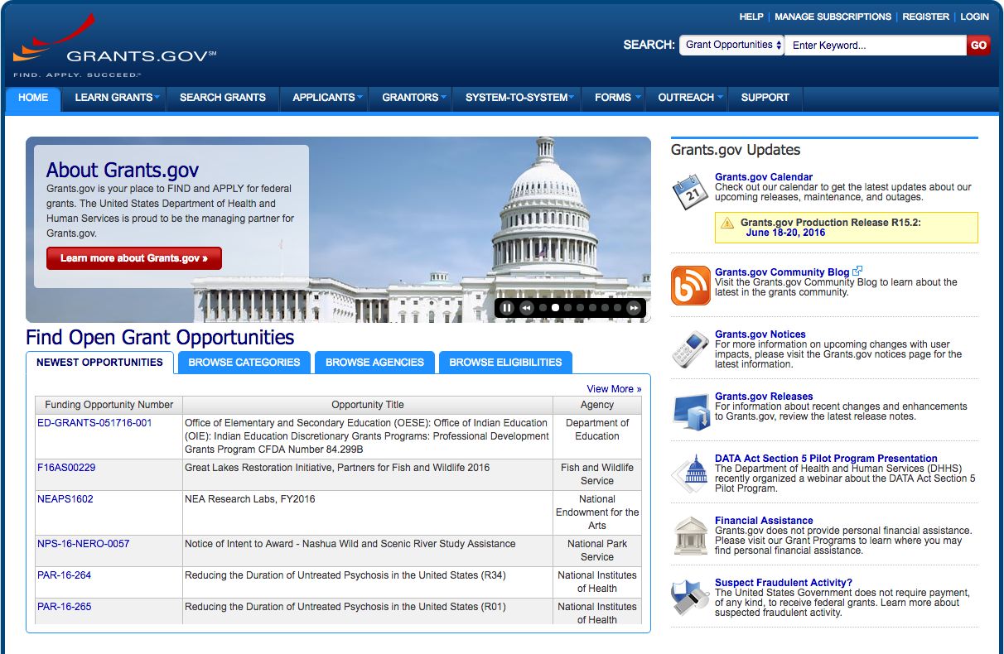

Slide 46
Review Application Requirements
Request for Applications
Currently available at http://ies.ed.gov/funding
Application Package
Currently available at www.grants.gov

Slide 47
Peer Review Process
Applications are reviewed for compliance and responsiveness to the RFA
Applications that are compliant and responsive are assigned to a review panel
Two or three panel members conduct a primary review of each application
At panel meeting, the most competitive applications are reviewed by full panel

Slide 48
Notification Process
All applicants will receive e-mail notification that the following information is available via the Applicant Notification System (ANS):
Status of award
Reviewer summary statements
If you are not granted an award the first time, plan on resubmitting, and talk to your Program Officer

Slide 49
Resources for Researchers
Visit links for faculty and researchers on IES website
Participate in webinars for the FY 2017 competitions

Slide 50
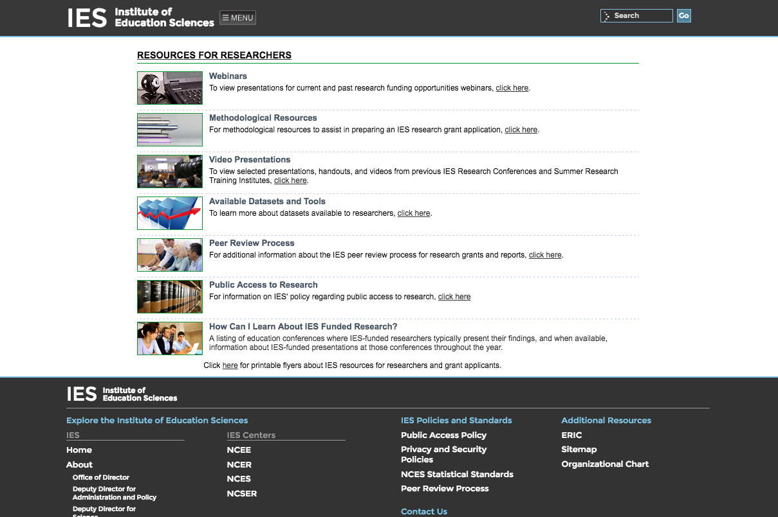
50

Slide 51
When Writing a Grant Application
Read the Request for Applications
http://ies.ed.gov/funding
Look at abstracts of funded projects
http://ies.ed.gov/ncer/projects
http://ies.ed.gov/ncser/projects
Take part in IES webinars
http://ies.ed.gov/funding/webinars/index.asp
Discuss your research idea with a program officer
Email a synopsis and schedule a time for a call
Email short questions

Slide 52
Help Us Help You
Read the Request for Applications carefully
Call or e-mail IES Program Officers early in the process
As time permits, IES program staff can review draft proposals and provide feedback
Don’t be afraid to contact us!

Slide 53
For More Information
http://ies.ed.gov/funding
Erin Higgins
Erin.Higgins@ed.gov
Katie Taylor
Katherine.Taylor@ed.gov

