Slide 1
Research Training Programs in
Special Education
Katie Taylor, Ph.D.
Program Officer
National Center for Special Education Research

Slide 2
Agenda
Introduction to IES and NCSER
Research Training Programs in Special Education
Early Career Development and Mentoring
Application Submission and Review

Slide 3
Legislative Mission of IES
Describe the condition and progress of education in the United States
Identify education practices that improve academic achievement and access to education opportunities
Evaluate the effectiveness of Federal and other education programs

Slide 4
Organizational Structure of IES
Office of the Director
National Board for Education Sciences
Standards & Review Office
National Center for Education Evaluation
National Center for Education Statistics
National Center for Education Research (NCER)
National Center for Special Education Research (NCSER)

Slide 5
Objectives of IES Grant Programs
Develop or identify education interventions (practices, programs, policies, and approaches) that enhance academic achievement and can be widely deployed
Identify what does not work and thereby encourage innovation and further research
Understand the processes that underlie the effectiveness of education interventions and the variation in their effectiveness

Slide 6
National Center for Special Education Research (NCSER)
NCSER sponsors a rigorous and comprehensive program of special education research designed to expand the knowledge and understanding of infants, toddlers and students with or at risk for disabilities from birth through high school.

Slide 7
Agenda
Introduction to IES and NCSER
Research Training Programs in Special Education
Early Career Development and Mentoring
Application Submission and Review

Slide 8
Research Training Program in
Special Education (84.324B)
The purpose is to prepare individuals to conduct rigorous and relevant special education and early intervention research that advances knowledge within the field and addresses issues important to education policymakers and practitioners.

Slide 9
Changes in the 2017 RFA
The Institute is accepting applications under one topic only: Early Career Development and Mentoring.
Early Career awards will be made as grants, as opposed to Cooperative Agreements.
Language was revised to make clear that consultants may be included, in addition to mentors and co-mentors.
You have the option of using SciENcv to create an IES Biosketch for each key person and significant contributor to include in your application.

Slide 10
Agenda
Introduction to IES and NCSER
Research Training Programs in Special Education
Early Career Development and Mentoring
  Purpose
  Requirements
  Narrative
  Appendices
  Budget
Application Submission and Review

Slide 11
Purpose of Early Career Program
Develop and maintain a strong cadre of independent researchers addressing the needs of infants, toddlers, children, and youth with disabilities, and their families and teachers
Provide support for an integrated research and career development plan for investigators in the early stages of their academic careers

Slide 12
Awards
Maximum Number: no more than 5 awards will be made
  Maximum Duration: 4 years
  Maximum Cost: $400,000 total (direct plus indirect)

Slide 13
Principal Investigator Requirements
Must have completed a doctoral degree or postdoctoral program no earlier than April 1, 2013 and no later than the start of the award period
Must hold a tenure-track position or research scientist position at an institution of higher education or must have accepted an offer for such a position to begin before the start of the award

Slide 14
Mentor Requirements
Designate a primary mentor
Include a mentor at your home institution
Select as mentors only individuals who were not your primary graduate school or dissertation advisor or postdoctoral supervisor

Slide 15
Mentor Recommendations
If proposing multiple mentors, include mentors with a variety of areas of expertise (e.g., content area and methodology)
Select mentors with research experience with children and youth with or at risk for disabilities, and/or their families or teachers, as well as your specific topic of interest
Select a mentor at your home institution to guide your career development there, as well as provide additional content and/or methodological expertise

Slide 16
Research Focus Requirements
Focus on infants, toddlers, preschool children, or students in K-12 with or at risk for disabilities, their families, teachers, related services providers, or other instructional personnel
Address student education outcomes:
  Developmental
  School readiness
  Academic
  Social and behavioral
  Functional

Slide 17
Required Sections of
Training Program Narrative
Significance
Research Plan
Career Development Plan
Personnel
Resources

Slide 18
Significance
Justify and describe:
  Need for further career development
  Research program and research questions
  Rationale for proposed research topic and goal
How will the research and career development activities enhance your knowledge and skills?

Slide 19
Special Education Research Topics (84.324A)
Autism Spectrum Disorders
Cognition and Student Learning in Special Education
Early Intervention and Early Learning in Special Education
Families of Children with Disabilities
Mathematics and Science Education
Professional Development for Teachers and Related Service Providers
Reading, Writing, and Language Development
Social and Behavioral Outcomes to Support Learning
Special Education Policy, Finance, and Systems
Technology for Special Education
Transition Outcomes for Secondary Students with Disabilities

Slide 20

Research Goals
Goal 1: Exploration
Goal 2: Development & Innovation
Goal 3: Efficacy & Replication
Goal 5: Measurement

Slide 21
Exploration Goal
Explore associations between malleable factors and student education outcomes
AND/OR identify factors and conditions that may mediate or moderate relations between malleable factors and student education outcomes
Possible methodological approaches include:
  Analyze secondary data
  Collect primary data
  Complete a meta-analysis
  Combination of above

Slide 22
Development & Innovation Goal
Develop an innovative intervention (e.g., curriculum, instructional approach, program, or policy) OR improve an existing education intervention
Development process must be iterative!
AND collect data on its feasibility, usability, and fidelity of implementation in actual education settings
AND collect pilot data on the intervention’s promise for improving student education outcomes

Slide 23
Efficacy & Replication Goal
Evaluate whether or not a fully developed intervention is efficacious under limited or ideal conditions
OR
Generate additional evidence for an efficacious intervention by directly replicating or varying the original conditions
OR
Gather follow-up data examining the longer term effects of an efficacious intervention
OR
Analyze retrospective (historical) secondary data to test the efficacy of an intervention implemented in the past

Slide 24
Measurement Goal
Development of new assessments or refinement of existing assessments, and the validation of these assessments
OR
Validation of existing assessments for specific purposes, contexts and populations

Slide 25
Research Plan and
Career Development Plan
Research and career development plans are designed to enhance the knowledge and skills of the Principal Investigator
Plans should be integrated, so that the career development plan supports the research plan

Slide 26

Research Plan: Major Elements
Focus of your research, topic area and goal
Research Design
Sample
Key outcome measures
Data analysis

Slide 27
Developing the Research Plan
Mentors should assist with development of Research Plan.
Less detail is expected compared to proposals submitted to the Special Education Research Grants competition.

Slide 28
Research Plan: Questions to Consider
What education problem do you want to solve? What research questions do you want to answer?
Does your research focus fit within one of the IES grant topics?
What content will you address? What sample will you study?
Does your research design fit the requirements of one of the IES goals?

Slide 29
Research Designs
Development & Innovation pilot studies may include:
  Fully-powered randomized controlled trials (RCT)
  Underpowered RCTs
  Single-case studies
  Quasi-experimental studies
Efficacy & Replication projects should use a research design that meets the WWC evidence standards:
  RCTs
  Sequential, Multiple Assignment, Randomized Trials (SMARTs)
  Regression discontinuity designs
  Single-case experimental designs
  Quasi-experimental designs

Slide 30
Career Development Plan
Describe the following components of your Career Development Plan
  Process of mentoring
  Educational opportunities to extend your expertise
Describe how both components of your Career Development Plan are integrated with and support the Research Plan

Slide 31
Example Educational Opportunities
IES Summer Institutes (e.g., RCT or single-case design)
Grant-writing workshops
Advanced statistical workshops or courses to learn new analysis skill (e.g., HLM, SEM)

Slide 32
Personnel
Expertise of your research team, including you, your mentors, and any consultants
  Qualifications, roles, and relationship to content and methodology foci of IES
  Mentors’ prior experiences with mentoring early career researchers
  Special education research projects conducted by mentors
Time commitments and letters of agreement

Slide 33
Resources
Describe the institutional capacity and your access to the resources needed to successfully complete this project.
  Do not use university boilerplate
  Describe institutional training supports (e.g., workshops, research groups on campus)
  Include start-up packages
Describe the resources to disseminate project results

Slide 34
Appendices
Appendix A (required for resubmissions): Response to the previous reviewers
Appendix B: Summary table of you and your mentors’ ongoing and recently completed SPED research projects
Appendix C: Letters of agreement from all mentors
Appendix D: Letters of agreement from your institution and from school partners, data sources, and consultants
Appendix E (optional): Examples of training or research materials and tables/charts that support the Program Narrative (e.g., project timeline)

Slide 35
Budget for Early Career Program
Up to 50% of PI’s academic year salary
Up to $3,000 per year for your mentors
Travel
  For you or your mentor(s) to meet when you are not at the same institution
  For specialized workshops at other institutions
  For professional conferences (including IES PI meeting in Washington, DC)

Slide 36
Agenda
Introduction to IES and NCSER
Research Training Programs in Special Education
Early Career Development and Mentoring
Application Submission and Review

Slide 37
Important Dates and Deadlines
Application Deadline | Letter of Intent Due Date | Application Package Posted | Start Dates
August 4, 2016 4:30:00pm DC Time | May 19, 2016 | May 19, 2016 | July 1, 2017 to Sept 1, 2017

Slide 38
Application Due Dates
Applications are accepted once a year.
The authorized representative at your institution (not the PI) actually submits the grant to IES.
For FY 2017, applications are due August 4, 2016 at 4:30:00pm Washington DC time.
We do NOT accept late applications.

Slide 39
Finding Application Packages
FY 2017 Application Packages available on
www.grants.gov

Slide 40
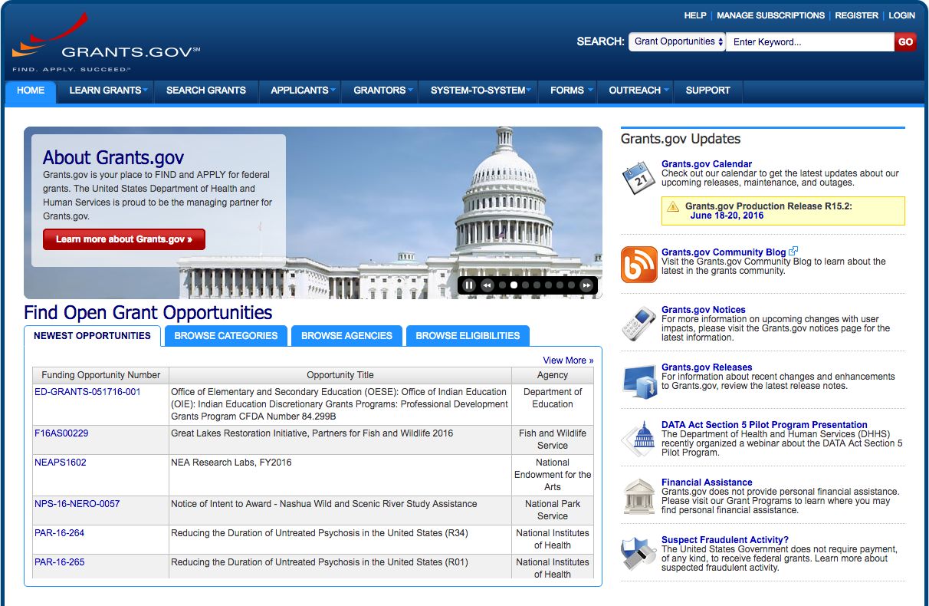

Slide 41
Peer Review Process
Applications are reviewed for compliance and responsiveness to the RFA.
Applications that are compliant and responsive are assigned to a review panel.
2-3 panel members conduct a primary review of each application.
Applications are rank ordered according to average overall score.
The most competitive applications are reviewed and scored by the full panel.

Slide 42
Peer Review Process Information
The Standards and Review Office
http://ies.ed.gov/director/sro/peer_review/index.asp

Slide 43
Notification
All applicants will receive e-mail notification that the following information is available via the Applicant Notification System (ANS):
  Status of award
  Reviewer summary statement
If you are not granted an award the first time, consider resubmitting and talk with the program officer.

Slide 44
Resources for Researchers
Visit the IES website for a variety of resources for researchers: http://ies.ed.gov/resourcesforresearchers.asp
Participate in webinars for FY 2017 competitions

Slide 45
Reminders
Attend to:
  Page, budget, and grant period limits
  Materials allowed in appendices
  Review criteria

Slide 46
Help Us Help You!
Read the Request for Applications carefully
Call or e-mail the project officer early in the process
As time permits, the program officer can review draft proposals and provide feedback
Don’t be afraid to contact the program officer!

Slide 47
For More Information
Funding Opportunities:
http://ies.ed.gov/funding
Program Officer:
Katie Taylor
Katherine.Taylor@ed.gov

