Slide 1
Early Career Development & Mentoring Programs
Katina Stapleton and Jennifer Schellinger
Program Officers
National Center for Education Research
ALN 84.305B Research Training Programs in the Education Sciences

Slide 2
Agenda
Overview of the IES NCER Early Career Development and Mentoring programs:
Early Career Development and Mentoring Program for Education Research (New)
Early Career Development and Mentoring Program for Faculty at Minority-Serving Institutions (Expanded)
Overview of technical assistance for NCER Early Career applicants

Slide 3
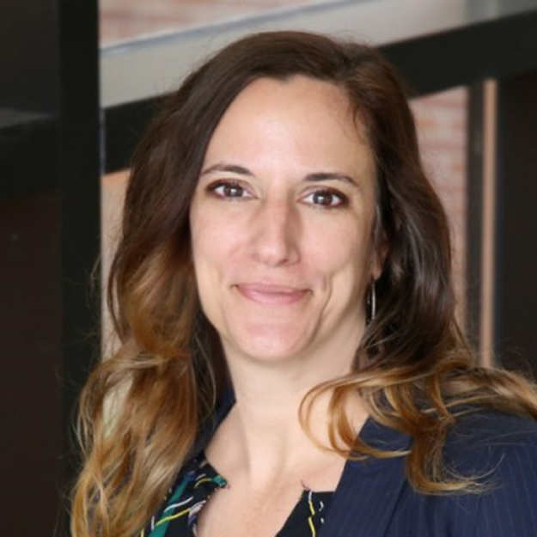
Program Officers
NCER Early Career Development and Mentoring Program for Education Research
Dr. Jennifer Schellinger Jennifer.Schellinger@ed.gov
NCER Early Career Development and Mentoring Program for Faculty at Minority Serving Institutions
Dr. Katina Stapleton Katina.Stapleton@ed.gov

Slide 4
Sneak Peek at What’s New
The NCER Education Research Training in the Education Sciences Request for Applications (ALN 84.305B)
includes two Early Career Development and Mentoring programs
increases the types of institutions and researchers that can apply
expands the types of research than can be conducted
provides MSIs with optional funding to support institutional grant administration

Slide 5
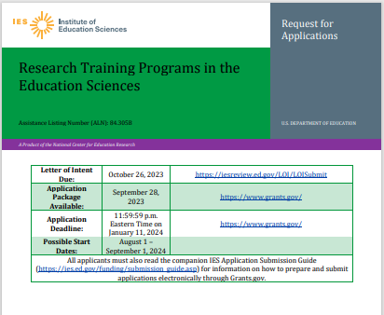
Overview
Early Career Mentoring and Development Program for Education Research
Max: $400,000 over 4 years
Early Career Mentoring and Development Program for Faculty at Minority Serving Institutions
Max: $400,000 + $200,000 (grant admin) over 4 years
Early Career
ER
https://ies.ed.gov/funding/24rfas.asp
Early Career
MSI

Slide 6
How to identify shared and unique Early Career requirements using this slide presentation
Blue represents Early Career Education Research (EC-ER)
Green represents additional requirements for Early Career MSI (EC-MSI)
Early Career
ER
VERY IMPORTANT: EC-MSI applicants will need to read both program descriptions because most are shared requirements. This is noted on the relevant slides.
Early Career
MSI
Note: In the RFA, the Early Career Mentoring and Development Program for Education Research is referred to as “Early Career”. However, for the purpose of this presentation, we are using the acronyms “Early Career Education Research” and “EC-ER” to more clearly differentiate this topic from the Early Career Mentoring and Development Program for Faculty at Minority Serving Institutions, referred to as “Early Career MSI” and “EC-MSI”
See the margin for relevant page numbers

Slide 7
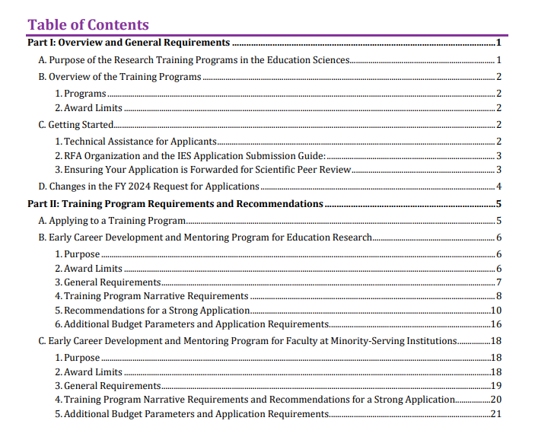
Read the RFA
Read the overview and general requirements - Part I
Read how to apply to a training program - Part II.A
Read program-specific requirements
Early Career ER - Part II.B
Early Career MSI - Part II.C
Part II.B.4 (Shared Narrative Requirements)
Part II.B.5 (Shared Recommendations)
Read the remainder of the RFA (Parts III – VI)
After reading the RFA, talk to a program officer and/or submit your letter of intent

Slide 8
Goals of the Early Career Programs
To prepare and support early career researchers to conduct high-quality education research
To increase the diversity of researchers and institutions funded by IES

Slide 9
Structure of the Early Career Programs
Each award will provide an early career faculty member or researcher with funding to
conduct research, including salary for protected time to conduct research
establish a longer-term research agenda
obtain career development guidance and support, including training under the guidance of an experienced mentor or mentors

Slide 10
Education Research Requirements of the Early Career Programs
Proposed early career research
must be relevant to education in the U.S.
must address factors under the control of U.S. education systems or must propose to improve education statistical and/or research methods
cannot focus primarily on students with or at risk for disabilities (except for learners in adult education/adult literacy programs)

Slide 11
NCER Early Career Eligibility Requirements
Institutional
Principal Investigator
Mentors
Award and Budget Parameters

Slide 12
Eligible Applicant & Principal Investigator Requirements
Both programs require an eligible applicant institution and an early career principal investigator.
The institution that is applying for the grant
The early career researcher who must work at the institution or organization applying for the grant
Eligible Applicant
Principal Investigator (PI)
See RFA p. 7 (EC-ER) and pp. 19-20 (EC-MSI)

Slide 13
Applicant Requirements for Early Career Education Research
The Early Career Development and Mentoring Program for Education Research topic requires a research institution (academic or non-academic) to be the applicant.
Institutions that have the ability and capacity to conduct rigorous research are eligible to apply. (Non-academic institutions are eligible to apply).
Eligible applicants include, but are not limited to, non-profit and for-profit organizations and public and private agencies and institutions, such as colleges and universities.
The application’s resource section should include a description of the institution’s capacity to conduct rigorous research.
.
See RFA p. 7 (EC-ER)

Slide 14
Applicant Requirements for Early Career MSI
The Early Career Development and Mentoring Program for Faculty at Minority-Serving Institutions topic requires a minority-serving institution (MSI) to be the applicant.
Specifically, the applicant institution must be an MSI located in the territorial United States that confers bachelor’s, master’s, or doctoral degrees in academic fields relevant to education. (Non-academic institutions are NOT eligible to apply.)
To qualify as an MSI, the institution must be eligible to receive assistance under sections 316 through 320 of part A of title III, under part B of title III, or under title V of the HEA. Information on eligibility under these authorities is available on the FY 2023 Eligibility Matrix at https://www2.ed.gov/about/offices/list/ope/idues/eligibility.html#el-ins
The application should describe how the institution qualifies as an MSI.
Special Feature: This topic provides additional fund for administrative support.
See RFA pp. 19-20 (EC-MSI)

Slide 15
Types of MSI Categories for Early-Career MSI
Alaska Native and Native Hawaiian-Serving Institutions (ANNH)
American Indian Tribally Controlled Colleges and Universities (TCCU)
Asian American and Native American Pacific Islander-Serving Institutions (AANAPISI)
Hispanic-Serving Institutions (HSI)
Historically Black Colleges and Universities (HBCU)
Predominantly Black Institutions (PBI)
Native American-Serving, Nontribal Institutions (NASNTI)
See RFA p. 19 (EC-MSI)

Slide 16
How Does My Institution Confirm MSI Eligibility?
Go to the OPE website
Download the Eligibility Matrix
Check status on matrix
Confirm types of degrees
Download the most recent matrix (Eligibility Matrix 2023) or visit the OPE site: https://www2.ed.gov/about/offices/list/ope/idues/eligibility.html.
The MSI must confer bachelors, masters, or doctoral degrees relevant to education to be eligible for the Early Career MSI topic.
See RFA p. 19 (EC-MSI)

Slide 17
How Does My Institution Use the Eligibility Matrix?
Click on the tab for relevant MSI category
Search for your university name
If your institution is on either the HBCU or TCCU tabs, it qualifies as an MSI for this competition.
If your institution is listed on another tab (excluding the SIP tab), scroll to the “Meets the 2023 Title III Eligibility Definition” column. If your institution is listed as “Yes” in that column, it qualifies as an MSI for this competition. See example in the screenshot.
After confirming your institution is an MSI, you must confirm that the MSI confers bachelors, masters, or doctoral degrees in at least one field relevant to education research.
Example of checking AANAPISI eligibility
If you have any questions about MSI eligibility, email Katina.Stapleton@ed.gov.
See https://www2.ed.gov/about/offices/list/ope/idues/eligibility.html

Slide 18
Eligible Institution FAQ
Can institutions submit more than one application?
Yes. An applying institution may hold more than one Early Career award from IES and may submit more than one application to either or both programs as long as each actual or proposed training application includes a different principal investigator and there is no overlap in mentors.
Can MSIs apply to either topic?
Yes. MSIs can apply to either Early Career ER or Early Career MSI provided that the institution meets the requirements for the specific program. However, the MSI can’t submit applications with the same PI to both programs.

Slide 19
PI Eligibility Requirements
For both programs, IES provides funds to the institution or organization of the early career faculty/researcher (referred to as the principal investigator) who is named in the application. In addition to the institutional employment requirements (which differ by competition), the principal investigator (PI)
must have completed a doctoral degree or postdoctoral position no earlier than April 1, 2018 and no later than the start of the award period
must be a citizen or permanent resident of the United States
must not have served or be serving at the time of award as a PI or co-PI on a research grant from IES
The PI’s doctorate may be in any field and should align with the knowledge and skills necessary for the proposed research, with the support of the PI's mentor(s).
See RFA p. 7 (EC-ER) and pp. 19-20 (EC-MSI)

Slide 20
PI Eligibility Requirements, continued
For both programs, Early Career PIs at academic institutions must hold a tenure-track position or research scientist position (not a visiting faculty or adjunct position) at the applying academic institution or must have accepted an offer for such a position to begin before the start of the award.
The position must be a regular, salaried position paid by the institution of higher education without a focus on training (not a postdoctoral fellowship).
EC-ER Only: For Early Career (ER) PIs at non-academic organizations, the PI must hold a non-temporary research position with a research career track inside the organization or must have accepted an offer for such a position to begin before the start of the award.
See RFA p. 7 (EC-ER) and pp. 19-20 (EC-MSI)

Slide 21
Principal Investigator FAQ
Can a PI submit more than one Early Career application? Can I submit an application to both Early Career programs? No. You can serve as PI on only one Early Career application to either the Early Career ER or Early Career MSI topic. You cannot be a PI on multiple applications under the same program (e.g., two Early Career MSI applications) or on an application to both programs. If you submit multiple applications as PI to one or both of these programs, IES will send only one of the compliant and responsive applications forward to reviewers
I have been offered a job, but I haven’t started yet. Can I still apply? Yes. In the case that the PI has accepted an offer from an academic or non-academic institution, the PI must include a letter of support in Appendix D from the future home institution indicating that an offer has been made and accepted. If your application is recommended for funding, IES will confirm employment before the award is made.

Slide 22
Principal Investigator FAQ, continued
I conduct research at a university, but my title isn’t “research scientist.” Am I eligible to apply? Because titles vary across universities, IES will determine eligibility on a case-by-case basis during application screening. It will be up to you to describe within the application how your position meets the principal investigator requirements. Generally speaking, to qualify as a “research scientist” regardless of position title, you should hold a regular, salaried, non-temporary, and non-training focused research position within the applying institution. If you hold a postdoctoral, visiting faculty, or adjunct position, you are not eligible to apply as a research scientist. If you have any questions, please contact Jennifer Schellinger (EC-ER) or Katina Stapleton (EC-MSI) before submitting your application.
How do I document that I meet the PI requirements? For both programs, along with describing your current position in the Personnel section, in Appendix D you may also choose to include a letter from the applying institution confirming your appointment status within their organization and whether your appointment status meets specific requirements of the topic.

Slide 23
Mentor Requirements
Both programss have the same requirements for mentors
Mentors may be from academic or nonacademic institutions, such as nonprofit and for-profit organizations or public and private agencies that conduct rigorous education research.
You must have one primary mentor.
You can have multiple additional mentors (co-mentors). However, at least one must be at your home institution.
Your mentors may not include your graduate school advisor, dissertation advisor, or postdoctoral supervisor.
Your dissertation committee members may be a mentor provided you did not have a direct advisor-advisee relationship in graduate school.
See RFA p. 8 (EC-ER) and p. 20 (EC-MSI)

Slide 24
Award Limits and Budget Parameters
There are shared and unique award limits and budget parameters by topic.
Max: $400,000 over 4 years
Max: $400,000 plus up to $200,000 (grant admin) over 4 years
Early Career
ER
Early Career
MSI
See RFA pp. 6-7, 16-17 (EC-ER) and pp. 18-19, 21-22 (EC-MSI)

Slide 25
Award & Budget Parameter Details
Both programs provide up to $400,000 (in direct and indirect costs) to support research and career development over no more than 4 years.
Funding for both topics includes
Costs of conducting the proposed research and executing the career development plan
Up to 50 percent of the PI’s salary
Up to $30,000 per year for mentor salary
Travel
Reasonable accommodations (if needed)
In addition, the Early Career MSI program also includes up to $200,000 in optional additional support for the direct costs of grant administration and management.
See RFA pp. 6-7, 16-17 (EC-ER) and pp. 18-19, 21-22 (EC-MSI)

Slide 26
Indirect Cost Limits
The Early Career ER and the Early Career MSI awards are considered training grants.
The U.S. Department of Education policy (34 CFR 75.562 (c)(2)) limits indirect cost reimbursement on a training grant to the recipient’s actual indirect costs, as determined by its negotiated indirect cost rate agreement, or 8 percent of a modified total direct cost base, whichever amount is less.
More information is found in the RFA. Questions about indirect cost rates should be
directed to the U.S. Department of Education’s Indirect Cost Group
https://www2.ed.gov/about/offices/list/ocfo/fipao/icgindex.html.
See RFA p. 36 (EC-ER and EC-MSI)

Slide 27
Training Program Narrative
Significance
Research Plan
Career Development Plan
Resources
Personnel

Slide 28
Important Reminder for EC-MSI Applicants
The Training Program Narrative requirements and recommendations for both programs are found under the EC-ER description.
Additional MSI-specific requirements and recommendations are found under the EC-MSI description.
See RFA pp.8-16, 20-21 (EC-MSI)

Slide 29
Requirements vs. Recommendations
Requirement = Must
The RFA includes general requirements as well as program-specific requirements. If your application does not include a required element, it will not be reviewed.
Recommendations for a Strong Application = Strongly Encouraged
The RFA includes recommendations that are intended to improve the quality of your application, and the peer reviewers will use these recommendations in their evaluation of your application.

Slide 30
The Strongest Training Program Narratives
Reflect the PI’s passion and potential as a future researcher, if provided additional training
Describe a research component that is
Based on strong theoretical or empirical research
Clearly described and justified
Feasible in the time and budget constraints
Practical for the non-researchers involved (e.g., students, practitioners, schools)
Important for the field of education sciences and addresses issues important to education policymakers and practitioners
Describe a career development plan that
Has clear, achievable goals
Is aligned with the PI’s overarching career trajectory and needs of PI’s research
Is integrated with or reflective of the research plan (and is not an afterthought!)
Include mentors with the relevant knowledge and experience and enough time to devote to mentoring

Slide 31
Significance Requirements
All Early Career Applicants must
Describe your need for further career development
Provide an overview of the proposed research project and your research questions
Identify a primary and, if applicable, secondary research topic that aligns with the focus of your research from the list provided in the RFA
Identify a project type that reflects the type and purpose of the work you will do from the list provided in the RFA
Early Career MSI Applicants must also
discuss how the applicant institution meets the MSI requirement
See RFA pp. 8-9 (EC-ER) and pp. 8-9, 20-21 (EC-MSI)

Slide 32
Research Plan Requirements
All Early Career research plans must describe the research design, sample, key outcome measures, and data analysis procedures. In addition,
if you are proposing to do research on how to improve student outcomes, you must describe how you will measure the academic outcomes of learners, which can reflect learning and achievement in content domains, as well as learners’ successful progression through education systems
if you are proposing to develop a statistical or research product, you must describe how you will measure whether your proposed statistical or research product works as intended and can be used by education researchers.
You must also describe your plans for developing a longer-term research agenda building on your proposed research.
Research Plan recommendations are in the RFA.
See RFA pp. 9-10, 12-15 (EC-ER) and pp. 9-10, 12-15, 20-21 (EC-MSI)

Slide 33
Tips for Developing Your Research Plan
Read the Research Plan requirements and recommendations very closely. Also remember
your research plan should be feasible and appropriate for addressing your research questions
your research plan should help motivate your career development plan
you do not need to be an expert in every aspect of the proposed research – this is meant to be a learning experience and your career development plan can articulate how you will build research expertise
you can refer to other RFAs for ideas about education research (84.305A Education Research Grants) or research methods and statistics (84.305D Statistical and Research Methodology in Education)
you can contact an Early Career program officer if you have any questions about your proposed research plan

Slide 34
Career Development Plan Requirements
All Early Career Development Plans must describe
how mentoring and other educational opportunities will be used to extend your expertise
how your career development activities will support or complement your Research Plan and contribute to the development of your longer-term research agenda
Examples of educational opportunities include
IES-funded methods trainings, such as the RCT, implementation science, or cost analysis trainings
grant-writing workshops
advanced statistical workshops or courses to learn new analysis skills
science communication and dissemination training
See RFA pp. 10, 15 (EC-ER) and pp. 10, 15, 21 (EC-MSI)

Slide 35
Tips for Developing your Career Development Plan
Read the Career Development Plan requirements and recommendations very closely. Also remember to
address gaps in your knowledge and training
align your career development plan to your research plan
include mentoring in support of goals and your development as a scholar (e.g., regular meetings, guidance on the research and career development plans, and support related to your development as a researcher)
include additional training activities aligned with goals (e.g., coursework, IES methods training, stats workshops, grant-writing seminars, dissemination training)

Slide 36
Personnel Requirements
The purpose of this section is to describe the relevant expertise, responsibilities, and time commitments of the PI, your mentor(s), and any other personnel.
All personnel sections must describe
discuss how you meet the PI eligibility requirements for the relevant Early Career program
your experience and expertise
date you received your doctorate (or completed your postdoctoral position)
names of your dissertation or academic advisor, and your postdoctoral supervisor (if applicable)
experience and expertise of all mentors and other personnel
See RFA pp. 7, 10, 15-16 (EC-ER) and pp. 10, 15-16, 19, 21 (EC-MSI)

Slide 37
Tips for Selecting Mentors & Other Personnel
Mentors:
no cap on the number
one must be from your home institution
should have unique and complementary expertise
should expand your perspective
can be chosen to support your research, career development, or both
Other personnel, like consultants, can be included to support a specific part of the research or to fill gaps in your mentorship
The combined expertise of you, your mentors, and any additional personnel should reflect the project’s content area and methods.

Slide 38
Resources
The purpose of this section is to describe the institutional resources to support you in successfully completing this project and disseminating the results.
All resource sections must describe the resources to support you in conducting the proposed project. This may include
resources to carry out both the research and training plan
resources to carry out your plans to disseminate results
your institution’s capacity to support early career researchers in managing grants and monitoring spending.
your institution’s experience supporting early career researchers
your plans for acquiring any resources that are not currently accessible, will require significant expenditures, and are necessary for the successful completion of the project, such as equipment, test materials, curricula, or training materials
EC-MSI Only: If you are requesting any optional funds for direct costs of grant administration and management, your resource section must also describe how those funds will be used (including how they will augment existing administrative support) and which offices will carry out what type of work.
See RFA pp. 10, 16 (EC-ER) and pp. 10, 16, 21 (EC-MSI)

Slide 39
Appendices
Appendix A: Dissemination Plan (required)
Appendix B: Response to Reviewers (required for resubmissions)
Appendix C: Table of your and your mentors’ ongoing and recently completed education research projects (required)
Appendix D: Letters of agreement from all mentors, your institution, school partners, data sources, and consultants (required)
Appendix E (optional):
Examples of training materials that support your career development plan
Examples of materials to be used in the intervention or assessment that is the focus of your project
Figures, charts, and tables that supplement the project narrative; examples of measures to be used in the project
See RFA pp. 31-33 (EC-ER and EC-MSI)

Slide 40
Next Steps
Discuss your research idea with a program officer.
Submit an official letter of intent
Email a short synopsis and schedule a time for a call
Email short questions
Attend additional Virtual Office Hours if you have questions or to learn more about the application process.
Contact your sponsored program office to let them know you are interested in applying to IES and to learn your institution's internal procedures for applying for federal grant funding.
Contact your proposed mentor(s) to discuss your research and career development plans, to receive their feedback on draft application material, and to write a letter of agreement to be your mentor for inclusion in the application.

Slide 41
Contact Us
Early Career Development and Mentoring Program for Education Research
Dr. Jennifer Schellinger Jennifer.Schellinger@ed.gov
Early Career Development and Mentoring Program for Faculty at Minority Serving Institutions
Dr. Katina Stapleton Katina.Stapleton@ed.gov

