Slide 1
How to Apply to IES Like a Pro: Tips on Navigating the Application Process With a Focus on 84.305B and 84.305D
Katina Stapleton and Jennifer Schellinger
Program Officers
National Center for Education Research

Slide 2
Mapping Your Journey With IES
Establishing interest in a (re)submission
Writing your application
Submitting your application
Waiting on the review process
Preparing yourself and team
You have found a RFA or topic you’re interested in but now what?
How do you connect with IES?
How can you apply like pro?
What happens after you apply?
What if you need to reapply?
You have questions.
We have answers!
Your journey may start this year with one RFA but could continue for years to come with resubmissions or new submissions

Slide 3
Start by contacting an IES program officer (and/or submitting a letter of intent).

Slide 4
If You Remember Only One Thing
Contact the IES program officer associated with the RFA or topic you’re interested in. We are here to help you!
For this fall’s NCER RFAs and topics:
Charles Laurin (Charles.Laurin@ed.gov) – Statistical and Research Methodology in Education (84.305D)
Jennifer Schellinger (Jennifer.Schellinger@ed.gov) – Early Career Development and Mentoring Program for Education Research (84.305B)
Katina Stapleton (Katina.Stapleton@ed.gov) – Early Career Development and Mentoring Program for Faculty at Minority-Serving Institutions (MSIs) (84.305B)
Lara Faust (Lara.Faust@ed.gov) – Methods Training for Education Research (84.305B)

Slide 5
Establishing Contact With IES
There are two primary ways to initiate contact with IES, and we encourage both:
Contact IES program staff associated with the competition.
Submit a letter of intent.
Letters of intent are not required, but we request you submit them because
IES uses them for internal planning.
IES program staff use them to identify applicants, ensure they find the right contact person/people, and track interests.
A letter of intent does not require extensive citations or thorough documentation. They should be short (~1 page) and summarize your interests and the project design and goals.

Slide 6
Meanwhile…you should also be gathering and digesting all the materials you and your team will need to prepare and submit your application.

Slide 7
Preparing Yourself and Your Team: Finding Documents
The request for applications (RFA) – https://ies.ed.gov/funding/24rfas.asp
Download a copy, noting any “*”, which denote version updates. This document will help you prepare the various sections of your application.
The IES Application Submission Guide – https://ies.ed.gov/funding/submission_guide.asp
This includes information on the technical steps you and your institution will need to take to submit your application in Grants.gov.
You may also want to explore abstracts from previously awarded grants:
https://ies.ed.gov/funding/grantsearch/
Pro Tips for Using Abstracts
If there’s a project you’re curious about, consider emailing the PI or an IES program officer to learn more about the project.
If you can’t find a project similar to yours, that doesn’t mean that IES couldn’t or wouldn’t fund the work. It means only that IES hasn’t yet.

Slide 8
Preparing Yourself and Your Team: Ensuring Access to Systems
Your institution will need to help with the final submission and will need to ensure that there is an organizational account in Grants.gov.
Talk to your institution now about
Grants.gov registration
The System for Award Management (SAM) registration
Your institution’s UEI (Unique Entity Identifier)
The designated E-Business Point of Contact (EBiz POC )
Anyone who wants to apply under 84.305B should flag the 8% cap on indirect costs. Some institutions may have restrictions on such caps.

Slide 9
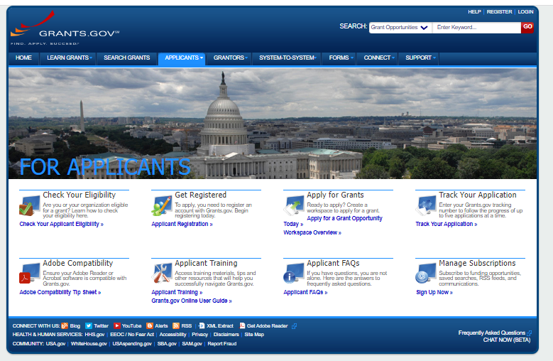
Where to Start on Grants.gov
Navigate to the For Applicants page on Grants.gov (https://www.grants.gov/web/grants/applicants.html)
From here, there are two pages that may be especially important:
Get Registered (https://www.grants.gov/web/grants/applicants/registration.html)
Apply for Grants (https://www.grants.gov/web/grants/applicants/apply-for-grants.html)
Most of the pre-submission work needs to be done by your institution. Your job is to support them and give them advanced notice that you intend to apply.

Slide 10
Preparing Yourself and Your Team: Time Management
Applications for 305D and 305B are due by 11:59:59 pm Washington DC time
on January 11, 2024
IES will not send late applications forward to review. Being on time is essential.
Check the deadlines that are listed on the RFA and online: https://ies.ed.gov/funding/futureComp.asp
Check with your institution now regarding internal deadlines.
Plan on uploading all documents days prior to the deadline in case there are glitches.
If you need letters of support, give people plenty of time to write and send them.

Slide 11
Now that you have all the raw materials, and your institution and team are aware of the funding opportunity, it’s time to start writing!

Slide 12
Writing Your Application: Using the Request for Applications (RFA)
Part I: Overview and General Requirements
Describes purpose, general requirements and eligibility, and changes
Helps you determine your interest and possible fit and how to get assistance
Part II: [name of section varies]
Describes the different topics or strands of the competition and each one’s goals, requirements, and recommendations
Helps you identify tips for writing a strong proposal
Part III: Preparing Your Application
Describes formatting requirements and recommendations, required and optional appendices, and other narrative content necessary
Helps you plan all the crucial supporting documents for your full proposal
Part IV: Competition Regulations and Review Criteria
Describes the IES competition process, federal requirements and regulations, and the review process
Helps you understand the “bigger” picture and the overarching timeline
Part V: Compliance and Responsiveness Checklist
Includes a quick checklist to help you make sure you have all the pieces your application needs to be compliant and responsive and sent forward to peer review
Part VI: Required Codes for Item 4b of the SF 424 Cover Sheet
Provides the necessary short-hand for filling in your application correctly
Although the number and naming of sections may vary slightly across RFAs, most have six major sections, each of which is relevant to you.
We encourage you to review each part.

Slide 13
Using the RFA: Understanding the Requirements and Recommendations
The RFA includes general requirements as well as topic-specific requirements (in Part II) under Requirements.
Denoted by the word must​
If your application does not include a required element, it will not be reviewed.
The RFA includes recommendations that are intended to improve the quality of your application.
See the “Recommendations for a Strong Application” section.
IES strongly encourages you to address the recommendations to the extent possible.
Peer reviewers will use these recommendations in their evaluation of your application.
Don’t forget: IES program officers are here to help

Slide 14
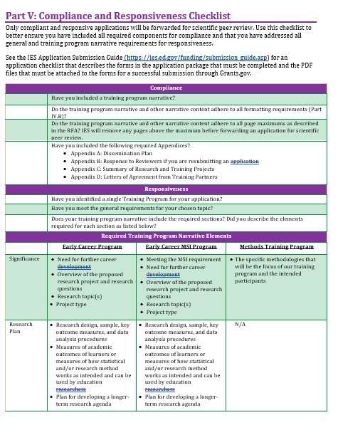
Using the RFA: Checking All the Boxes
IES sends only compliant and responsive applications forward for scientific peer review. If you forget something, it could mean your application will not be reviewed.
Pro Tips for Ensuring You Have Everything You Need –
Review the checklist at the end of the RFA to give you a quick overview of the different required elements (Part V: Compliance and Responsiveness Checklist).
Don’t forget the appendices – use them to help reviewers visualize content in your application narrative AND to make sure you include the required elements.

Slide 15
Writing Your Application: Engage Your Readers
Pro Tips to Keep in Mind
Use clear headings and/or numbering to help people navigate the document.
Present a clear story about the issue your research or your training aims to resolve and why you and your team are best positioned to address the issue you identified.
For Early Career Program applicants, show how you could continue to grow as a researcher if provided additional support for training and mentoring.
Use your space wisely and consider using the appendices.
Avoid overuse of formatting such as underlying, bolding, italics, font changes, color, or combinations to convey meaning.
Because reviewers may use screen readers or other assistive technologies, consider opting for simple formatting (e.g., left-justification, consistent font).
Always think of the peer reviewers’ experience.
Try to create an easy-to-follow, engaging story.
You will have interdisciplinary reviewers, so be careful about over-reliance on jargon and acronyms.

Slide 16
Writing Tips for Resubmissions
Identify your application as a resubmission.
If you previously submitted this or a similar application to the same topic, it will be considered a resubmission.
If you have submitted a similar application to a different topic or RFA, it will be considered a resubmission.
If you have any questions about whether your application would be considered a resubmission, contact an IES program officer for feedback.
Contact an IES program officer for feedback about your resubmission
Discuss reviewer comments
Discuss your plan to respond to reviewer comments
Share draft application materials with the program officer for feedback on how you addressed reviewer comments
Respond to reviewer’s comments in Appendix B (required)
Should describe how the revised application is responsive to prior reviewer comments
Should be 3 pages or less
Don’t forget: IES program officers are here to help

Slide 17
While you’re working on your narrative, you also need to be working in the application system itself…

Slide 18
Writing Your Application: Using Your Team Wisely
Most projects require multiple individuals with varying areas of expertise. Sometimes, these team members assist with writing or developing the application.
Make sure that every component of your work has at least one person whose expertise in that component is clearly stated in the Personnel section.
It is common for applied research applications to have different people are helping to write sections.
Team meetings to discuss the overarching theoretical model, analyses, training/mentoring plans, etc. will help create a consistent flow.
Early Career Program applicants should have their mentor(s) read drafts.
Pro Tip for Collaboration
If you delegate writing or editing responsibilities, be sure to have enough time to consolidate and ensure the narrative (and appendices) make sense when read together.
If you have enough time, IES program officers may be able to read sections of your narrative and meet with you for feedback.

Slide 19
Submitting Your Application
If you have trouble completing the forms or submitting your application through Grants.gov, contact Grants.gov:
1-800-518-4726
support@grants.gov
IES staff do not operate Grants.gov and cannot help you effectively.
You will be submitting your application through Grants.gov.
Generally, different individuals will upload different components:
The PI will write and be responsible for the narrative sections.
The institution may be responsible for budget forms and agreements, but this can vary.
Always build in sufficient time to upload and confirm the different components.
Use Grants.gov’s Applicant FAQs: https://www.grants.gov/web/grants/applicants/applicant-faqs.html
Remember: IES will not send late applications forward for review.

Slide 20
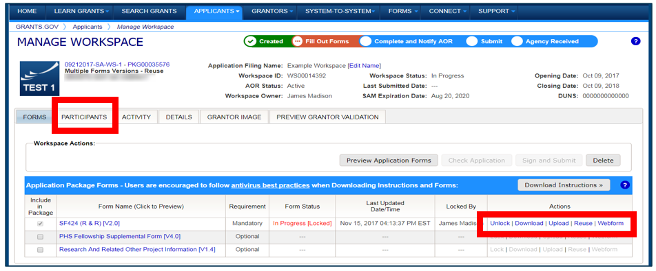
Submitting Your Application: Your Workbench
You and your team will use the Grants.gov Workbench to get, fill in, and upload your application components and ultimately to submit application components.
Multiple people may simultaneously access and fill out the mandatory and optional forms within an application.
The Participants tab lists the members of a workspace who work as a team to complete the required forms for a federal grant.
The Actions options allow you to access forms, upload items, etc.
See also: https://www.grants.gov/web/grants/applicants/workspace-overview.html

Slide 21
Upon Submission: Emails to Look for
First e-mail confirms that you have attempted to upload an application into the Grants.gov system
Application tracking number assigned (e.g.,GRANT00234567)
Second e-mail indicates…
EITHER application successfully validated by Grants.gov
OR application has been rejected due to errors
Third e-mail indicates…
U.S. Department of Education has retrieved application from Grants.gov.
Fourth email (from the U.S. Department of Education) contains an 11-digit PR/Award number unique to your application. Use this number to track your application from this point forward.

Slide 22
Post-submission: Where Your Application Goes Next
After you fully upload your application and Grants.gov validates it…
The U.S. Department of Education receives the applications for processing and transfer to the IES Peer Review Information Management Online (PRIMO) system (https://iesreview.ed.gov/).
Once in PRIMO, you can track the progress of your application via the Applicant Notification System (ANS).
Approximately 1 to 2 weeks after the application deadline, IES sends invitation emails to applicants who have never applied to IES before to create their individual PRIMO ANS accounts. (Both the PI and the AOR will receive invitation emails. )
Approximately 4 to 6 weeks after the application deadline, all applicants (new and existing ANS users) will begin to receive a series of emails about the status of their application.
See the IES Application Submission Guide (https://ies.ed.gov/funding/submission_guide.asp) for additional information about ANS and PRIMO.

Slide 23
And now you wait (and possibly prepare for a resubmission).

Slide 24
Waiting on the Review Process: General Process
IES assigns all compliant and responsive applications to an IES review panel according to the match between the overall expertise of reviewers on each panel and the content and methodological approach proposed in each application (see https://ies.ed.gov/director/sro/reviewers.asp).
These experts review and score your proposal, and if your application scores well enough, your application will go to the full panel.
The full panel discusses and scores your application, if forwarded to the full panel.
IES begins the “Award Decision” process and considers the following:
Scientific merit as determined by scientific peer review
Performance and use of funds under a previous federal award
Contribution to the overall program of research (or training) described in this request for applications
Ability to carry out the proposed research (or training) within the maximum award and duration requirements
Availability of funds
Note: The program officers are not involved in the review process or choice of reviewers.
(See the procedures: https://ies.ed.gov/director/sro/application_review.asp)

Slide 25
The Review Process: More About the Reviewers
Here are some basic steps the reviewers take:
At least two primary reviewers will complete written evaluations of your application, identifying strengths and weaknesses related to each of the review criteria.
These reviewers assign a score for each criterion and an overall score.
IES averages your reviewers’ overall scores to calculate an average overall score.
IES prepares a preliminary rank order of applications.
The full panel considers and scores only those applications deemed to be the most competitive and to have the highest merit, as reflected by the preliminary rank order.
NOTE: A reviewer may nominate any application for consideration by the full panel that the reviewer believes merits full panel review but that would not have been included in the full panel meeting based on its preliminary rank order.
(See list of panels and reviewers: https://ies.ed.gov/director/sro/reviewers.asp).
Pro Tip: Notes on Reviewer Comments
If your application is sent for review, you will get the reviewers’ comments.
You will get scores (for the criteria and overall) only if your application goes to the full panel.
The program officers can help you interpret the feedback and comments you get.

Slide 26
Review Process: Waiting to Hear Back and What to Do Afterwards
Keep in mind that the total review process will take months. You can track your application in the PRIMO system, but the IES staff will not have additional information for you during this time.
If you hear back from IES after panels requesting additional information, you may contact the IES staff who emailed you for clarification about any of the questions, but you should respond in the given timeframe.
If you learn that your application was not recommended for consideration of funding, you should review the comments and contact the IES program officer for the competition or topic to discuss the advisability of and strategy for undertaking a resubmission.
If you learn that your application was deemed non-compliant or non-responsive and was not forwarded for review, you may also contact the IES program officer for the competition or topic to discuss a possible resubmission.
Resubmissions are common for IES. If IES recompetes the RFA or topic, we encourage you to resubmit.

Slide 27
Your Journey With IES: You Are Not Alone
Establishing interest in a (re)submission
Preparing yourself and team
Writing your application
Submitting your application
Waiting on the review process
IES Program Officers Are Here for You

