Slide 1
IES FY 2020 Grant Competitions: Application Submission Process
EMILY J. DOOLITTLE, Ph.D.
National Center for Education Research
SARAH BRASIEL, Ph.D.
National Center for Special Education Research
Notes:
Welcome to the IES Application Submission Process webinar. My name is Emily Doolittle and I am a program officer in the National Center for Education Research. I am joined by my colleague Sarah Brasiel who is a program officer in the National Center for Special Education Research.
In the webinar today, we will provide an overview of how to submit a grant application to IES for the current fiscal year 2020 funding opportunities.

Slide 2
WHAT YOU WILL LEARN TODAY
How to find application materials
How to use Grants.gov
What to include in an application
How to format your application
Program-specific information
Notes:
Today you will learn how to apply for an IES grant, with a focus on how to find the materials you need, how to use grants.gov to complete and submit your application, and some general information about what to include in your application and how to format important components of your application. You will also learn about general requirements that apply to all IES grant programs.

Slide 3
The IES Research Centers
NCER - National Center for Education Research
CFDA 84.305
NCSER - National Center for Special Education Research
CFDA 84.324
Notes:
IES has two research centers, each of which offers funding opportunities. The research centers’ grant competitions are identified using a CFDA number, which stands for the Catalogue of Federal Domestic Assistance. All National Center for Education Research (also known as NCER) competitions are identified with the CFDA number 84.305, and all National Center for Special Education Research (also known as “nik-ser”) competitions are identified with the CFDA number 84.324. Individual grant programs within each center are identified using an alpha character (A, B, C, etc.). More on that later.

Slide 4
What are the Research Centers Competing in FY 2020?
Notes:
So, what are the research centers competing in FY 2020? Each center runs one or more competitions each fiscal year. Some are competed regularly while others are not.

Slide 5
FY 2020 NCER Research Grant Programs
Education Research Grants (84.305A)
Research Training Programs in the Education Sciences (84.305B)
Predoctoral Interdisciplinary Research Training Program
Postdoctoral Research Training Program
Methods Training for Education Researchers
Education Research and Development Centers (84.305C)
Improving Opportunities and Achievement for English Learners in Secondary School Settings
Improving Teaching and Learning in Postsecondary Institutions
Improving Access, Instruction, and Outcomes in Gifted Education
Notes:
NCER is accepting applications to five grant programs in FY 2020:
The Education Research Grants program is the main grants program for NCER, designated with CFDA number 84.305A.
NCER is also accepting applications to its Research Training in the Education Sciences program (84.305B) in three areas: Predoctoral Interdisciplinary Research Training Program; Postdoctoral Research Training Program; and Methods Training for Education Researchers.
The Education Research and Development Centers program (84.305C) is competed infrequently. For FY 20, NCER is accepting applications for three R&D Centers: Improving Opportunities and Achievement for English Learners in Secondary School Settings; Improving Teaching and Learning in Postsecondary Institutions; and Improving Access, Instruction, and Outcomes in Gifted Education.

Slide 6
FY 2020 NCER Research Grant Programs (Continued)
Statistical and Research Methodology in Education (84.305D)
Statistical and Research Methodology Grants
Early Career Statistical and Research Methodology Grants
Research Grants Focused on Systematic Replication (84.305R)
Notes:
NCER is also accepting applications to its Statistical and Research Methodology in Education program (84.305D also known as Stats and Methods) for the regular Stats and Methods grants as well as Early Career Stats and Methods Grants.
Finally, NCER has a new competition for Research Grants Focused on Systematic Replication (84.305R)

Slide 7
Education Research (CFDA 84.305A)
Career and Technical Education
Cognition and Student Learning
Early Learning Programs and Policies
Education Technology
Effective Instruction
English Learners
Improving Education Systems
Postsecondary and Adult Education
Reading and Writing
Science, Technology, Engineering, and Mathematics (STEM) Education
Social and Behavioral Context for Academic Learning
Notes:
Now, let’s look more closely at the main NCER grants program, Education Research. Under this program, we accept applications to multiple topic areas. There are 11 standing topics this year. There are no special topics this year. If you are applying to this grants program, you will need to identify the topic area on your application cover sheet to help make sure your application is assigned appropriately for peer review. I’ll return to this later.

Slide 8
FY 2020 NCSER Research Grant Programs
Special Education Research Grants (84.324A)
Research Training Programs in Special Education (84.324B)
Postdoctoral Research Training Program in Special Education and Early Intervention
Early Career Development and Mentoring
Methods Training Using Single Case Designs
Research Grants Focused on Systematic Replication (84.324R)
Notes:
NCSER is accepting applications to three grant programs in FY 2020:
The Special Education Research Grants program is the main grants program for NCSER, designated with CFDA number 84.324A.
The Research Training Programs in Special Education (84.324B) is accepting applications under three topic areas: Postdoctoral Research Training Program in Special Education and Early Intervention, Early Career Development and Mentoring, and Methods Training Using Single Case Designs
Finally, NCSER has a new competition for Research Grants Focused on Systematic Replication (84.324R)

Slide 9
Special Education Research (CFDA 84.324A)
Autism Spectrum Disorders
Cognition and Student Learning in Special Education
Early Intervention and Early Learning in Special Education
Families of Children with Disabilities
Professional Development for Educators and School-Based Service Providers
Reading, Writing, and Language Development
Science, Technology, Engineering, and Mathematics (STEM) Education
Social and Behavioral Outcomes to Support Learning
Special Education Policy, Finance, and Systems
Technology for Special Education
Transition Outcomes for Secondary Students with Disabilities
Special Topics:
Career and Technical Education for Students with Disabilities
English Learners with Disabilities
Systems-Involved Students with Disabilities
Notes:
Like the Education Research program in NCER, the Special Education Research Grants programs is the primary grants program for NCSER with multiple topic areas. There are 11 standing topics and three special topics in FY2020. The special topics are Career and Technical Education for Students with Disabilities, English Learners with Disabilities, and Systems-Involved Students with Disabilities

Slide 10
Application Due Dates Vary by Competition
August 29, 2019
Education Research (84.305A)
Special Education Research (84.324A)
Research Training Programs in the Education Sciences (84.305B)
Research Training Programs in Special Education (84.324B)
Statistical and Research Methodology in Education (84.305D)
Research Grants Focused on Systematic Replication (84.305R and 84.324R)
September 26, 2019
R&D Centers (84.305C)
Notes:
Pay attention to due dates. For FY 2020, the research centers are accepting applications on two different due dates – know the due date for your competition. IES does not accept late applications. More on that later.
Seven competitions are accepting applications on or before August 29th, 2019 – Education Research, Special Education Research, Research Training Programs in the Education Sciences, Research Training Programs in Special Education, Statistical and Research Methodology in Education, and the NCER and NCSER Research Grants Focused on Systematic Replication.
Applications to NCER’s R&D Center Competition are due on or before September 26, 2019.

Slide 11
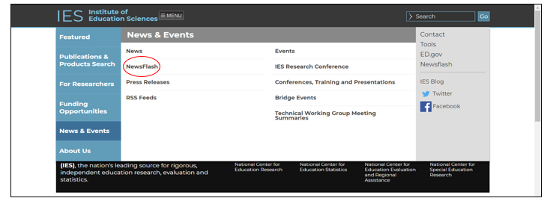
IES NewsFlash (1 of 2)
Notes:
Before you go to the IES website to learn more about these programs and the requirements for an application, I recommend that you sign up for the IES NewsFlash, an email alert system that can help you stay up to date with the latest news and information from IES, including upcoming research grant competitions. To sign up for the IES NewsFlash, hover your mouse over the News and Events tab on the main IES webpage, and choose NewsFlash from the list.

Slide 12
IES NewsFlash (2 of 2)
Notes:
Here, you can sign up to receive email alerts from one or more of the IES Centers. To receive information about funding opportunities, sign up for both the NCER and NCSER NewsFlashes.

Slide 13
How to Find Application Materials
Notes:
Now, let’s review how to find the materials you will need to submit an application to one of these research grant competitions at IES.

Slide 14
RFAs and Application Packages
Find the Request for Applications for the competition you want to apply to:
Requirements to get to peer review
Recommendations for a strong application
Find the Application Submission Guide
Information about submitting your application through Grants.gov
Find the Application Package for your competition – all the forms needed for a complete application
Notes:
You need three things to apply. First you need the Request for Applications, or RFA, which contains information for writing your Project Narrative including requirements that must be met to advance to peer review and recommendations for a strong application. The RFAs are located on the IES website. Second, you will need the Application Submission Guide which contains information about submitting your application using grants.gov. You also need to find the correct application package, which contains the forms that you will need to complete – that is located on the Grants.gov website.

Slide 15
Requests for Applications (RFAs)
The Requests for Applications (RFAs) for all competitions are available on the IES Website on the Funding Opportunities Page
Funding Opportunities
Notes:
You can find all RFAs for current fiscal year competitions on the IES Website on the Funding Opportunities Page

Slide 16
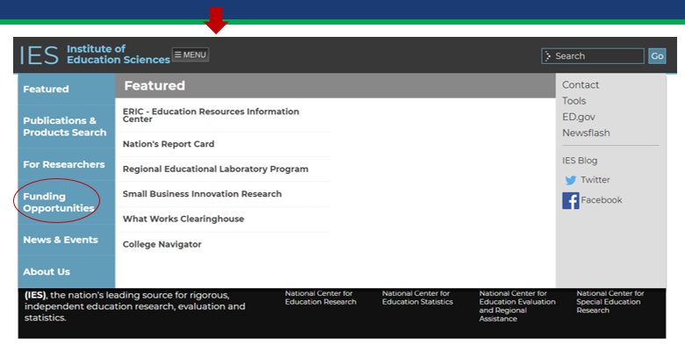
RFAs on the IES Website
Notes:
To get to the Funding Opportunities page, go to the main IES page then click “Menu” – from the drop down select “Funding Opportunities.”

Slide 17
IES Funding Opportunities
Notes:
On the left-hand side of the page you will see a list of steps to follow to submit a research grant application to IES. Links to the RFAs are circled in red.
On the right-hand side you see the competitions that are accepting applications in FY 2020.

Slide 18
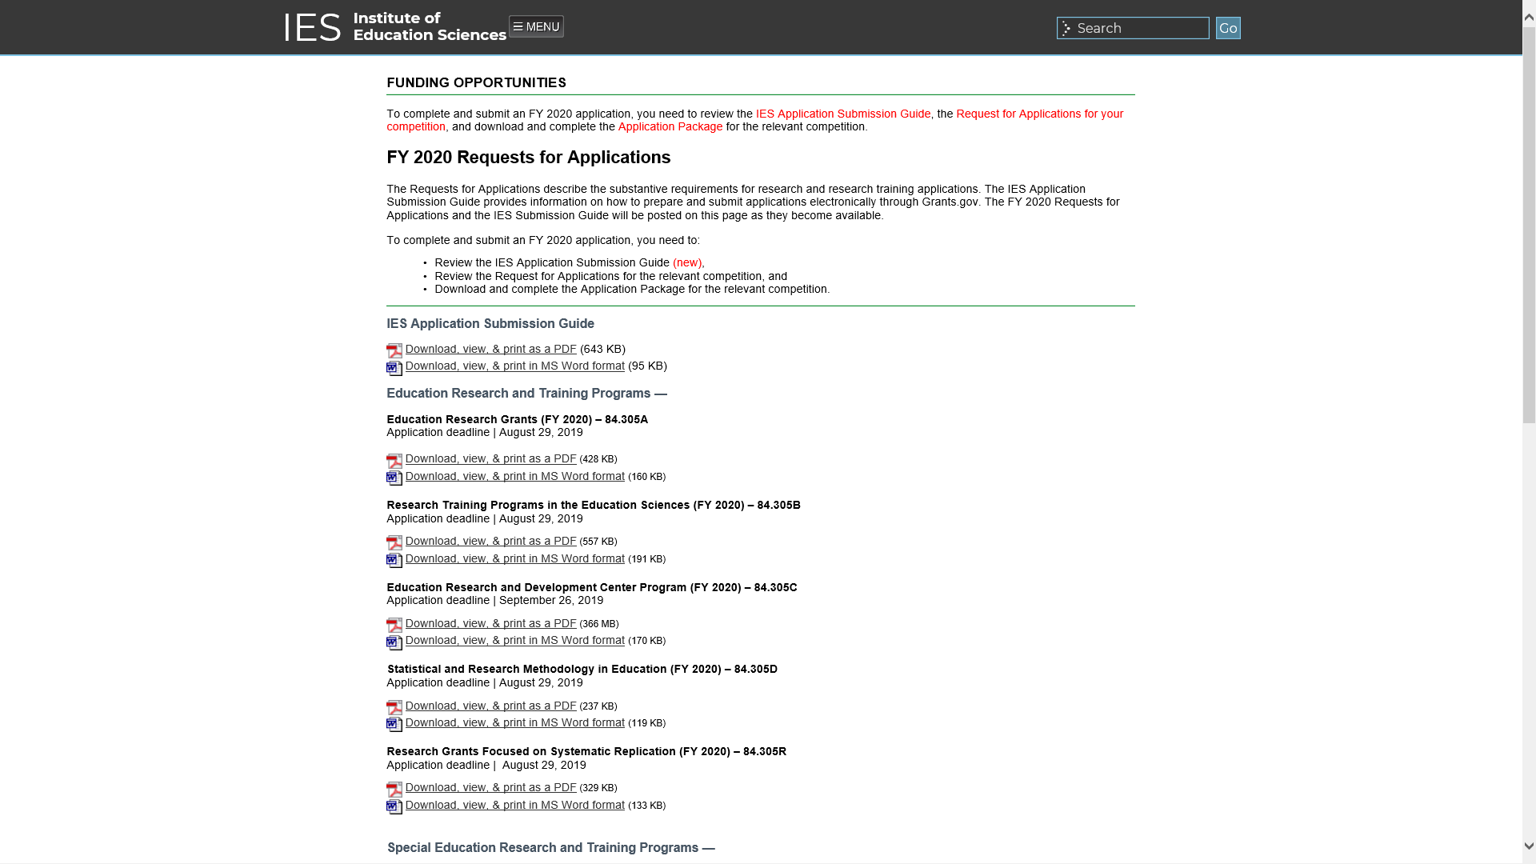
RFAs
Notes:
You can download RFAs either as a PDF or as a Word Document.

Slide 19
How to Use Grants.gov
Notes:
Now let’s turn to Grants.gov, where you will find the application package for your competition.

Slide 20
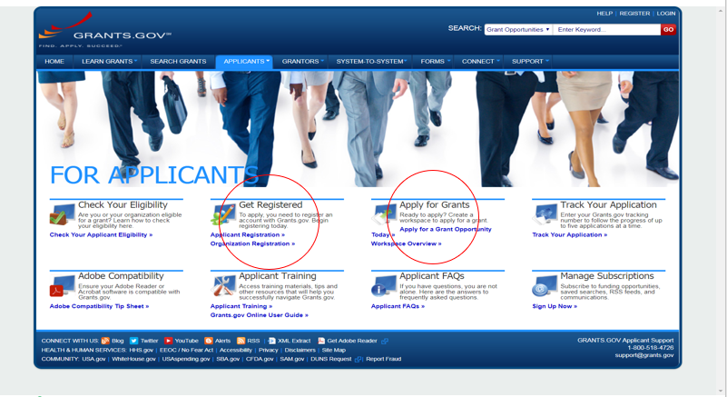
Where to Start on Grants.gov
Notes:
I recommend that you start on the “For Applicants” page on Grants.gov. Here you will find links to Get Registered and Apply for Grants – both circled in red. Start with registration to ensure your organization is registered in time to submit your application well in advance of the deadline date. More on that later.

Slide 21
Registration Overview
Organizations need these before using Grants.gov to apply for federal grants:
Data Universal Numbering System (DUNS) Number
Active System for Award Management (SAM) registration
Grants.gov Account: You only need one. Uses unique email, username & password.
Profile(s): Can have multiple within one Grants.gov account.
Notes:
Before you can register your organization on Grants.gov, you need a DUNS Number and an active System for Award Management, or SAM registration. Each organization only needs one Grants.gov account. Within each account, you can have multiple User Profiles to allow more than one person to work on a single grant application.

Slide 22
Get Registered
Notes:
Registration (and annual renewal) on Grants.gov involves multiple steps that can take several weeks depending on a variety of factors. Your Organization Registration in Grants.gov must be active in order to submit an application to IES. Make sure your organization registration is complete in plenty of time to meet the application deadline for your competition.

Slide 23
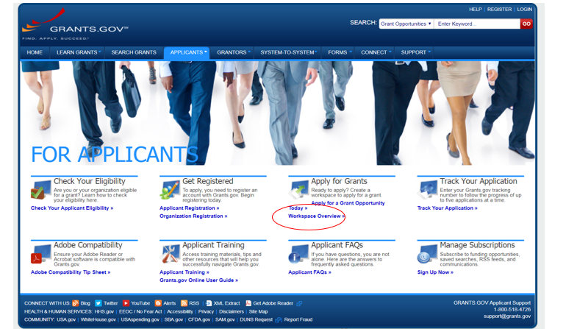
Apply for Grants
Notes:
Once you have attended to your organization’s registration status in Grants.gov, you will need to find the application package for your competition. Go to Apply for Grants and select “Apply for a Grant Opportunity Today.”
If you are not familiar with Workspace, you can read an overview of how to apply using Workspace here as well (circled in red).

Slide 24
Workspace Overview
Notes:
Workspace is the standard way for organizations to apply for federal grants in Grants.gov.

Slide 25
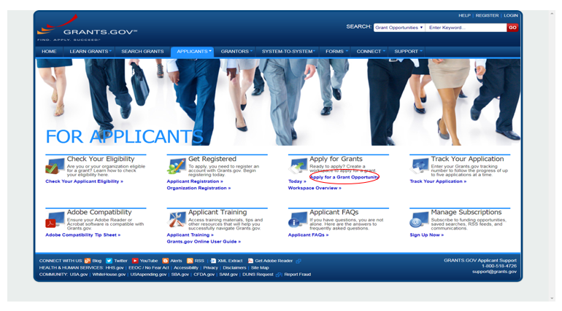
Apply for a Grant Opportunity
Notes:
Now let’s go to “Apply for a Grant Opportunity Today” and I’ll show you how to find the application materials for your competition.

Slide 26
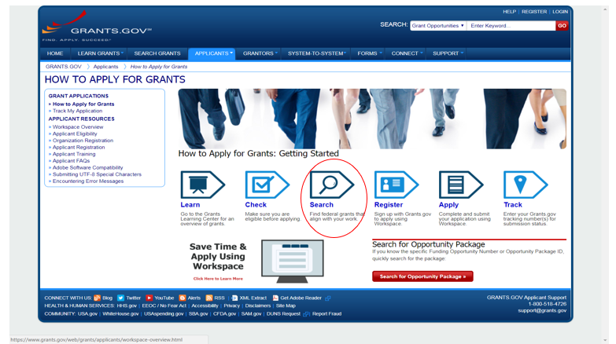
Use the Search function
Notes:
The easiest way to find the application package for your competition is to use the Search function in Grants.gov (circled in red)

Slide 27
Search by CFDA Number
Search by CFDA number without the alpha character
All NCER competitions use 84.305
All NCSER competitions use 84.324
Notes:
Search by CFDA number for the competition you wish to apply to, without the alpha character. As a reminder, all grant competitions offered by NCER use 84.305 as the CFDA number, and all those offered by NCSER use 84.324.

Slide 28
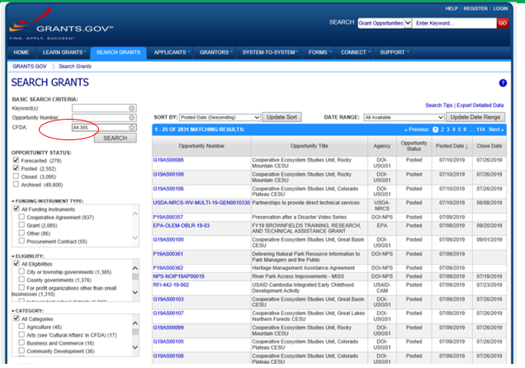
Enter CFDA (numbers only)
Notes:
Search by CFDA using the numbers only. Here, I’ve entered “84.305” in the search field (circled in red).

Slide 29
CFDA Search Results
Grants.gov search yields more than one application package
Download the application package designated for your competition
Look at the Opportunity Title and the CFDA number
Notes:
When you search by CFDA number (without the alpha character), you will get a list of all of the competitions offered. Make sure you select the Opportunity Title and CFDA number for your competition to get the correct package.

Slide 30
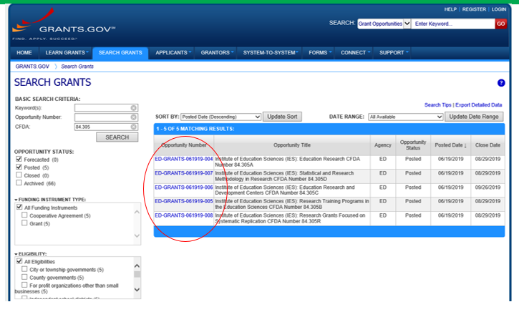
NCER Application Packages (CFDA: 84.305)
Notes:
Here is the result of a search by CFDA 84.305. This list (circled in red) shows the five NCER grant competitions that are accepting applications for FY 2020 funding. Click on the Opportunity Number to get to the application forms for each competition.

Slide 31
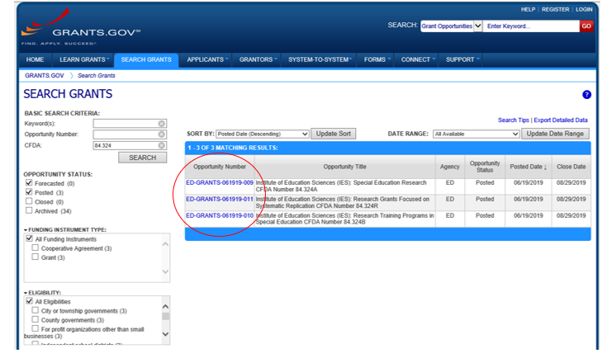
NCSER Application Packages (CFDA: 84.324)
Notes:
Here is the list of NCSER’s three funding opportunities when I search by CFDA 84.324. Again, click on the Opportunity Number to get to the application forms for your competition.

Slide 32
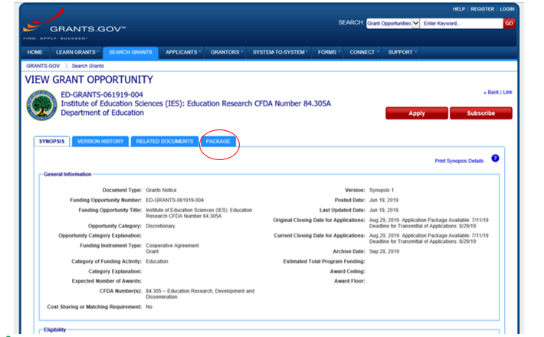
Grant Opportunity Example
Notes:
Here is the Grant Opportunity for Education Research (CFDA 84.305A). Click on the Package tab to view the application package and apply (circled in red).

Slide 33
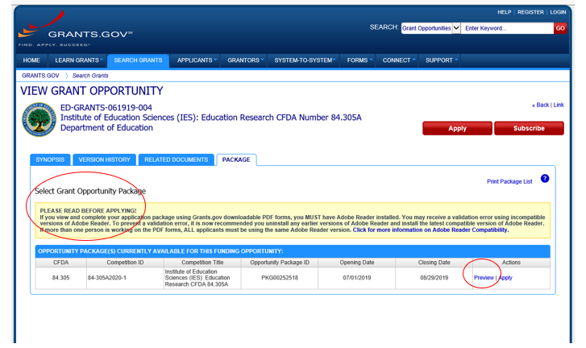
Preview Grant Opportunity
Notes:
Note the “Please Read Before Applying!” section - read these instructions to ensure that you have the correct version of Adobe Reader to view and complete the application package.
Click the Preview link to access read-only forms and application instructions before you apply.

Slide 34
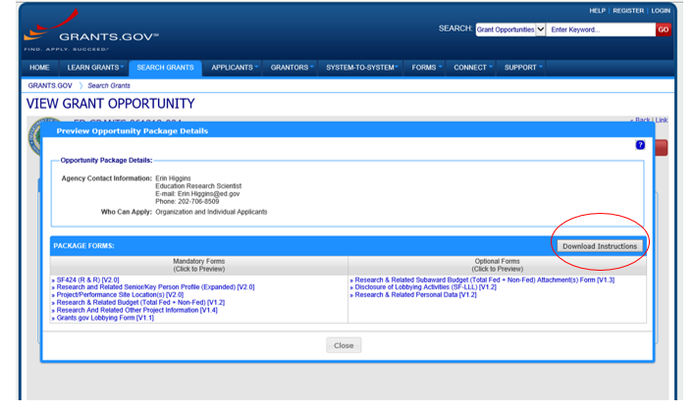
Mandatory and Optional Forms
Notes:
When you click Preview, you can see the mandatory and optional forms for this competition. If you click on any of these links it will take you to a preview of that form.
If you click “Download Instructions” (circled in red) you will open up a copy of the IES Application Submission Guide that is used for all IES grant competitions. As a reminder, the Application Submission Guide is also available on the IES website on the funding opportunities page.

Slide 35
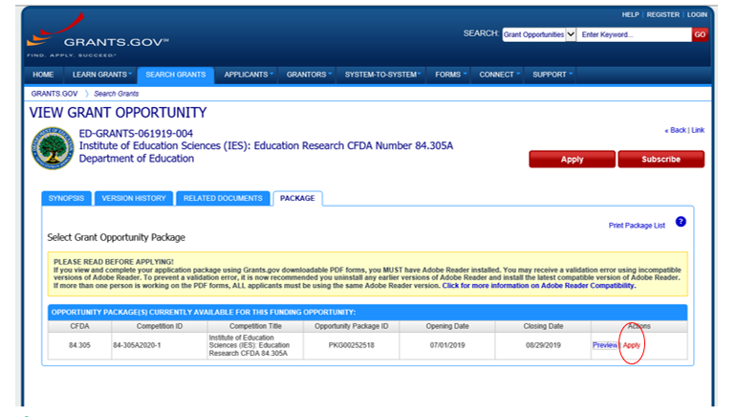
Apply for a Grant Opportunity (Continued)
Notes:
Back to the Package tab where you can click “Apply” to apply!

Slide 36
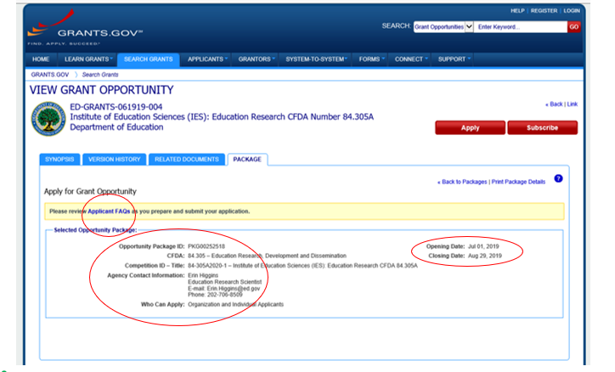
Opportunity Package
Notes:
Here, you can access Grants.gov’s Applicant FAQs, check the deadline (see Closing Date), and confirm you have found the correct application package (all circled in red). Here you can also find Agency Contact Information (an IES Program Officer) if you have any immediate questions for someone at IES about the application materials for your competition. When you’re ready, click the Apply button (upper right hand corner) to begin working on your application. You can work on the application before your Grants.gov registration is complete, however, your registration must be complete before you can submit your application.

Slide 37
Applying with Workspace
Notes:
Now I’ll show you how to apply using Workspace.

Slide 38
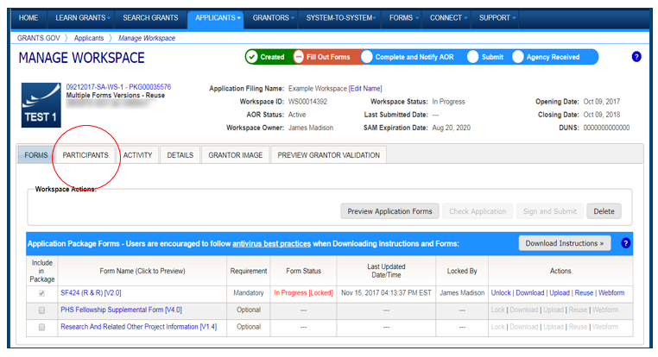
Example Workspace
Notes:
Workspace is a shared, online environment where you work on your grant application.
Multiple people may simultaneously access and fill out the mandatory and optional forms within an application. This is an example Workspace from Grants.gov to show you what the environment looks like. Now I’ll show you some features of the Workspace.
The Participants tab lists the members of a workspace who work as a team to complete the required forms for a federal grant.

Slide 39
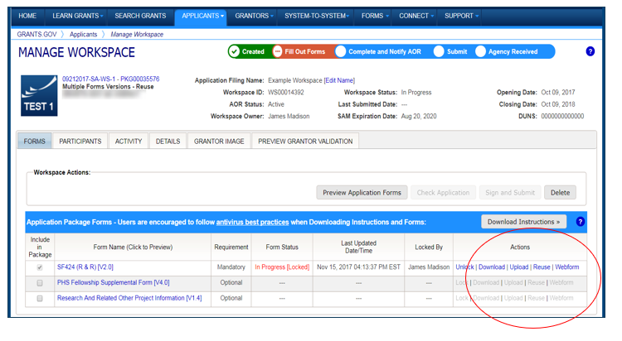
Completing Workspace Forms
Notes:
Under Actions (bottom right of the screen shot) you have several options.
Click Webforms to fill out the forms online
Click Download to complete PDF forms
Click Upload to submit completed PDF forms
Click Lock/Unlock forms to prevent other Workspace members from editing a form as needed
Click Reuse if you want to use a form from another workspace

Slide 40
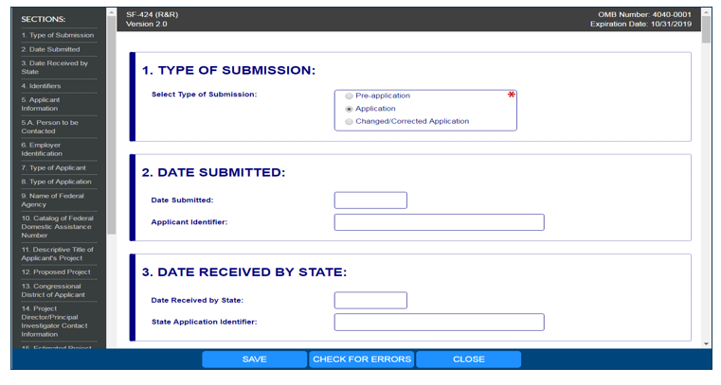
Completing Webforms
Notes:
Let’s review some basic features of the webforms.
Complete the form in your web browser
Navigate by clicking Sections (see left-hand side)
Use the “Tab” key to move through the form fields
Required fields are marked by a red asterisk

Slide 41
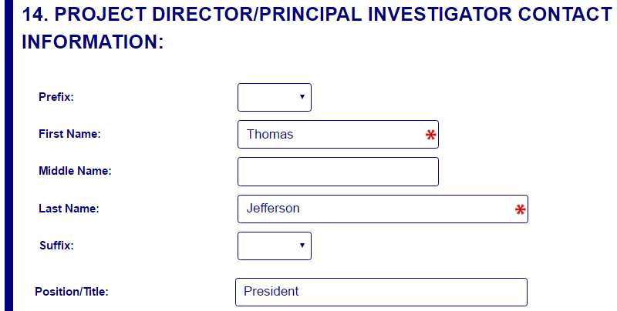
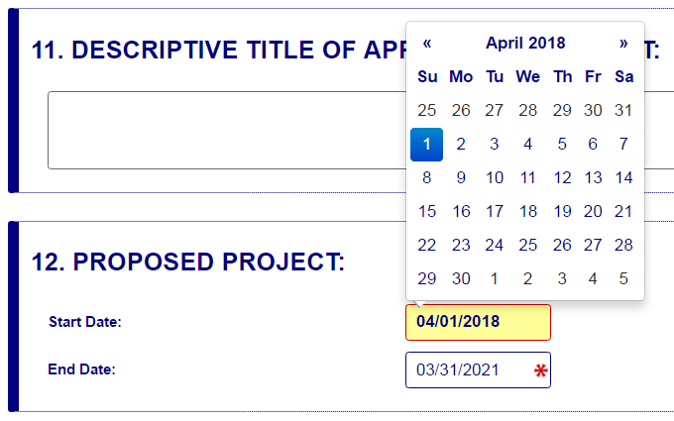
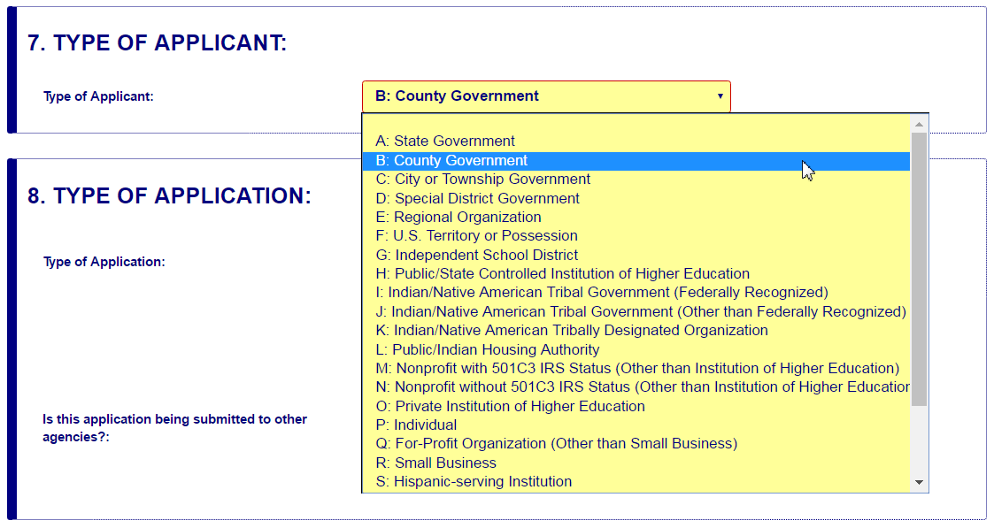
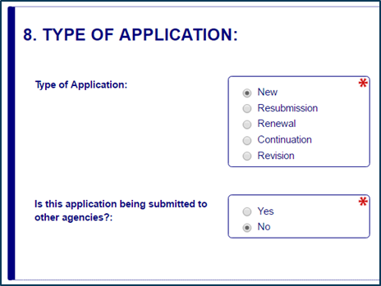
Enter Data
Open text entry
Dates/calendar
Drop-down menu
Radio buttons (multiple choice)
Notes:
You will enter information into the webform in a variety of ways, including entering your own text, using a drop down menu or using a pop-up calendar that allows you to choose dates, and selecting radio buttons for multiple choice fields

Slide 42
Completing Webforms (1 of 3)
Hover mouse over form fields for help
Pop-up messages explain how to fill out form fields
Notes:
If you need help while working on the webform, hover your mouse over the field where you will see a pop-up message that explains what is needed.

Slide 43
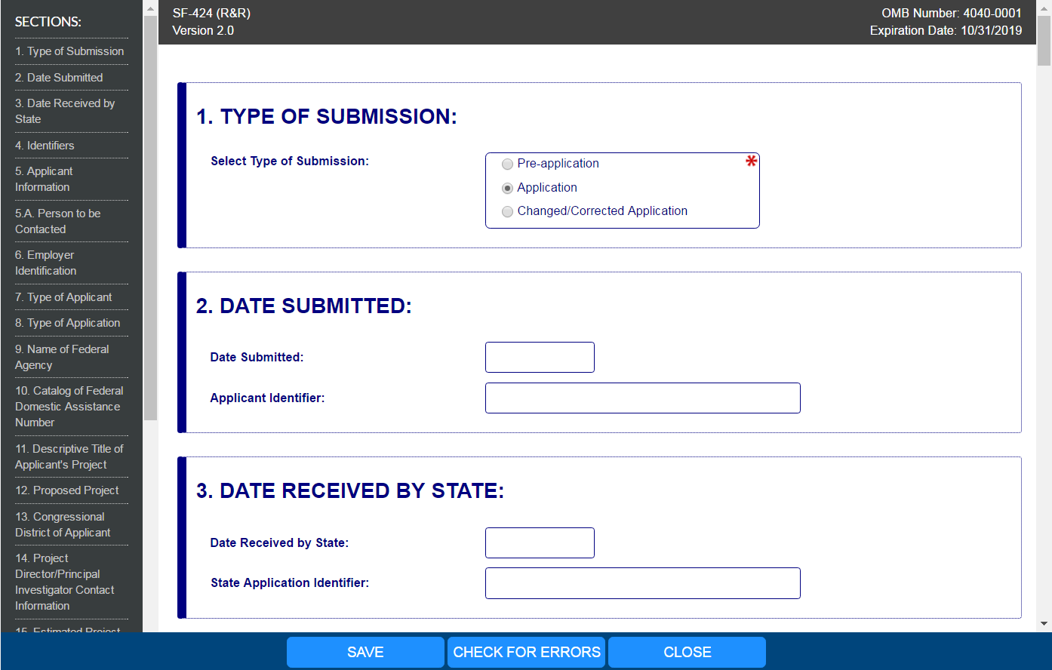
Completing Webforms (2 of 3)
Forms will auto save every 5 minutes
Complete the SF-424 Application for Federal Assistance form first to pre-populate fields in other forms in the application package
Notes:
Other features to note in webforms: they will autosave every 5 minutes. Also, you should complete the SF-424 Application for Federal Assistance form first because it will pre-populate other forms in the application package

Slide 44
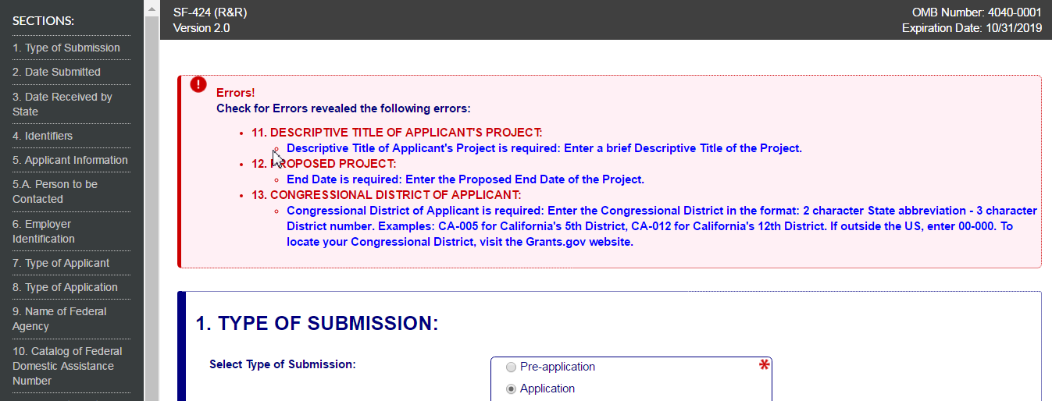
Completing Webforms (3 of 3)
Check for Errors: Form validation & field-level errors
Notes:
At the bottom of each webform, there is a tab “Check for Errors” that will tell you if there are any errors in the form. For example, if you haven’t filled in a field that is required, when you click the Check Package for Errors button you will get a message telling you what is needed.

Slide 45
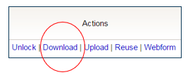
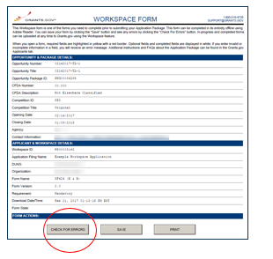
Completing PDF Forms (1 of 2)
PDF Form Basics:
Option to download PDF forms to complete in Adobe software
Upload PDF forms to Workspace
Notes:
If you don’t want to use the webform option, you can download the forms and complete them using Adobe software. Once completed, you then upload them to workspace. Note that the PDF forms also have a Check for Errors button.

Slide 46
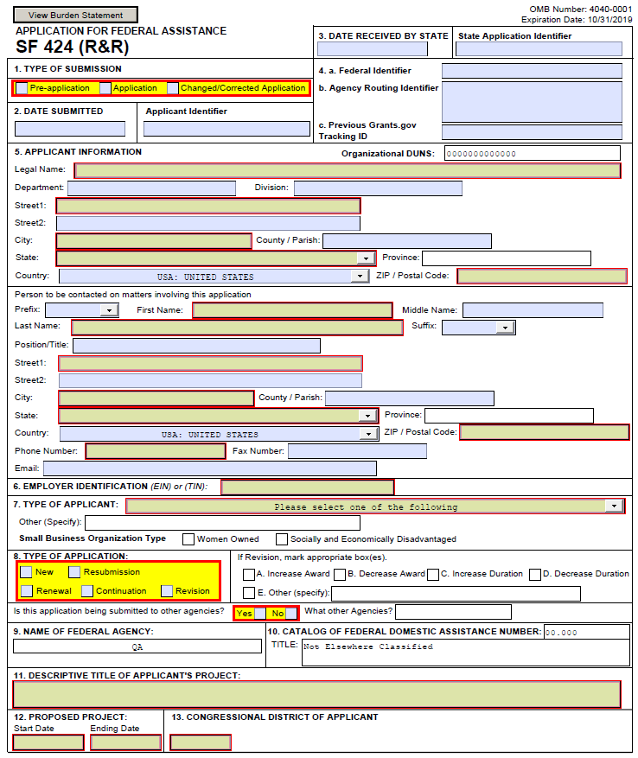
Completing PDF Forms (2 of 2)
PDF Form Basics:
Tab through form fields
Required fields are flagged
Hover mouse over form fields for help
Error messages explain how to fill out form fields
Notes:
If using PDF forms, you can move through the form using the Tab key. Note that required fields are flagged. As with the webforms, you can hover your mouse over form fields if you need help.

Slide 47
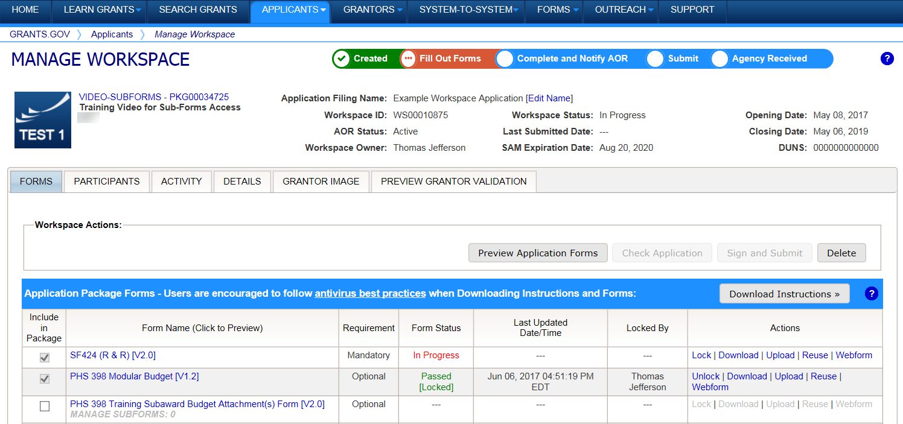
Reusing Workspace Forms
Workspace Features
Reuse past forms
Data retained for three years
Notes:
Whether using webforms or PDF forms, you always have the option of reusing a form. Grants.gov will keep your forms for three years.

Slide 48
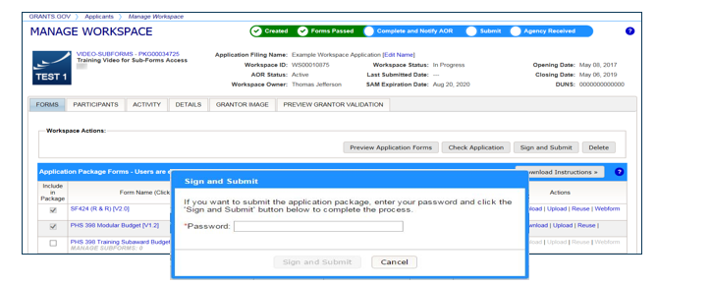
Workspace: Submit Application
Process:
Workspace Owner notifies users with AOR role to submit
Note you need your Grants.gov password to submit
Notes:
When you’re ready to submit your application, the Workspace Owner (the participant with that assigned role) must notify the Authorized Organization Representative (AOR) that it is ready to submit. The AOR is the Workspace participant with the authority to submit the application.
Also, please note that you need your Grants.gov password in order to submit the application.

Slide 49
More on Grants.gov
Notes:
Now, we will go over more features of Grants.gov to help you complete and submit your application successfully and on-time.

Slide 50
Grants.gov Software Requirements
Adobe software
To read and complete the application forms
To convert Word, Excel, or other documents to PDF documents
Grants.gov can help with checking software and downloading the version you need
Notes:
As noted earlier, you need Adobe software to read and complete the application forms. In addition, you will attach documents to the application forms that contain the substance of your application (more on that later). IES recommends that you use PDF files. If you need help converting your files to PDF, grants.gov has resources to check the version you have and download the version you need if you don’t have the correct version.
Note: If you can see the application package, you are able to complete and submit grant applications on Grants.gov.

Slide 51
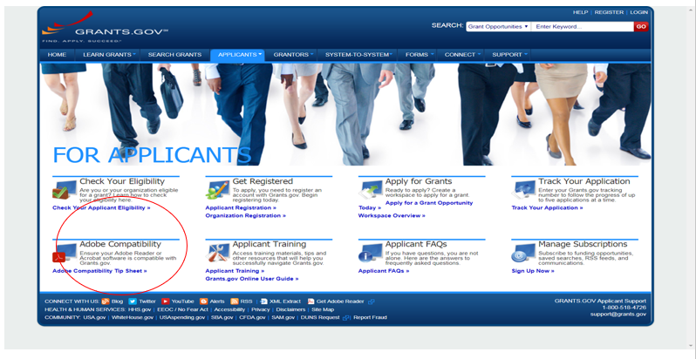
Adobe Resources on Grants.gov
Notes:
Back on the For Applicants page, there is a section on Adobe Compatibility (circled in red) that you can use to ensure you have the right version of Adobe to submit your application.

Slide 52
Application Submission
IES accepts applications submitted electronically using Grants.gov
IES does NOT accept applications by e-mail
This is NOT an official application, and it will NOT be sent forward for peer review
Notes:
You must submit your application through grants.gov. You cannot e-mail your application to the Program Officer. If you do that, your application will not be sent forward for peer review.

Slide 53
Grants.gov Submission (1 of 2)
Applications received by Grants.gov are date- and time-stamped
Your application must be…
Fully uploaded and submitted
Date- and time-stamped by the Grants.gov system
Submitted no later than 11:59:59 p.m. Eastern Time on the application deadline date – different dates for different competitions
Late applications will not be reviewed!
Notes:
Applications received by grants.gov are date and time stamped and the time is stamped to the second. Your application must be fully uploaded and submitted, and the date and time stamp must be no later than 11:59:59 p.m. Eastern Time on THE DUE DATE in order for IES to review your application.
Late applications will not be reviewed.

Slide 54
Grants.gov Submission (2 of 2)
IES will not accept your application in paper format unless you qualify for one of the following exemptions:
You do not have access to the Internet
You do not have the capacity to upload large documents to the Grants.gov system
Contact the relevant IES Program Officer (see RFAs) if you believe you qualify for this exemption
Notes:
IES will not accept your application in paper format unless you qualify for one of the following exceptions:
If you do not have access to the Internet or you do not have the capacity to upload large documents to the grants.gov system, then you can qualify for an exception to the online submission.
If you think you qualify for this exemption, contact the relevant IES program officer to explain your situation and learn more.

Slide 55
Grants.gov Submission Problems
If you have trouble completing the forms or submitting your application through Grants.gov
Contact Grants.gov First!
1-800-518-4726
support@grants.gov
Use Grants.gov’s Applicant FAQs
Notes:
If you have any trouble completing the forms in the application package or submitting your application through grants.gov, your first step should be to contact grants.gov. You can call their 800 number or send an email. When you contact Grants.gov for help, they will give you a case number that you need to keep. Once you have your case number, contact your IES Program Officer and let them know about the problem and the steps that you have already taken to remedy the problem.

Slide 56
Applicant FAQs
Notes:
On the Applicant FAQ page, Grants.gov provides several resources that may help if you are experiencing any difficulties with your application.

Slide 57
Late Applications
If Grants.gov determines there was a technical problem with their system, and that the problem caused the application to be late, you may email the relevant IES program officer to petition your case
However, IES will not accept an application that was late due to failure to follow Grants.gov’s submission guidelines
Notes:
IES does not accept late applications. If Grants.gov determines that there was a technical problem with the grants.gov system, and that the problem with the system affected your ability to submit your application on time, we will accept your application. If that is the case, email the IES program officer with your Grants.gov Case Number.
Please note, though, that the vast majority of the time, there is not a technical problem with Grants.gov; instead, it is a common error that leads to problems that slow you down and that could make your application late! IES will not accept an application that was late because the Grants.gov submission guidelines weren’t followed.

Slide 58
Track your application on Grants.gov
Use the Grants.gov “Track My Application” link to verify on-time, valid submissions
Use your assigned Grants.gov Tracking Number (e.g.,GRANT00234567)
Notes:
You can track your application on grants.gov using the Track My Application link to verify that your submission was on time and valid. You can track the application this way from the time you begin the upload process until IES receives the application and assigns a unique identifier.

Slide 59
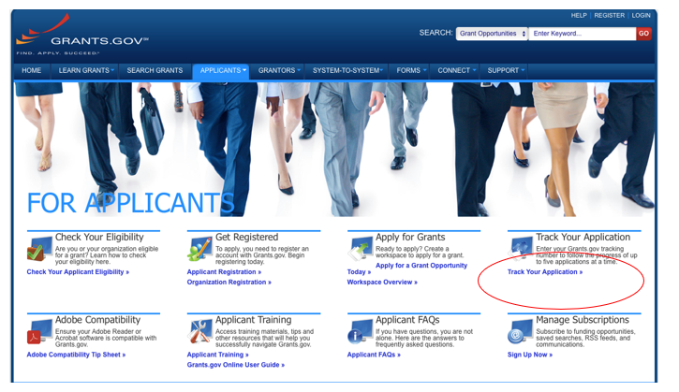
Track Your Application
Notes:
You access the Track My Application page from the For Applicants page where you can select Track Your Application.

Slide 60
Track and Check the Status of Your Application
Notes:
Enter the Grants.gov tracking number for your submission to follow your application’s progress through the Grants.gov system.

Slide 61
Grants.gov Submission Confirmation
Comes by email
3 emails from Grants.gov
Followed by a 4th email from the U.S. Department of Education
Notes:
You will get confirmation of your submission from grants.gov and IES in the form of four e-mails. The first three e-mails come from grants.gov, and the fourth e-mail comes from IES, U.S. Department of Education (ED).

Slide 62
From Grants.gov
First e-mail confirms that you have attempted to upload an application into the Grants.gov system
Application tracking number assigned (e.g.,GRANT00234567)
Second e-mail indicates…
EITHER application successfully validated by Grants.gov
OR application has been rejected due to errors
Third e-mail indicates…
U.S. Department of Education has retrieved application from Grants.gov.
Notes:
The first e-mail confirms that you have attempted to upload your application to grants.gov. At this point, your application will be assigned a tracking number that starts with G–R–A–N–T, grant. The second e-mail you receive will indicate either that your application has been validated by grants.gov or that your application has been rejected due to errors. If it has been rejected, you will need to go back and fix the errors. This is yet another reason that you should submit your application early, because you want to make sure you have enough time to fix any problems if your application is rejected. The third e-mail you receive from grants.gov indicates that the Department of Education has retrieved your application.

Slide 63
Department of Education Confirmation
You will receive a 4th e-mail from the U.S. Department of Education with a PR/Award number unique to your application (e.g., R305X20XXXX or R324X20XXXX).
Use this number to track your application from this point forward.
If your application is late (as determined by Grants.gov), this email will state that it was late and your application will not be given further consideration.
Notes:
This final email contains an identifier, called a PR/Award number, that is unique to your application. It will start with R, then 305 or 324 depending on which center you submitted your application to, and then the letter of the competition and a series of digits. Once you get this PR/Award number, use this R305 or R324 number to track your application on the IES Peer Review Website, which I will describe next. If your application was submitted late, this e-mail will state that it was late and that it will not be given further consideration.

Slide 64
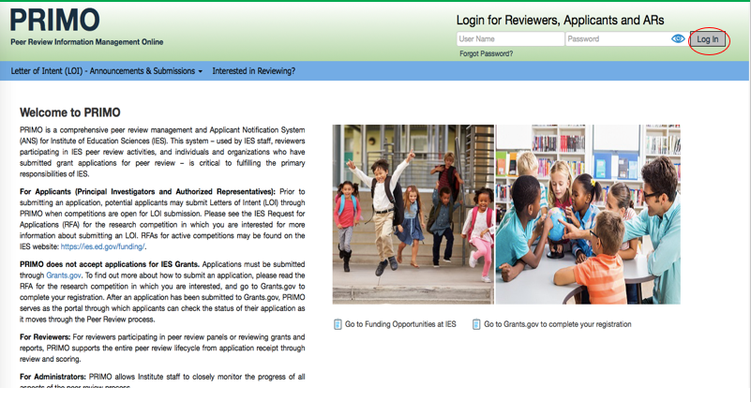
PRIMO
Notes:
IES has a peer review website called PRIMO – Peer Review Information Management Online. After submitting your application, you will be invited to set up your PRIMO applicant account to keep track of the status of your application as it is reviewed.

Slide 65
IES Peer Review Website
PRIMO: Peer Review Information Management Online
A few weeks after the application deadline, look for up to 3 emails from IESHelp@prsmhosting.com
1st email: Subject line “IES – PRIMO Applicant Notification System (ANS) – Status of Application (Part 1 of 2) “ provides login information
2nd email: Subject line “IES-PRIMO Applicant Notification System (ANS) – Status of Application (Part 2 of 2) “ provides password
3rd email (or 1st email if you already have an ANS Account): Subject line “FY2020 Application Status Update – Institute of Education Sciences – PRIMO ANS” tells you to login to PRIMO to see the status of your application.
Contact the relevant program officer if you do not receive these emails
Notes:
A few weeks after the application deadline you will receive up to 3 emails about PRIMO’s Applicant Notification System (ANS). From this point forward, all communication about the status of your grant application will come from this system.
The 1st email has the subject line “IES – PRIMO Applicant Notification System (ANS) – Status of Application (Part 1 of 2)“ and provides login information
The 2nd email has the subject line “IES-PRIMO Applicant Notification System (ANS) – Status of Application (Part 2 of 2) “ and provides password information
The 3rd e-mail (or 1st email if you already have an ANS Account) has the subject line “FY2020 Application Status Update – Institute of Education Sciences – PRIMO ANS” and tells you to login to PRIMO to see the status of your application.
If you do not receive these emails, please contact your IES program officer so we can help you get set up.

Slide 66
What’s included in an application?
Notes:
Hello, this is Sarah Brasiel from the National Center for Special Education Research and I am now going to continue this webinar and talk about what is included in an application.

Slide 67
Application Contents
Forms
Research & Related (R&R) Forms (SF 424 form family)
Assurances
PDF File Attachments
Project Summary/Abstract
Project Narrative
Appendices (SOME ARE REQUIRED, SOME ARE NOT)
Bibliography & References Cited
Human Subjects Narrative
Narrative Budget Justification
Biographical Sketches of Key Personnel (including Current and Pending Funding)
Notes:
An application consists of several important forms – the SF-424 Research and Related, or R&R, form family – and PDF files with the substantive content of your application that are attached to the forms. This substantive content includes a project abstract, a Project Narrative, several appendices (some of which are required, some optional), a reference list, a human subjects narrative, and bio sketches for key personnel.

Slide 68
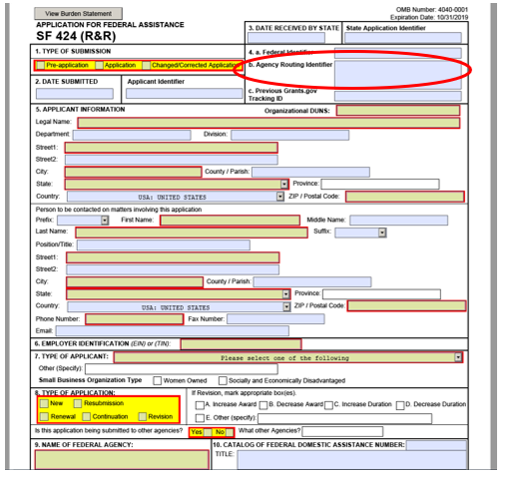
SF 424 (Cover Sheet)
Notes:
This is the SF424 cover sheet. As mentioned earlier, you should fill this form out first because it will pre-populate the other forms in the application package.
Please note Item 4B, the Agency Routing Identifier. This is not a required form field according to Grants.gov, but IES would like you to enter information into this field to help us make sure your application is routed appropriately.
Please reference the Application Submission Guide page 24-26 to find the appropriate Agency Routing Number.

Slide 69
Item 4b “Agency Routing Identifier”
This item is used to…
Screen applications for responsiveness to the competition requirements
Assign applications to the appropriate scientific peer review panel
Your application may be rejected as nonresponsive or assigned inaccurately for scientific review of merit if this field is not completed using the correct codes (see Request for Applications for codes)
Notes:
The Agency Routing Identifier, Item 4B, is used to screen applications for responsiveness and to assign applications to the appropriate scientific peer review panel. If your application doesn’t include an agency routing identifier or if it is incorrectly identified, your application may be rejected as nonresponsive or assigned inaccurately for scientific review.

Slide 70
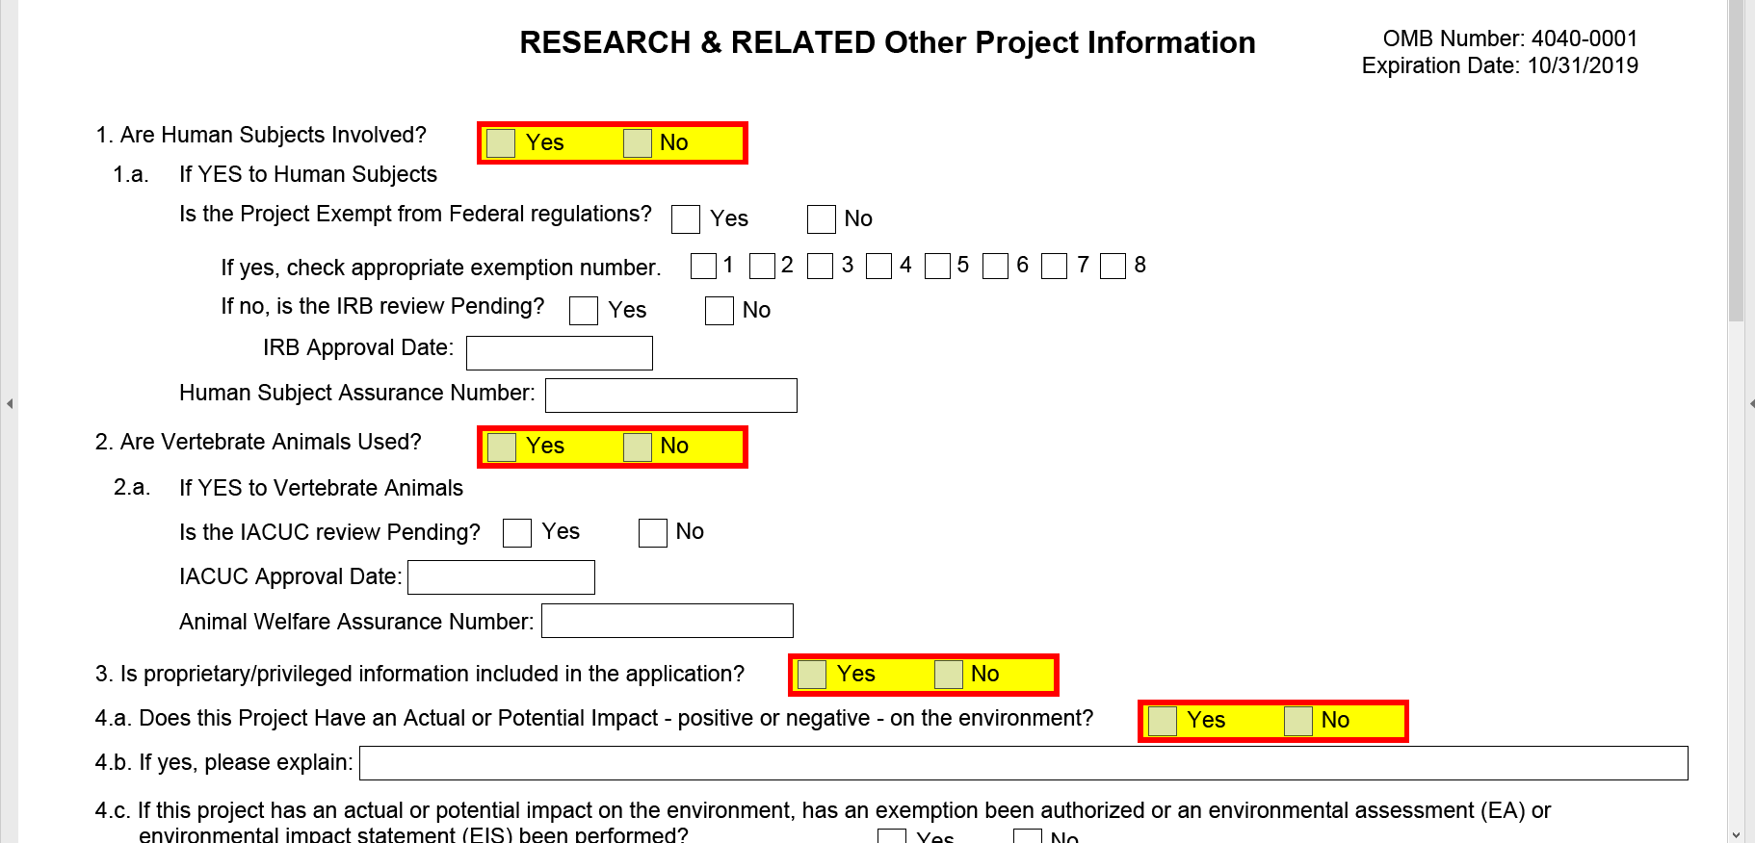
Other Project Information Form
Notes:
This is the Other Project Information form (shown on slide), which is where you will attach the substantive portions of your application, like your project abstract and narrative. All attachments must be PDF files.

Slide 71
Important Tips for PDF Files
PDF files are the only approved file type accepted by the Department of Education
PDF files must be:
in a read-only, non-modifiable, “flattened” format
given a unique file name
No more than 50 characters
Avoid special characters
individual files (no PDF Portfolio, interactive, or fillable files)
not password protected
Notes:
The Department of Education will only accept an application that uses PDF files as attachments. The forms included in the application package provide the means for you to attach Adobe Portable Document Format (PDF) files. You must attach read-only, non-modifiable, “flattened” PDF files; any other file attachment will not be accepted by the Department.
Grants.gov has additional requirements for PDFs, including a unique name for each file, names that are no more than 50 characters and that avoid special characters. Finally, you must use individual files that are non-fillable and not password protected. See Grants.gov’s Applicant FAQs for more information about PDF files.

Slide 72
PDF Attachments
The Substantive Content of Your Application
Notes:
Next I will talk about PDF Attachments. The substantive content of your application.

Slide 73
Project Summary/Abstract
Recommended Page Length: no more than 1 page, single-spaced
Attach at #7 on the “Other Project Information” form
***Include the research topic (and project type for 305A and 324A) in the Abstract and make sure this information agrees with Item 4b of SF 424 (R&R) Application for Federal Assistance.
Notes:
The Project Summary or Abstract has a page limit of one page single-spaced. You should add it as a PDF file attachment under number seven on the Other Project Information form. Make sure that you adhere to margins and formatting recommendations, which we are going to go over later. You should include your research topic and project type in the Project Summary or Abstract if you are applying to 84.305A or 84.324A. This information should match the information provided in Item 4B of the SF424 form.

Slide 74
Project Narrative (1 of 2)
Recommended Page Length: see the relevant RFA, typically no more than 25 pages
Attach at #8 on the “Other Project Information” form
Notes:
Project Narratives have varying recommended page limits and it depends on the competition to which you are applying, so make sure that you check the RFA to determine your recommended page limit for your Project Narrative. The Project Narrative should be added as an attachment under Item number eight on the Other Project Information form.

Slide 75
Project Narrative (2 of 2)
Four (or five) sections (see relevant RFA):
Significance
Research Plan
Personnel
Resources
Information for each section is detailed in the RFA:
Part II: Topic Requirements
Part III: Project Type Requirements (for 305A and 324A)
Notes:
The Project Narrative has four or five sections depending on the competition to which you are applying, so you should read the relevant RFA. Most of the applications will have Project Narratives that include Significance, Research Plan, Personnel, and Resources sections. Information for each of these sections is detailed in the RFA.

Slide 76
Appendices
See relevant RFA for information about appendices
Appendices and alpha codes (A-F) vary by competition
Some are required, some are not
Notes:
See relevant RFA for information about appendices. Appendices and alpha codes (A-F) vary by competition. Some are required; some are not.

Slide 77
Appendix A: Dissemination Plan
Recommended Page Length: no more than 2 pages, single-spaced
Include at end of the Project Narrative and submit as part of the same PDF file attachment
Notes:
Dissemination plans should be tailored to the audiences that may benefit from the findings and reflect the unique purposes of the research goals.
Appendix A: Dissemination Plan is Required
It should be included at the end of the Project Narrative and submitted as part of the same PDF file attachment. In other words, the same file as your Project Narrative should also include Appendix A at the end. Make sure you adhere to margin, format, and font size recommendations.

Slide 78
Appendix B: Resubmissions - Response to Reviewers
Recommended Page Length: no more than 3 pages, single-spaced
Include at end of the Project Narrative after other appendices and submit as part of the same PDF file attachment
This is Required for Resubmissions only
Describe how revised proposal is responsive to prior reviewer feedback
Indicate prior application number
Notes:
Appendix B: Response to Reviewers is Required for Resubmission
Appendix B should be 3 pages single-spaced. This appendix is required for resubmissions only. For resubmissions, you must use up to three pages to describe how your revised proposal is responsive to prior feedback from the reviewers. Make sure you indicate your prior application number in those three pages in Appendix B.

Slide 79
Appendix C: Supplemental Charts, Tables, and Figures
Recommended Page Length: no more than 15 pages, single-spaced
Include at the end of the Project Narrative and submit as part of the same PDF file attachment
Notes:
Appendix C: Supplemental Charts, Tables, and Figures is Optional. Appendix C has a recommended page limit of 15 pages single-spaced. It should be included at the end of Appendix B and submitted as part of the same PDF file attachment. Make sure you adhere to margin, format, and font size recommendations.

Slide 80
Appendix D: Examples of Intervention or Assessment Materials
Recommended Page Length: no more than 10 pages, single-spaced
Include after the Project Narrative and submit as part of same PDF file attachment
Notes:
Appendix D: Examples of Intervention or Assessment Materials is Optional
Appendix D has a recommended page limit of 10 pages single-spaced. It should be included at the end of Appendix C and submitted as part of the same PDF file attachment. Make sure you adhere to margin, format, and font size recommendations.

Slide 81
Appendix E: Letters of Agreement
Recommended Page Length: None
Include at end of the Project Narrative and submit as part of same PDF file attachment
Notes:
Appendix E: Letters of Agreement is Optional
Appendix E has no page limit. It should be included at the end of Appendix D and submitted as part of the same PDF file attachment. Again, make sure you adhere to margin, format, and font size recommendations.

Slide 82
Appendix E. Include letters of agreement from research partners
E.g., schools, districts, consultants
Letters should clearly indicate understanding of time, space, and resources that will be required if the application is funded
Do not reduce the size of the letters
But, scanned documents can increase the size of your application, which may take longer to upload – make sure you don’t miss the 11:59:59 pm Eastern Time deadline!
Notes:
Appendix E should include letters of agreement from your research partners; that may be schools or districts, it may also be consultants who will work on your project. Do not reduce the size of the letters. Make sure they are full-size. The letters should clearly indicate an understanding of the time, space, and resources that will be required of the partner if the application is funded.
If you include scanned documents as part of a PDF file- for example, Letters of Agreement in Appendix E-scan them at the lowest resolution to minimize the size of the file and expedite the upload process. PDF files that contain graphics and/or scanned material can greatly increase the size of the file attachments and can result in difficulties opening the files. The average discretionary grant application totals 1 to 2 MB; therefore, check the total size of your application package before you attempt to submit it. Very large application packages can take a long time to upload, putting the application at risk of being received late and therefore not accepted by the Institute.

Slide 83
Appendix F: Data Management Plan
Recommended Page Length: no more than 5 pages, single-spaced
Include at end of the Project Narrative and submit as part of same PDF file attachment
See RFA to determine if your application requires a DMP
Notes:
Appendix F: Data Management
Appendix F, the data management plan, is required only for the Initial Efficacy and Follow-Up project types, under 305A and 324A. There is a page recommendation of five pages single-spaced. Appendix F should be included at the end of Appendix E and submitted as part of the same PDF attachment. Make sure you adhere to margin, format, and font size requirements.
See your particular RFA to determine if your application requires a Data Management Plan

Slide 84
Bibliography & References Cited
Recommended Page Length: None
Use APA style
Attach at #9 on the “Other Project Information” form
Include complete citations
Notes:
For your bibliography and references cited, there is no page recommendation. You should use APA style; that is the American Psychological Association style. You should add the references as a PDF file under number nine on the Other Project Information form. Make sure you adhere to margin, format, and font size recommendations and that your citations are complete.

Slide 85
Human Subjects Narrative
Recommended Page Length : None
Attach at #12 (“Other Attachments”) on the “Other Project Information” form
Submit exempt research narrative or nonexempt research narrative
Notes:
The Human Subjects Narrative has no page limit, and again, it should be added as an attachment, a PDF file, on number 12 on the Other Project Information form. Note that Item 12 on that form says Other Attachments, it does not specifically say Human Subjects Narrative, but that is where you want to upload your file. So you either need to submit an exempt human subjects narrative or a nonexempt human subjects narrative.

Slide 86
Human Subjects Narrative: Exempt
6 exemptions (see Department’s website)
Include information on involvement of human subjects to determine whether exemptions are appropriate
Notes:
You can learn more about exemptions on the Department’s website – provide enough detail to determine whether the exemption is appropriate or not.

Slide 87
Human Subjects Narrative: Nonexempt
Include…
Human subjects involvement and characteristics
Sources of materials
Recruitment and informed consent
Potential risks
Protection against risk
Importance of the knowledge to be gained
Collaborating sites
Notes:
If you are conducting nonexempt human subject work, your narrative should include the involvement and characteristics of the human subjects, the sources of materials and data, the recruitment and informed consent process, discussion of potential risks and protection against those risks, the importance of the knowledge to be gained, and collaborating sites.

Slide 88
Research & Related Budget (Total Fed+Non-Fed) Form
Notes:
Next we are going to talk about the budget form.

Slide 89
Common Mistakes Applicants Make When Filling Out the Budget Form
Notes:
In this section I will review some of the common mistakes that we see in budget forms.

Slide 90
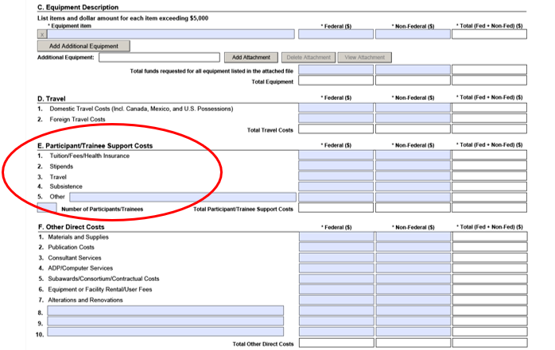
Participant/Trainee Support Costs
Notes:
Section E. Participant/Training Support Costs (circled in red) should only be used for training grant applications (305B or 324B).

Slide 91
Time Commitment of Senior/Key Personnel
Fill in the Calendar months or the Academic and Summer Months that each key person will be working in each project year.
IES wants to know level of effort over the calendar year (include percentage of 12-month period for each key person in narrative budget justification)
Notes:
The next common mistake we see is the Time Commitment of Senior and Key Personnel. Under the Senior Key Person Profile is where you enter the information for your key personnel, including the current and pending support as an attachment.
For the time commitment of each person, on the SF424 budget form, make sure you fill in the calendar months or the academic plus summer months that they will be devoting to the project.

Slide 92
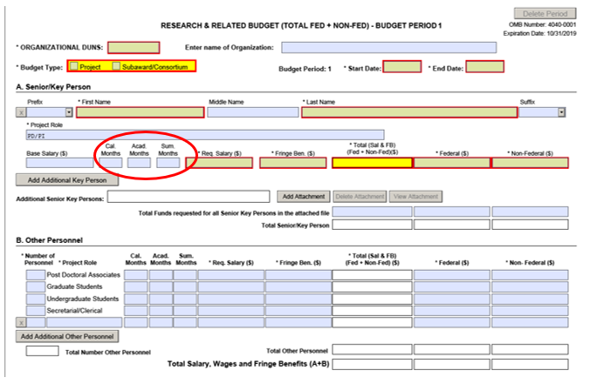
Time Commitment of Senior/Key Personnel
Notes:
You will see that months is circled in red.

Slide 93
Budget Maximums
IES sets budget maximums for grants
Budget maximums vary by RFAs, Topics, and Research Project Types
Make sure that your budget does not exceed the maximum allowed
Notes:
IES sets budget maximums for grants. Budget maximums vary by RFAs, topics, and research project types. Make sure that your budget does not exceed the maximum allowed.

Slide 94
Narrative Budget Justification
Recommended Page Length : None
Create a single document with budget justification for all years of the entire project
Attach to the R&R Budget (Total Federal + Non-Federal) form at Section L of the first budget period
Notes:
For the budget, you also need to include a Narrative Budget Justification. The Narrative Budget Justification has no page limit, and you should add it as an attachment, a PDF file, to the R&R Budget form. Adhere to margin, format, and font size recommendations. This should be a single document with all of the budget justification for all years of the entire project in one file. Attach this file at Section L of the first budget period.

Slide 95
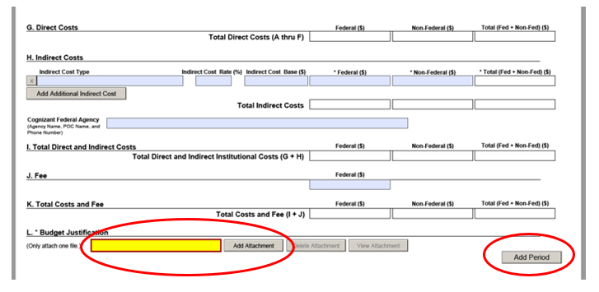
Research & Related Budget (Total Fed+Non-Fed) Form (Continued)
Notes:
This is what the form looks like (on the slide), and you can see that toward the bottom there in red I have circled where you add the Narrative Budget Justification. Notice also the circle at the bottom right corner, that says, “Add Period.” That is how you add another period for multiple year projects.

Slide 96
Narrative Budget Justification
Provide sufficient detail to allow reviewers and IES to judge whether costs are reasonable
Make sure narrative justification aligns with budget
To allow for easy cross-checking, organize narrative justification
EITHER within year by category
OR within category by year
Notes:
Your Narrative Budget Justification should provide sufficient detail to allow reviewers and IES to judge whether your costs are reasonable. Make sure your Narrative Budget Justification aligns with the budget. In other words, make sure that the numbers in your narrative match the numbers on your form. We recommend that, in order to allow for easy cross-checking, you organize either within year by category or within category by year.

Slide 97
More on the Narrative Budget Justification
Subawards should not duplicate costs in main award
Include time commitments (calendar year % effort) and descriptions of responsibilities of PI and other key personnel
Clearly indicate cost-shares
Donation of personnel time, lab space, etc.
Notes:
Sub-awards, if you have them, should not duplicate the costs in the main award. Include the time commitment and descriptions of responsibilities for the principal investigator and other key personnel. You need to clearly indicate cost shares in your Narrative Budget Justification, if you have them.

Slide 98
The Indirect Cost Rate
Use institution’s negotiated federal indirect cost rate
Use off-campus indirect cost rate when appropriate following the terms of your institution’s negotiated agreement
Don't include as direct costs things that are really indirect costs (as defined by your negotiated agreement)
Indirect cost rate agreement must be in place at the time of the award to claim indirect costs
Notes:
For the Indirect Cost Rate you need to use your institution’s negotiated federal indirect cost rate. You should use the off-campus indirect cost rate when appropriate following the terms of your institution’s negotiated agreement. Do not include as direct costs things that are really indirect costs. You need to check your negotiated agreement and make sure that you are only including indirect costs in this category. The Indirect Cost Rate Agreement must be in place at the time of award in order for you to claim indirect costs.

Slide 99
Subaward Budget
Use R&R Subaward Budget (Fed/Non-Fed) Attachment(s) Form
Listed under Optional Documents
Extract and attach a budget form (PDF document) for each institution that will hold a subaward on the grant
Separate budgets are required only for subawardee/collaborating organizations that perform a substantial portion of the project
Notes:
Use the R&R Sub-Award Budget Attachment forms if you have sub-awards. This is listed under Optional Documents. If you don’t have any sub-awards, you don’t need to complete this optional document, but if you do, then you need to complete this form, extracting and attaching budgets for as many sub-awards as you are including. You need to extract and attach a budget form for each institution that will hold a sub-award. Separate budgets are required only for those sub-awardees and collaborating organizations that perform a substantial portion of the work.

Slide 100
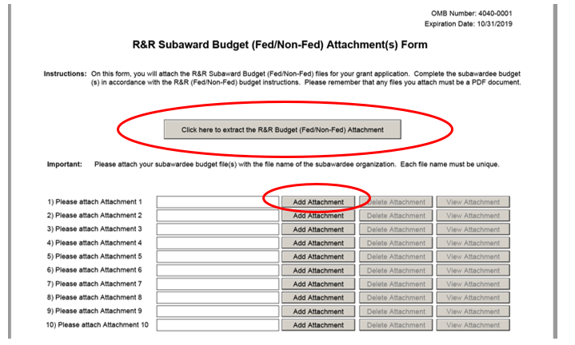
R&R Subaward Budget (Fed/Non-Fed) Attachment(s) Form
Notes:
This is what the R&R Sub-Award Budget Form looks like (shown on slide). You will notice the big red circle is where you click to extract the form. The small red circle shows you where you would attach the form once it is complete. You need a separate form for each sub-award. If you have three sub-awards, you need to extract the form three times, fill in each one, save each with a unique name following Grants.gov instructions for naming these PDF files, and then attach each to this form under one, two, and three.

Slide 101
Biographical Sketches of Key Personnel
Attach as a single PDF file for each key person
Recommended Page Length : 5 pages (i.e., a 4-page abbreviated c.v. and a 5th page listing grant support)
Attach this PDF at “Attach Biographical Sketch” field of Research & Related Senior Key/Person Profile (Expanded)
The Institute encourages you to use the IES Biosketch available through SciENcv or you may develop your own biosketch format.
Notes:
Next, we are going to talk about the biographical sketches for key personnel. You should attach a single PDF file for each person. Each biographical sketch is limited to four pages. For example, many people submit an abbreviated curriculum vita (CV). Each biographical sketch needs to adhere to margin, format, and font size recommendations. It should be attached as a PDF at the Attach Biographical Sketch field of the Research and Related Senior Key Personnel Profile. The Institute encourages you to use the IES Biosketch available through SciENcv or you may develop your own biosketch format.

Slide 102
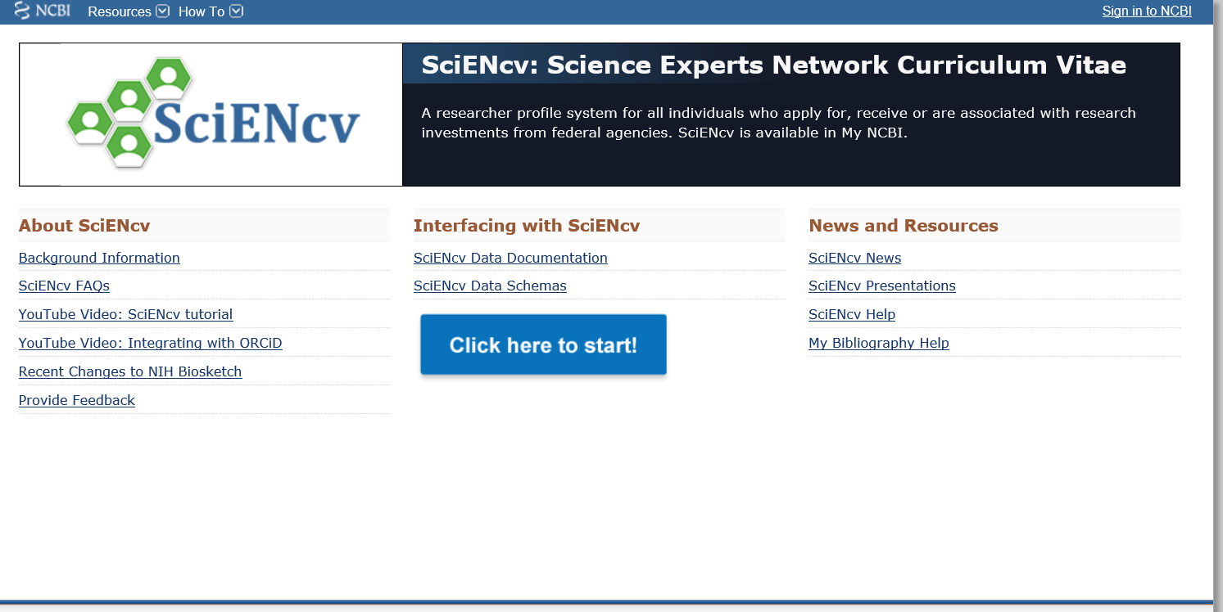
IES Biosketch
Notes:
You can find the IES Biosketch here – To begin you click the blue button

Slide 103
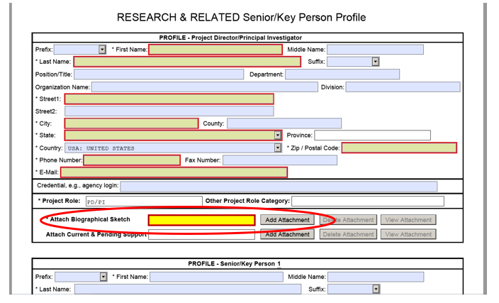
Attach Biosketch to the Senior/Key Person Profile form
Notes:
This is where, circled in red at the bottom (shown on slide), you would attach the biographical sketch, and you need to do it separately for each key person.

Slide 104
Other Mandatory Forms
Notes:
There are a few other mandatory forms that you need to fill out for your application.
The first is the Project Performance Site Location form. The second is the Assurances for Non-Construction Programs, and the third is the Grants.gov Lobbying Form (formerly the ED Combined Assurances form). I am going to show you what they look like (on the next few slides).

Slide 105
Project Performance Site Location Form
Notes:
This is the Project Performance Site Location form (shown on slide).

Slide 106
Assurances for Non-Construction Projects Form
Notes:
This is the Assurances for Non-Construction Projects form (shown on slide).

Slide 107
Certification Regarding Lobbying Form
Notes:
This is the Grants.gov Lobbying Form (formerly the ED Combined Assurance form) (shown on slide).

Slide 108
Formatting Recommendations
Notes:
Our last topic will be application format recommendations.
To strive for consistency across applicants, we provide formatting recommendations.

Slide 109
Formatting PDF Files (1 of 3)
Page
8.5-inch X 11-inch
On one side only
1-inch margins at top, bottom, and both sides
Notes:
The same format recommendations are used for the Abstract, the Project Narrative, the appendices, the bibliography, the Human Subject Narrative, Narrative Budget Justification, biographical sketches, and list of current and pending support—in other words, everything that you need to create on your own as opposed to just filling out a form. A page is defined as 8-1/2 by 11 inches and one side. We recommend having a 1-inch margins at the top, bottom, and both sides of the page.

Slide 110
Formatting PDF Files (2 of 3)
Type size/font size
12-point font
Type density, including characters and spaces, no more than 15 characters per inch (cpi)
No more than 6 lines of type within a vertical inch
Spacing
Text single-spaced
Notes:
We recommend that the height of your letters not be smaller than 12-point, and your type density, including both characters and spaces, must be no more than 15 characters per inch. We suggest making sure you have no more than six lines of type within a vertical inch. In general, if you use a 12-point Times New Roman font and single-spacing, you should be fine on all of these type size and font size recommendations. We recommend these things for two reasons: first, so that we make sure that your text is legible for all of our reviewers, but also to ensure that everyone has the same amount of space for their Project Narrative and all the other components of your application.

Slide 111
Formatting PDF Files (3 of 3)
Graphs, Diagrams, Tables, and Charts
Graphs, diagrams, tables, and charts should reproduce well in black and white
Figures, charts, tables, and figure legends may be smaller in size but must be readily legible
Notes:
If you have graphs, diagrams, and tables, which you are allowed to have, you should make sure that they reproduce well in black and white. So make sure, for instance, if you have some kind of pie chart or bar graph, that in black and white you can tell the difference between the different sections of the pie or different bars. We recommend that your graphs, diagrams, tables, and charts conform to the same type size as the rest of the materials with your application. Figures, charts, and table legends may be smaller in size but should still be readily legible.

Slide 112
General Program Information
Notes:
Now, we will turn to general program information.

Slide 113
Eligibility Information
Applicants must have the ability and capacity to conduct scientifically valid research
Cost sharing or matching is not required
Notes:
IES considers applicants eligible if they have the ability and capacity to conduct scientifically-valid research. IES does not require cost sharing or matching as part of the grant award.

Slide 114
Award Information
Awards depend on
Availability of funds
Quality of applications received (peer review)
Scope of work proposed (i.e., Project Type in 305A or 324A, Topic in other RFAs)
Budget maximums
Notes:
Awards depend on the availability of funds. Also, the number of awards will depend on the quality of the applications that we receive, and the size of the awards depends on the scope of the projects that are being proposed. The size of the award is also contingent on the budget maximum set for that particular competition, or topic or project type within a competition.

Slide 115
Final Reminders
Notes:
Here are a couple final reminders.

Slide 116
Application Checklist
Each RFA has an Application Checklist at the end that you can use to determine whether you have…
Provided required information for each mandatory form in Grants.gov electronic application package
Attached correct PDF files to proper form
Completed certifications and assurances
Notes:
Use the application checklist in the Request for Applications for the competition you are submitting to in order to determine that you have provided all of the required information for each form, that you have attached the correct PDF files to the proper form, and that you have completed all of the certifications and assurances.

Slide 117
Grants.gov Reminders
Use “Check Package for Errors” button on application package
Upload application and confirm validation by Grants.gov before 11:59:59 p.m., Eastern Time on due date
Due Dates Vary by Competition!
Use “Track My Application” in Grants.gov
Pay attention to Email (4 in total) – look for PR/Award number and date/time stamp
Notes:
You should use the Check Package for Errors button in the application package in order to make sure that you have completed all of the required forms.
You need to upload your application and confirm that it is validated by grants.gov before 11:59:59 p.m. Eastern time; You can use the Track My Application function on grants.gov to make sure that your application has been uploaded and validated.
Pay attention to your e-mails; you will get four in total. Look for the PR award number and the date/time stamp in the final email to verify that your application was received on time.

Slide 118
More Grants.gov Reminders
Register in Grants.gov early
Download the application package designated for your competition and deadline
Submit your application early
Three or four days in advance
Notes:
Remember to register for grants.gov early. If you aren’t sure if your institution is registered for grants.gov, you should do it as soon as this webinar is over just to make sure.
Make sure that you download the application package designated for your competition and your deadline.
I recommend you submit your application early if at all possible, at least 3 or 4 days in advance of the deadline so that you have enough time to correct any errors and try to submit again before the deadline.

Slide 119
And last but not least…
Contact the IES Program Officer for your Competition!
To learn more about substantive requirements for an application
For help with completing forms in application package
Notes:
Last but not least, I have said this before but I will say it again, contact your Program Officer if you have any questions. They can help you with the substantive requirements for your proposal, and they can also help you with completing forms in the application package. So make sure you reach out to your Program Officer.

Slide 120
Important Links
IES Funding Opportunities
Grants.gov
Notes:
Here is the link for the IES funding page and the grants.gov website.

