Slide 1
Introduction to the National Assessment of Educational Progress
Emmanuel Sikali, PhD
National Center for Education Statistics
Notes:
Greetings, I am Emmanuel Sikali with the assessment division of the National Center of Education Statistics or NCES. This webinar is provided as a joint effort between NCSER, NCES and AIR to provide an introduction to NAEP

Slide 2
Overview
Introduction to NAEP
Assessment Design
Sampling Design
Reporting
Notes:
This webinar will give you an introduction to the National assessment of Educational Progress or NAEP, as well as its assessment design, the sampling design, and how these assessment results are reported.

Slide 3
Introduction to NAEP
Notes:
Introduction to NAEP

Slide 4
NAEP Program of Assessments
Notes:
The national assessment of Educational progress is made of two major assessments: the Main NAEP and the Long-Term trends. The main NAEP is grade based while the Long-Term trends if age based. Let’s start with the main NAEP
The main NAEP assesses students in public and non-public schools at grade 4, 8, and 12; public school students at grade 4 and 8 for states and Trial Urban Districts. The trial urban district assessment is conducted for students in selected school districts. The National Assessment governing board selects participating districts.
The Long-Term Trend assessment assesses students in Mathematics and Reading for public and non-public schools’ students at ages 9, 13, and 17.
This webinar will focus only on the main NAEP assessment.
Slide 5

Slide 5












Main NAEP: Subjects Assessed
Reading
Science
Geography
Economics
Music
Technology and Engineering Literacy
Mathematics
Writing
Civics
U.S. History
Vocabulary
Visual Arts
Notes:
Here is the list all the subjects that NAEP used to assess either at the national, state or Urban district level. You can see all 12 with their respective icons. Until 2017, all the subjects on this slide appeared on the schedule of assessments. Some of these subjects were administered only at the 12th grade level like economics while others such as Technology and Engineering Literacy or TEL at grade 8. The TEL assessment assesses skills that might have been learned out of school. Moving forward, all the grey-out subjects will no longer be assessed, due to budgetary constraints.

Slide 6

Jurisdictional Coverage (1 of 3)
The Nation
Notes:
NAEP reports results at the national level, for public and non-public students for all subjects that it assesses.

Slide 7
Jurisdictional Coverage (2 of 3)
States
Notes:
Mathematics and Reading are the only two subjects that have results for all 50 states, the District of Columbia, the Department of Defense Schools, and Puerto Rico. We should note here that in Puerto Rico students are assessed only in mathematics at grade 4 and 8, but not reading.

Slide 8
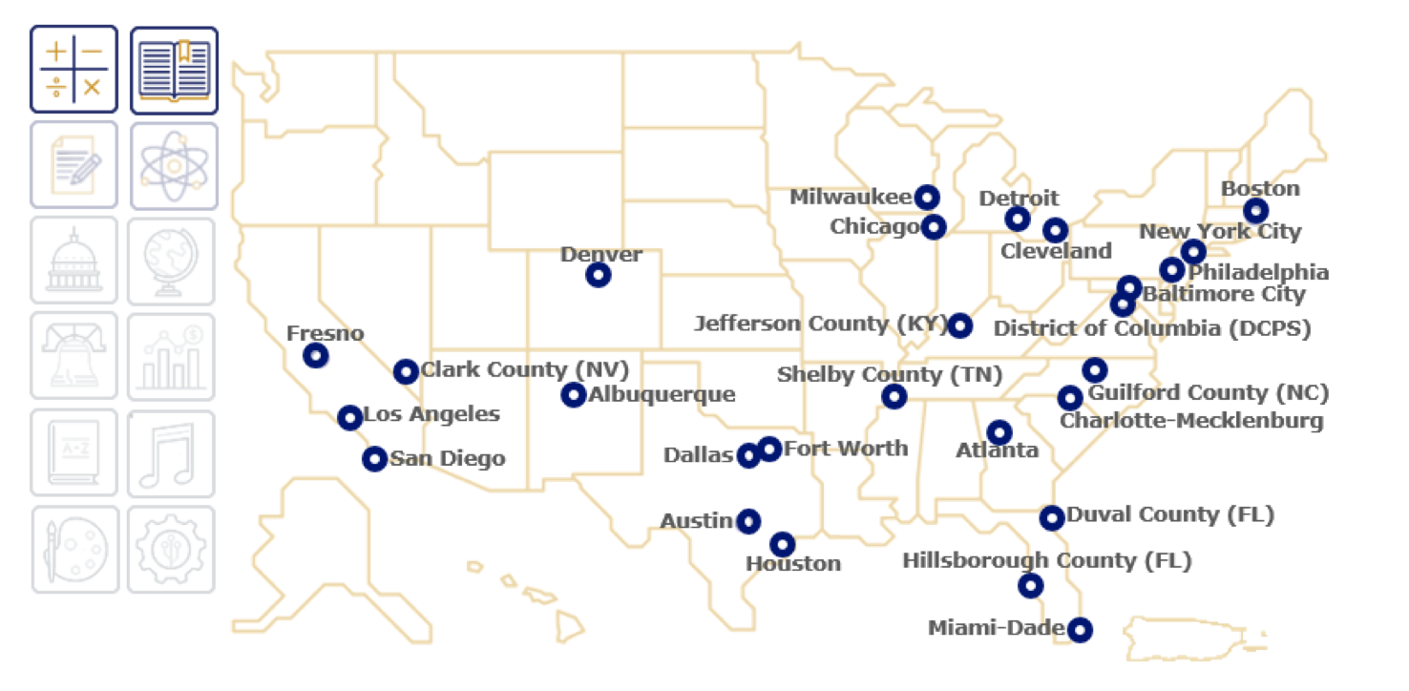
Jurisdictional Coverage (3 of 3)
Trial Urban District Assessment (TUDA)
Notes:
Here is a map showing the 27 Trial Urban District Assessment—TUDA—districts. Again, these are large urban districts that have volunteered to administer NAEP to an oversample in their district so they can obtain their own results.

Slide 9
Assessment Design
Notes:
Now let us focus on assessment design

Slide 10
NAEP Content Development ( 1 of 3)
  Content to be assessed are specified in the framework—the test blueprint
  Background information to be collected is specified in a survey information framework
  Question development includes: cognitive labs, pilot testing, bias and sensitivity reviews, stakeholder reviews, and field testing
Notes:
During a NAEP administration, students receive cognitive and non-cognitive items. Cognitive items are developed using specifications from the specific subject framework. These frameworks developed by the National Assessment Governing board or NAGB are the test blueprints. Each framework, specifies, the content and sub-content area to be assessed, the complexity, the item types to be used in each assessment.
Non-cognitive items are used to collect some individual characteristic of students, their teachers, and the schools they attend They are developed using a survey information framework.
Before these items are used in an assessment, they undergo intensive reviews by experts before conducting cognitive labs, pilot or field testing.

Slide 11
NAEP Content Development (2 of 3)
A framework specifies:
  Number of sub-contents to be assessed and their weights toward the composite scale
      Mathematics has five subscales: Algebra; Data Analysis, Statistics, & Probability; Geometry; Measurement; Number Properties & Operations
      Reading currently has two subscales: Reading for literary experience, Reading for information
  Distribution of items by sub-contents
  Complexity level of items
  Format of items
Notes:
A NAEP framework specifies many aspects of the content targeted for assessment.
The framework identifies the number of sub-components, sometimes referred to as sub-scales, and the weights of each subscale to the overall scale for an assessed content.
For example, the framework identified five sub-components for mathematics and two subcomponents for reading.
Similarly, there are subcomponents for other subjects .
The number of subcomponents can vary between subjects and between grades within a subject. The number of subcomponents can change between years.
In addition to the number of subcomponents, the framework specifies distributions of items by sub-scales, items’ complexity and item format.

Slide 12
NAEP Content Development (3 of 3)
Notes:
Instrument development encompasses three principles.
The goal for developing the content of a NAEP instrument is to have the full coverage of what the Governing Board has specified in the assessment framework:
Approach is to develop a large pool of items within the available resources and present a smaller portion of those items to an individual student to minimize student burden.
Procedure involves multiple committees in the development of the framework, content of the instrument and administration of the instrument.

Slide 13
Assessment Content: Cognitive Items
Discrete items
Scenario-based tasks
Hands-on tasks
Response types
  Selected response
    Multiple choice (including multiple-select)
    Drag and drop
    Zone
    Drop down
  Constructed response
    Short constructed response
    Extended constructed response
Notes:
The cognitive part of the NAEP assessment includes discrete items, scenario-based tasks, and hybrid Hands-on tasks.
There are two response types: selected response types include multiple choice, multiple select multiple choice, drag & drop, zone, Drop down
and constructed response types that can be short or extended constructed responses.
For some assessments, ancillary materials are provided to students. For example, a periodic table and mathematics formula are provided at grade 12 depending on the assessment, while a writing handout is provided at grades 4, 8, or 12.
Starting from 2017 NAEP transitioned from paper and pencil assessment to digital assessments in mathematics and reading at grade 4 and 8. For these digital assessments, the testing environment or eNAEP includes digital tools, such as: rulers, bar graphs; Interactive Item Components; Equation editor; Calculators just to name a few.

Slide 14
Assessment Content:
Contextual Questionnaires
Student
  Demographic characteristics
  Opportunities to learn in and outside of the classroom
  Educational experiences
Teacher
  Training
  Instructional practices
School
  School policies and characteristics
Notes:
After completing the two 30-minute content sections, students are prompted to answer questions about their educational experiences inside and outside the classroom.
Similar surveys are also given to teachers and school administrators.
As part of most NAEP assessments, three types of survey questionnaires are used to collect information:
Student questionnaires collect information on students' demographic characteristics, opportunities to learn in and outside of the classroom, and educational experiences. They are completed by students; During the 15 minutes allotted for the questionnaire following the cognitive component of the assessment, students are encouraged to answer as many questions as they feel comfortable with, and they can skip any question they do not want to answer. All responses are kept confidential. Student names are never reported with their responses or with other information collected by NAEP.
Teacher questionnaires gather information on teacher training and instructional practices. They are completed by teachers mainly at grades 4 and 8 (rarely at grade 12).School questionnaires gather information on school policies and characteristics and are completed by the principal or assistant principal. To ensure that necessary accommodations are provided, schools also provide information about students with disabilities (SD) or English language learners (ELL).
Here are some example questions from a school questionnaire:
Does your school or district offer tenure to teachers?
In the last school year, how many full-time teachers were new to your school?
In this school year, were each of the following types of computers or other digital devices are available in your school for student use? Select all that apply.
In your school, is there a wireless Internet connection that students can use for schoolwork?
Is there a literacy coach available (full-time or part-time) to eighth-grade teachers at your school?

Slide 15
NAEP Assessment Design
Long test, short form
A portion of cognitive items form a booklet
Each sampled student receives a booklet: two, 30-minute cognitive item blocks
Due to NAEP’s matrix design, data at the school or individual student level is not reliable for reporting
Notes:
Because NAEP is a large-group assessment, each student takes only a small part of the overall assessment. Each sampled student takes two cognitive item blocks that contain content area questions.
For digitally based assessment or DBA– two, 30-minute blocks
For paper and pencil assessment– two, 25-minute blocks
Due to NAEP’s design, data at the school or individual student-level is not reliable for reporting. This is because students take too few items for the data to be reliable for individuals.
We should note that, only when the student scores are aggregated at levels such as the urban district, state or national that the data are considered reliable and valid estimates of what students know and can do in the content area. This is why school- or student-level results are never reported

Slide 16
Assessment Design.
NAEP assessment design must:
  validly cover a larger area of content in each subject than typical state assessment programs
  minimize data collection costs, as well as the burden on students
Notes:
NAEP is mandated by public law 107-279. Section 303 of this law specifies among other things the type of sampling methods and lists subgroups of the population that NAEP must report results.
To accomplish that, the design, operations, and reporting of NAEP must function efficiently and with rigor. There are many techniques and methods applied to the operations of NAEP and some innovations in the field of large-scale assessment came out of the needs and opportunities NAEP created.

Slide 17
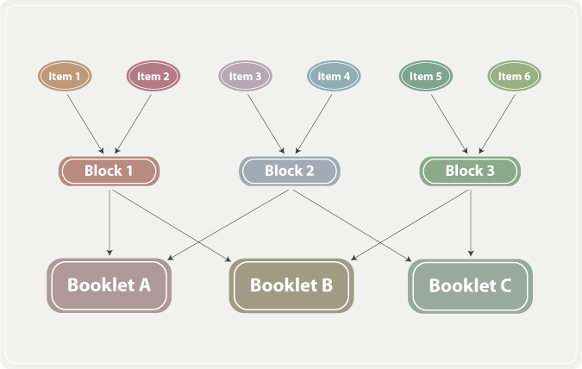
NAEP Assessment Design:
Matrix Sampling
Long assessment, but a short test for students
  100-170 items in Reading
  180 – 259 items in Mathematics
Notes:
One method used to construct each NAEP assessment is matrix sampling. Matrix sampling is a sampling plan in which different samples of respondents take different samples of items.
The number of cognitive items developed varies by subject and grade. For example, the number of items in any one assessment for reading is between 100 and 170 and for mathematics is between 180 and 250. Each student does not take each item. In fact, every item is exposed to about ¼ of the student sample.
The figure shows how cognitive items are assembled into blocks and then blocks into booklets.
As you can see, in step 1, items are selected,
at step 2: items are paired to develop a block of items, that is, item 1 paired with item 2 in block one, item 3 paired with item 4 into block 2 and item 5 paired with item 6 in block 3. Such pairing can be more complex as the number of items increases . Blocks are created such that they are similar in average difficulty, content distribution and complexity level.
At step 3: Blocks are paired to develop booklets. Block 1 is paired with block 2 in booklet A and again, block 1 is paired with block 3 in booklet B, while block 2 is paired with block 3 in booklet C.
Systematic pairing is necessary to ensure proper distribution of items across the population.

Slide 18
NAEP Assessment Design:
Blocks to Booklets
Balanced Incomplete Block design (BIB, focused or partial) is used to create test booklets with interlocking blocks of items for a grade and subject.
Each block:
    appears at least once in every position of a booklet
    appears the same number of times in each position
    is paired with other block once
    presented to equal portions of students
Booklets are arranged for distribution to schools in sets.
Notes:
Further, NAEP test booklets are created with interlocking blocks of items. Each block appears once in every positions of a test form administered to a student.
Booklet design can vary by subjects and grade.

Slide 19
NAEP Assessment Design: Booklet to Student
Booklets are organized according to sequences designed to ensure equal distribution of them across all sessions
The same booklet should not be given to too many students or should not be the first in every set.
Notes:
In distributing booklets during an assessment administration:
Booklets are organized according to sequences designed to ensure equal distribution of them across all sessions.
Booklets are alternated in a sequence within each session when multiple subjects are assessed in a year.
We also make sure that one single booklet should not be distributed to too many students or should not be placed at the top of all “sets” of booklets.
Rotating booklets through different positions within a bundle, the chance of not using any one type of booklet is equalized.

Slide 20
NAEP Assessment Design: Booklet to Student (up to 2015)
Each sampled student receives a booklet: two 30-minute cognitive item blocks and one 15-minute survey questionnaire block
Due to NAEP’s matrix design, data at the school or individual student level is not reliable for reporting
Notes:
Each sampled student takes two cognitive item blocks in a booklet. For DBA the time limit is 30 minutes for each block.

Slide 21
NAEP Delivery Model Starting from 2017
Notes:
Starting from 2017, the mathematics and reading assessments were administered digitally. Under this assessment delivery model, each sampled school is assessed in one day. The field staff drops into the school and sets up a controlled environment that relies entirely on NAEP-owned devices.
As you can see on the slide, in the controlled environment there are student tablets and a monitor tablet. During the testing environment the field staff monitors the students’ progression.
At the end of the session, each student’s data are saved and transmitted to the administrator tablet, and the administrator tablet transmits the data to the NAEP central server.

Slide 22
NAEP Assessment Design: Type of Data Collected
Cognitive and non –cognitive data is collected as with paper and Pencil assessment. In addition computer administration allows the collection of Process data
The Process data is a new type of data
Notes:
The data captured from each student are sequences of actions taken by the examinee. These actions, could be mouse clicks, the change of the default background, the use of a calculator, the selection of a response, the use of text-to-speech, just to name a few. For more information about these data refer to the introduction to NAEP Process data.

Slide 23
Sampling
Notes:
In the next section, we will give a brief introduction of NAEP sampling.

Slide 24
NAEP Sampling
Notes:
NAEP uses the common core of data or CCD to sample public schools.
Schools on this database are classified by school location, the racial ethnic composition of the schools, as well as the school performance on the state assessment. In each stratum, schools are ordered then sampled with probability proportional to their school size. The final list is sent to the U.S. Department of Education to confirm that the information is accurate and up to date.

Slide 25




Drawing a State NAEP Sample
~100-150 schools across states/jurisdictions for which scores were reported
~2,700 students assessed in each state/jurisdiction
~30 students per subject per school
Notes:
NAEP sampling ensures approximately equal sample sizes for each state’s public schools. There are approximately 100 to 150 schools were selected for each gradeand subject. In 2017, there were about 2,700 students assessed for each grade and subject, and each student in a school has an equal chance of being selected for NAEP.
Individual student demographics do not play a role in which students are selected to participate within a school. In each school about an equal number of students are assessed in reading and mathematics. The preset number of students is about 30 students per subject per school. Within each school and grade to be assessed students are selected at random to participate.

Slide 26
NAEP Design Implications
Students take only samples of items (missing data by design)
NAEP sampling involves multiple strata and each has a probability of selection
Different sampling rates within a strata ensures adequate representation of the portion of population at the strata
Special training and software is needed to analyze NAEP data
Notes:
The matrix sampling used by NAEP to create the short test form used to assessed students effectively creates missing data by design.
NAEP samples are stratified and clustered. Which means that special training and software is needed to analyze the NAEP data.

Slide 27
Reporting
Notes:
Let’s transitioned to NAEP reporting

Slide 28
Reporting Metrics
Scale scores range from 0-500 points or 0-300 points depending on the subject
Percentile scores show the scale score attained by lower- (10th and 25th), middle (50th), and higher- (75th and 90th) performing students
Achievement levels summarize the percentage of students reaching or exceeding cut points for
  NAEP Basic,
  NAEP Proficient, and
  NAEP Advance
Notes:
NAEP reports scale scores, percentile scores, and achievement levels. Scale scores range from 0-500 for mathematics and reading at grades 4 and 8 or 0-300, for other subjects. In NAEP, the percentile score is defined by the percentage of students scoring lower than a particular scale score. NAEP reports on scores at the 10th, 25th, 50th, 75th, and 90th percentiles. For example, if the 25th percentile score is 281, then 25 percent of the students scored below 281. There are three achievement levels for NAEP. They are:
NAEP Basic which denotes partial mastery of prerequisite knowledge and skills that are fundamental for proficient work at each grade
NAEP Proficient is solid academic performance for each grade assessed; students reaching this level have demonstrated competency over challenging subject matter, including subject-matter knowledge, application of such knowledge to real-world situations, and analytical skills appropriate to the subject matter
NAEP Advanced is Superior performance

Slide 29
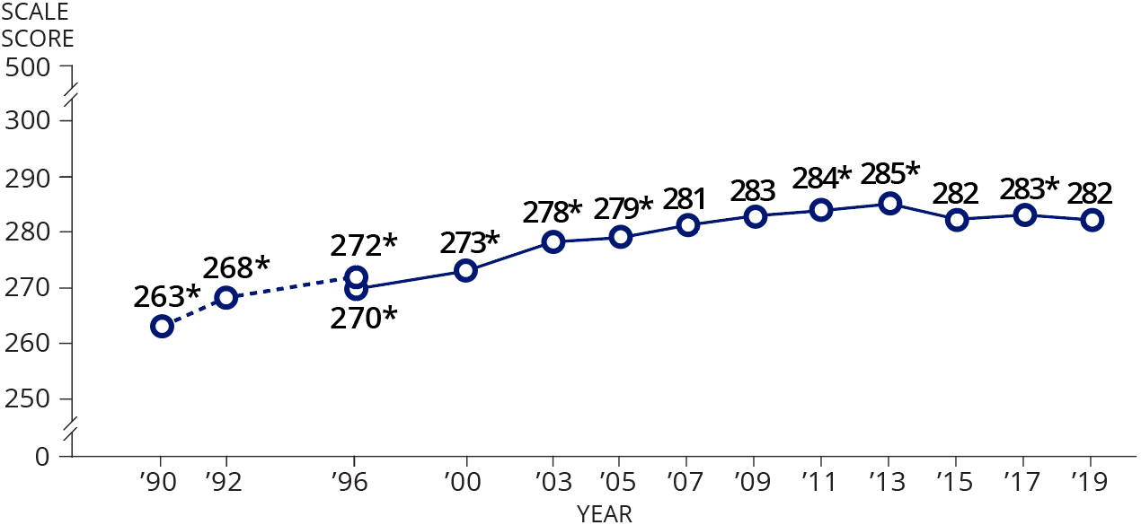
Scale Scores
MATHEMATICS
GRADE 8
Notes:
In this example is taken from the 2019 mathematics grade 8 report card. It shows the trend line from 1990 to 2019. For example, we can see that in 2019 student’s scale score was 282. In 1990 it was 263. We can also see that compared to 2017, students scores were lower. This is denoted by the star on 283.

Slide 30
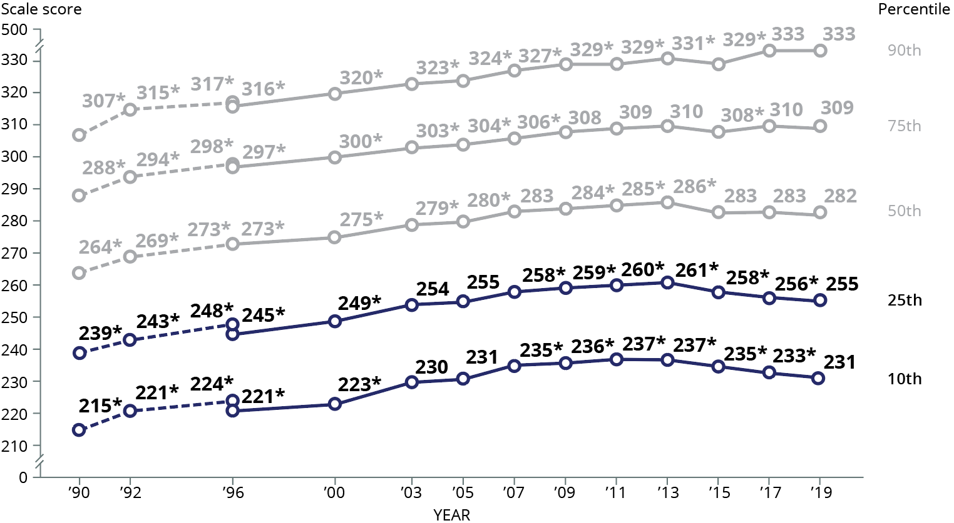
Percentile scores
MATHEMATICS
GRADE 8
Notes:
In this example taken from the same NAEP report card, we can see that in comparison to 2017, the 2019 mathematics scores were statistically not different for eighth-graders performing at the 75th and 90th percentile, but they were statistically lower for students at the 10th and 25th percentiles.

Slide 31
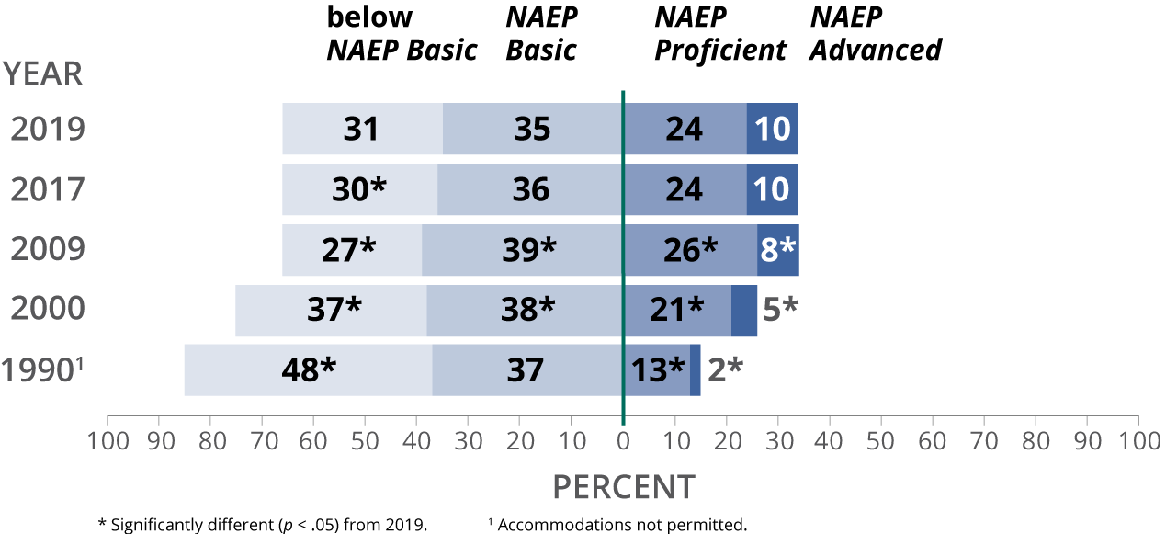
Achievement Levels
MATHEMATICS
GRADE 8
Notes:
If we focus only on the top bar, we can see that in 2019 there were 31 percent of students scoring below NAEP basic, and 10 percent scoring at NAEP proficient. NAEP will also report that in 2019, 69 percent of 8th graders score at or above NAEP basic.
Compare to 2017, the percentage of students scoring below basic was statistically larger in 2019. The asterisk indicates statistical significance.

Slide 32
Key Takeaways
NAEP is comprised of two components: main NAEP and long-term trend.
Students receive a portion of cognitive items and answer contextual questions.
NCES draws random samples of students from states and selected urban districts for representativeness.
In addition to cognitive and survey data, NCES also collects process data
To report NAEP results, one must take into account NAEP psychometrics and the complex sampling design.
Notes:
We learned that NAEP has two main components, the main NAEP that’s grade based and the long-term trend that is age based.
NAEP uses complex sample design to select the students.
Each student is assessed using only short form made of samples of items, and survey questionnaires. Starting from 2017, NAEP mathematics and reading assessment have been administered digitally. During these digital assessments, NAEP collects process data.
Analysts must account for the NAEP psychometrics and complex sample design while analyzing the NAEP data.

Slide 33
Questions?
Please submit your questions until July 30th at IES.Webinar.Questions@ed.gov. Updates will be posted to the Frequently Asked Questions document on the webinar website every few weeks.
Notes:
Please submit your questions until July 30th at IES.Webinar.Questions@ed.gov. We will make sure to frequently post answers to the questions you might have when listening to this presentation.

Slide 34
Thank You
Notes:
Thank you!

