Slide 1
Project Contract Info
This presentation was prepared for the Institute of Education Sciences (IES) under Contract ED-IES-17-C-0004 by the Regional Educational Laboratory (REL) Appalachia administered by SRI International. The content of the presentation does not necessarily reflect the views or policies of IES or the U.S. Department of Education nor does mention of trade names, commercial products, or organizations imply endorsement by the U.S. Government.
The original version of the presentation can be found on the REL Appalachia website here: REL AP link for PDF file: https://ies.ed.gov/ncee/edlabs/regions/appalachia/resources/pdfs/continuous-improvement-coaching_facilitator-slides_Acc.pdf
If you plan to use these slides to facilitate a training or professional development session, please retain this disclaimer at the beginning of the presentation, even if you choose to add your organization’s logo or make revisions to the slides to meet the needs of your audience. In the occurrence that changes are made, please add a note that: Amendments to the original slides have been made as necessary in order to specifically address the purpose of this presentation.

Slide 2
Continuous Improvement Coaching Facilitators’ Workbook Accompanying presentation slides
Presenter Name
Title Here
Presenter Name
Title Here

Slide 3
How to use these slides
These slides serve as examples as you facilitate your school’s continuous improvement initiative. They follow the process described in the Facilitators’ Workbook.
The slides include seven sections:
Welcome
Phase 1: Set the Foundation
Phase 2: Plan
Phase 3: Do
Phase 4: Study
Phase 5: Act
Next steps
Each section starts with “how to use these slides” and is followed by the example presentation to use as a starting point for facilitating your improvement team’s activities.
When using the slides, remember to delete the “How to” slide in each section.
Notes:
​

Slide 4
How much time will the continuous improvement process require?
Timing will vary depending on your continuous improvement project, team, and the time of year.
We recommend the following timeframes for each phase:
Phase 1 (Set the Foundation) typically requires between two and five team meetings.
Phase 2 (Plan) typically requires two or three team meetings.
Phase 3 (Do) will vary depending on the type of intervention you select.
Phase 4 (Study) typically requires one team meeting.
Phase 5 (Act) typically requires one or two team meetings.

Slide 5
Welcome!
Notes:
Talking Points
Welcome to this meeting.
We are all here because we are interested in implementing a change at [site] to improve student outcomes.
Together, we will embark on a step-by-step process for continuous improvement, an approach that seeks to improve a system through small-scale changes repeatedly evaluated by multiple tests. This process will ground our work for our improvement initiative.

Slide 6
How to use these slides
Remember to delete this “How to” slide.
Recommendations:
Start each meeting with an agenda with times clearly stated.
Prepare the team for each meeting by stating the objective as part of the step-by-step improvement process.

Slide 7
Example agenda slide
Time | Agenda item
9:30 – 9:45 a.m. | Welcome and introductions
9:45 – 11:30 a.m. | Meeting topic(s)
11:30 – 11:45 a.m. | Wrap-up and next steps
Notes:
Facilitator's Note
• Make sure to update times and agenda items as needed.

Slide 8
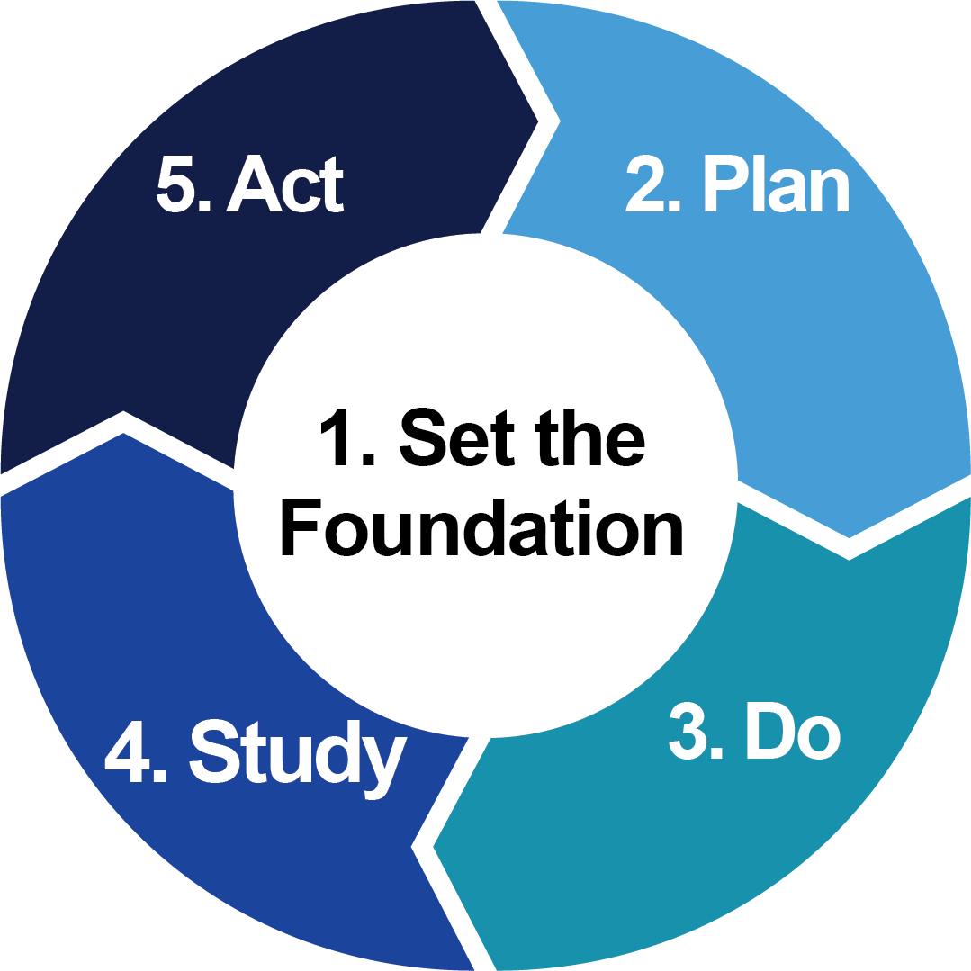
Step-by-step improvement process
Today’s meeting objectives are:
[Objective 1]
[Objective 2]
Notes:
Talking Points
We are embarking on a five-phase journey grounded in a Plan-Do-Study-Act (PDSA) cycle that will allow us to implement a change, monitor this change, and then determine whether the small changes we made actually led to an improvement.
Facilitator's Note
• Add objectives for this meeting
References
Tichnor-Wagner, A., Wachen, J., Cannata, M., & Cohen-Vogel, L. (2017). Continuous improvement in the public school context: Understanding how educators respond to plan–do–study–act cycles. Journal of Educational Change, 18(4), 465–494. https://doi.org/10.1007/s10833-017-9301-4

Slide 9
Phase 1: Set the Foundation
Notes:
Talking Points
The first phase we dive into will allow us to "set the foundation" for our PDSA cycle.
Facilitator's Note
• Do not skip over this phase as this is the foundation for the PDSA cycle. This phase is critical to identifying an evidence-based practice to implement.

Slide 10
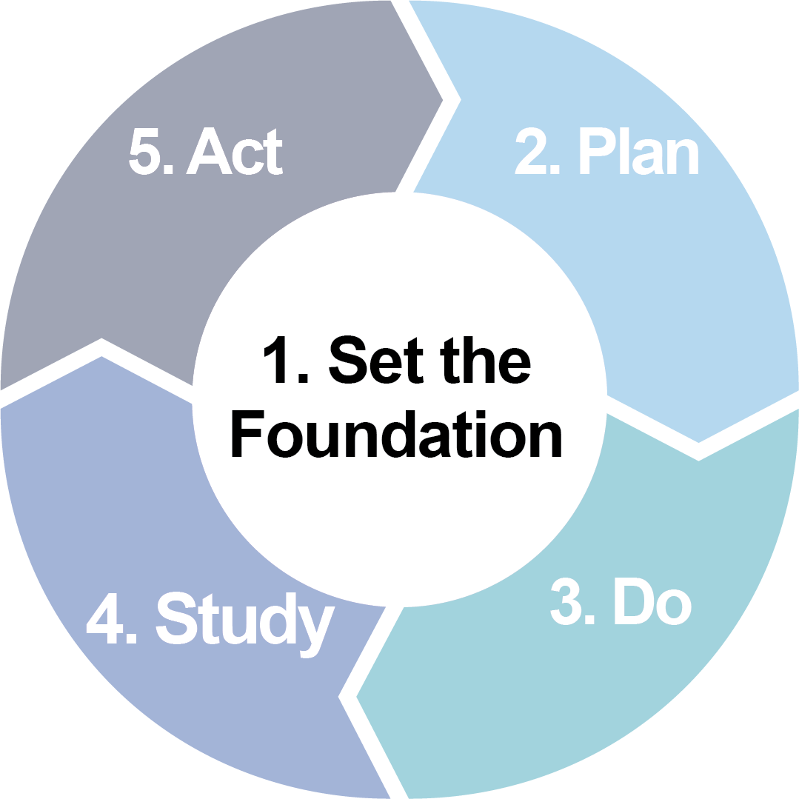
How to use these slides
Remember to delete this “How to” slide.
Recommendations:
Do not skip over this phase as this is the foundation for the PDSA cycle. This phase is critical for identifying an evidence-based practice to implement.
Collect various data about your school or district to support the root-cause analysis, but do not get bogged down with data. The goal is to fully understand and clearly state the problem you want to address.
In the “What to do in this phase” slide, use the analogy of building a house. The purpose of this phase is to build a strong foundation.
Review pages 5–14 of the Facilitators’ Workbook for more details about the phase.

Slide 11
What to do in this phase
1
Define the problem.
2
Create your theory of action.
3
Select an evidence-based strategy.
Notes:
Talking Points
As with any construction project, our improvement initiative needs a strong foundation on which to build. Digging deeply into perceived needs and problem approaches is time well invested.
To build the foundation for our improvement initiative, we will:
Define the problem
Create a theory of action, and
Select an evidence-based strategy
References
Image source: Pixabay. (2020). https://pixabay.com/photos/construction-concrete-foundation-5372898/

Slide 12
Define the problem: Compile multiple data types for analysis
Attendance, absenteeism, dropout rates
State assessments and proficiency scores
School grades, courses, and graduation rates
Student social-emotional outcomes
Notes:
Talking Points
We’ll begin with defining our perceived school challenge/problem.
Defining and clarifying the problem ensures that we focus our efforts on strategies that will positively impact student outcomes.
This effort requires us to analyze multiple data types to understand what the learning environment is like for students.
Relying solely on student achievement data may limit our view of the learning environment, so when possible, we should include perceptions from students, teachers, and/or families as appropriate to capture the learning environment of the school.
Data sources might include:
Attendance, absenteeism, dropout rates
State assessments and proficiency scores
School grades and courses
Student social-emotional outcomes
References
Image source: Pixabay. (2015). https://pixabay.com/illustrations/magnifying-glass-search-to-find-1019982/

Slide 13
Determine root cause using the Five Whys process
The Five Whys process allows improvement teams to dig into the problem statement and consider why the current system produces the undesired outcomes.
(Institute of Education Sciences, 2015)
Notes:
Talking Points​
With a clear gap in student outcomes identified, getting to the root of the problem is the next step, and the Five Whys template can help us with this process.
The Five Whys process allows us to dig into the identified problem (gap) and consider why the current system produces the undesired outcomes.
Facilitator's Note​
• Although many variables can impact student outcomes, it's important to keep discussions focused on reasons within a school’s control (e.g., school policies, procedures, instructional practices, etc.) rather than reasons beyond the school’s purview (e.g., student characteristics, family background, etc.).
• The Five Whys process can help the improvement team think about why the learning environment may be experienced differently by different students and may provide insights about which school practices to adjust.
References
•Institute of Education Sciences. (2015, February 11). Root cause analysis: How adaptive leaders use root cause analysis to collaboratively solve student achievement needs. [video]. Youtube. https://www.youtube.com/watch?v=81iB75kjag8
•Image source: Vecteezy. (n.d.). https://www.vecteezy.com/vector-art/354977-root-vector-icon

Slide 14
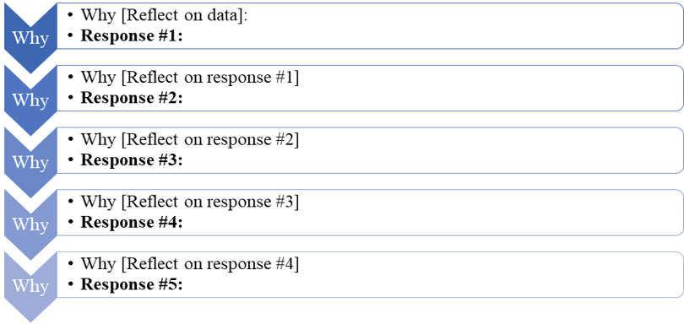
Five Whys template
(Institute of Education Sciences, 2015)
Notes:
Talking Points​
We will now spend some time together filling out the Five Whys template to identify the root cause of our problem.
Facilitator's Note​
• A blank template with directions for how to use it can be found in appendix C.
• Depending on team dynamics, responses to the Five Whys template can be filled out together as a team, or team members can reflect on responses individually and then share together as a group.
• Refer to appendix D for an example from a use-case scenario.
• Make sure to allot ample time for team reflections and discussion for this exercise. Allocate enough time for everyone to share their thoughts and to move through each question. Plan for about 25 minutes for this activity. The amount of time may differ depending on size and dynamics of the group.
References
Template adapted from Institute of Education Sciences. (2015, February 11). Root cause analysis: How adaptive leaders use root cause analysis to collaboratively solve student achievement needs. [video]. Youtube. https://www.youtube.com/watch?v=81iB75kjag8

Slide 15
Finalize the problem statement
Your problem statement should be specific so you can develop clear action steps to reach desired outcomes.
Too vague: “Students are not graduating from high school college- and career-ready.
Specific: “Students are not prepared for the social, emotional, and academic rigors of postsecondary schools because they are chronically absent from high school.”
Notes:
Talking Points​
Now that we have completed our data analysis and identified a root cause, we are now ready to finalize our problem statement.
Our problem statement should be specific, one that articulates the gap or other pattern you see in student outcomes as well as the root cause of it, so that clear action steps can be developed to reach desired outcomes.
The samples on this slide will help us distinguish between a statement that is too vague or sufficiently specific.
Facilitator's Note
• Once a problem statement is identified, add it to the theory of action template in appendix C.

Slide 16
Create your theory of action
A theory of action offers a graphical representation of your improvement initiative and helps your team articulate how school resources and actions lead to desired outcomes.
Notes:
Talking Points​
Now that we have a problem statement, the next step is to develop a theory of action to address the problem.
A theory of action offers a graphical representation of our improvement initiative and helps us articulate how school resources and actions lead to desired outcomes.
The theory of action includes the problem statement, inputs, key components of the evidence-based practice, and the desired short-, mid-, and long-term outcomes.
Simplified, a theory of action would have three main parts: Inputs—Key Components—Outcomes.
We’ll use a backward-design process to develop our theory of action, so this segment begins with identifying outcomes.

Slide 17
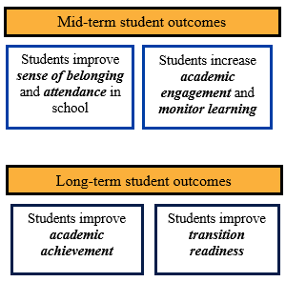
Start with long- and mid-term outcomes
Use a backward-design process to identify outcomes.
(Shakman & Rodriguez, 2015)
Notes:
Talking Points​
We'll start this process by considering the long-term outcomes of our improvement initiative. That is, if our improvement effort works as planned, how will our outcomes be reached? Using a backward-design process will help us increase the likelihood of achieving our long-term outcome.
You'll notice that these outcomes describe desired improvements for students.
We’ll spend a few minutes to identify our long-term outcomes, and then our mid-term outcomes.
Facilitator's Note​
• Share the sample long-term student outcomes on the slide.
• With the long-term outcomes articulated, work with your team to identify the mid-term outcomes. Again, these outcomes describe desired improvement for students.
• A blank template of this theory of action can be found in appendix C.
• Make sure to allot ample time for team reflections and discussion during this exercise. Allocate enough time for everyone to share thoughts. Plan for about 20 minutes for this activity. The amount of time may differ depending on size and dynamics of the group.
References
Template adapted from Shakman, K., & Rodriguez, S. M. (2015). Logic models for program design, implementation, and evaluation: Workshop toolkit (REL 2015–057). Washington, DC: U.S. Department of Education, Institute of Education Sciences, National Center for Education Evaluation and Regional Assistance, Regional Educational Laboratory Northeast & Islands. https://ies.ed.gov/ncee/edlabs/regions/northeast/pdf/REL_2015057.pdf

Slide 18
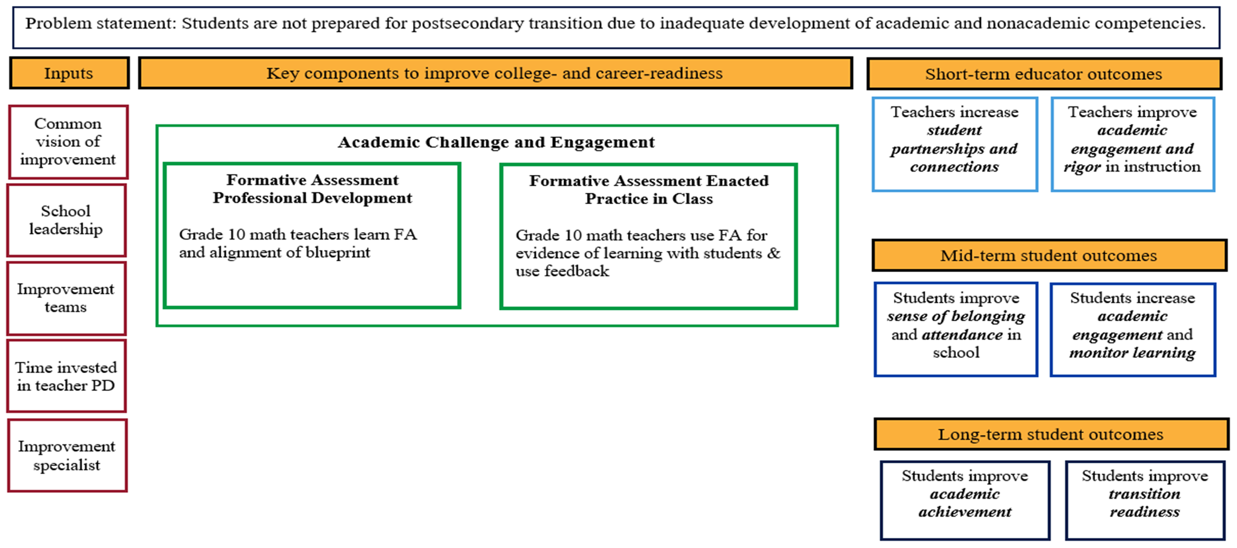
Identify change agents, short-term outcomes, and inputs
(Shakman & Rodriguez, 2015)
Notes:
Talking Points​
Changes in student outcomes are prompted by adult behaviors and actions, and thus we should determine who within the school (e.g., administrator, teacher, counselor, etc.) has the greatest opportunity to influence the desired student outcomes. These individuals are recognized as change agents for whom short-term outcomes are identified because their short-term outcomes directly influence mid-term student outcomes.
As a change agent, a teacher might have a short-term outcome for improving student academic engagement. You see this on the slide. If you have identified additional change agents, you might have additional short-term outcomes.
We’ll spend a few minutes to identify our short-term outcomes, and then the inputs available to support the improvement initiative.
Facilitator's Note​
• A secondary change agent for these outcomes could be the school’s guidance counselor. The guidance counselor might have a short-term outcome of Guidance counselor increases outreach to students on postsecondary options. If primary and secondary change agents are both identified, make sure to include them both in the theory of action.
• Once you identify short-term outcomes, work with your team to list the inputs available to support the improvement initiative.
• A blank template of this theory of action can be found in appendix C.
• Make sure to allot ample time for team reflections and discussion during this exercise. Allocate enough time for everyone to share thoughts. Plan for about 20 minutes for this activity. The amount of time may differ depending on size and dynamics of the group.
References
Template adapted from Shakman, K., & Rodriguez, S. M. (2015). Logic models for program design, implementation, and evaluation: Workshop toolkit (REL 2015–057). Washington, DC: U.S. Department of Education, Institute of Education Sciences, National Center for Education Evaluation and Regional Assistance, Regional Educational Laboratory Northeast & Islands. https://ies.ed.gov/ncee/edlabs/regions/northeast/pdf/REL_2015057.pdf

Slide 19
Select an evidence-based practice
Select an evidence-based practice:
Compile evidence-based practices.
Refer to ESSA’s four levels of evidence.
Select an evidence-based strategy as a team.
(Shakman & Rodriguez, 2015)
Notes:
Talking Points​
Now that we have identified our problem statement, inputs, short-, medium-, and long-term outcomes, we will identify evidence-based practices to help us achieve our outcomes.
To do this, we will first compile a list of options to consider (e.g., multi-tiered system of support, formative assessment practices, social-emotional learning blocks) and then go through a vetting process considering the level of evidence supporting each practice, to ensure the selected practice is best aligned to our school’s problem, context, and resources.
• If your team needs assistance identifying an evidence-based practice, consider reaching out to district personnel or to trusted sources for help, such as the Regional Educational Laboratory (Ask A REL is a free service that functions like a virtual reference desk) and the What Works Clearinghouse (WWC) website (which provides practice guides, intervention reports, and other resources).
• A list of resources for identifying evidence-based interventions is provided in the Additional Resources section of the Set the Foundation phase of the Facilitators Workbook.
• Team members may also have learned about possible evidence-based practices through their professional networks or through professional learning opportunities.
• Compiling possible evidence-based practices for your team’s consideration will likely require research, so allot sufficient time for the research to occur prior to convening the entire team.
• A blank template of this logic model can be found in appendix C.
References
Template adapted from Shakman, K., & Rodriguez, S. M. (2015). Logic models for program design, implementation, and evaluation: Workshop toolkit (REL 2015–057). Washington, DC: U.S. Department of Education, Institute of Education Sciences, National Center for Education Evaluation and Regional Assistance, Regional Educational Laboratory Northeast & Islands. https://ies.ed.gov/ncee/edlabs/regions/northeast/pdf/REL_2015057.pdf

Slide 20
Assessing options: Four levels of evidence in ESSA
At least one well-designed and implemented correlational study Includes controls for statistical bias
Promising
At least one well-designed and implemented quasi-experimental study
Moderate
At least one well-designed and implemented experimental study
Strong
Well-specified logic model or theory of action
Includes ongoing efforts to collect evidence
Demonstrates a rationale
For full description of ESSA evidence standards, see https://www.ed.gov/policy/elsec/leg/essa/guidanceuseseinvestment.pdf
For alignment between the What Works Clearinghouse evidence standards and ESSA evidence standards, see https://www.ies.ed.gov/ncee/wwc/essa
Notes:
Talking Points​
The four levels of evidence in the Every Student Succeeds Act (ESSA) are one framework that can help us to identify promising practices.
Facilitator's Note​
• Improvement teams are encouraged to identify practices that align with one of the four levels of evidence as described in the Every Student Succeeds Act (ESSA).
• The descriptions on this slide will help team members better understand each tier of ESSA’s evidence levels.
• Whenever possible, it is recommended that you adopt interventions/programs with the highest level of evidence (Strong) to increase the likelihood of benefiting students.
• Be sure that you have the resources necessary to implement these interventions/programs with integrity.

Slide 21
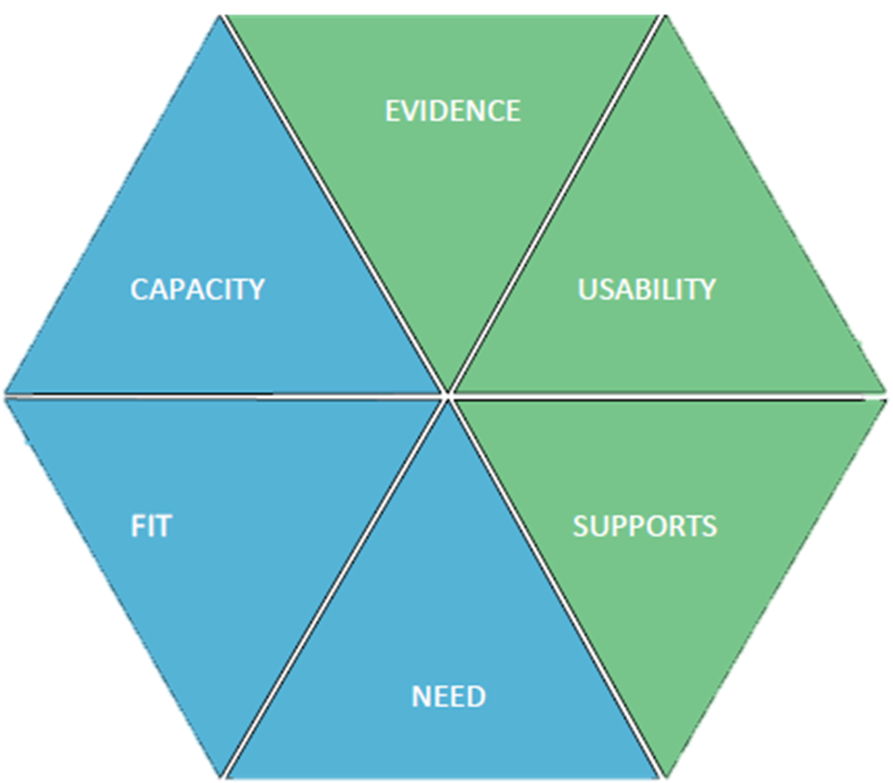
Vetting your options
What?
Determine which practice best meets the needs of your school and is practical in your context.
How?
Hexagon Tool
Applicability of Evidence-Based Interventions document
• Program Indicators
• Implementing Site Indicators
(Metz & Louison, 2019; REL West, 2020)
Notes:
[slide is animated]
Talking Points​
We can use the Hexagon exploration tool to review options for promising practices.
The tool provides a systemic approach to selecting an evidence-based practice.
REL West has also created a tool to assess feasibility of evidence-based interventions. The tool prompts teams to consider additional factors, such as whether PD time or other resources are needed to implement the program well.
Facilitator's Note​
• By this point, the team should have a short list of possible evidence-based practices.
• A blank template of the Hexagon tool can be found in appendix C.
• Refer to appendix D for an example from a use-case scenario.
References
Metz, A., and Louison, L. (2019). The Hexagon Tool: Exploring Context. Chapel Hill, NC: National Implementation Research Network, Frank Porter Graham Child Development Institute, University of North Carolina at Chapel Hill. Based on Kiser, Zabel, Zachik, & Smith (2007) and Blasé, Kiser, & Van Dyke (2013) © 2019 NIRN – University of North Carolina at Chapel Hill
Regional Educational Laboratory West. (2020, March). Applicability of evidence-based Interventions [Infographic]. U.S. Department of Education, Institute of Education Sciences. https://ies.ed.gov/ncee/edlabs/infographics/pdf/REL_WE_Applicability_of_Evidence_Based_Interventions.pdf

Slide 22
Phase 2: Plan
Notes:
Talking Points
Now we are ready to dive into our PDSA cycle — Plan.

Slide 23
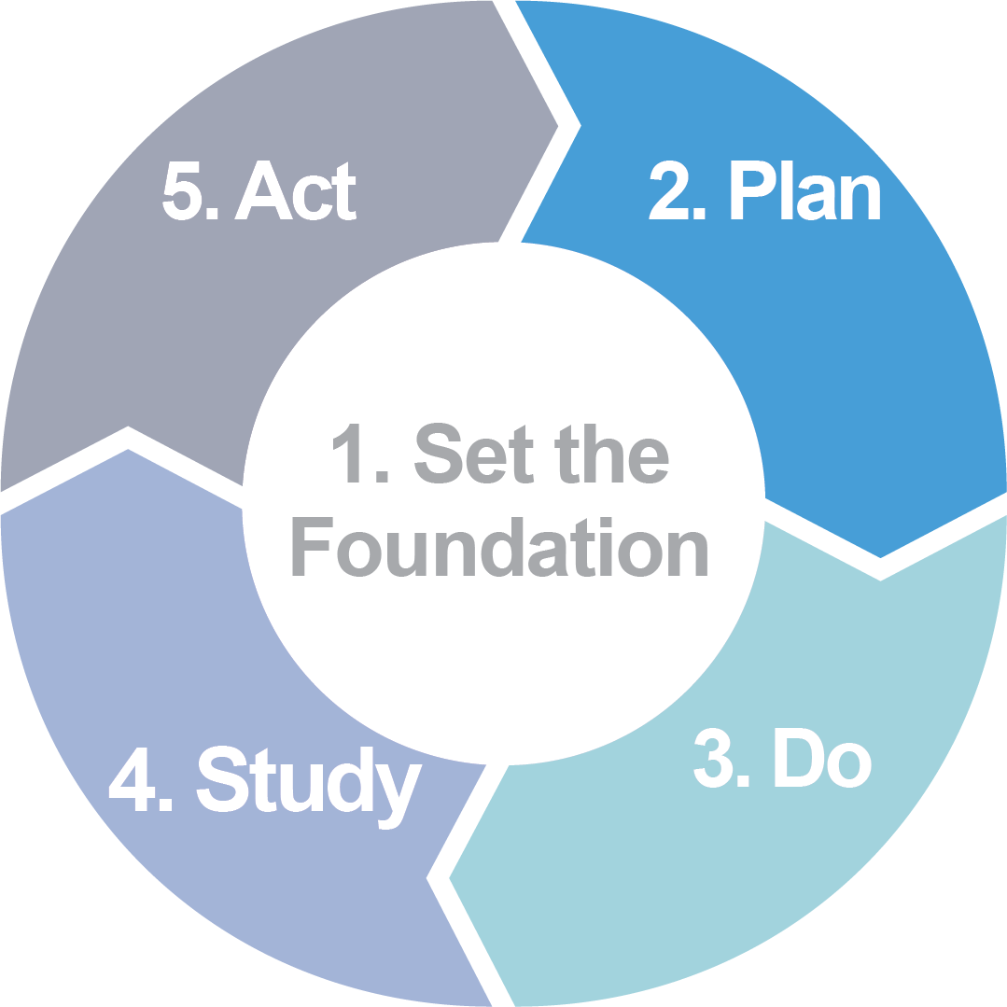
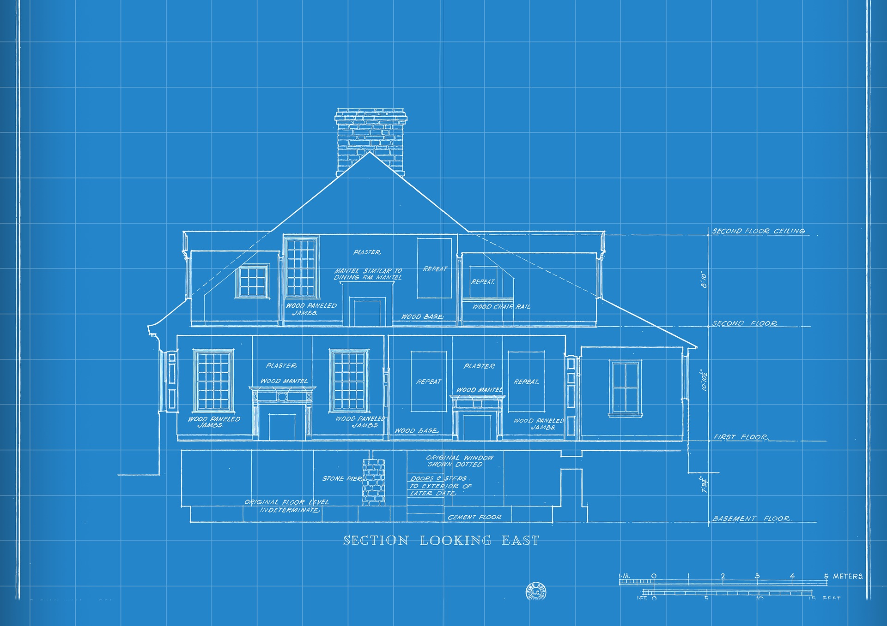
What to do in this phase
1
List the action steps.
2
Identify data to collect.
3
Make predictions.
Notes:
Talking Points
Now that we have gone through phase 1 of our continuous improvement planning, our improvement initiative has a strong foundation on which to build.
As with any construction project, we are now ready to build a blueprint of the structure or house we plan to build. That is, we develop a "plan.“ Taking the time to plan for our improvement initiative is time well invested.
To develop the plan of our improvement initiative, we will:
List the action steps
Identify data to collect
Make predictions.
References
Image source: Pixabay. (2018). https://pixabay.com/illustrations/technology-blueprint-house-drawing-3216744/

Slide 24
How to use these slides
Remember to delete this “How to" slide.
Recommendations:
This phase is like a lesson plan. You will break down the implementation of the evidence-based practice into action steps.
In the “What to do in this phase” slide, use the analogy of building a house. This phase is to create a blueprint of the house.
Review pages 15–21 of the Facilitators’ Workbook for more details about the phase.

Slide 25
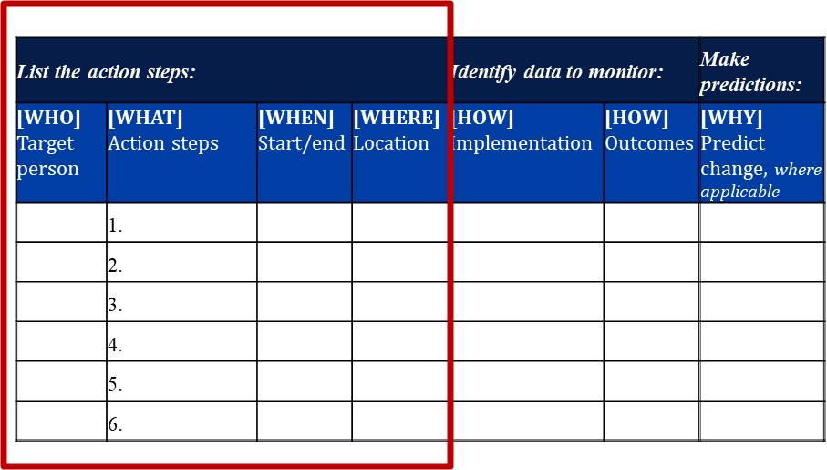
List the action steps
Who will implement each activity and action step?
What is the action step the team will take to accomplish the evidence-based practice?
When and where will each activity or action step happen?
(Collis & Foster, 2018)
Notes:
Talking Points
During this phase, we will figure out the steps and activities we need to implement the evidence-based practice we selected. We will spend some time thinking about the who, what, when, and where of our action plan.
Key things to think about in the action plan include the following questions:
What are we trying to accomplish or improve?
What change might we make and why?
How will we know that change is an improvement?
Facilitator's Note
• A blank template of this organizer can be found in appendix C.
• Refer to appendix D for an example from a use-case scenario.
• Make sure to allot ample time for team reflections and discussion during this exercise.
References
Template adapted from Collis, S., & Foster, K. (2018, March 7). TIME for Care: Quality improvement for practice managers [PowerPoint slides]. SlideShare. https://www.slideshare.net/NHSEngland/improving-services-leading-change-implementing-change-in-rapid-cycles

Slide 26
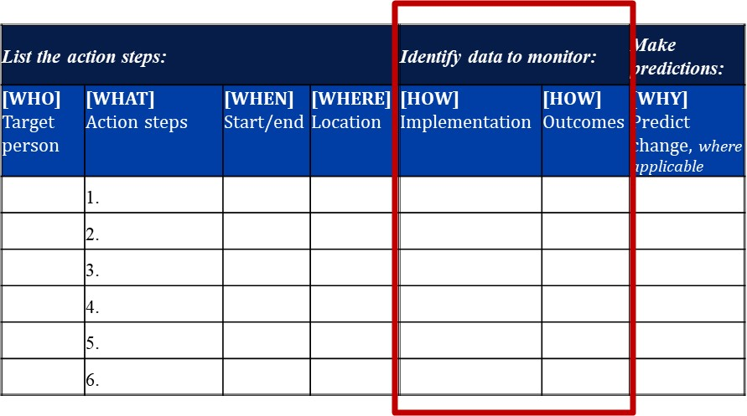
Identify data to monitor
How will you collect implementation and outcome data?
Before thinking about new data, think about:
What data do we already collect?
Can we collect those data more consistently and systematically?
(Collis & Foster, 2018)
Notes:
Talking Points
As we continue to plan for our implementation, we should also determine how we will assess our improvement effort.
Identifying data to monitor helps create a process that becomes the foundation for the Do, Study, and Act phases that follow.
We’ll want two types of data in our plan:
Implementation checkpoints. These data will help you determine if you implemented the action steps as planned.
Outcome data. These data will help you determine if your evidence-based practice is yielding the expected changes (e.g., increased student engagement, increased attendance, etc.).
Facilitator's Note
• Encourage team members to think about data collection methods they already use. For example, if teachers use self-reflection logs, these logs could document implementation activities.
• A blank template of this organizer can be found in appendix C.
• Refer to appendix D for an example from a use-case scenario.
• Make sure to allot ample time for team reflections and discussion for this exercise.
References
Template adapted from Collis, S., & Foster, K. (2018, March 7). TIME for Care: Quality improvement for practice managers [PowerPoint slides]. SlideShare. https://www.slideshare.net/NHSEngland/improving-services-leading-change-implementing-change-in-rapid-cycles

Slide 27
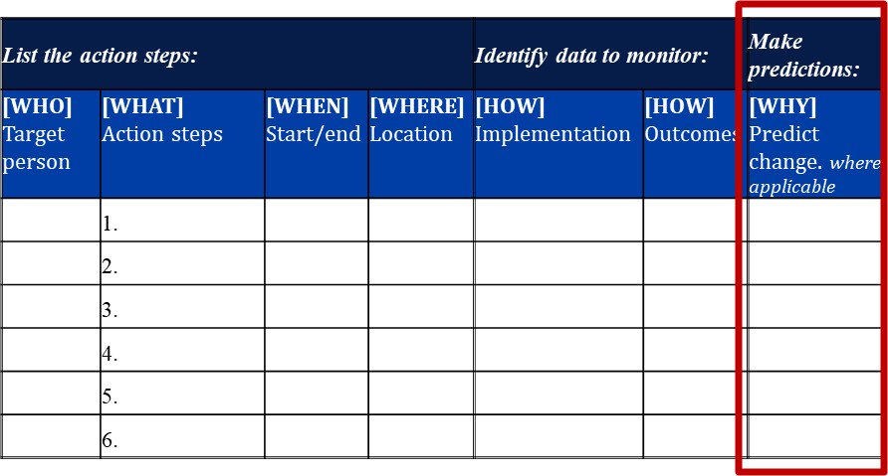
Make predictions
Prediction is key to the process.
What change is predicted?
The predictions will be used again in the “Act” phase.
(Collis & Foster, 2018)
Notes:
Talking Points
This is a critical part of the Plan phase as it sets up the scientific process of the continuous improvement cycle so that we can quickly learn what worked well and what didn’t. Your predictions can be compared to a hypothesis in a scientific investigation and will be used during the Study phase of our improvement cycle.
Now that we have identified our action steps and the data we'll monitor, we are ready to predict how we believe our action steps will actually play out.
You may make a prediction for each action step, or if more appropriate, you may make predictions that include multiple action steps.
Facilitator's Note
• A blank template of this organizer can be found in appendix C.
• Refer to appendix D for an example from a use-case scenario.
• Make sure to allot ample time for team reflections and discussion during this exercise.
References
Template adapted from Collis, S., & Foster, K. (2018, March 7). TIME for Care: Quality improvement for practice managers [PowerPoint slides]. SlideShare. https://www.slideshare.net/NHSEngland/improving-services-leading-change-implementing-change-in-rapid-cycles

Slide 28
Phase 3: Do
Notes:
Talking Points
Now we are ready to dive into phase 3 — Do.

Slide 29
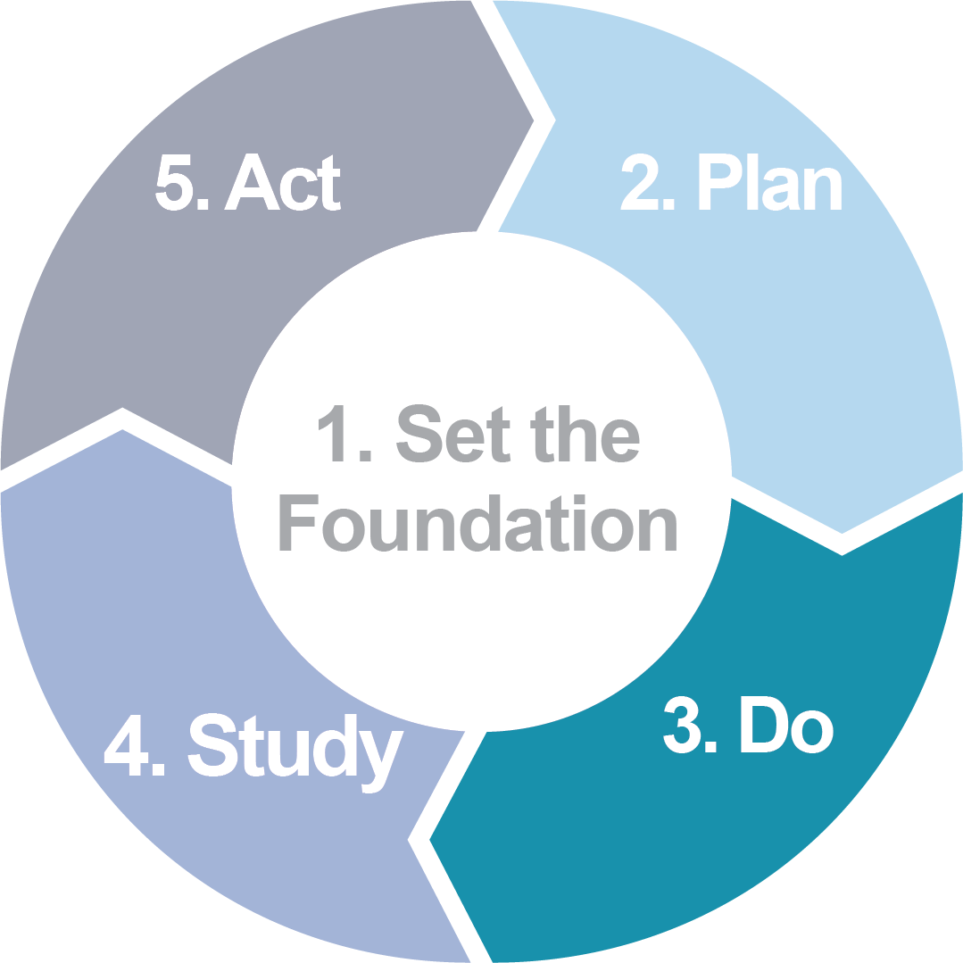
How to use these slides
Remember to delete this “How to” slide.
Recommendations:
In this phase you will enact (do) the action steps you identified in your plan. The key to this phase is to collect data on implementation and outcomes.
In the “What to do in this phase” slide, use the analogy of building a house. This phase is to construct the house, following the blueprints.
Review pages 22–27 of the Facilitators’ Workbook for more details about the phase.

Slide 30
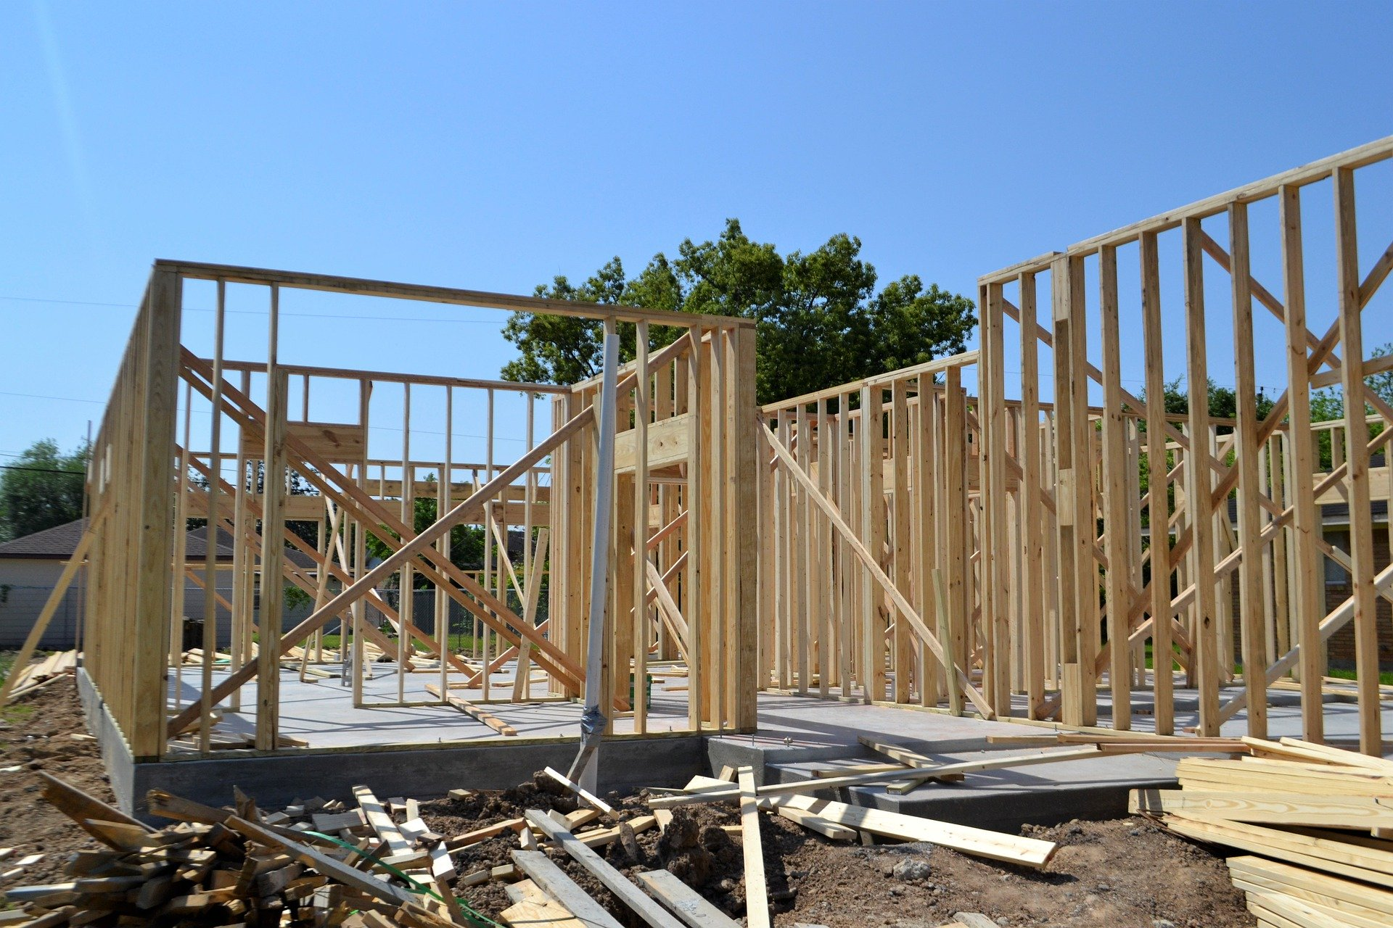
What to do in this phase
1
Implement the action steps.
2
Monitor your data.
Notes:
Talking Points
As with any construction project, once the blueprint is approved, you will follow the blueprint and build the house. In the PDSA cycle, this is the Do phase.
In this phase, we'll implement our action steps and monitor data on how our selected evidence-based practice works in our context.
This phase includes two steps:
Implement the action steps.
Monitor our data.
References
Image source: Pixabay. (2019). https://pixabay.com/photos/foundation-home-development-house-4578492/

Slide 31
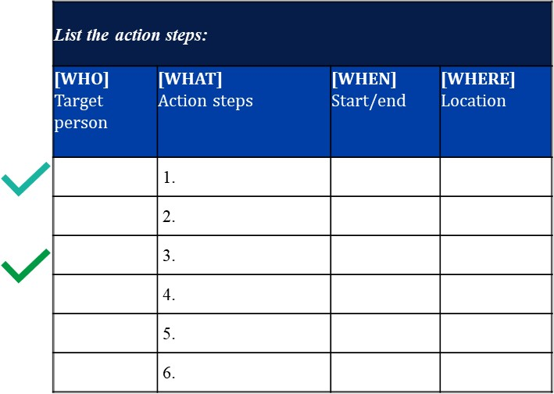
Implement the action steps
Implement the action steps
Just do it… Start implementing the action steps.
Remember to collect the implementation and outcomes data.
(Collis & Foster, 2018)
Notes:
Talking Points
During this phase, we will execute the action steps and monitor the data we identified in Phase 2.
Key questions to ask ourselves during this phase are:
Are the action steps executed as written in the plan?
Where and how is our evidence documented?
Facilitator's Note
• The template in this slide is completed by the team in Phase 2. This slide offers a reminder of the actions to be taken.
• Refer to appendix D for an example from a use-case scenario.
• Your team should meet regularly and review your action plan. Frequency of meetings might align with how often teachers are making changes, or with how often data are being collected. Check in with implementers to determine if supports are needed.
References
Template adapted from Collis, S., & Foster, K. (2018, March 7). TIME for Care: Quality improvement for practice managers [PowerPoint slides]. SlideShare. https://www.slideshare.net/NHSEngland/improving-services-leading-change-implementing-change-in-rapid-cycles

Slide 32
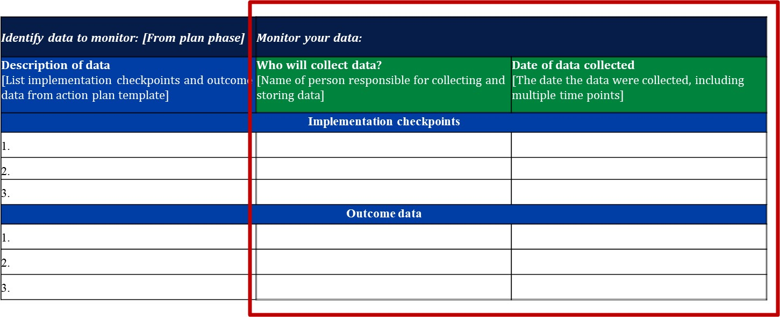
Collect your data
Collect your data
(Collis & Foster, 2018)
Notes:
Talking Points
Adhering to a data-monitoring process can be challenging, so establishing a manageable and efficient protocol will help us stick with the process.
We can use this data organizer to help us keep to an efficient protocol.
Facilitator's Note
• Determine if your team wants to use a collaborative digital space to upload artifacts and notes and how they want to record the data that will be monitored. This will vary depending on the type of data you are collecting, so there is no one template that will work for every team.
• A blank template of this data organizer can be found in appendix C.
• Refer to appendix D for an example from a use-case scenario.
References
Template adapted from Collis, S., & Foster, K. (2018, March 7). TIME for Care: Quality improvement for practice managers [PowerPoint slides]. SlideShare. https://www.slideshare.net/NHSEngland/improving-services-leading-change-implementing-change-in-rapid-cycles

Slide 33
Phase 4: Study
Notes:
Talking Points
Now we are ready to dive into phase 3 — Do.

Slide 34
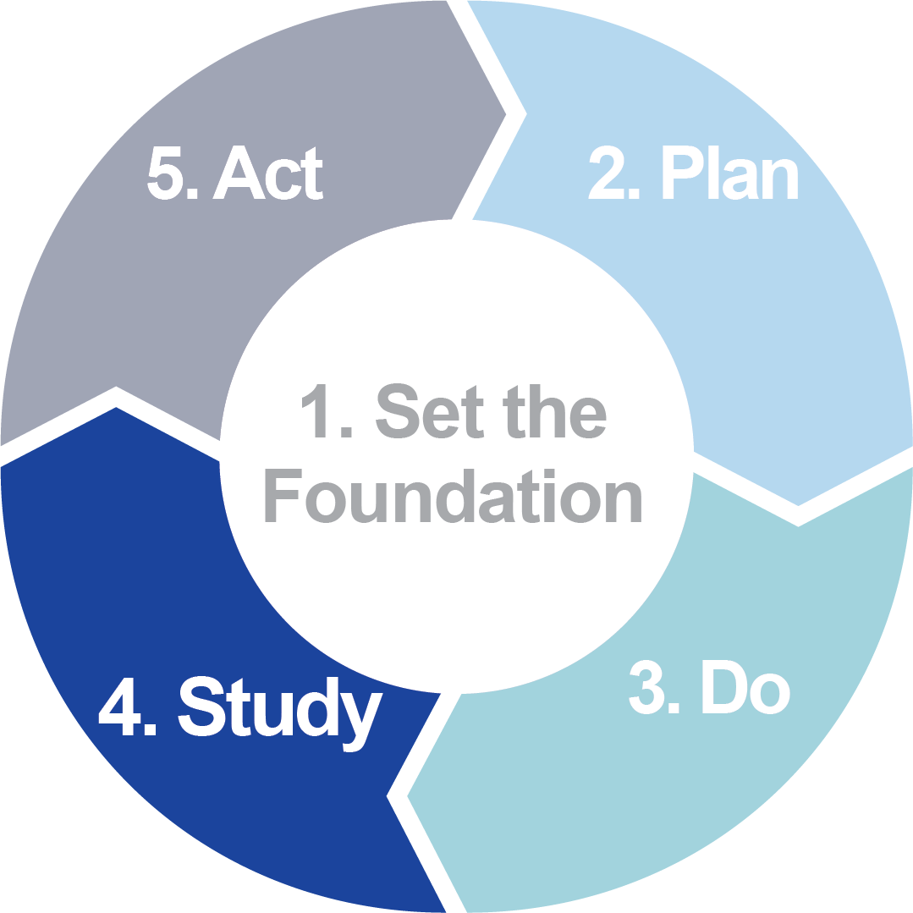
How to use these slides
Remember to delete this “How to” slide.
Recommendations:
In this phase, you will compare the predictions made in the Plan phase to what occurred during implementation. Remind your team that this is not a “gotcha!” This is about improvement.
In the “What to do in this phase” slide, use the analogy of building a house. During this phase, the house is inspected. We will study the actual construction (Do phase) and compare that work to the original blueprints (Plan phase) to consider our next steps in the Act phase.
Review pages 28–33 of the Facilitators’ Workbook for more details about the phase.

Slide 35
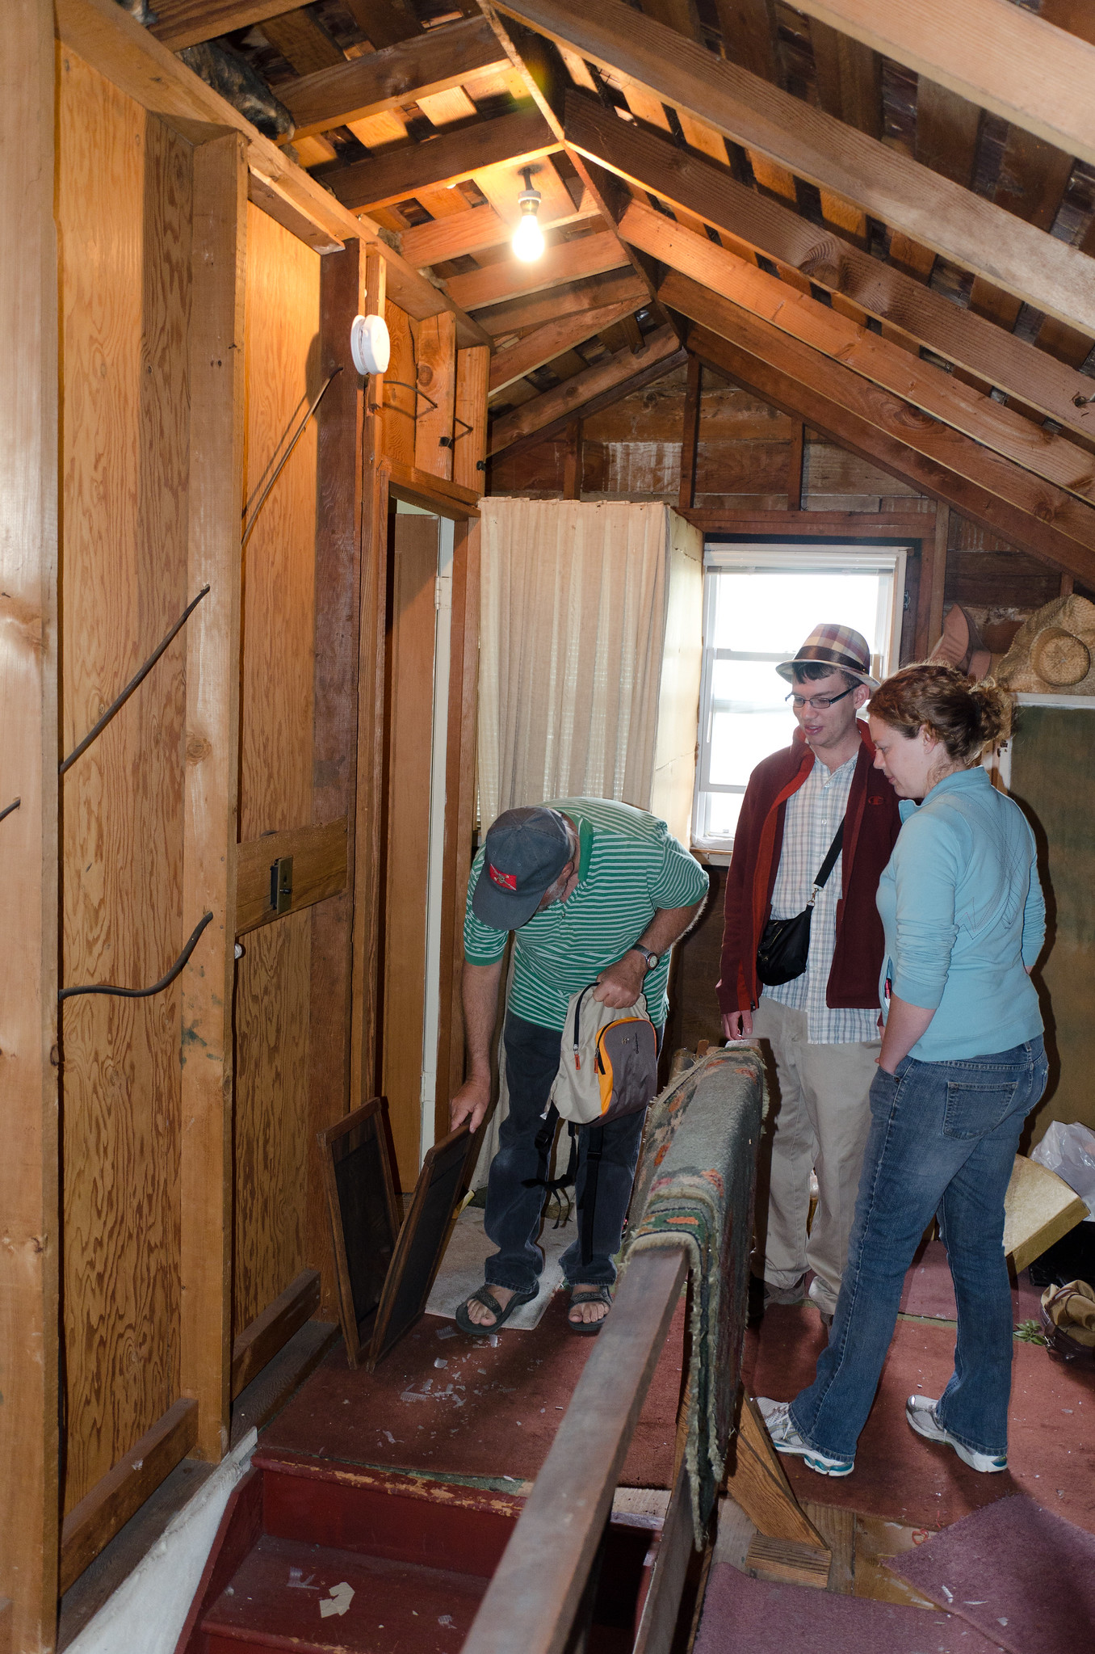
What to do in this phase
1
Compare initial predictions with actual occurrences.
2
Identify patterns and trends to inform next steps.
Notes:
Talking Points
Now that we have constructed our building based on the specifications in the blueprint, we’ll examine the building to learn whether the blueprint was followed or if deviations to the plan occurred. In the PDSA cycle, this inspection occurs during the Study phase.
In this phase, we will study our enacted process to learn what worked, what did not work, and identify patterns or trends that might inform next steps. If deviations to the original plan did occur, discuss how these deviations improved or impeded implementation and outcomes.
This phase includes two steps:
Compare initial predictions with actual occurrences.
Identify patterns or trends to inform next steps.
References
Image source: Flickr. (2011). https://www.flickr.com/photos/reidab/6051588198/

Slide 36
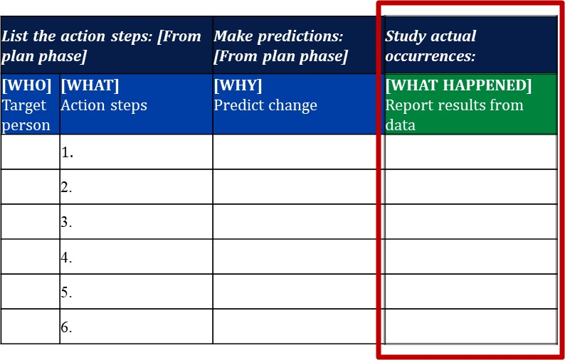
Compare predictions to actual occurrences
Analyze the data collected
Report the results in the action plan template
Describe what actually happened when the action step was implemented
(Cherasaro et al., 2015)
Notes:
Talking Points
We will now spend some time reviewing and reflecting on what actually happened as a result of implementation.
Facilitator's Note
• To prepare for the Study phase, you should schedule a one-hour improvement team meeting for data review.
• A blank template of this data organizer can be found in appendix C.
• Refer to appendix D for an example from a use-case scenario.
References
Template adapted from Cherasaro, T. L., Reale, M. L., Haystead, M., & Marzano, R. J. (2015). Instructional improvement cycle: A teacher’s toolkit for collecting and analyzing data on instructional strategies (REL 2015–080). Washington, DC: U.S. Department of Education, Institute of Education Sciences, National Center for Education Evaluation and Regional Assistance, Regional Educational Laboratory Central. https://ies.ed.gov/ncee/edlabs/regions/central/pdf/REL_2015080.pdf

Slide 37
Identify patterns and trends to inform next steps
Tips for reviewing
Describe, don’t interpret.
Remember we’re learners.
Take turns sharing.
Questions to ask
Did our predictions match our results?
What patterns do you see?
What actions/events might have influenced implementation of the evidence-based practice?
Notes:
Talking Points
As we study our enacted plan, let's consider these tips and questions.
Facilitator's Note
• Make sure to allot ample time for team reflections and discussion for this exercise.

Slide 38
Phase 5: Act
Notes:
Talking Points
Now we are ready to dive into phase 3 — Do.

Slide 39
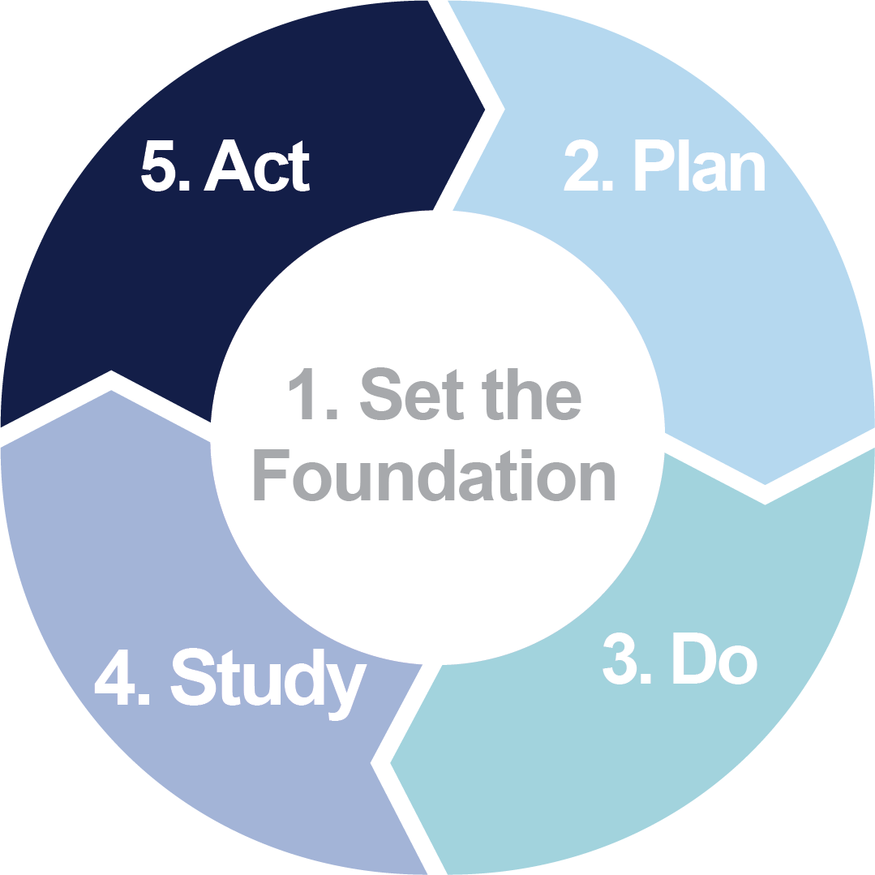
How to use these slides
Remember to delete this “How to” slide.
Recommendations:
Make sure to congratulate your team members for their effort throughout the first four improvement phases and help them appreciate what the team learned. Remember that the process is about improvement, so missteps can become opportunities.
In the “What to do in this step” slide, continue the analogy of building a house. The Act phase allows the homeowners to make the house their own. They can adjust or tweak items noted during the inspection that will improve how the home meets the needs of the family.
Review pages 34–40 of the Facilitators’ Workbook for more details about the phase.

Slide 40
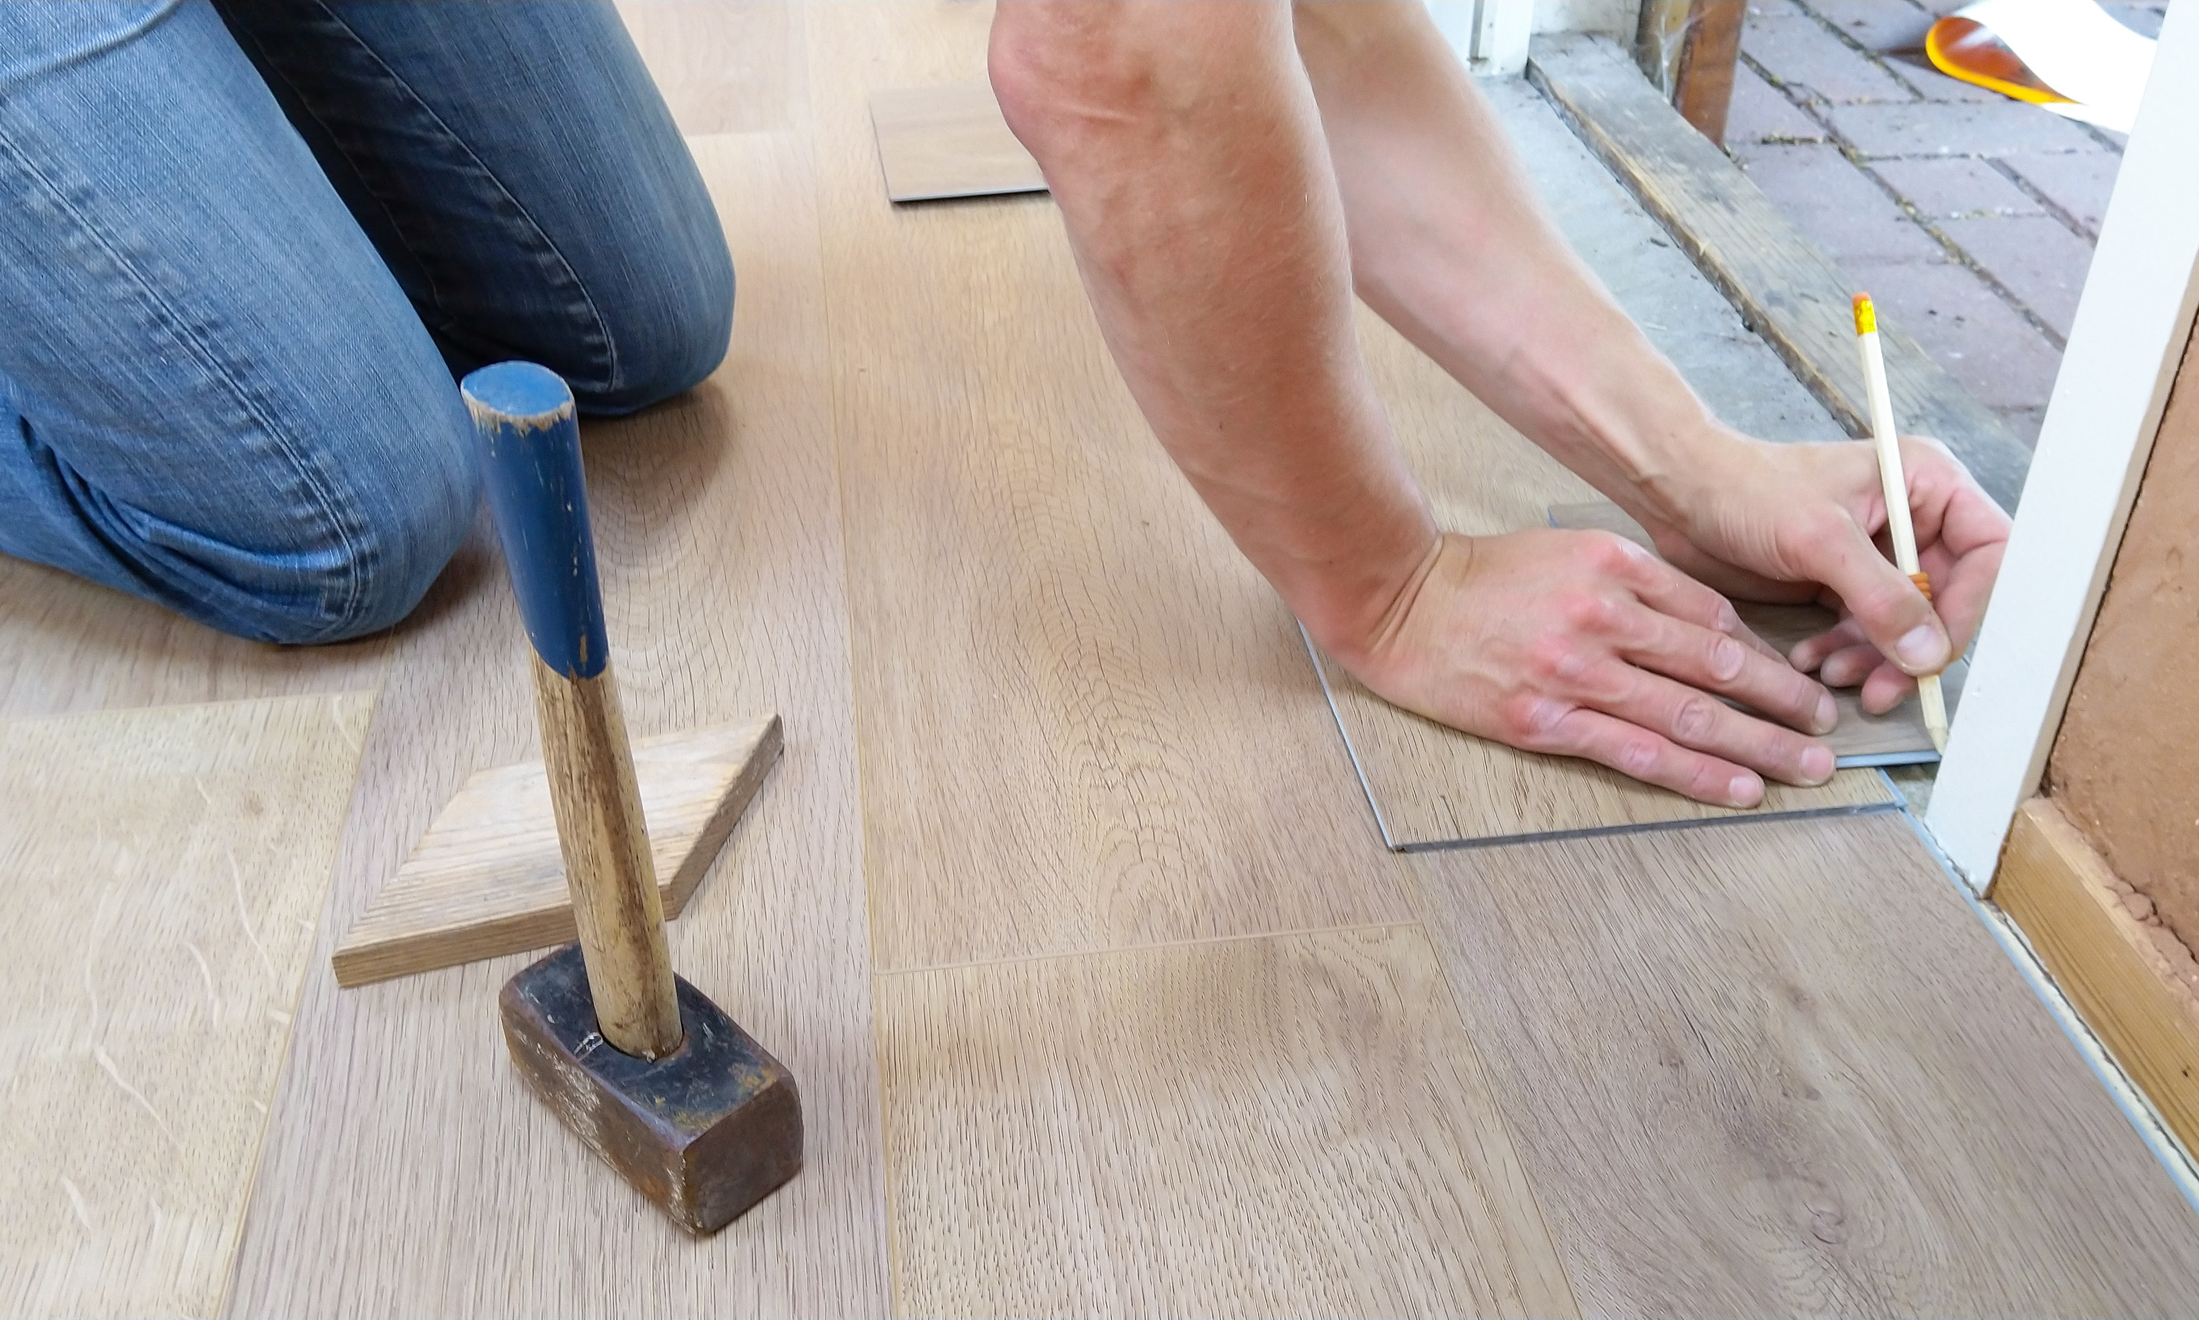
What to do in this phase
1
Identify new learnings
2
Think about next steps, adjustments, and improvements
Notes:
Talking Points
As with any construction project, once the house is inspected, there are often things that need adjustment. Upon finding something amiss, the official does not demand that the house be demolished and rebuilt, but instead identifies which items to fix. This is like the PDSA Act phase, in which school teams decide to make adjustments.
This phase includes two steps:
Identify new learnings.
Think about next steps, adjustments, and improvements.
References
Image source: Pexels. (n.d.). https://www.pexels.com/search/home%20renovation/

Slide 41
Reflect on next steps
Congratulations on reaching the Act phase!
It’s time to reflect and decide next steps!
Notes:
Talking Points
The fifth and final step of the process is Act. Let’s congratulate ourselves on making it to this step in the cycle!
Let’s also remind ourselves — the scientific process is at the heart of the PDSA cycle — learning what worked, what did not work, and refining implementation will help us improve student outcomes.
Rather than demolishing what we built, our task is to decide what adjustments to make in our process so that we can continue to improve outcomes.

Slide 42
Think about next steps, adjustments, and improvements
Individually record your thoughts on next steps by answering these four guiding questions.
We will use a round-robin approach to share our learnings and discuss next steps.
(Cherasaro et al., 2015)
Notes:
Talking Points
We’ll use the guiding questions on this slide to help use determine next steps. Remember to base your recommendations on the data we collected in the Do phase and the analysis we conducted during the Study phase.
What did we learn when we studied the data and information?
What revisions should make to our action steps?
What are our immediate next steps?
What are our longer term next steps?
Facilitator’s Notes:
Provide think-time to allow team members to respond to the questions individually prior to discussing these as a whole group. Once team members have responded to the questions, you might begin by encouraging each member to share his or her biggest takeaway from the summary of learnings we prepared in the Study phase.
A blank template of these questions can be found in appendix C.
Refer to appendix D for an example from a use-case scenario.
References
Template adapted from Cherasaro, T. L., Reale, M. L., Haystead, M., & Marzano, R. J. (2015). Instructional improvement cycle: A teacher’s toolkit for collecting and analyzing data on instructional strategies (REL 2015–080). Washington, DC: U.S. Department of Education, Institute of Education Sciences, National Center for Education Evaluation and Regional Assistance, Regional Educational Laboratory Central. https://ies.ed.gov/ncee/edlabs/regions/central/pdf/REL_2015080.pdf

Slide 43
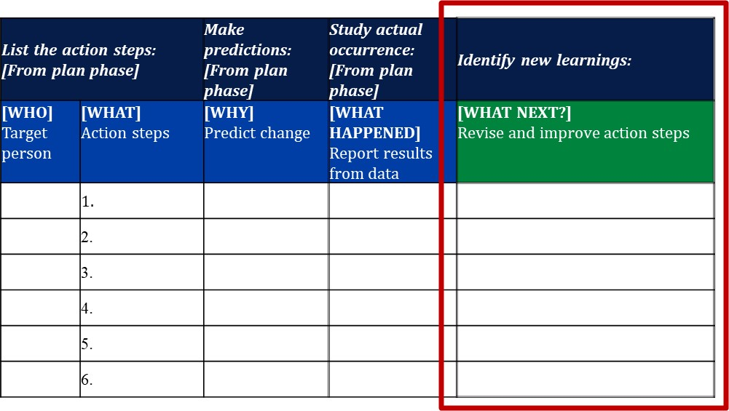
Identify new learnings
What insights do you have?
What are new learnings?
(Cherasaro et al., 2015)
Notes:
Talking Points
Now we will finalize our next-step decisions and record these on our template. These decisions will guide our actions in the next PDSA cycle.
Facilitator's Note
• A blank template of this data organizer can be found in appendix C.
• Refer to appendix D for an example from a use-case scenario.
References
Template adapted from Cherasaro, T. L., Reale, M. L., Haystead, M., & Marzano, R. J. (2015). Instructional improvement cycle: A teacher’s toolkit for collecting and analyzing data on instructional strategies (REL 2015–080). Washington, DC: U.S. Department of Education, Institute of Education Sciences, National Center for Education Evaluation and Regional Assistance, Regional Educational Laboratory Central. https://ies.ed.gov/ncee/edlabs/regions/central/pdf/REL_2015080.pdf

Slide 44
Next Steps
Notes:
Talking Points
Now we are ready to dive into phase 3 — Do.

Slide 45
How to use these slides
Remember to delete this “How to” slide.
Recommendations:
Always end a meeting with next steps, clearly specifying who is doing what and what to expect in the next meeting.
Given people’s busy schedules, this might be a good time to get calendars out and verify the next meeting date and time.

Slide 46
Reflecting on the meeting
What is something we discussed that squared with your experience?
What are three points you want to remember?
What is a lingering question still going around in your mind?
Notes:
Facilitator's Note
• Use this time for team reflections as needed.

Slide 47
Next steps
Confirm meeting date
Review to-do list
Next meeting’s objectives
Notes:
Facilitator's Note
• Record next steps and send to team so everyone is clear on next steps.

