Slide 1
Module 1 presentation Planning for a

Slide 2
Outline
Is a survey the right approach?
Planning for a survey.
Considerations.
Activity.

Slide 3
Outline
Is a survey the right approach?
Planning for a survey.
Considerations.
Activity.

Slide 4
First, are you sure you want to create a survey?
Notes:
A survey can produce quantitative descriptions of the characteristics and attributes of a population.
Surveys are appropriate data collection tools for many purposes but are not the best method for every research project.
Other methods can be considered before deciding to create a survey.

Slide 5
Other data collection options
Interviews?
Focus groups?
Observations?
Analyze existing data?
Notes:
The four primary options for data collection, other than surveys, are semi-structured interviews, focus groups, observations, and analyzing existing data.

Slide 6
Interviews
Notes:
Interviews are suitable for investigating complex topics without well-defined research questions.

Slide 7
Focus groups
Notes:
Focus groups may reveal interesting perspectives about a topic through group interaction. The discussion among participants about a topic can provide a more rich description of their views and experiences than a set of individual interviews or surveys with the same people.
Focus group methodology is described in module 8.

Slide 8
When to use focus groups instead of a survey
Focus Groups
Surveys
Notes:
In some cases, a focus group study may be more appropriate than a survey study. A focus group is preferred if:
The important details and questions surrounding the topic are not well known or well defined.
The topic is complex, and you want to understand people’s views and positions.
You do not need a representative sample of a population to meet the goals of the project.
You think group interaction may reveal interesting perspectives about the topic.
The issues or response categories are not clear.
It is important to have individuals with a diverse range of opinions interact with each other.
It is important to hear from and be responsive to multiple stakeholder groups.
You are interested primarily in individuals’ feelings and perceptions.
You are trying to understand individuals’ or organizations’ processes.

Slide 9
Observations
1. Planning for a Survey
Notes:
Observations can be used to collect data about behaviors or practices (for example, teacher-child interactions) that might not be reported accurately in a survey.

Slide 10
Analyzing existing data
Notes:
Analyzing existing data can be a cost-effective way to explore relationships between variables in administrative data files.

Slide 11
Outline
Is a survey the right approach?
Planning for a survey.
Considerations.
Activity.

Slide 12
Think about how the results will be used.
Research goals
Notes:
What are your goals? What do you want to learn from the survey results?
Describe current practices or behaviors.
Understand attitudes.
Evaluate the outcomes of a program or an initiative.
Consider the following:
Available funds.
Timeframe.
With whom will the findings be shared?
What actions or decisions will the survey results inform?

Slide 13
Clarify your research goals.
Notes:
When specifying the goals of the survey provide a clear explanation of why the survey is being created, whom the results will be shared with, and how the results will be used.
Clarify the actions or decisions you want the results of the survey to inform. Why do you want this information? For example:
Should we spend more resources to encourage non–English-speaking parents to participate in kindergarten orientation activities?
What is the best way to allocate resources for increasing school safety at our high schools?
Consider all stakeholders when setting the goals for a survey.

Slide 14
Define your research questions.
Notes:
Write research questions, describing what you want answered by your survey data. Research questions should describe what you want to know and about whom. Consider the following examples:
What barriers to school involvement are non–English-speaking parents experiencing?
How physically safe do high school students feel at their school, and how does this relate to school safety measures?

Slide 15
Align research questions to your research goals.
Notes:
Evaluate each research question against the survey’s research goals. Resist the temptation to add topics and items that do not directly serve the stated purpose.
One strategy to help clarify the plans for the survey is to envision writing the survey findings. What do you want to say in your report? For example:
“____ percent of parents of English learner kindergartners and ____ percent of parents of non–English learner kindergartners attended kindergarten orientation activities.”
“ ____ percent of high school students reported witnessing violent crime in the school building or on school grounds in the past year.”
Be mindful of time and budget when establishing what the survey will accomplish. Spend time preparing and gaining consensus on the goals and research questions. These important documents will guide every decision along the way.

Slide 16
Define each construct in your research questions.
Notes:
A construct is an idea or a characteristic that may be thought of in different ways (for example, family engagement, leadership, or highly qualified). Explicitly defining the constructs for a survey is important at the planning stage. To ensure consideration of all important elements of a survey, survey developers should look to the literature, existing surveys, experts, stakeholders, and their own prior knowledge and experiences.
Be specific when defining constructs. For example, if district administrators are interested in teacher perceptions of family engagement, then the survey might cover topics such as attendance at school events, frequency of communication, and shared decisionmaking. It will be important to reach a consensus on what each construct means and which aspects are important to include on a survey.

Slide 17
Example research question:
How is participation in extracurricular activities related to our high school students’ academic engagement?
Notes:
Example research question: How is participation in extracurricular activities related to our high school students’ academic engagement?
What do you want to know about participation in extracurricular activities?
What is the type of activity (for example, social, academic, sports, or club)?
What is the type of participation (for example, leadership role)?
How many different activities do students participate in?
What amount of time per week do they spend in activities?
How many school years have students been involved in the activity?
There are multiple ways to define and measure the construct academic engagement.
Review academic literature.
Convene a panel of experts in the field.
Consult existing surveys that measure the construct.
Constructs such as this are typically measured with a set of items.

Slide 18
Identify subgroups of interest.
Notes:
Within the population you want to describe (for example, students, teachers, or schools), across what characteristics do you want to compare the survey findings? Consider the following:
Student: gender, race/ethnicity, grade level, English learner status, special education status, and eligibility for the school lunch program.
Teacher: gender, race/ethnicity, grade level, license area, and years of experience.
School: grade levels, enrollment, percentage of students from minority backgrounds, and school type.
Determine what subgroup comparisons would be of interest. These subgroups should be chosen based on a perceived relationship with the survey’s topic of interest. For example, if a survey is about the implementation of Response to Intervention statewide, it should include items that relate to school characteristics that might affect implementation (for example, school size, school type, grade levels, and the number of qualified personnel).
Determining the appropriate subgroups to identify in the survey sample is important so that the findings can be presented in light of these different subgroups. In some cases, the subgroup characteristics can be linked to the survey responses by linking identification numbers to administrative files or other databases and will not need to be included as additional items on the survey. For example, if school identification numbers are linked to school surveys, information about the school that can be obtained through records, such as school size, would not need to be included as survey items.

Slide 19
Determine your unit of analysis.
Notes:
The unit of analysis is the set of people, programs, or institutions the researcher wants to make statements about. For example, you might want to make statements about the following groups:
Students (for example, 30 percent of the students walk to school).
Families (for example, 30 percent of the families have a child who walks to school).
Schools (for example, 30 percent of the schools have a majority of students who walk to school).
Districts (for example, 30 percent of the districts have a majority of students who walk to school).
As another example, if the goal of the survey is to describe the characteristics of afterschool academic programs, the unit of analysis is the program. The program director, teacher, and student data will be structured so that the findings are about the program (for example, the percentage of programs that provide transportation, the percentage of programs with at least one highly qualified teacher, or the average number of students enrolled in a program).
It may be useful to consider multiple units of analysis for a survey about afterschool programs (for example, the percentage of schools with a program or the percentage of parents in schools with a program who are aware of the program).
Ensure that whom the survey is administered to and the unit of analysis align with the data structure needed to answer the research questions.

Slide 20
Identify who will provide the most accurate data for each construct.
Notes:
Carefully identifying who can best provide the information needed will help determine the design of the study. For instance, if workshop participants are interested in measuring kindergarteners’ adjustment to school, consider whether kindergartners themselves, teachers, or parents will be best suited to provide that information. This decision has implications for how the survey will be developed and administered.
Example research question: How physically safe do high school students feel at their school, and how does this relate to schools’ safety measures?
High school students can report how safe they feel.
Who is best able to report on school safety measures (the principal, teachers, a trained observer, or security staff)? Are multiple respondents needed to get a complete picture?
Example research question: What professional supports are available and used by elementary school math teachers?
Teachers can report what supports they know about and use.
Who will give the most accurate data about what supports are available?
The unit of analysis and the data source are not always the same.

Slide 21
Careful planning is essential for developing a survey.
Notes:
In summary:
Clarify the purpose of the survey.
Write research questions.
Carefully define important constructs.
For drawing comparisons, determine the important subgroups of interest.
Determine the most knowledgeable respondent or respondents for each construct. Decide if multiple respondents are needed to meet the survey goals.

Slide 22
Outline
Is a survey the right approach?
Planning for a survey.
Considerations.
Activity.

Slide 23
Reliability is the consistency with which a set of items measures an attribute.
(Pastor, 2013)
Notes:
Reliability and validity are important considerations at multiple stages of survey development.
Reliability is the consistency with which a set of items measures an attribute. A reliable item is interpreted the same way by all respondents and adequately covers the elements of each construct, thereby producing stable results about those constructs. For a single item, reliability can relate to how item wording ensures that a respondent will understand the item the same way at different points in time. It also can relate to the extent to which different respondents understand an item to have the same meaning. With a group of items measuring the same construct, reliability can relate to the extent to which the items are answered consistently (for example, if item 1 is answered yes, then item 2 should also be answered yes).
Survey items that are not reliable do not produce consistent responses at different points in time and across respondents. This inconsistency introduces measurement error (Pastor, 2013).

Slide 24
Validity is the extent to which the inferences made based on survey responses are accurate and meaningful.
(Pastor, 2013)
Notes:
Validity is the extent to which the inferences made based on survey responses are accurate and meaningful. A valid survey instrument provides results that accurately reflect the measured constructs and the target population as intended by the individuals who designed the survey and who will interpret the results.
A valid item measures what the researchers intend it to measure. For example, a question on student perceptions of school safety must accurately measure student perceptions of safety in the school and not safety elsewhere.
Survey items that are not valid do not capture the true meaning of the construct and therefore do not measure what the researcher intended (Pastor, 2013).

Slide 25
Outline
Is a survey the right approach?
Planning for a survey.
Considerations.
Activity.

Slide 26
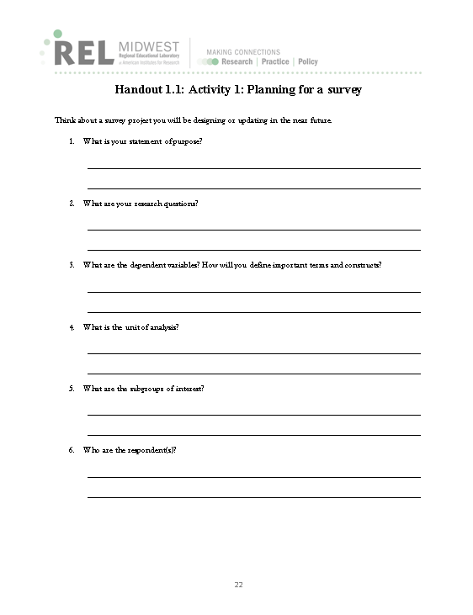
Activity 1: Planning for a survey

Slide 27
Additional resources
Kendziora, K., & Boccanfuso, C. (2011). School climate survey series: Survey management [Survey webinar series for the National Center on Safe Supportive Learning Environments]. Retrieved April 1, 2016, from http://safesupportiveschools.ed.gov/index.php?id=9&eid=6.
Shindler, J. (2011). School climate survey series: Survey development [Survey webinar series for the National Center on Safe Supportive Learning Environments]. Retrieved April 1, 2016, from http://safesupportiveschools.ed.gov/index.php?id=9&eid=8.
For more information, please visit the following websites:
The American Association for Public Opinion Research: http://www.aapor.org/.
Public Opinion Quarterly: https://poq.oxfordjournals.org/.
Journal of Survey Statistics and Methodology: http://jssam.oxfordjournals.org/content/current.

Slide 28
Reference
Pastor, D. A. (2013, April). Considerations in evaluating, selecting and developing data sources and measures. IES webinar for Regional Educational Laboratories.

