Slide 1

Module 2 presentation
Exploring existing item sources

Slide 2
Outline
Why use existing survey items?
About existing sources.
Examples of sources.

Slide 3
Outline
Why use existing survey items?
About existing sources.
Examples of sources.

Slide 4
Why use existing survey items?
Notes:
When developing a survey, a good strategy is to look at other tested surveys on a similar topic and consider borrowing or adapting existing items.
Why?

Slide 5

Why use existing survey items?
Notes:
Time

Slide 6

Why use existing survey items?
Notes:
And money (if hiring someone to develop survey items).

Slide 7

Why use existing survey items?
Notes:
Using existing survey items not only saves time and money but also allows you to measure constructs in the same way that others in the field have measured them.
Although writing new survey items may seem easy, if done correctly, it is actually a difficult and time-consuming process. New survey items need to be tested to ensure that they are capturing the information accurately and often require several revisions.
Not all existing survey items have been tested for reliability, validity, and other important psychometric properties. Whenever possible, use trusted sources that test survey items for reliability and validity. Some of these sources are cited here and in handout 2.1. When in doubt, check the documentation of existing survey items for details on their reliability and validity.
Ensure that you have permission to use an item before including it on your questionnaire.

Slide 8
Outline
Why use existing survey items?
About existing sources.
Examples of sources.

Slide 9

Existing surveys
Notes:
This discussion highlights sources from which you can find existing items and answer scales. The sources are from two centers within the Institute of Education Sciences:
National Center for Education Statistics (NCES).
National Center for Education Evaluation and Regional Assistance (NCEE).

Slide 10
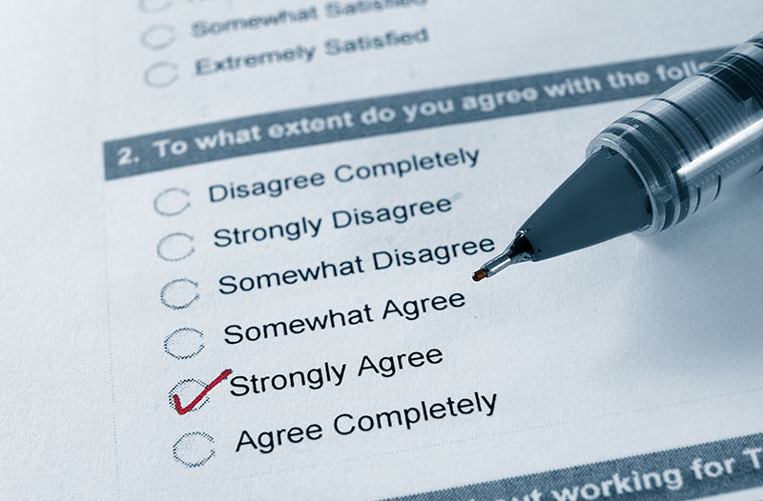
Considerations:
Borrowing items
How was the item
asked originally?
Who answered the
question originally?
Notes:
Before borrowing an existing item, consider the following:
What was the mode of the survey (for example, phone interview, computer, or paper and pencil survey)? The mode can affect how an item is asked. For example, a survey administered on the phone by an interviewer allows the survey respondent to clarify any confusing aspects of an item. If you borrow an item designed to be asked over the phone to use in a paper-and-pencil survey that respondents must answer on their own, ensure that important terms and constructs are defined clearly.
Who answered the original survey (for example, students, parents, or teachers)? Different groups may think and talk about the same topic differently, so carefully consider how an item may need to be adapted for the type of respondent answering the survey.
One further consideration is whether the borrowed item is publicly available or if permission is needed. Always provide citations for borrowed items.

Slide 11
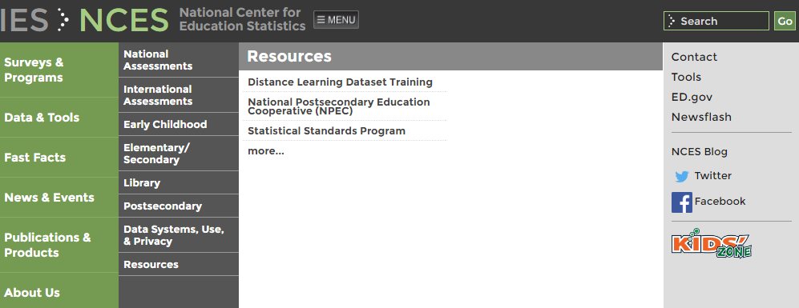
NCES surveys
Notes:
You can search NCES surveys online (http://nces.ed.gov) to identify items or scales for your survey. Survey experts have evaluated items and scales on these surveys to determine that they are capable of yielding valid and reliable data for a given population.
Check survey-specific documentation, such as data file user manuals, methodology reports, and psychometric reports, for detailed information on reliability and validity.

Slide 12
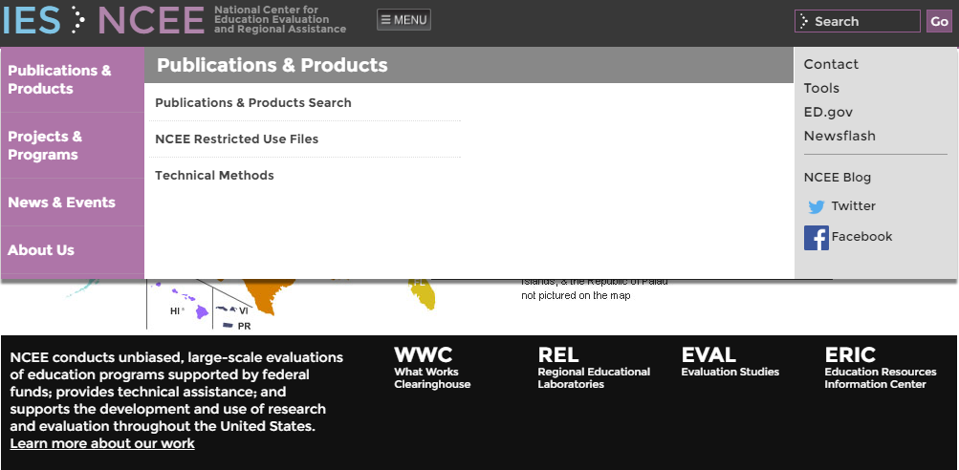
NCEE reports
Notes:
You can also search NCEE reports that summarize and detail survey item sets related to specific constructs, such as school readiness or student engagement (http://ies.ed.gov/ncee/; click on “Publications & Products”). Many of the reports detail survey items and sets of survey items used in evaluation studies.

Slide 13



Topics
Notes:
NCES and NCEE administer surveys on a variety of topics, such as:
Parent involvement.
School climate.
School readiness.

Slide 14


Survey respondents
Notes:
NCES and NCEE also administer surveys to a variety of respondents, such as:
Teachers.
Parents.
School administrators.
Students.

Slide 15
Outline
Why use existing survey items?
About existing sources.
Examples of sources.

Slide 16
NCES schools and staffing survey
Notes:
The NCES Schools and Staffing Survey includes items about teacher perceptions and practices (http://nces.ed.gov/surveys/sass/).

Slide 17
Parent and family involvement survey
Notes:
The NCES National Household Education Surveys include survey items for parents about many education topics (https://nces.ed.gov/pubsearch/pubsinfo.asp?pubid=2013028rev). See also http://nces.ed.gov/nhes/.

Slide 18
Education longitudinal study of 2002
Notes:
The NCES Education Longitudinal Studies include surveys of secondary teachers and students. An example of a set of items for a student survey about school climate can be found at http://nces.ed.gov/surveys/els2002/.

Slide 19
NCEE reports: Student, teacher, and classroom measures
Notes:
The NCEE report Compendium of student, teacher, and classroom measures used in NCEE evaluations of educational interventions is a two-volume compilation and review of 94 student, teacher, and classroom outcome measures used in IES-funded evaluations between 2005 and 2008 (http://ies.ed.gov/ncee/pubs/20104012).

Slide 20
NCEE reports:
Student engagement
Notes:
The NCEE report Measuring student engagement in upper elementary through high school: A description of 21 instruments reviews 21 instruments that measure student engagement through the later years of elementary school through high school. Scales (that is, a set of survey items, typically three or more, that measure a construct) include student reports, teacher reports, and observation (http://ies.ed.gov/ncee/edlabs/regions/southeast/pdf/REL_2011098.pdf).

Slide 21
NCEE reports:
Character education
Notes:
The NCEE report Survey of outcomes measurement in research on character education programs reviews the constructs, frameworks, and measures of character education programs. Examples include student outcomes, such as critical thinking and decisionmaking, attitudes, and various behaviors (http://ies.ed.gov/ncee/pdf/2009006.pdf).

Slide 22
NCEE reports:
School readiness
Notes:
The NCEE report A review of methods and instruments used in state and local school readiness evaluations reviews the methods and instrumentation used in school-readiness analyses and program evaluation (http://files.eric.ed.gov/fulltext/ED497789.pdf).

Slide 23
NCEE reports: Resiliency and youth development
Notes:
The NCEE report measuring resilience and youth development: the psychometric properties of the Healthy Kids Survey describes the psychometric properties of resilience measures in the resilience and youth development component of the Healthy Kids Survey (http://ies.ed.gov/ncee/edlabs/projects/project.asp?ProjectID=84).

Slide 24
Other resources:
Social-emotional learning
Notes:
The NCEE report Compendium of preschool through elementary school social‐emotional learning and associated assessment measures focuses on 5- to 10-year-olds and outlines a variety of scales that measure social-emotional
learning (http://www.isbe.state.il.us/learningsupports/pdfs/sel-compendium.pdf).

Slide 25
Other resources:
School climate
Notes:
The National Center on Safe Supportive Learning Environments website (http://safesupportiveschools.ed.gov/index.php?id=133) has links to approximately 50 school climate surveys or surveys that include school climate items. Some of these surveys are copyright protected, so check with the publisher before using any items.

Slide 26
Other resources: Q-Bank
Notes:
Q-Bank is a resource that provides information about survey items included on many federal surveys (http://wwwn.cdc.gov/qbank/Home.aspx). It offers access to thousands of items that appear on federal surveys. Users can search items by keywords, topic, agencies that tested a item, and specific surveys where the item appears. Searches return links to reports that describes findings related to testing of the items (for example, cognitive interview results). Typically, searches will link to reports related to items tested for a particular survey. Q-Bank is not a comprehensive system of every item on all federal surveys.

Slide 27
Other resources: Common education data standards
Notes:
The Common Education Data Standards standardize the way that agencies collect basic information so that comparisons can be made across local, state, and federal agencies. The website has standardized definitions of common variables (https://ceds.ed.gov/).

Slide 28

Final notes for existing items
Notes:
Many existing item sources are available. In addition to the sources cited earlier, there are other federal surveys that include survey items about disabilities and student risk-taking behavior. Examples include the American Community Survey administered by the U.S. Census Bureau and the Youth Behavior Risk Survey administered by the Centers for Disease Control and Prevention.
Finally, ensure that you have permission before using existing items. Check technical manuals to ensure that the item measures what you want to measure.

Slide 29
Additional resources
Shindler, J. V. (2011). Survey development [Survey webinar series for the National Center on Safe Supportive Learning Environments]. Retrieved April 1, 2016, from
http://safesupportiveschools.ed.gov/index.php?id=9&eid=8.
For more information, please visit the following sites:
The American Association for Public Opinion Research: http://www.aapor.org/.
Public Opinion Quarterly: https://poq.oxfordjournals.org/.
Journal of Survey Statistics and Methodology: http://jssam.oxfordjournals.org/content/current.

Slide 30
Reference
Pastor, D. A. (2013, April). Considerations in evaluating, selecting, and developing data sources and measures. IES webinar for Regional Educational Laboratories.

