Slide 1
Module 4 presentation Pretesting survey items

Slide 2
Pretesting items ensures validity.
Notes:
Pretesting is a set of processes for reviewing items before using them in the final survey (Lavrakas, 2008). Pretesting increases the validity of a survey by ensuring that the relevant aspects of the topics are included that respondents understand the items as intended.
The results of pretesting will inform revisions to the survey to improve its validity.
If items have been administered or tested previously but will be used in a different context, with a different type of respondent, or in a different survey mode, you should still pretest them to ensure that they will work well in your context.

Slide 3
Set pretest goals.
Notes:
Pretesting should have its own set of specific goals. What do you want to learn about? Example goals could include:
To ensure that the survey items appropriately capture all facets of the topic under investigation.
To examine whether respondents understand what the survey items are asking.
To test response categories so that all respondents interpret them in a similar way.

Slide 4
Outline
Methods to test new survey items:
Expert reviews.
Cognitive interviews.
Focus groups.
Field testing.
Notes:
Depending on the goals of the study, survey developers may employ one, or possibly all four, pretesting methods.

Slide 5
Outline
Methods to test new survey items:
Expert reviews.
Cognitive interviews.
Focus groups.
Field testing.

Slide 6
Expert reviews
Notes:
If you ask experts to review a draft of the survey, give specific guidance about what aspects of the survey you want them to focus on. Experts may provide valuable insights into what important items might be missing from the survey or how to improve the wording of survey items given their knowledge of certain respondent types. Be sure to provide background about the purpose and eventual use of the survey results so that the experts can offer the most appropriate feedback.
Expert reviews can also occur at other points in the survey development process. For example, you may ask experts to suggest surveys from which to borrow items, review findings from other pretest methods, or help make final revisions.

Slide 7
Who are the experts in the area you want to study?
Notes:
Experts can be academics, practitioners, or other professionals who are knowledgeable about the topics covered in the survey. Who are the leading experts in the topic you want to study?
Although expert reviewers can provide depth of knowledge on a subject, they often do not represent the viewpoint of the respondent. Therefore, pretesting surveys with potential respondents is also encouraged.

Slide 8
Outline
Methods to test new survey items:
Expert reviews.
Cognitive interviews.
Focus groups.
Field testing.

Slide 9
Cognitive interviews
9
1. Planning for a Survey
Notes:
A cognitive interview is a one-on-one interview between an interviewer and a respondent that is designed to reveal how respondents understand and respond to the survey items. The technique draws from the field of cognitive aspects of survey methodology (Jabine, Straf, Tanur, & Tourangeau, 1984; Lavrakas, 2008).
Four key processes are investigated:
How respondents understand and interpret an item.
How respondents retrieve information to answer the item.
The process respondents use for making a decision.
How respondents answer the item.

Slide 10
Cognitive interviews: Purpose
A cognitive interview is an appraisal of the survey questions.
Notes:
A cognitive interview is an appraisal of the item being administered. It is geared toward uncovering sources of error.

Slide 11
Cognitive interviews: Purpose
A cognitive interview is not a test.
Notes:
A cognitive interview is not a test of whether the respondent answers the items correctly. Although the respondent’s answer is of interest, specifically in identifying response errors, the interviewer is equally interested in how the respondent arrives at that answer, how the respondent interacts with the items, and what the respondent says.

Slide 12
Cognitive interviews: Schedule
Round 1
Interviews
Round 2
Interviews
Round 3
Research questions
Review findings
Make changes
Final report
(if needed)
Interviews
Review findings
Review findings
Make changes
Notes:
This slide shows a typical cognitive interview schedule, beginning with documentation of the research questions for the cognitive interviews and ending with a final summary of interview findings and recommendations for the final survey draft.
Round 1 usually catches major misunderstandings of the items, particularly if they are new. After round 1, review your notes and revise the items as necessary.
Ideally, you will have time to conduct at least one more round to ensure that the revised items eliminate any confusion identified in round 1.
Multiple rounds with multiple respondents (for example, three rounds with nine respondents each) may be needed to incorporate feedback, revise items, and test the revised items. As a general rule of thumb, cognitive interviews can cease when no new sources of error are discovered after interviewing several respondents.
You may wish to write a final report that details the number of interviews conducted, important respondent characteristics, and a summary of your procedure and findings.

Slide 13
Structure your cognitive interview.
Notes:
The basic outline of a cognitive interview is:
Recruit individuals from the target population.
Identify who will conduct the interviews.
Train interviewers on the cognitive interviewing techniques discussed in this module.
Conduct the interviews.
Compile and review interview notes.

Slide 14
Identify cognitive interview respondents.
Notes:
It is important to make sure that the respondents who participate in cognitive interviews are similar to the respondents who will take the survey. For example, if you are designing a survey about teacher professional development and perceptions about the usefulness of training content, think about all kinds of teachers who will participate in the final survey (for example, new teachers and science teachers).
Recruit cognitive interview participants who are similar to the sample (and important subgroups) who will take the final survey.
Recruitment is similar to that of focus groups (see module 8).
Use flyers, newspapers, the Internet, and points of contact for rare populations.

Slide 15
Cognitive interviewer
Who should do the interviews?
Notes:
Who should do the interviews?
Someone:
With good interpersonal skills.
With knowledge of issues related to measurement.
Familiar with surveys and survey design.
Familiar with the survey topic.
(Willis, 2005).

Slide 16
Interview approaches
Concurrent “think-aloud”
Retrospective probing
Notes:
It is not the interviewer’s role to explain what an item means; rather, the interviewer gets the respondent to talk about what he or she was thinking when answering the item (that is, what the respondent thinks the item is asking).
Cognitive interviewers often employ two types of interview approaches: concurrent think-alouds and retrospective probing. The goal of the interview will determine which approach is used. Interviewers can use either method or a mixture of both.

Slide 17
Concurrent “think-aloud”
Ask participants to verbalize what they are thinking.
Notes:
What happens in concurrent think-alouds?
Respondents verbally tell you what they are thinking as they answer an item.
Respondents allow the interviewer to understand their cognitive processes in answering the item.
In a concurrent think-aloud, the interviewer asks the respondent to read the item aloud and verbalize aloud what he or she is thinking about when formulating an answer. After the respondent thinks through and gives a response, the interviewer should seek clarification on statements that may represent sources of error. Concurrent think-alouds are useful when knowing the process that a respondent uses to answer an item is important.
For example, suppose that you are testing an item that asks parents about weekly, regularly scheduled child care arrangements with relatives (“Does this child have any regularly scheduled relative care arrangements in a typical week?”). To answer this item, parents are required to think through who cares for the child, and whether the care is regularly scheduled on a weekly basis.
The interviewer should pay attention to how the parent answers. Parents may forget about certain days or times of the week, such as weekends or evenings, when a child is cared for by a relative. Are all days of the week mentioned, or are there gaps in days or times (are evenings mentioned?). If, after several interviews, it is determined that parents are omitting relative care arrangements, the item may need to be revised, either through changes in wording or format.
Concurrent think-alouds also may be useful when you are testing a brand new item that has never been used before. Sometimes important sources of error can be found by just having the respondent think aloud while answering an item.

Slide 18
Retrospective probing
Ask specific questions after task completion.
Notes:
In retrospective probing, interview questions are asked after the respondent has completed a task: an item, a section of the survey, or the entire survey. Interview teams should determine which is most appropriate for their needs (Willis, 1999).
Retrospective probing provides targeted information about how respondents navigate through, interact with, and answer the items. Retrospective probes are useful when testing items that have been used before, or in later stages of survey development when finalizing the survey and ensuring that no lingering issues with understanding remain.
Retrospective probing is less taxing for the respondent than concurrent think-alouds, but some detail in how respondents answer an item may be lost because respondents may be unable to accurately recall what they were thinking when they answered an item.

Slide 19
“Think-aloud” advantages and disadvantages
Notes:
What are the advantages of think-alouds?
There is less concern for interviewers leading respondents and causing bias.
Less interviewer training involved because respondents do most of the talking while the interviewer actively listens.
The open-ended format lends itself to richer information that otherwise may not be collected.
What are the disadvantages of think-alouds?
Respondents must be given an example of a probe because not everyone is used to thinking aloud.
The burden is on respondents because they are required to verbalize their thoughts while interviewers actively listen and jot down notes.
Some respondents may not explain their thought process and just give an answer to the survey item.
Some respondents may stray from the survey item and interview question at hand.
(Willis, 1999)

Slide 20
“Retrospective probing” advantages and disadvantages
Notes:
What are the advantages of retrospective probing?
It is less taxing for respondents because they are not required to verbalize their thoughts.
Retrospective probes are a more structured type of interview, where the interviewer asks predetermined interview questions and the respondents answer. Therefore it can be easier to keep respondents focused on the survey item and interview question at hand.
The interviewer has more control of the interview (compared with concurrent think-alouds) and can ensure that the respondent stays on task.
What are the disadvantages of retrospective probing?
The more structured interview protocol (compared with the more open-ended think-aloud) could lead to respondents giving only superficial answers because many of the interview questions are predetermined.
The interviewer could unintentionally—by the way that questions are phrased or asked—lead respondents to answer in a particular way.
More interviewer training may be needed on the cognitive interview protocol and follow-up interview questions (for example, scripted and spontaneous probes) based on feedback from respondents.

Slide 21
Types of probes
Scripted and spontaneous
Notes:
Scripted probes are predetermined interview questions that all respondents are asked. Scripted probes are based on the
cognitive interview protocols and driven by the goals of the interviews.
Spontaneous probes are interview questions that arise out of something specific that the respondent said. Allowing the
interviewer to react to what a respondent says may uncover sources of error that were previously unknown.
In practice, most cognitive interviews include a combination of both scripted and spontaneous probes (in other words, interview
questions; Willis, 1999).
Retrospective probes are a type of scripted probe that are asked of everyone and are driven by the goals of the interviews (for
example, what you want to know). However, sometimes more spontaneous probes are needed to further clarify what the
respondent says. The following slides provide examples of probes that interviewers can use and adapt.

Slide 22
Cognitive interview example probes
What does the word equivalent mean to you?
In your own words, what is this question asking you to do?
Can you tell me how sure you are that you. . .?
Notes:
Comprehension or interpretation: What does the word equivalent mean to you?
Paraphrasing: In your own words, what is this item asking you to do?
Confidence judgment: Can you tell me how sure you are that you…?
(Willis, 1999)

Slide 23
Types of probes
Why do you think this question was asked?
Was it easy or hard to answer this question?
How do you remember. . .?
Notes:
Recall: How do you remember…?
Specific: Why do you think this item was asked?
General: Was it easy or hard to answer this item?
(Willis, 1999)

Slide 24
Cognitive interview probes
Was this question easy or hard for you to answer?
It was easy!
Notes:
Possible probes:
Were there any items you were unsure about?
Does this cover all of your involvement?
Unscripted follow-up probes:
Probe: Was this item easy or hard for you to answer?
Respondent: It was easy!
Follow-up probe: Can you tell me why it was easy?
(Willis,1999)

Slide 25
Conduct the interview.
Notes:
As respondents arrive for the cognitive interviews, have them complete any necessary documentation to participate, such as signing an informed consent form. If interviews are recorded, this must be included in the informed consent form and made known to the respondent.
In the interview process, the interviewer:
Begins with an overview of the purpose of the study.
Demonstrates an example of a “think-aloud” probe (if this approach is used) so that the respondent is clear about what is expected.
Asks questions of interest based on the interview protocol.
Ends the interview.
Cognitive interviews usually take 30–60 minutes. (The interviewer should be cognizant of the time. If the survey is long, the interviewer should prioritize sections and items for which more information is needed.)

Slide 26
Review notes and document findings.
Notes:
After completing the cognitive interview, review the notes (and audio tapes if sessions were recorded) as soon as possible so that important details are not forgotten.

Slide 27
Cognitive interviews: Analysis
Review notes and listen to audio recordings of interviews.
Notes:
Analysis is done by reviewing notes and listening to audio recordings of interviews:
Look for common themes across interviews.
Return to the research questions and discuss findings and unexpected problems.
Revise problematic items to improve their clarity.
Discuss items with the team, make changes, and conduct more interviews.
Note that the analysis may take twice as long as the interviews.
Use later interviews to fine-tune the survey.

Slide 28
Cognitive interviews: Example 1
Notes:
Respondent 2 had problems with the definitions. Suggested percentages in definitions to clarify the categories are as follows:
Slight oversupply = 25 percent higher than what I needed.
Extreme oversupply = 50 percent higher than what I needed.
How could you modify the survey item based on this feedback?
The response categories should be clearly defined so that all respondents interpret them in a similar way. Cognitive interviewers asked respondents to tell, in their own words, what the words shortage and oversupply meant, but the respondents went through different thought processes to answer the item. After the interviews, the team revisited the item’s focus.

Slide 29
Cognitive interviews: Example 1
Notes:
The cognitive interview team decided that the item was really trying to capture how easy or difficult it was for the district to hire teachers in specific areas.
Rather than asking respondents to differentiate between extreme shortage and extreme oversupply, they turned to response categories borrowed from a National Center for Education Statistics survey. This slide shows the revised item.

Slide 30
Cognitive interviews: Example 2
Notes:
The respondent stated that there was a difference between finding short-term and long-term substitutes. How would you revise the survey item based on this feedback?

Slide 31
Cognitive interviews: Example 2
Notes:
This slide shows the revised item for example 2 (Lavrakas, 2008).

Slide 32
Outline
Methods to test new survey items:
Expert reviews.
Cognitive interviews.
Focus groups.
Field testing.

Slide 33
Focus groups
1. Planning for a Survey
Notes:
Focus groups are a type of qualitative research that can be used to pretest items during survey development. Focus groups typically have one or two moderators and six to eight participants. Depending on the goal of the pretest, the participants may include experts or potential respondents.
Focus groups can provide a better understanding of whether the survey covers all the important elements of the topic and how typical respondents interpret or react to the items on the survey. The group format allows for discussions about how well the items cover all the relevant aspects of the survey topic. Focus groups may highlight potential sources of error, but because of the group setting, it may be difficult to get into detailed discussions about that error. Focus groups typically last 60–90 minutes. Additional information on focus groups is in module 8.

Slide 34
Ask participants to comment on survey items as a group.
Notes:
Focus group participants can be asked to comment on an early draft of a survey as a group to:
Identify unclear concepts.
Explain how they conceptualize each topic on a list.
Generally, focus groups are best suited for generating ideas about an unfamiliar topic. They can also inform researchers on how to write items to capture accurate responses.
Cognitive interviews are the preferred method when you have a good understanding of the topic you are trying to measure and want to refine the survey items.

Slide 35
Outline
Methods to test new survey items:
Expert reviews.
Cognitive interviews.
Focus groups.
Field testing.

Slide 36
Field testing
Notes:
A field test is a small-scale administration of the survey designed to evaluate the survey items and administration procedures. Field test data may suggest item revisions if, for example, there are many missing responses for certain items or nearly all the respondents answered an item with the same response. Typically, high-stakes surveys include a field test.
Field tests can include methodological experiments (for example, comparing approaches to maximizing response rates or alternative item wording).
The sample size for a field test is determined by the budget available. Typically, the larger the sample, the more comparisons you can make between different groups. Field-test samples should reflect the characteristics of the target population.

Slide 37
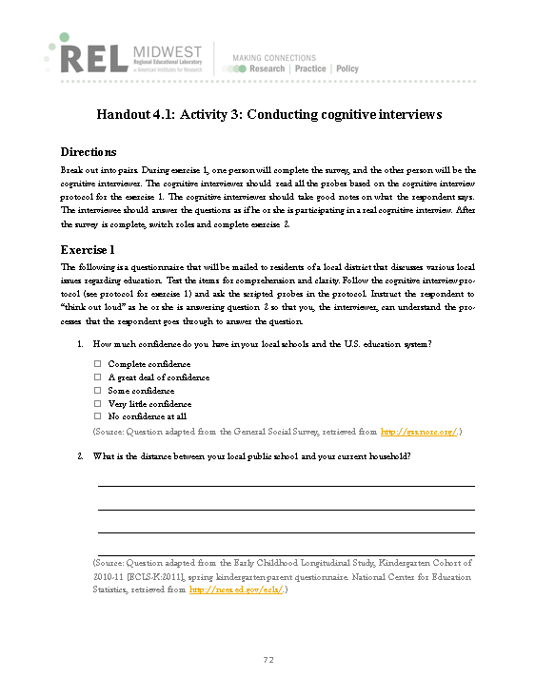
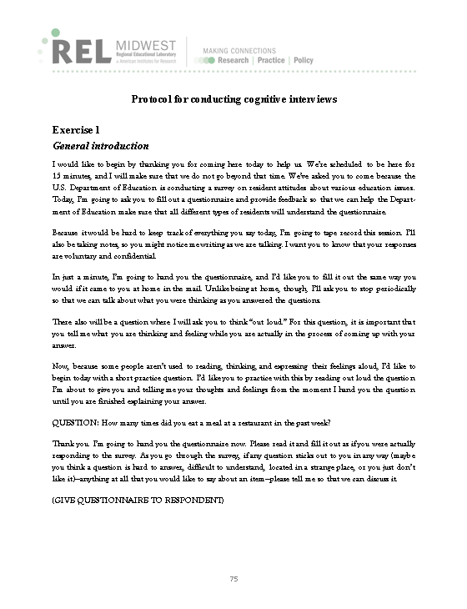
Activity 3: Conducting cognitive interviews

Slide 38
Additional resources
For more information, please visit the following websites:
The American Association for Public Opinion Research: http://www.aapor.org/.
Public Opinion Quarterly: https://poq.oxfordjournals.org/.
Journal of Survey Statistics and Methodology: http://jssam.oxfordjournals.org/content/current.

Slide 39
References
Jabine, T. B., Straf, M. L., Tanur, J. M., & Tourangeau, R. (1984). Cognitive aspects of survey methodology: Building a bridge between disciplines. Washington, DC: The National Academies Press. Retrieved April 1, 2016, from http://www.nap.edu/catalog/930/cognitive-aspects-of-survey-methodology-building-a-bridge-between-disciplines?_sm_au_=iVVjJQZpVk2tF7q.
Lavrakas, P. J. (2008). Encyclopedia of survey research methods. Thousand Oaks, CA: SAGE.
Willis, G. B. (1999). Cognitive interviewing: A “how-to” guide. Rockville, MD: Research Triangle Institute. Retrieved April 1, 2016, from http://www.appliedresearch.cancer.gov/areas/cognitive/interview.pdf.
Willis, G. B. (2005). Cognitive interviewing: A tool for improving questionnaire design. Thousand Oaks, CA: SAGE.

