Slide 1
Module 7 presentation Response rates

Slide 2
Outline
What are response rates?
Strategies for maximizing response rates.
Nonresponse bias.
Summary of best practices.

Slide 3
Outline
What are response rates?
Strategies for maximizing response rates.
Nonresponse bias.
Summary of best practices.

Slide 4
What is a response rate?
Notes:
The response rate is the percentage of people who complete and return a survey out of the total number of eligible sample members. It is a measure of the level of success achieved in collecting survey data (American Association for Public Opinion Research, 2009a).

Slide 5
Calculating response rate
Notes:
The response rate is calculated by dividing the number of completed surveys by the total number of surveys distributed or the total number of eligible sample members (American Association for Public Opinion Research, 2009a). For example, if a survey is sent to a teacher who you later learn has retired and your target population is “current teachers”, that teacher is not eligible and not included in the denominator.

Slide 6
Calculating response rate
For example: If you send out 200 questionnaires and you get 125 questionnaires back, your response rate is 62.5%.

Slide 7
Why are response rates important?
Notes:
The response rate is one way to gauge whether survey results represent the target population:
A high response rate maximizes the chance that the results are representative of the target population.
A low response rate increases the chance of biased results, which cannot be generalized to the target population.

Slide 8
Is there a standard target response rate?
Notes:
No standard target response rate exists. Higher response rates typically (but not always) mean that data better reflect the target population.
Various federal agencies have standards for data collection response rates. For example, the National Center for Education Statistics has a response rate target of 85 percent. For some contexts, a response rate in the 70 percent range is considered adequate. Achieving a high response rate should be a priority for any survey project (Groves, 2006).

Slide 9
Outline
What are response rates?
Strategies for maximizing response rates.
Nonresponse bias.
Summary of best practices.

Slide 10
What influences response rates?
Notes:
Response rates are influenced by:
Salience of the topic—interest of respondents in the topic of the survey.
Personalized requests and communications.
Multiple follow-up contacts.
Respondents’ respect for and trust in the survey sponsor.
Conciseness and easiness of the questionnaire.
Data collection mode.
(Dillman, 2000).

Slide 11
How do you maximize response rates?
Notes:
How do you maximize response rates?
Generate positive publicity for your survey.
Send an endorsement letter from a respected leader.
Appeal to people’s tendency to help—ask them to help by giving their input.
Make the survey topic salient:
Ensure that respondents see the value of the survey and their responses.
Point out respondents’ personal connection to the topic.
Tailor and personalize communications about the survey and its purpose.
Make the survey attractive and easy to complete and return.
Provide clear instructions about how to complete and submit the survey.
Show positive regard; say thank you.
Ensure the confidentiality of the information provided.
Provide an incentive (a token of appreciation).
For a mail survey, provide return postage.
Follow up several times by mail, email, telephone, or in person.
Use a combination of survey modes (for example, telephone plus mail, or online plus mail).
(Dillman, 2000).

Slide 12
Personalize communications
Notes:
To motivate people to respond, appeal to their tendency to help.
Use the person’s name and if appropriate or possible, personalize salutations.
Impersonal: ”Dear principal.“
Personal: ”Dear Principal Lopez.“
Personalize the importance of the survey to the respondent.
Impersonal: ”This survey will help us better understand the importance of instructional coaching for elementary school reading specialists.“
Personal: ”This survey will provide information that can help better support you as a reading specialist and enable you to better support your students.“
Use recognizable logos or graphics.
Tailor the materials to a school or district, if appropriate or possible, using local letterhead or colors.
(Scheuren, n.d.)

Slide 13
Incentives
Notes:
Research shows that incentives increase response rates (see handout 7.1; Dillman, 2000). In general, a prepaid incentive works better than a promised reward for completing the survey.
Types of incentives:
Cash (most effective).
Nonmonetary gift (for example, a coffee mug or a pen).
Lotteries – for example, respondents are promised a chance of winning a prize (the least effective).

Slide 14
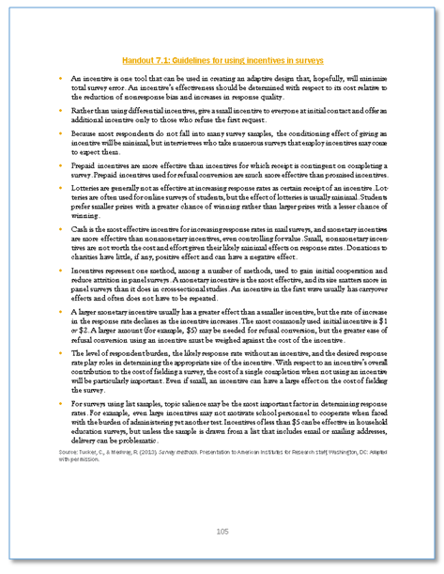
Handout 7.1

Slide 15
Contact participants
Notes:
Consider making the following contacts:
Brief prenotification (in online surveys this is particularly useful because bounceback notifications of undeliverable emails allow time to update the contact list before the survey invitations are sent).
Survey mailed with a cover letter or survey link send in an invitation email.
Thank you follow-up.
Reminder with replacement questionnaire or survey link.
Final contact: Reminder with replacement questionnaire or survey link.
Thank you note.
(See appendix A; Dillman, 2000; Scheuren, n.d.)

Slide 16
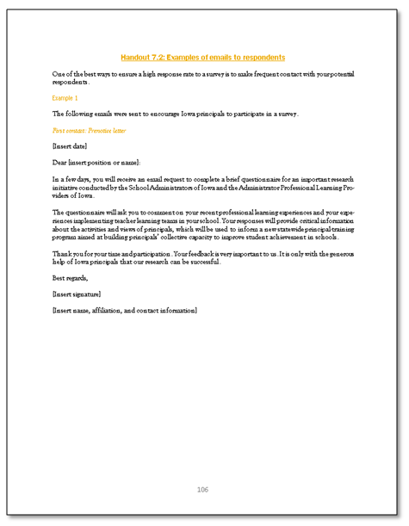
Handout 7.2

Slide 17
Follow-up
Notes:
Nonrespondents are individuals who were randomly chosen for the sample and given the survey but did not return it. Failure to follow up with nonrespondents can ruin an otherwise well-designed survey (Dillman, 2000; Scheuren, n.d.).
About a week or two after sending the survey, send a gentle reminder to anyone who has not responded. Allow an adequate amount of time between the survey being sent out and the time it would take someone to respond. The follow-up timeline differs by mode. For phone or web online surveys, follow up within a week. For mailed questionnaires, follow up within two weeks. The reminder can be by email, postcard, or phone call.

Slide 18
Outline
What are response rates?
Strategies for maximizing response rates.
Nonresponse bias.
Summary of best practices.

Slide 19
Who are your nonrespondents?
Notes:
A potential for nonresponse bias exists if responders and nonresponders differ on characteristics that are related to the topic of interest. Responders and nonresponders may differ in many ways, but as long as the differences are not related to the topic of interest, they should not result in nonresponse bias.
However, if these differences are related to the topic of interest, nonresponse bias could arise (Groves, 2006).
Nonresponse bias harms the validity of the survey. It weakens the ability to draw accurate conclusions about the target population.
If the characteristics of survey respondents and nonrespondents that are different are also related to the topic of interest, there may be bias, and the data should not be generalized, even if the response rate is relatively high.
If the characteristics of the survey respondents are the same as the nonrespondents, it may be okay to generalize the results to the population, even if the response rate is low.
Even if all measured characteristics are the same for respondents and nonrespondents, there may be nonresponse bias related to unmeasured differences.

Slide 20
Measure nonresponse bias.
Notes:
How can nonresponse bias be measured? Assess the degree to which your survey respondents are different from the people in the sampling frame on key characteristics. Ideally, the sampling frame includes some key characteristics on which you can compare respondents with nonrespondents. For example, a sampling frame of teachers may include each teacher’s grade level, tenure, and gender (Groves, 2006).
Nonresponse bias cannot be truly measured because the true value of what is being estimated is rarely known. However, the possibility of nonresponse bias can be measured.
Example:
Two hundred elementary and secondary teachers need to be contacted for a survey.
The secondary teachers have annual assessments at the same time and are less likely to answer the survey.
Because of a response rate of 35 percent from of secondary teachers, the survey data may not be representative of all teachers because secondary teachers will be underrepresented.
Compare the percentage of respondents who teach elementary and secondary school grades with the percentage of elementary and secondary school teachers in the sampling frame.
If the percentages are notably different and you think that elementary and secondary teachers differ on the topic of interest (for example, methods for addressing discipline problems), you likely have nonresponse bias. The degree of bias is related to the degree that the topic of interest relates to grade level.

Slide 21
Nonresponse example
Bias analysis
Teacher characteristic | Total eligible teachers (%) | Completed survey respondents (%) | Difference (%) | Percent relative difference
Grade level
Elementary | 45 | 65 | +20 | 20/45 = 44%
Secondary | 55 | 35 | -20 | 20/55 = 36%
Notes:
Bias analysis:
Look at the difference between the percentage distributions of the eligible teachers and the responding teachers, by characteristic.
Difference can be expressed as percent relative difference, which is the difference between the eligible percentage and the respondent percentage, divided by the eligible percentage, and multiplied by 100. In this case, the relative differences are 44 percent for elementary teachers and 36 percent for secondary teachers, which suggests that bias may be occurring.
If you think that elementary and secondary school teachers differ on the topic of interest, (for example, importance of teacher collaboration), a difference in their response rates may affect the validity of the results. The presence of nonresponse bias depends on whether a link exists between the characteristics of the respondents and nonrespondents and the topic of interest.

Slide 22
Address potential bias.
Notes:
What if large differences between characteristics of respondents and nonrespondents are found?
Describe the results in terms of who did respond.
Do not imply that the results apply to anyone other than those who responded.
Specify who responded (that is, the group the data represent).
Report results by subgroups for which there were large differences in response rates (for example, by elementary and secondary school teachers).
Consult a statistician about other options for addressing nonresponse bias.
(Scheuren, n.d.)

Slide 23
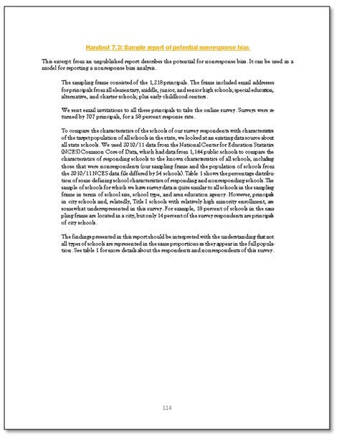
Handout 7.3

Slide 24
Acknowledge low response rates.
Notes:
If the response rates are low (for example, lower than 70 percent), use a summary statement in reporting results, such as: ”The response rate was only 42 percent, so care should be taken when reviewing these results. The results should be applied to individuals who responded, not to the entire population of teachers“ (Scheuren, n.d.). If a nonresponse bias investigation suggests that the responders and nonrespondents were similar on certain characteristics, this could be noted as evidence about the potential representativeness of data from a study with a low response rate.

Slide 25
Outline
What are response rates?
Strategies for maximizing response rates.
Nonresponse bias.
Summary of best practices.

Slide 26
Best practices
Notes:
What are the best practices regarding response rates? Follow the strategies presented here to maximize the response rate:
Monitor response rate overall and within groups of interest during data collection, and target additional follow-up contact if warranted.
Calculate and report the response rate.
Examine the data for nonresponse bias.
Discuss the survey results in the context of the response rate and any possible nonresponse bias identified.
(American Association for Public Opinion Re-search, 2009b)

Slide 27
Additional resources
For more information, please visit the following websites:
The American Association for Public Opinion Research: http://www.aapor.org/.
Public Opinion Quarterly: https://poq.oxfordjournals.org/.
Journal of Survey Statistics and Methodology: http://jssam.oxfordjournals.org/content/current.

Slide 28
References
American Association for Public Opinion Research. (2009a). Best practices. Deerfield, IL: Author. Retrieved April 1, 2016, from http://www.aapor.org/Best_Practices1.htm.
American Association for Public Opinion Research. (2009b). Standard definitions: Final dispositions of case codes and outcome rates for surveys (6th ed.). Deerfield, IL: Author.
Dillman, D. A. (2000). Mail and internet surveys: The total design method (2nd ed.). New York, NY: Wiley.
Groves, R. M. (2006). Nonresponse rates and nonresponse bias in household surveys. Public Opinion Quarterly, 70(5), 646–675.
Scheuren, F. (n.d.). What is a survey? Alexandria, VA: American Statistical Association. Retrieved April 1, 2016, from http://www.whatisasurvey.info/.

