Slide 1
Welcome! As you settle in, please take a moment to reflect on this question and jot down your thoughts
This presentation was prepared for the Institute of Education Sciences (IES) under ED-IES-17-C-0009 by Regional Educational Laboratory Northwest, administered by Education Northwest. The content of the presentation does not necessarily reflect the views or policies of IES or the U.S. Department of Education nor does mention of trade names, commercial products, or organizations imply endorsement by the U.S. Government.
If you plan to use these slides to facilitate a training or professional development session, please retain this disclaimer at the beginning of the presentation, even if you choose to add your organization’s logo or make revisions to the slides to meet the needs of your audience. In the occurrence that changes are made, please add a note stating that: “Amendments to the original slides have been made as necessary in order to specifically address the purpose of this presentation.”

Slide 2
Welcome! As you settle in, please take a moment to reflect on this question and jot down your thoughts-1
What concerns do you have about your students’ social and emotional needs as they return to school?
https://pixabay.com/photos/thinker-at-a-loss-think-to-play-1294490/
Notes:
Notes in these facilitator slides are both directional and scripted. Feel free to use the script in whatever way works best for you, as long as you are true to research described in the Facilitator Guide. Directions are in italics, suggested scripts are in “quotation marks.”
Welcome participants as they arrive. Invite them to jot down responses to the question. Consider collecting these responses in a Google Doc or other shared online document or using sticky notes if you are meeting in person. If using sticky notes, place the blank notes on the tables for participants to access as they get settled. Place a large chart paper on a surface and ask them to place their sticky notes on the chart paper.
Begin with a few opening remarks that set a welcoming and supportive tone.
Take a moment after you welcome participants to call attention to what they are sharing. Keep the document handy as you will refer to it later.

Slide 3
Lessons from the COVID-19 pandemic: Evidence-based resources for professional development facilitators
Social and emotional learning, grades 6–12
10/15/20
This presentation was prepared under Contract ED-IES-17-C-0009 by Regional Educational Laboratory Northwest, administered by Education Northwest. The content does not necessarily reflect the views or policies of IES or the U.S. Department of Education, nor does mention of trade names, commercial products, or organizations imply endorsement by the U.S. Government. Presenters using this slide deck are not affiliated with REL Northwest at Education Northwest nor the U.S. Department of Education. Users should cite the source deck posted on the REL Northwest website.
Notes:
Before presenting, insert the names and titles of presenters.
When presenting, introduce yourself, your professional background, your experience with teaching (if applicable), and your pronouns. Please make clear during your opening remarks that presenters are not affiliated with REL Northwest at Education Northwest nor the Institute of Education Sciences.

Slide 4
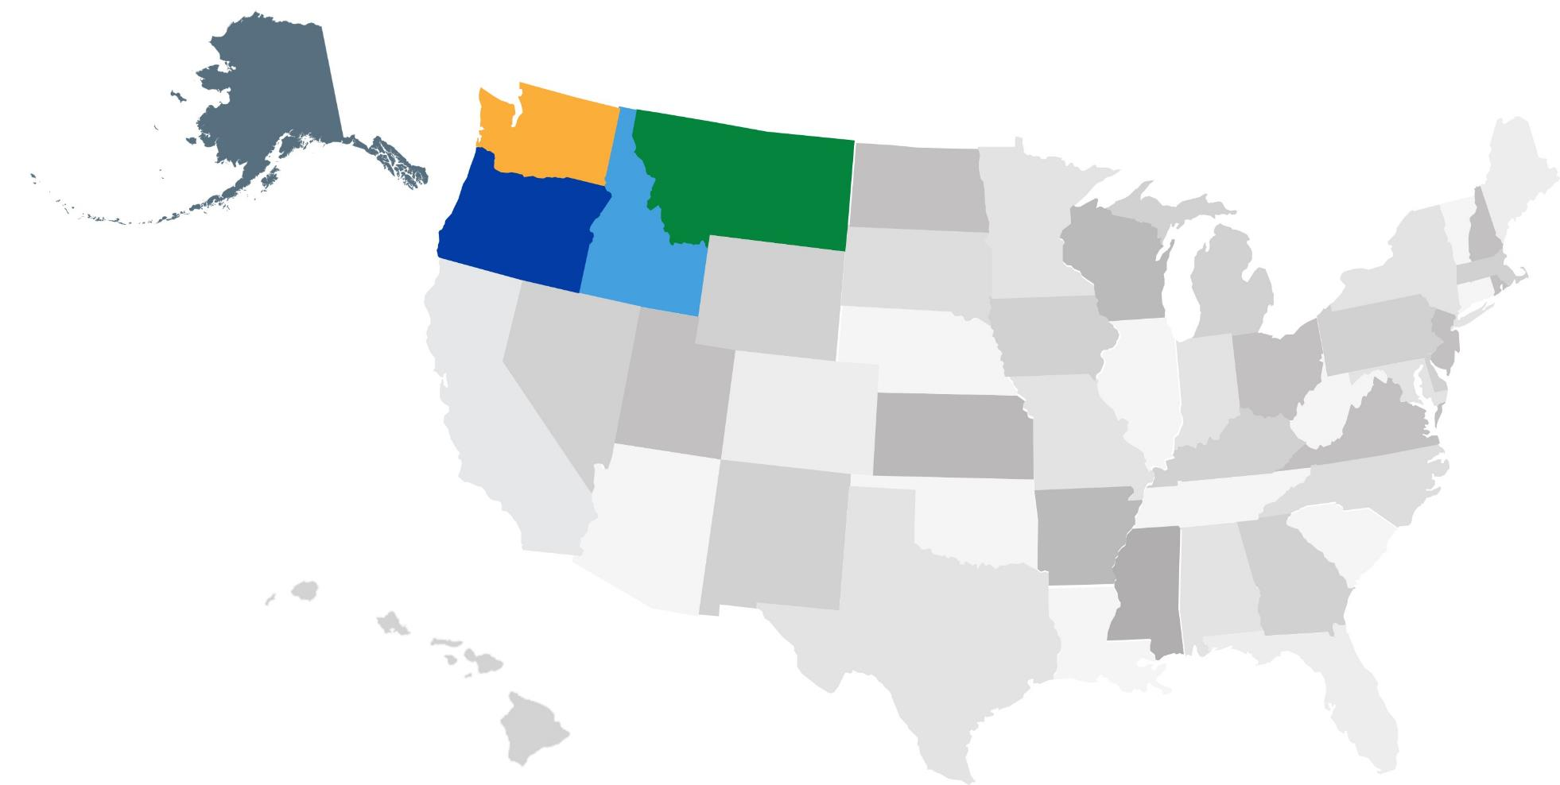
Regional Educational Laboratory (REL) Northwest
Notes:
“This training was developed by REL Northwest. REL Northwest is one of 10 regional educational laboratories across the United States that serve their respective geographic regions. The goal of the REL program is to help states and districts use data to address important policy issues and improve educational practices. We provide these services to local stakeholders through partnerships.
“The U.S. Department of Education’s Institute of Education Sciences selects organizations to operate each REL through a competitive bidding process. Education Northwest holds the contract for the Northwest region, which covers the five Northwest states.”

Slide 5
REL COVID-19 resources
Researchers from the 10 RELs produced and curated resources to support teachers in response to the pandemic
Nearly 30 evidence-based resources addressing SEL are posted for educators
As in-person learning resumes, many of the evidence-based practices identified in these resources can be used to support in-person, hybrid, and fully remote instruction
Notes:
“Last year, in response to COVID pandemic pressures and the need to transition instruction to fully online, researchers from the 10 RELs collaborated to produce and curate resources. These materials are posted on the REL COVID-19 Evidence-Based Resources web page for access by educators. Nearly 30 evidence-backed studies, blogs, webinars, and infographics addressing SEL are posted.
As in-person learning resumes, educators may wish to familiarize themselves with several evidence-based practices in these resources that will support implementing social and emotional learning in in-person, hybrid, and fully remote learning environments.”

Slide 6
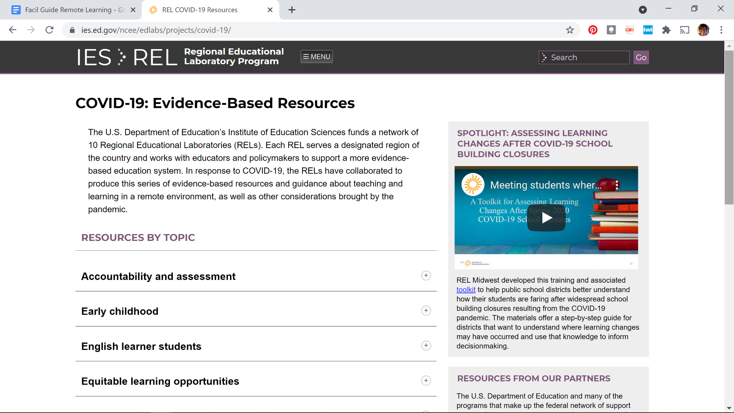
REL COVID-19 resources website
https://ies.ed.gov/ncee/edlabs/projects/covid-19/
Notes:
https://ies.ed.gov/ncee/edlabs/projects/covid-19/
You may wish to switch from slides to the webpage itself and demonstrate scrolling down and opening the list of “Social and emotional learning and mental health.”
"The REL COVID-19 resources web page is organized by topics. You may wish to explore the site to find resources on a range of topics that REL researchers have compiled for use. This presentation, which highlights work by REL Northwest to synthesize SEL resources and create activities, draws on collective thinking from REL researchers across the nation who have been working for well over a year to create supports for educators during the pandemic.”

Slide 7
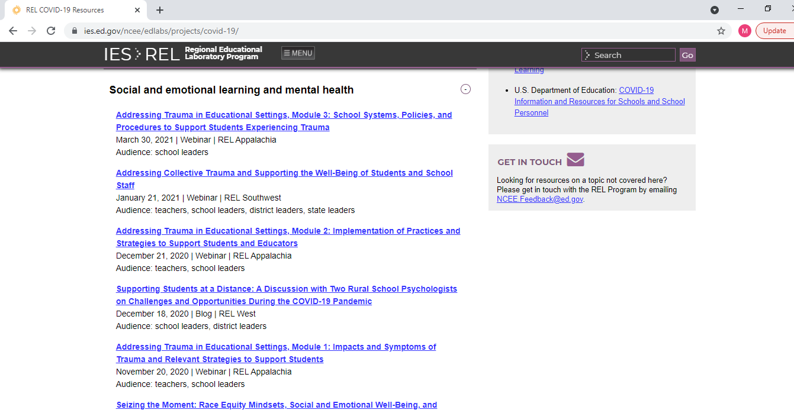
REL COVID-19 resources website-1
https://ies.ed.gov/ncee/edlabs/projects/covid-19/
Notes:
“Scroll down on the website until you reach ‘Social and emotional learning and mental health’ to access these resources. Note that while this section includes information on issues of trauma and mental health that students may have experienced, this session is focused on social and emotional learning.”
You may prefer to delete this slide and switch from slides to the webpage itself and demonstrate scrolling down and opening this list of “Remote learning strategies.”

Slide 8
Module overview
Definitions and context
https://pixabay.com/photos/startup-business-people-students-849805/
Reflect and wrap up
Social and emotional learning for teachers
https://pixabay.com/photos/startup-meeting-brainstorming-594090/
https://pixabay.com/photos/science-class-dissect-lab-1121481/
Social and emotional learning for students
https://pixabay.com/photos/students-education-school-young-2817247/
Notes:
“This professional development learning module offers evidence-based resources to help middle and high school teachers strengthen their social and emotional learning (a.k.a. SEL) instructional activities to address issues introduced by the COVID-19 pandemic. The shift to hybrid and remote learning environments, reinforced by social distancing, isolated youth from one another and limited sustained contact with their teachers. Societal changes to address racial equity, cultural responsiveness, and social justice also may have exposed students to stressful experiences. The result is that as teachers re-enter classrooms, they will encounter students with learning gaps exacerbated by family and personal experiences that may have affected their self-efficacy and mental well-being. Paying attention to teacher and student SEL needs can help strengthen education. After setting the context, this professional development module will focus on evidence-based practices for attending to one’s own SEL needs and how to support students.”
“You can always go back through the session on your own, deepening your understanding of SEL with each iteration.”

Slide 9
Module purposes
Define and learn about social and emotional learning (SEL)
Explore connections between racial equity and cultural responsiveness and SEL
Learn and try out some evidence-based SEL practices
https://pixabay.com/photos/arrow-target-bullseye-goal-aim-2886223/
Notes:
Read the slide
“This module will support you to learn more about SEL and to explore ways to align SEL practices with academics and learning in your classroom.”

Slide 10
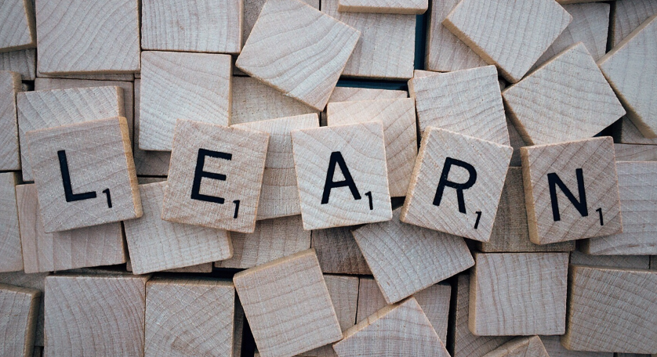
Module learning outcomes and ethos
By the end of this module, participants will be able to identify, describe, and practice evidence-based strategies to support social and emotional learning for students and educators.
This module introduces SEL and highlights some evidence-based strategies in depth.
https://pixabay.com/photos/learn-word-scrabble-letters-wooden-1820039/
Notes:
Read the slide.
“This module is not aimed at making participants experts at SEL.”
“It is meant to support deeper learning and offer ways to bring SEL into participants’ practice—with the understanding that each educator has a different context, different content, specific expertise and experience, and different students with different needs.”

Slide 11
Today’s agenda
Definitions and context
SEL and teachers
Evidence-based practices
Small-group breakouts
SEL and students
Evidence-based practices
Small-group breakouts: Using an evidence-based practice
Small-group share out
Feedback on the module
https://pixabay.com/photos/prairie-path-field-scenic-natural-1246633/
Notes:
(Change the slide if you are only doing part of the agenda today)
“During this interactive professional development session, I will share some research about social and emotional learning and introduce some evidence-based practices. You also will be invited to participate in activities to help you understand the practices.”
Read the slide.

Slide 12
Definitions and context
https://pixabay.com/photos/startup-business-people-students-849805/
Notes:
This is a divider slide to indicate the transition in content.

Slide 13
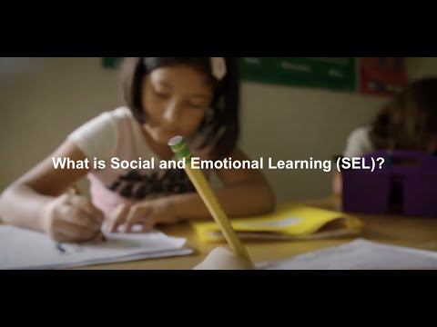
What is social and emotional learning (SEL)?
SEL is the process through which young people and adults acquire and apply knowledge, skills, and attitudes to help them understand themselves, connect with others, achieve their goals and support their communities.
(CASEL, 2021)
Notes:
Ensure the video “What is social and emotional learning” is cued up to skip the ad (click the ‘Skip Ad’ at the 5-second mark). Access the 3.22-minute video at: https://www.youtube.com/watch?v=Y-XNp3h3h4A
“I want to take a moment to ensure we have a shared understanding of what we mean by ‘social and emotional learning’ or SEL.”
“We will watch a brief video that defines these terms.”
Show the 3 and ½ minute video.
“CASEL defines SEL as ‘the process through which young people and adults acquire and apply the knowledge, skills, and attitudes that help us to understand ourselves, connect with others, achieve our goals and support our communities.’”
“What does this look like in our schools and learning environments? You will find that some of these things educators do naturally and have honed skills around. You may or may not have thought of these as social and emotional learning; with the research-based information we have about social and emotional learning, you may want to be even more intentional about honing these practices. Some of these ideas you may not currently engage in and you might want to try as you explore how to bring SEL practices into your own practice.“

Slide 14
Reflection
What did you see in this definition of SEL that you already include in your practice?
What did you see about SEL that is new to you or that you want to learn more about?
https://pixabay.com/photos/lightbulb-bulb-light-idea-energy-1875255/
Notes:
For two minutes: As you finish the video, ask participants to choose one of these two questions and popcorn ideas out to the entire group. If people are hesitant to speak, invite people to put comments in the chat (if virtual) and/or consider ‘planting’ someone in the audience to say something to jumpstart the conversation. You also should prepare your own thoughts in the event people are slow to speak.

Slide 15
Why SEL matters
Research shows that SEL supports students to:
Build life skills, such as communications and critical thinking
Develop social and emotional competence, such as goal-setting and interpersonal skills
Develop positive attitudes toward themselves and others
Engage in prosocial behavior
Improve their academic outcomes
Earn higher GPAs
Score higher on standardized tests
(Durlak et al., 2011; Sklad et al., 2012)
Notes:
Read this slide. The purpose of this slide is to introduce core ideas about why SEL matters, and the following slide on why it matters right now.
“The information we have about implementing social and emotional practices indicates that SEL supports student social growth and results in stronger academic outcomes.”
Walk through the bullets on the side.
“As we return to school, it is helpful to recall that ‘one in 6 school aged children’ struggled with a mental health condition before the pandemic (REL West, 2020a). During the pandemic, we have continued to see students report feeling isolated, lonely, frustrated, confused, and anxious. As we support our students, evidence-based research on SEL practices provide some ways to address their needs.”

Slide 16
Why SEL matters right now
We have and will continue to experience “cascading collective traumas”
Global pandemic
Race-based historical traumas
Social unrest
Extreme weather events
https://pixabay.com/illustrations/earth-globe-water-fire-flame-1023859/
(Watson et al., 2020)
Notes:
“Students were experiencing stress that was impacting their social and academic development before the pandemic. We continue to experience what REL Southwest calls ‘collective traumas.’ These are traumas or experiences that impact an entire society.”
“Right now, we are experiencing several collective traumas. Each of the collective traumas listed here are impacting us and students and families are challenged with housing insecurity, economic uncertainty, the loss of loved ones, and other experiences.”
Consider asking participants to take three minutes and talk to their elbow partner about how any of these traumas showed up in their learning environment last year. If facilitators have extended time, participants could break into small groups and spend time discussing how worries or reactions to each of these traumas manifested in their learning environment last year.

Slide 17
SEL and teachers
https://pixabay.com/photos/science-class-dissect-lab-1121481/
Notes:
Make the transition to the next section if you are continuing or forecast where you will pick up in the next session if you are wrapping up your first session here.

Slide 18
SEL and teachers-1
SEL is not only about supporting students...
Successful social and emotional learning engages educators as learners to support their own growth
https://pixabay.com/illustrations/avatar-clients-customers-icons-2191918/
(Reyes et al., 2012; Becker et al., 2014)
Notes:
“Teachers are coming out of one challenging year and entering another year of challenges.”
“We know from research that ‘teacher well-being can be linked to both teacher effectiveness and student performance’ (REL Pacific, 2020b). As we navigate this school year, educators continue to face unprecedented challenges, including
Disruptions to routines in schooling
Isolation
‘Uncertainty about personal safety and health’ (REL Pacific, 2020b)
Teacher shortages (Rogers & Spring, 2020)
The loss of loved ones”
We also know from research that “[t]eachers who were mandated to teach SEL but did not cultivate their own practice worsened their students’ social and emotional skills. However, teachers who enhanced their own social and emotional skills improved not only their own well-being but also the social, emotional, and academic development of their students (Reyes et al., 2012).”
Read the slide. The next slide provides teachers time to talk about some of their own worries and challenges.

Slide 19
Discussion: Teachers and SEL
What concerns do you have about your own social and emotional needs as you return to school?
How have you and your colleagues been impacted by the societal challenges of the past year(s)?
Notes:
See the Handout in Attachment C: Evidence-Based SEL Practices to Promote Teacher Well-being.
Make sure that teachers have access to the physical paper or online document where they shared their worries as they entered the training.
“As you joined us today you shared some worries you have and what you think your students and families may be worried about right now. We are now going to do an activity to explore some of the issues you identified and potential strategies to address them. We will reconvene and have an opportunity to discuss what we identified, so please keep track of ideas you would like to share.”
Break into small groups of three to four to engage in the discussion and activity outlined in Appendix C.

Slide 20
Evidence-based practices to promote teacher well-being
Daily practices
Practice self-reflection and check in regularly with yourself and others
Protect personal time (away from work) and establish healthy boundaries in the workplace
Express yourself in fun, creative ways
Take five “mini-vacations” a day
Be mindful and meditative
https://pixabay.com/vectors/exclamation-mark-button-symbol-48283/
(Abenavoli et al., 2013; Braun et al., 2019; Fowler, 2015; Hydon et al., 2015; Jennings et al., 2013; Lomas et al., 2017; Roeser et al., 2013; Sprang et al., 2019; Turgoose & Maddox, 2017; Von der Embse et al., 2019; Zarate et al., 2019)
Notes:
Reconvene the whole group.
In your small groups, you had the opportunity to think about using some evidence-based practices and to discuss what some of these mean to you.
The evidence practices shared today are evidence-based and were chosen because they can be implemented without adopting a complete SEL program and in a relatively short amount of time. They give you the opportunity to try some things out and determine what you might want to explore further.
Read the suggested evidence-based practices.
Note that some of these are more straightforward than others and that some will appeal to some educators and not others. Let them know that the goal is to look for what may work for themselves.

Slide 21
Evidence-based practices to promote teacher well-being-1
Connecting with colleagues for personalized professional learning
Speak with your colleagues to identify learning partners with whom you can schedule time to discuss SEL
Co-create with colleagues professional learning that you can use to inform your adoption of SEL instruction
Engage with groups that instill personal pride and professional identity
https://pixabay.com/vectors/exclamation-mark-button-symbol-48283/
(REL Midwest, 2020)
Notes:
“Research also suggests that engaging in personalized professional learning that promotes social and professional engagement with other educators can support teachers' overall well-being. Consider taking the following steps to support you in connecting with your colleagues to partner in learning more about and adopting SEL practices and seek out other groups that can help you build your confidence and abilities. Ideally, your colleagues and/or groups will have a shared commitment to addressing students' social and emotional needs."
Read the slide. Participants will have a chance to share about the evidence-based practices they discussed in the small groups on the next slide.

Slide 22
Small-group share-out
What evidence-based practices did you explore in your small group discussions?
What ideas did you generate for how you might try out one or more of the evidence-based practices?
(REL Midwest, 2020)
Notes:
Ask participants to volunteer to share out some of the evidence-based practices they explored in their small-group discussions.
As they share, consider asking them if they thought of specific ways they plan to try out some of the practices.

Slide 23
SEL and students
https://pixabay.com/photos/students-education-school-young-2817247/
Notes:
Make the transition to the next section if you are continuing or forecast where you will pick up in the next session if you are wrapping up your first session here. This section is intended to support educators in addressing students’ SEL learning needs and offers evidence-based practices to help them understand and practice these concepts.

Slide 24
Rationale
“[E]xperiencing a sense of belonging, a sense of safety, a sense of purposeful challenge in the work they do in school makes a huge difference in how much students engage, how much they invest in their learning, and ultimately how much they achieve. … Students who have positive, healthy relationships with adults at school and with peers are better able to apply themselves to their schoolwork.”
– Ross Wiener, Aspen Institute
(REL West, 2020c)
Notes:
Read the slide.
“As we discussed earlier in this training, research shows that SEL supports students to:
build life skills
develop social and emotional competence, such as goal setting and interpersonal skills
develop positive attitudes toward themselves and others
engage in prosocial behavior
improve their academic outcomes
higher GPAs
higher standardized test scores”
(Durlak et al., 2011; Sklad et al., 2012)

Slide 25
Evidence-based practices
Understand available social and emotional support services for students within your building and district
Elevate student voice to promote student SEL
Infuse cultural responsiveness into classrooms and curriculum to help students feel respected and valued and connected to other
Acknowledge that student behavior is communication
Connect with families and communities
https://pixabay.com/vectors/exclamation-mark-button-symbol-48283/
Notes:
“This module was created to provide teachers the opportunity to understand what SEL is and introduce them to a few evidence-based practices that have been proven to work. Today we are going to spend some time exploring these five evidence-based SEL practices to support students’ social and emotional learning.”
Read the slide.

Slide 26
Evidence-based practices-1
Understand available social and emotional support services for students (e.g., counseling) within your building and district
Map available resources
Share the available resources
Visible representations
Directories or guides
Conduct a needs assessment to determine necessary support services
Identify strengths and gaps in available support services
Clarify priorities to meet your student needs
https://pixabay.com/vectors/exclamation-mark-button-symbol-48283/
(National Center for School Mental Health, 2020; REL Appalachia, 2020)
Notes:
Read the slide.
“The National Center for School Mental Health describes resource mapping as ‘an active, ongoing process to identify, visually represent, and share information about internal and external supports and services; it is used to inform effective use of resources.’” (p. 3)
“Educators in most buildings and learning environments have access to multiple resources that can support students' social and emotional needs. It is helpful for teachers to know what these are and how students can access them. This means taking the time to map out what resources are available. You may be able to come up with some of these mentally right now. There are also most likely others that you might not know about. It can be helpful to work with colleagues on resource mapping and to consider who else you might ask who can provide additional ideas.”
“It is also important not just that you have this map, but that you share the available resources with students. Consider how your students might best engage with the resources. For example, do you need to provide translations? Would your students benefit from a resource created to support learners with special communication needs? Would your students best engage with a directory or a visual representation?”
“Finally, consider doing a type of needs assessment to identify where you have strong support resources and where you might need others.”

Slide 27
Evidence-based practices-2
Elevate student voice to promote student SEL
Make learning collaborative; co-create with students
Be intentional about creating space and opportunities for healthy interactions
Engage in virtual dialogues
Administer student surveys to collect perspectives and provide for meaningful share-back
Give students options for engagement and completing work
Create excitement about the learning process rather than focusing exclusively on the end goal of the product
https://pixabay.com/vectors/exclamation-mark-button-symbol-48283/
(Chafouleas et al., 2016; Cole et al., 2013; Nakamura & Park, 2020; NCSSLEs, 2020; REL West, 2020b; SAMHSA, 2014; Wolpow et al., 2009)
Notes:
Read the slide.
“Elevating student voice helps students take perspectives and interact with peers/adults. The research suggests that taking specific and targeted actions to engage student voice increases the social and emotional learning of students.”
“The potential suggested practices to elevate student voice are evidence-based and offer some ways you can try out some SEL evidence-based practices as you begin to explore SEL.”
Note that many teachers may share that they already do all these things. The important piece here is to tie these to SEL and to the fact that elevating student voice has a positive impact on students’ social and emotional wellbeing.”
You may want to highlight that some of these seem straightforward, like engaging in virtual dialogues, while others might seem new or more complicated. For example, you might want to specifically discuss what it means to create excitement about the learning process—shifting the focus from what we already know and can do to how we are learning new things and growing.
You may also want to note that much of what the Student Voice Team found focuses on ways to improve the education system and may feel out of your hands as a teacher. It is evident that systems change is key to meeting the needs they identify. However, there are also practices individual teachers and groups of educators can adopt to elevate student voice around the five identified student voice expressions.

Slide 28
Evidence-based practices-3
Infuse cultural responsiveness into classrooms and curriculum to help students feel respected, valued, and connected to others
Do a cultural/gender inventory of classroom materials to determine who is absent from the materials and ensure that classroom materials recognize, respect, and appreciate diversity
Establish the expectation that differences should be celebrated in your learning environment
Emphasize that people can be different and have things in common at the same time
https://pixabay.com/vectors/exclamation-mark-button-symbol-48283/
(Montgomery, 2001; Weinstein et al., 2004; Villegas & Lucas, 2007)
Notes:
Read the slide.
“At first glance, this evidence-based practice can seem overwhelming. The key is to think about ways you can infuse and include cultural responsiveness throughout your practice. The three bulleted suggestions offer ways that you can celebrate differences and ensure that your learning environment is aimed at supporting each student.”
“Ensuring that your learning environment contains diverse representations around culture, race, and gender can be a first step in this process. Finding ways to celebrate differences can create a space where each student can feel respected and experience respecting and valuing differences in other students.”
“It can be helpful to remember that in our learning environments we are setting the expectations for how students experience and treat each other. Teachers have the opportunity to model celebrating differences and nurturing spaces where equity and social justice are centered in learning.”

Slide 29
Evidence-based practices-4
Acknowledge that student behavior is communication
Behavior is communication! Fight, flight, or freeze responses may look like defiance, noncompliance, or task avoidance.
Consider how you respond to challenging student behaviors
Reframe your reaction => Respond vs. React
Maintain calm teacher presence to defuse challenging student behavioral situations
https://pixabay.com/vectors/exclamation-mark-button-symbol-48283/
(Pate, 2020; Perry, 2017)
Notes:
Read the slide.
“Research indicates that student behavior, especially what we think of as disruptive behavior, is communicating something important to us about a student’s social and emotional needs. This may seem obvious and, as educators, many of us most likely engage this idea regularly as we plan and work with students. However, in a busy classroom or crowded hallway, this idea can be hard to hold onto.”
“Spending time planning for how you might respond to disruptive behavior to best support students’ SEL needs can help you maintain the presence you want.”

Slide 30
Evidence-based practices-5
Connect with families and communities
Avoid using deficit perspectives of low-income families and families of color about their children’s education
See families as the experts and leaders
Trust families and students
Give families space to share challenges that may affect their children and engage them in co-creating solutions to those challenges
https://pixabay.com/vectors/exclamation-mark-button-symbol-48283/
(Crespin-Palmer, 2020)
Notes:
Read the slide.
“In order to support students’ social and emotional learning, it is important to build and nurture relationships with families and communities. Families and communities often bring knowledge, strengths, and resources to the table that can enhance and support your learning environment and students.”
“It is key to engage families in sharing the challenges they are experiencing, even the challenges to learning environments, and to trust that families are the experts about their students and what they need. Building these partnerships can be challenging and sometimes biases can show up in us or in the system where we work. It is important to work to build relationships with authentic trust and to look for ways families can bring their expertise, knowledge, and skills into your learning environment. Keep in mind that families and the home conditions that are established have strong, if in some instances, indirect implications for students' SEL development.”

Slide 31
Small-group activities
Support Students’ Social and Emotional Learning
Evidence-Based Practices to Support SEL for Students
Understand available SEL support services for students within your building and district
Elevate student voice to promote student SEL
Infuse cultural responsiveness into classrooms and curriculum to help students feel respected, valued, and connected to others
Acknowledge that student behavior is communication
Connect with families and communities
Notes:
“Now we are going to take a little time to dig deeper into these evidence-based practices. We will be breaking into small groups, where you will have time to work independently and collaboratively to try out one of these practice and think about what it might look like for you.
“We will have a small-group session for each of the five evidence-based practices. You can choose a small group based on the practice that interests you. If any of the small-groups has more than ten people, you can break into smaller groups to do the same activity.
“Once you get through the introduction and reach the ‘activity instructions’ noted by the gold bar (in most cases, it will on the second page of the handout), the timekeeper can start walking the group through the steps in this handout.
"Before you finish, each small group is asked to reflect on the activity and prepare to share with the rest of the large group.
“Now you get to choose which small group you want to take part in.
Distribute the handouts and explain where they can go to meet with their small groups.
“Please join the small group of your choosing now. “

Slide 32
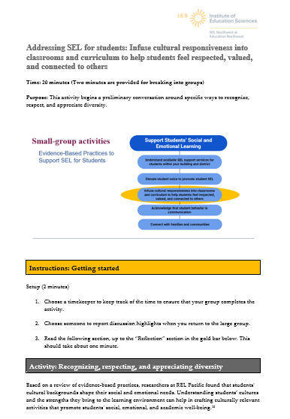
Getting started
In your small groups:
Refer to your handout; it will be marked by the title and the graphic
Follow the directions under the first gold bar to identify a timekeeper
Notes:
“You will find a small-group activity guide in your packet. They are listed in the order on the infographic.”
“You will only have time to do one activity in this session. However, you have all the handouts, and all activities are self-guided, so you can work on these independently or with your colleagues, such as in a PLC.”

Slide 33
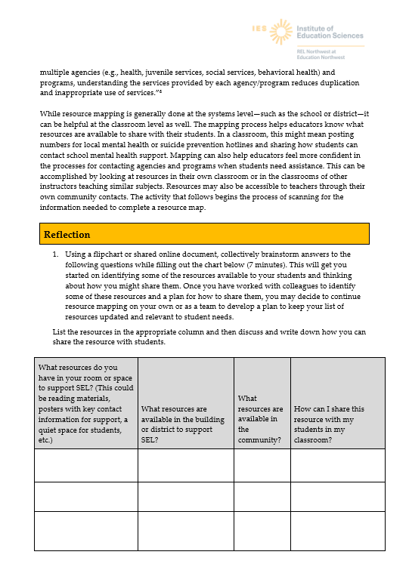
Follow the activity instructions
Read the activity explanation and start to scan the instructions
After one or two minutes of silent reading, the timekeeper points the group to the list of steps under “activity instructions” gold bar
The timekeeper moves the group along according to the time allotted for each step
Notes:
This slide is animated.
“After you have identified your timekeeper, take a minute or two to read the setup to the activity and start to scan the directions.”
Click to pull up the second arrow as you read the second bullet. Then click to pull up the third bullet.

Slide 34
Reflection and feedback
Please share highlights of what you discussed in your small groups
https://pixabay.com/photos/startup-meeting-brainstorming-594090/
Notes:
“Please return your attention to the whole group. I would like to take some time to ask small groups to share what you discussed and whether you talked about some practices that seem promising to you.“
When the group reconvenes, ask the volunteer reporters to share the highlights of their discussions.
Understand the resources available to your students
Elevate student voice
Infuse equity and social justice into curriculum
Respond to troubling behavior in supportive ways
Support families and communities

Slide 35
Wrap-up
https://pixabay.com/illustrations/idea-empty-paper-pen-light-bulb-1876659/
Notes:
Thank participants for their engagement.

Slide 36
Feedback on the professional development session
Notes:
If you would like to have feedback from participants about how the professional development session went, you can provide them with your own evaluation form or process. Note that this feedback is intended for your purposes and not for use by the REL. You may want to check whether the Expected Outcomes were achieved and/or ask for questions that remain.

Slide 37
Contact Us
REL Northwest at Education Northwest
1417 NW Everett Street, Suite 310
Portland, OR 97209
ies.ed.gov/ncee/edlabs/regions/northwest
@relnw
800-547-6339

Slide 38
Thank you!
Notes:
Thank them for their engagement

Slide 39
References
Abenavoli, R. M., Jennings, P. A., Greenberg, M. T., Harris, A. R., & Katz, D. A. (2013). The protective effects of mindfulness against burnout among educators. The Psychology of Education Review, 37(2), 57–69 as cited in REL Appalachia. (2020, November). Addressing trauma in educational settings: Module 2: Implementation of practices and strategies to support students and educators [Presentation]. https://ies.ed.gov/ncee/edlabs/regions/appalachia/events/event_12-21-20_addressing-trauma-in-educational-settings_module-2.asp
Becker, E. S., Goetz, T., Morger, V., & Ranellucci, J. (2014). The importance of teachers' emotions and instructional behavior for their students' emotions— experience sampling analysis. Teaching and Teacher Education, 43, 15–26 as cited in REL Pacific. (2020b, June 22). Reflecting on teacher wellbeing during the Covid-19 pandemic. https://ies.ed.gov/ncee/edlabs/regions/pacific/blogs/blog28_reflecting-on-teacher-wellbeing-during-COVID-19-pandemic.asp.
Braun, S. S., Roeser, R. W., Mashburn, A. J., & Skinner, E. (2019). Middle school teachers’ mindfulness, occupational health and well-being, and the quality of teacher-student interactions. Mindfulness, 10(2), 245-255. https://doi.org/10.1007/s12671-018-0968-2 as cited in REL Appalachia. (2020, November). Addressing trauma in educational settings: Module 2: Implementation of practices and strategies to support students and educators [Presentation]. https://ies.ed.gov/ncee/edlabs/regions/appalachia/events/event_12-21-20_addressing-trauma-in-educational-settings_module-2.asp
Casel. (2021, June 21). What is social and emotional learning (SEL)? [Video]. YouTube. https://www.youtube.com/watch?v=Y-XNp3h3h4A; this video is available on the CASEL CARES Initiative website that is cited in REL Pacific. (2020a, May). https://ies.ed.gov/ncee/edlabs/regions/pacific/blogs/blog26_key-considerations-for-promoting-SEL-during-covid-19.asp

Slide 40
References, continued
CASEL. (2020, December). What is SEL? https://casel.org/what-is-sel/ as cited in REL Pacific. (2019, June 24). An introduction to social and emotional learning [Webinar]. https://ies.ed.gov/ncee/edlabs/regions/southwest/events/2021/webinar-012121.aspx as cited in REL Pacific. (2020a, May). Key considerations for promoting culturally relevant SEL during COVID-19. https://ies.ed.gov/ncee/edlabs/regions/pacific/blogs/blog26_key-considerations-for-promoting-SEL-during-covid-19.asp
Chafouleas, S. M., Johnson, A. H., Overstreet, S., & Santos, N. M. (2016). Toward a blueprint for trauma-informed service delivery in schools. School Mental Health, 8(1), 144–162. https://doi.org/10.1007/s12310-015-9166-8 as cited in REL Appalachia. (2020, November). Addressing trauma in educational settings: Module 2: Implementation of practices and strategies to support students and educators. [Presentation], https://ies.ed.gov/ncee/edlabs/regions/appalachia/events/event_12-21-20_addressing-trauma-in-educational-settings_module-2.asp
Cole, S. F., Eisner, A., Gregory, M., & Ristuccia, J. (2013). Helping traumatized children learn: Creating and advocating for trauma-sensitive schools (Vol. 2). Massachusetts Advocates for Children as cited in REL Appalachia. (2020, November). Addressing trauma in educational settings: Module 2: Implementation of practices and strategies to support students and educators. [Presentation], https://ies.ed.gov/ncee/edlabs/regions/appalachia/events/event_12-21-20_addressing-trauma-in-educational-settings_module-2.asp
Crespin-Palmer, V. (2020). RISE Colorado presentation as cited in REL West. (2020, July 29). Strategies for educators to support the social and emotional needs of students impacted by the COVID-19 pandemic and the demand for racial justice: Plans for reopening schools [Webinar] in Supporting the social and emotional needs of educators and students. https://ies.ed.gov/ncee/edlabs/regions/west/Events/Details/361#w2

Slide 41
References, continued-1
Durlak, J. A., Weissberg, R. P., Dymnicki, A. B., Taylor, R. D., Schellinger, K. B. (2011, February). The impact of enhancing students’ social and emotional learning: A meta-analysis of school-based universal interventions. Child Development, 82(1), 405–432. https://gostrengths.com/wp-content/uploads/2012/10/Meta-Analysis-Child-Development-Full-Article1.pdf as cited in REL Pacific. (2019, June 24). An introduction to social and emotional learning [Webinar]. https://ies.ed.gov/ncee/edlabs/regions/southwest/events/2021/webinar-012121.aspx as cited in REL Pacific. (2020a, May). Key considerations for promoting culturally relevant SEL during COVID-19. https://ies.ed.gov/ncee/edlabs/regions/pacific/blogs/blog26_key-considerations-for-promoting-SEL-during-covid-19.asp
Fowler, M. (2015). Dealing with compassion fatigue. The Education Digest, 81(3), 30–35 as cited in REL Appalachia. (2020, November). Addressing trauma in educational settings: Module 2: Implementation of practices and strategies to support students and educators [Presentation]. https://ies.ed.gov/ncee/edlabs/regions/appalachia/events/event_12-21-20_addressing-trauma-in-educational-settings_module-2.asp
Graham, A., & Truscott, J. (2019). Meditation in the classroom: supporting both student and teacher wellbeing? International Journal of Primary, Elementary and Early Years Education, 3(13), 1–13 as cited in REL Pacific. (2020, June 22). Reflecting on teacher wellbeing during the Covid-19 pandemic. https://ies.ed.gov/ncee/edlabs/regions/pacific/blogs/blog28_reflecting-on-teacher-wellbeing-during-COVID-19-pandemic.asp.
Henderson, A. T., & Mapp, K. L. (2002). A new wave of evidence: The impact of school, family, and the community connections on student achievement. SEDL. https://www.sedl.org/connections/resources/evidence.pdf as cited in REL West. (2020b, July 29). Strategies for educators to support the social and emotional needs of students impacted by the COVID-19 pandemic and the demand for racial justice: Plans for reopening schools [Webinar] in Supporting the social and emotional needs of educators and students. https://ies.ed.gov/ncee/edlabs/regions/west/Events/Details/361#w2

Slide 42
References, continued-2
Hydon, S., Wong, M., Langley, A. K., Stein, B. D., & Kataoka, S. H. (2015). Preventing secondary traumatic stress in educators. Child and Adolescent Psychiatric Clinics, 24(2), 319–333. https://doi.org/10.1016/j.chc.2014.11.003 as cited in REL Appalachia. (2020, November). Addressing trauma in educational settings: Module 2: Implementation of practices and strategies to support students and educators [Presentation]. https://ies.ed.gov/ncee/edlabs/regions/appalachia/events/event_12-21-20_addressing-trauma-in-educational-settings_module-2.asp
Jennings, P. A., Frank, J. L., Snowberg, K. E., Coccia, M. A., & Greenberg, M. T. (2013). Improving classroom learning environments by cultivating awareness and resilience in education (CARE): Results of a randomized controlled trial. School Psychology Quarterly, 28(4), 374–390. https://doi.org/10.1037/spq0000035 as cited in REL Appalachia. (2020, November). Addressing trauma in educational settings: Module 2: Implementation of practices and strategies to support students and educators [Presentation]. https://ies.ed.gov/ncee/edlabs/regions/appalachia/events/event_12-21-20_addressing-trauma-in-educational-settings_module-2.asp
Liu, L. B., Song, H., & Miao, P. (2018). Navigating individual and collective notions of teacher wellbeing as a complex phenomenon shaped by national context. Compare: A Journal of Comparative and International Education, 48(1), 128–146 as cited in REL Pacific. (2020b, June 22). Reflecting on teacher wellbeing during the Covid-19 pandemic. https://ies.ed.gov/ncee/edlabs/regions/pacific/blogs/blog28_reflecting-on-teacher-wellbeing-during-COVID-19-pandemic.asp.
Lomas, T., Medina, J., Ivtzan, I., Ruprecht, S., & Eiroa-Orosa, F. (2017). The impact of mindfulness on the wellbeing and performance of educators: A systematic review of the empirical literature. Teacher and Teaching Education, 61(1), 132–141. https://doi.org/10.1016/j.tate.2016.10.008 as cited in REL Appalachia. (2020, November). Addressing trauma in educational settings: Module 2: Implementation of practices and strategies to support students and educators [Presentation]. https://ies.ed.gov/ncee/edlabs/regions/appalachia/events/event_12-21-20_addressing-trauma-in-educational-settings_module-2.asp

Slide 43
References, continued-3
Montgomery, W. (2001). Creating culturally responsive, inclusive classrooms. Teaching Exceptional Children, 33(4), 4- 9. https://doi.org/10.1177/004005990103300401 as cited in REL Appalachia. (2020, November). Addressing trauma in educational settings: Module 2: Implementation of practices and strategies to support students and educators. [Presentation], https://ies.ed.gov/ncee/edlabs/regions/appalachia/events/event_12-21-20_addressing-trauma-in-educational-settings_module-2.asp
Nakamura, J., & Park, Y. (2020). Incorporating social-emotional learning (SEL) into everyday academic instruction: How do I do it? Student Behavior Blog. https://studentbehaviorblog.org/incorporating-social-emotional-learning-sel-into-everyday-academic-instruction-how-do-ido-it/ as cited in REL Appalachia. (2020, November). Addressing trauma in educational settings: Module 2: Implementation of practices and strategies to support students and educators. [Presentation], https://ies.ed.gov/ncee/edlabs/regions/appalachia/events/event_12-21-20_addressing-trauma-in-educational-settings_module-2.asp
National Center for School Mental Health (NCSMH). (2020). School mental health quality guide: Impact. NCSMH, University of Maryland School of Medicine. http://www.schoolmentalhealth.org/media/SOM/Microsites/NCSMH/Documents/Quality-Guides/Needs-Assessment-&-Resource-Mapping-2.3.20.pdf as cited in REL Appalachia. (2020, November). Addressing trauma in educational settings: Module 2: Implementation of practices and strategies to support students and educators. [Presentation], https://ies.ed.gov/ncee/edlabs/regions/appalachia/events/event_12-21-20_addressing-trauma-in-educational-settings_module-2.asp.
National Center on Safe Supportive Learning Environments (NCSSLE). (2020). Trauma-sensitive schools training package. https://safesupportivelearning.ed.gov/trauma-sensitive-schools-training-package as cited in REL Appalachia. (2020, November). Addressing trauma in educational settings: Module 2: Implementation of practices and strategies to support students and educators. [Presentation]. https://ies.ed.gov/ncee/edlabs/regions/appalachia/events/event_12-21-20_addressing-trauma-in-educational-settings_module-2.asp

Slide 44
References, continued-4
Pate, C. M. (2020). Strategies for trauma informed distance learning. Center to Improve SEL and School Safety, WestEd. https://selcenter.wested.org/wp- content/uploads/sites/3/2020/05/SEL_Center_Strategies_for_Trauma_Informed_Distance_Learning_Brief.pdf as cited in REL West. (2020b, July 29). Strategies for educators to support the social and emotional needs of students impacted by the COVID-19 pandemic and the demand for racial justice: Plans for reopening schools [Webinar] in Supporting the social and emotional needs of educators and students. https://ies.ed.gov/ncee/edlabs/regions/west/Events/Details/361#w2
Perry, B. (2017). The 3 Rs: Reaching the learning brain. https://beaconhouse.org.uk/wp- content/uploads/2019/09/The-Three-Rs.pdf as cited in REL West. (2020b, July 29). Strategies for educators to support the social and emotional needs of students impacted by the COVID-19 pandemic and the demand for racial justice: Plans for reopening schools [Webinar] in Supporting the social and emotional needs of educators and students. https://ies.ed.gov/ncee/edlabs/regions/west/Events/Details/361#w2
REL (n.d.). Covid-19: Evidence-based resources. Retrieved from https://ies.ed.gov/ncee/edlabs/projects/covid-19/
REL Appalachia. (2020, November). Addressing trauma in educational settings: Module 2: Implementation of practices and strategies to support students and educators. [Presentation], https://ies.ed.gov/ncee/edlabs/regions/appalachia/events/event_12-21-20_addressing-trauma-in-educational-settings_module-2.asp
REL Midwest. (2020, April). Research-based resources, considerations, and strategies for remote learning. https://ies.ed.gov/ncee/edlabs/regions/midwest/pdf/eventslides/remote-learning-slides-508.pdf
REL Pacific. (2019, June 24). An introduction to social and emotional learning [Webinar]. https://ies.ed.gov/ncee/edlabs/regions/southwest/events/2021/webinar-012121.aspx as cited in REL Pacific. (2020a, May). Key considerations for promoting culturally relevant SEL during COVID-19. https://ies.ed.gov/ncee/edlabs/regions/pacific/blogs/blog26_key-considerations-for-promoting-SEL-during-covid-19.asp

Slide 45
References, continued-5
REL Pacific. (2020a, May). Key considerations for promoting culturally relevant SEL during COVID-19. https://ies.ed.gov/ncee/edlabs/regions/pacific/blogs/blog26_key-considerations-for-promoting-SEL-during-covid-19.asp
REL Pacific. (2020b, June). Reflecting on teacher wellbeing during the Covid-19 pandemic. https://ies.ed.gov/ncee/edlabs/regions/pacific/blogs/blog28_reflecting-on-teacher-wellbeing-during-COVID-19-pandemic.asp.
REL Southwest. (2021a, January). Addressing collective trauma and supporting the well-being of
students and school staff: Understanding collective trauma [Presentation]. https://ies.ed.gov/ncee/edlabs/regions/southwest/events/pdf/2021jan21/Addressing-Collective-Trauma-2-508.pdf
REL Southwest. (2021b). Addressing collective trauma and supporting the well-being of students and school staff: Presentation 4: Breakout session 2: Integrating trauma-sensitive approaches and social and emotional learning (SEL) to create safe, supportive, and culturally responsive schools [Presentation]. https://ies.ed.gov/ncee/edlabs/regions/southwest/events/pdf/2021jan21/Addressing-Collective-Trauma-4-508.pdf
REL West. (2020a, July). School social work in the time of Covid-19: When human-centered work moved online. Institute of Education Sciences. https://ies.ed.gov/ncee/edlabs/regions/west/Blogs/Details/20.
REL West. (2020b, July 29). Webinar 2: Strategies for educators to support the social and emotional needs of students impacted by the COVID-19 pandemic and the demand for racial justice: Plans for reopening schools [Webinar] in Supporting the social and emotional needs of educators and students. https://ies.ed.gov/ncee/edlabs/regions/west/Events/Details/361#w2
REL West. (2020c, October). Webinar 3: Seizing the moment: Race equity mindsets, social and emotional well-being, and outcomes for students [Webinar]. https://ies.ed.gov/ncee/edlabs/regions/west/Events/Details/361#w3.

Slide 46
References, continued-6
Reyes, M. R., Brackett, M. A., Rivers, S. E., White, M., & Salovey, P. (2012). Classroom emotional climate, student engagement, and academic achievement. Journal of Educational Psychology, 104(3), 700–712. https://doi.org/10.1037/a0027268 as cited in REL Southwest. (2021b). Addressing collective trauma and supporting the well-being of students and school staff: Presentation 4: Breakout session 2: Integrating trauma-sensitive approaches and social and emotional learning (SEL) to create safe, supportive, and culturally responsive schools [Presentation]. https://ies.ed.gov/ncee/edlabs/regions/southwest/events/pdf/2021jan21/Addressing-Collective-Trauma-4-508.pdf
Roeser, R. W., Schonert-Reichl, K. A., Jha, A., Cullen, M., Wallace, L.,Wilensky, R., et al. (2013). Mindfulness training and reductions in teacher stress and burnout: Results from two randomized, waitlist-control field trials. Journal of Educational Psychology, 105(3), 787–804. https://doi.org/10.1037/a0032093 as cited in REL Appalachia. (2020, November). Addressing trauma in educational settings: Module 2: Implementation of practices and strategies to support students and educators [Presentation]. https://ies.ed.gov/ncee/edlabs/regions/appalachia/events/event_12-21-20_addressing-trauma-in-educational-settings_module-2.asp
Rogers, K. & Spring, B. (2020, Oct 9). A shortage of teachers and Covid-19 create a perfect storm for the education system. CNBC. https://www.cnbc.com/2020/10/09/teacher-shortage-and-covid-19-create-challenge-for-education-system.html as cited in REL Southwest (2021, January). Addressing collective trauma and supporting the well-being of students and school staff: Understanding collective trauma [Presentation]. https://ies.ed.gov/ncee/edlabs/regions/southwest/events/pdf/2021jan21/Addressing-Collective-Trauma-2-508.pdf.
Sklad, M., Diekstra, R. F. W., Ritter, M., Ben, J. (2012, November). Effectiveness of school-based universal social, emotional, and behavioral programs: Do they enhance student’s development in the area of skill, behavior, and adjustment? Psychology in the Schools 49(9). DOI:10.1002/pits.21641 as cited by as cited in Institute of Education Sciences. (2019, July 3). An introduction to social and emotional learning [Video]. Youtube. https://www.youtube.com/watch?v=ZGRzqRV-i0k.
Sprang, G., Ford, J., Kerig, P., & Bride, B. (2019). Defining secondary traumatic stress and developing targeted assessments and interventions: Lessons learned from research and leading experts. Traumatology, 25(2), 72–81. https://doi.org/10.1037/trm0000180 as cited in REL Appalachia. (2020, November). Addressing trauma in educational settings: Module 2: Implementation of practices and strategies to support students and educators [Presentation]. https://ies.ed.gov/ncee/edlabs/regions/appalachia/events/event_12-21-20_addressing-trauma-in-educational-settings_module-2.asp

Slide 47
References, continued-7
Substance Abuse and Mental Health Services Administration (SAMHSA). (2014). SAMHSA’s concept of trauma and guidance for a trauma-informed approach. https://store.samhsa.gov/sites/default/files/d7/priv/sma14-4884.pdf as cited in REL Appalachia. (2020, November). Addressing trauma in educational settings: Module 2: Implementation of practices and strategies to support students and educators. [Presentation], https://ies.ed.gov/ncee/edlabs/regions/appalachia/events/event_12-21-20_addressing-trauma-in-educational-settings_module-2.asp
Toshalis, E., & Nakkula, M. J. (2012). Motivation, engagement, and student voice. Boston, MA: Jobs for the Future.
https://studentsatthecenterhub.org/resource/motivation-engagement-and-student-voice/
Turgoose, D., & Maddox, L. (2017). Predictors of compassion fatigue in mental health professionals: A narrative review. Traumatology, 23(1),172–185. http://dx.doi.org/10.1037/trm0000116 as cited in REL Appalachia. (2020, November). Addressing trauma in educational settings: Module 2: Implementation of practices and strategies to support students and educators. [Presentation], https://ies.ed.gov/ncee/edlabs/regions/appalachia/events/event_12-21-20_addressing-trauma-in-educational-settings_module-2.asp.
Villegas, A. M., & Lucas, T. (2007). The culturally responsive teacher. Educational Leadership, 64(6), 28-33. http://www.rbteach.com/sites/default/files/villegas.pdf as cited in REL Appalachia. (2020, November). Addressing trauma in educational settings: Module 2: Implementation of practices and strategies to support students and educators. [Presentation], https://ies.ed.gov/ncee/edlabs/regions/appalachia/events/event_12-21-20_addressing-trauma-in-educational-settings_module-2.asp
Von der Embse, N., Ryan, S., Gibbs, T., & Mankin, A. (2019). Teacher stress interventions: A systematic review. Psychology in Schools, 56(8), 1328–1343 as cited in REL Appalachia. (2020, November). Addressing trauma in educational settings: Module 2: Implementation of practices and strategies to support students and educators. [Presentation], https://ies.ed.gov/ncee/edlabs/regions/appalachia/events/event_12-21-20_addressing-trauma-in-educational-settings_module-2.asp

Slide 48
References, continued-8
Watson, M. F., Bacigalupe, G., Daneshpour, M., Han, W., & Parra-Cardona, R. (2020). COVID-19 interconnectedness: Health inequity, and the climate crisis, and collective trauma. Family Process, 59(3), 832–846. https://www.researchgate.net/publication/342496424_COVID19_Interconnectedness_Health_Inequity_the_Climate_Crisis_and_Collective_Trauma as cited in REL Southwest. (2021a, January). Addressing collective trauma and supporting the well-being of
students and school staff: Understanding collective trauma [Presentation]. https://ies.ed.gov/ncee/edlabs/regions/southwest/events/pdf/2021jan21/Addressing-Collective-Trauma-2-508.pdf.
Weinstein, C. S., Tomlinson-Clarke, S., & Curran, M. (2004). Toward a conception of culturally responsive classroom management. Journal of Teacher Education, 55(1), 25–38. https://doi.org/10.1177/0022487103259812 as cited in REL Appalachia. (2020, November). Addressing trauma in educational settings: Module 2: Implementation of practices and strategies to support students and educators. [Presentation], https://ies.ed.gov/ncee/edlabs/regions/appalachia/events/event_12-21-20_addressing-trauma-in-educational-settings_module-2.asp
WestEd. (2020). Creating coherent safe and supportive environments through SEL, trauma informed practices, and restorative practices alignment [Video]. https://vimeo.com/467850824.
Wiener, R. (2020, December). Seizing the moment: Race equity mindsets, social and emotional well-being, and outcomes for students. Supporting the Social and Emotional Needs of Educator and Students [Webinar] as seen in REL West. (2020c, December). Seizing the moment: Race equity mindsets, social and emotional well-being, and outcomes for students [Video]. YouTube. https://www.youtube.com/watch?v=2UhA4WxLanc

Slide 49
References, continued-9
Wolpow, R., Johnson, M. M., Hertel, R., & Kincaid, S. O. (2009). The heart of learning and teaching: Compassion, resiliency, and academic success. Washington State Office of Superintendent of Public Instruction Compassionate Schools as cited in REL Appalachia. (2020, November). Addressing trauma in educational settings: Module 2: Implementation of practices and strategies to support students and educators. [Presentation]. https://ies.ed.gov/ncee/edlabs/regions/appalachia/events/event_12-21-20_addressing-trauma-in-educational-settings_module-2.asp
Zarate, K., Maggin, D., & Passmore, A. (2019). Meta-analysis of mindfulness training on teacher well-being. Psychology in the Schools, 56(1), 1700–1715. https://doi.org/10.1002/pits.22308 as cited in REL Appalachia. (2020, November). Addressing trauma in educational settings: Module 2: Implementation of practices and strategies to support students and educators. [Presentation], https://ies.ed.gov/ncee/edlabs/regions/appalachia/events/event_12-21-20_addressing-trauma-in-educational-settings_module-2.asp

