Slide 1

Professional Learning Community
EMERGENT LITERACY
Module 2: Phonological Awareness
Session 4
What Phonological Awareness Is
When It Develops
Why It Is Important
Notes:
NOTES
Session 4 will take approximately 90 minutes.
Prior to Session 4, participants will have read pages 2–7 in the Participant Guide:
What Is Phonological Awareness?
When Does Phonological Awareness Develop?
Why Is Phonological Awareness Important?
Under “SAY” in these speaker notes:
Regular text indicates what you should say.
Italicized text indicates something you and/or the participants should do.
SAY Thank you for participating in our Professional Learning Community, or PLC, on Emergent Literacy. Briefly introduce yourself. If participants do not know each other, facilitate introductions.

Slide 2
Purpose of Our
Professional Learning Community (PLC)
To engage in collaborative learning experiences to support preschool teachers in applying evidence-based language and literacy strategies.
Notes:
SAY The purpose of our PLC is to engage in collaborative learning experiences to support preschool teachers in applying evidence-based language and literacy strategies in their instruction. I look forward to learning together!

Slide 3
Norms For Our PLC
Presume
positive intentions
Cell phones on silent
Pay attention to self and others
Notes:
NOTES
Consider your group to determine how much detail about the norms will be helpful to review.
SAY PLCs typically have norms that the group can agree to in order to be productive. Here are three norms, or ground rules, for our way of work:
Cell phones on silent will help us have an uninterrupted session .
Pay attention to self and others: This means contributing, listening, and being aware of how you and others are responding to each other. Be sure to give everyone a chance to talk and encourage others who seem reluctant to join in. Sometimes people who are reluctant to talk are thinking. They may not be comfortable jumping in, but they may have something important to say.
Presume positive intentions: This means pausing before responding. Usually when people contribute to a conversation, they intend to be constructive. So, always respond positively to keep the discussions productive.
Is there anything we should add to the list?

Slide 4
Modules and Sessions
Module | Topic | Session | Duration
1 | Print Knowledge | 1 | 90 minutes
 |  | 2 | 90 minutes
 |  | 3 | 60 minutes
2 | Phonological Awareness | 4 | 90 minutes
 |  | 5 | 90 minutes
 |  | 6 | 60 minutes
3 | Vocabulary | 7 | 90 minutes
 |  | 8 | 90 minutes
 |  | 9 | 60 minutes
4 | Oral Language | 10 | 90 minutes
 |  | 11 | 90 minutes
 |  | 12 | 60 minutes
Notes:
NOTES
If you are completing this PLC in order (beginning with Module 1 and moving through Module 4) then you won’t need to spend time on this slide.
It is recommended that the sessions be completed in sequential order.
The timeline for completing the sessions can be flexible. If the recommended time for each session is not available, complete what you can with the time you have and then pick up where you left off the next time you meet.
Once a schedule of the sessions is established, have participants record the schedule on page vi in the Participant Guide. They can also track completed sessions by recording the date in the last column.
SAY Here is an overview of the modules and sessions of this PLC. There are four modules, and each module includes three sessions, for a total of 12 sessions. Each module has a separate Facilitator Guide, Participant Guide, and accompanying videos.
Module 1 addresses print knowledge, Module 2 covers phonological awareness, Module 3’s focus is vocabulary, and the content of Module 4 is oral language.
You can record the date, time, and location of each session on page v in the Participant Guide.

Slide 5
Five-Step Process for PLC Sessions
Debrief
Define and Discuss Session Goals and Content
Learn and Confirm
Collaborate and Practice
Reflect, Plan, and Implement
Notes:
SAY A five-step process for collaborative learning is used for every session. Table 2 on page iii in the Participant Guide describes the process. The process was adapted from Wald and Castleberry’s (2000) five stages of work for groups engaging in a collaborative learning cycle. This framework will provide a predictable structure for our sessions and support our learning together. I’d like to describe each step and the icon that you will see on the slide to alert us to where we are in the process during each session.
Step 1 Debrief is identified by talking bubbles. During step 1, you will discuss experiences and reflections about the content and an instructional practice that you planned and implemented since the previous session.
Step 2 Define and Discuss Session Goals and Content is identified by a target, which tells us what we will zero in on for this session. I will summarize the previous session’s goals and this session’s goal—a sort of “where we’ve been and where we’re going.” I will also share foundational and background information while we engage in discussions or activities that support the Self-Study Reading that you completed prior to the session.
Step 3 Learn and Confirm is identified by a magnifying glass to illustrate that we will look closely at information that you read about in the Self-Study Reading. You will explore new practices and compare them to current practices. Here is where we will access and build your background knowledge and experiences related to the topic of the session. I will explicitly teach the session’s content through, for example, models, videos, and discussions.
Step 4 Collaborate and Practice is identified by tools. Here, you will collaborate in pairs or small groups to practice applying strategies and activities.
Step 5 Reflect, Plan, and Implement is represented by signs with arrows pointing back, for reflect, and forward for plan and implement. You will reflect on what you learned during the session. You will also plan how the activities and strategies will be implemented in your classroom prior to the next session, and then you will implement your plan. It is important that everyone is prepared at the start of the next session to share your experiences.

Slide 6
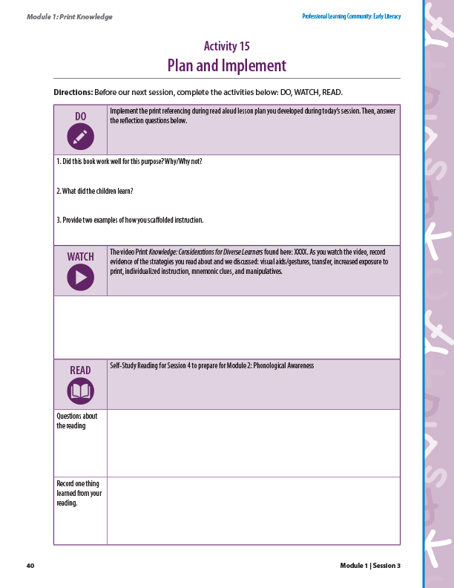
Debrief
  Implement print referencing lesson plan.
  Did the book work well? Why/why not? What did
  the children learn? How did you scaffold instruction?
  Video 8: Small-Group Explicit Instruction for the Letter M.
  Review evidence of effective strategies.
  Self-Study Reading for Session 4.
  Comments and questions?
Notes:
NOTES
Allow up to 10 minutes for this activity.
If you have a small group, ask for volunteers to share with the whole group. If you have a large group, consider having triads discuss and then ask a volunteer from each small group to share with the large group.
SAY At the end of Session 3, you were asked to complete Activity 15: Plan and Implement on page 38 in the Participant Guide from Module 1. Please turn to this activity so we can debrief and share our reflections.
DO You were asked to implement the print referencing during read-aloud lesson plan you developed during the last session and answer reflection questions. See questions on slide. Ask volunteers to share their answers.
WATCH You also watched Video 8: Small-Group Explicit Instruction for the Letter M (https://youtu.be/rWAItYgEKc0). What evidence of the strategies for English learner students and students with disabilities that we discussed in the last session did you record? Ask for volunteers to share their answers.
Key Points About the Video
Emphasize the following information if the participants do not.
Visual aid: uppercase and lowercase M on letter card
Mnemonic device: uppercase and lowercase M with a picture of a mountain
Manipulatives: magnetic letters
Individualized instruction worked with one child at the end of the lesson
READ What were some questions or comments that you recorded after you read the Self-Study Reading for Session 4? Discuss participants questions and comments.

Slide 7
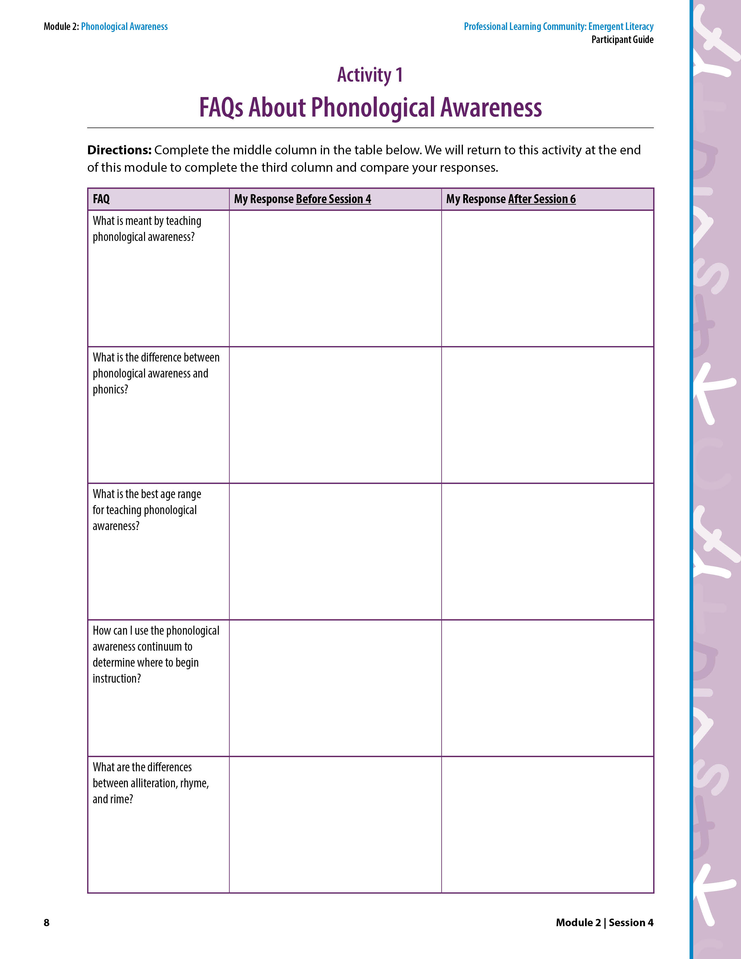
Activity 1: FAQs About Phonological Awareness
Record your responses in the middle column.
We will return to this activity at the end of this Phonological Awareness module to compare responses.
Notes:
NOTES Allow 5 minutes for this activity.
SAY Each time we see this Purple Banner it tells us we will complete an activity in the Participant Guide. Let’s start by looking at Activity 1: FAQs About Phonological Awareness on page 8 in the Participant Guide. Please take 5 minutes to read each frequently asked question and record a response in the second column.
Participants work independently for 5 minutes to answer FAQs.
We are not going to discuss your answers now, but we will return to these FAQs at the end of the module. At the end of Session 6, you will answer these questions again (in the third column) and reflect on how your answers have changed after the three sessions on phonological awareness.

Slide 8

Define and Discuss
Session Goals and Content
Understand phonological awareness and why it is important
Understand the phonological awareness continuum
Notes:
SAY During this session, we will dive into the content that you read prior to this session. The goals for Session 4 are to understand phonological awareness and why it is important. Another goal is to understand the phonological awareness continuum.
To reach these goals, we will follow the five-step process previously described. Activities include discussions, watching and reflecting on videos, practicing instructional strategies, making instructional plans, and implementing and reflecting on those plans.

Slide 9
Self-Study Reading for Session 4
What Is Phonological Awareness?
When Does Phonological Awareness Develop?
Why Is Phonological Awareness Important?
The Phonological Awareness Continuum
Notes:
NOTES
Allow 2 minutes.
Turn and Talk is a commonly used activity to encourage accountable talk that is purposeful to learning a concept or skill. The facilitator poses a question, participants turn and talk to a shoulder partner about the question, and volunteers share out highlights from the paired discussion.
A shoulder partner is someone you are sitting next to.
SAY Each time you see this icon (three heads talking) on the slide, it means we have a collaborative activity, usually a discussion, that is not in the Participant Guide. Let’s dive into phonological awareness by discussing the content you read prior to this session. Read the titles on the slide.
Consider this question: What is phonological awareness? To discuss this, we will use a method for accountable talk called Turn and Talk. This is where you take turns talking and listening with your shoulder partner, or person next to you. You can do this in your classroom too. This is an excellent way to have every child in your classroom engaged at once rather than calling on one child at a time to respond. Now, let’s try it. Turn and talk to your shoulder partner about this question: What is phonological awareness? We will share out ideas in 30 seconds.
Participants turn and talk for 30 seconds. Then, ask volunteers to share ideas.

Slide 10
What Is Phonological Awareness?
The understanding that speech can be broken down into parts, or units of sound, and the ability to manipulate those parts.
An auditory or oral skill that does not involve reading letters or words.
Children listen, speak, point, and gesture during phonological awareness instruction and practice.
Notes:
SAY Phonological awareness is an awareness that spoken language can be broken down into small units. It is an auditory or oral skill, so no print is involved. To teach and practice phonological awareness, children listen, speak, point, and gesture.

Slide 11
Units of Language
  Units refer to a sound structure of language that can be manipulated in phonological awareness tasks.
Notes:
SAY A unit of language is a sound structure of language, like a syllable, that can be manipulated. This figure shows that phonological awareness begins with larger units of language and moves toward smaller units of language.
The largest unit of language is a word, such as sunshine.
A smaller unit of language is a syllable. For example, the word picnic has two syllables that can be manipulated—we can separate the syllables: pic-nic.
Even smaller than a syllable, is the unit of language called onset-rime. The onset is the initial sound or sounds before the vowel, and the rime is the vowel and everything that follows it. So, for the word map the onset is /m/ and the rime is /ap/.
The smallest unit of language is the phoneme. A phoneme is an individual sound. There are three phonemes in the word sun: /s/ /u/ /n/.
Understanding the units of language will help you make instructional decisions about the phonological awareness activities you plan for children. Even though having phonemic awareness is important when learning to read in the conventional sense, preschool children are not expected to have phonemic awareness already.

Slide 12
The Important “P Words”
  Phonological awareness
  Phonemic awareness
  Print knowledge
  Phonics
  Alphabetic principle
Notes:
NOTES
Some definitions of print knowledge include reading words “by sight” and environmental print. For example, when a child recognizes the word bowl because it is written on the cat bowl. Or, when a child recognizes environmental print such as saying “McDonalds” when he or she sees the golden arches.
Point out that the information on this slide is on a one-page document in the Reproducible Materials section of the Participant Guide. It is designed for teachers to print out and use as a reminder of these terms.
SAY These words are all related because they are important foundational skills for literacy.
Phonological awareness is the understanding that speech can be broken down into parts and the ability to manipulate those parts at the word, syllable, onset-rime, and phoneme levels. So, you can think of phonological awareness as an umbrella term that includes every level of phonological awareness. Notice the picture to remind us is of a teacher and child speaking and listening.
Phonemic awareness is the ability to notice, think about, and work with the individual sounds in spoken words. Phonemic awareness includes only skills at the phoneme, or individual sound, level. Notice the picture to remind us shows a picture of a mat and the person saying the individual phonemes (sounds) of mat, not reading the word mat.
As we learned in Module 1, Print knowledge is knowing letter names, letters sounds, and concepts of print. Print knowledge does not include reading words, whereas phonics does. Notice the picture is of a child saying a letter name and a letter sound (not using that knowledge to read any words).
Phonics is using printed letters and letter-sound relationships to read words. It is also a method for teaching reading by matching printed letters with letter sounds. The difference between print knowledge and phonics is that print knowledge does not include using knowledge of letter sounds to read words. Notice the picture to remind us a child is using knowledge of letter sounds to read a word that is in print.
The Alphabetic principle is the understanding that there are systematic and predictable relationships between written letters and spoken sounds. We help children build this understanding through teaching phonological awareness, print knowledge, and in later grades, phonics.

Slide 13
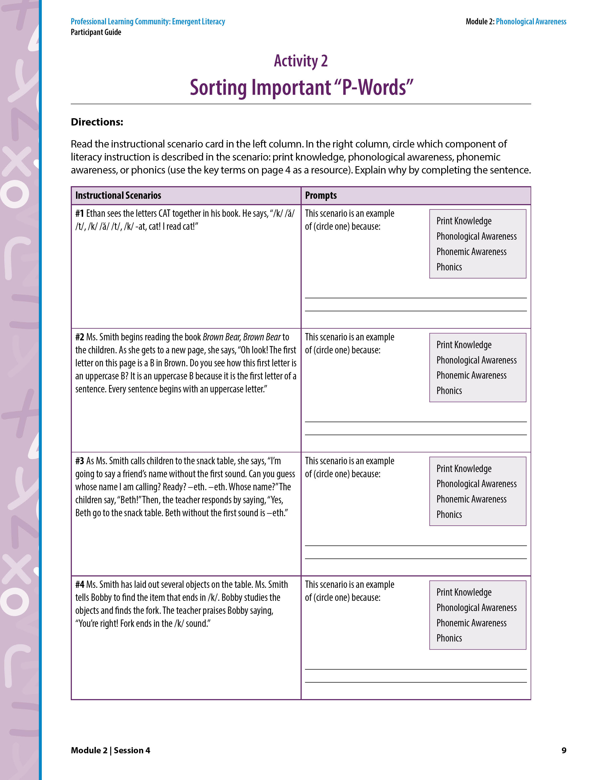
Learn and Confirm
Activity 2: Sorting Important “P-Words”
1. Identify which component of literacy instruction is described in each scenario: print knowledge, phonological awareness, phonemic awareness, or phonics.
2. Explain.
Notes:
NOTES
Allow about 15 minutes for this activity.
Step 3 is Learn and Confirm. Here is where you access and build participants’ background knowledge and experiences related to the topic of the session. Participants are explicitly taught the session’s content through, for example, models, videos, and discussions.
SAY Turn to Activity 2: Sorting Important “P-Words” on page 9 in the Participant Guide. For this activity, we will work in pairs or triads. Read each instructional scenario in the left column. In the right column, circle which component of literacy instruction is described in the scenario: print knowledge, phonological awareness, phonemic awareness, or phonics. Finally, explain why by completing the sentence. Use the key terms from page 4 as a resource. It’s important to note that the phonics instructional scenarios would typically be too challenging for preschool children and not taught in preschool. They are included in this activity for us to understand the differences among these components of reading and to highlight the importance of emergent literacy skills for learning to read later in school. Allow about 15 minutes for this activity.
Answers
Scenario 1: Phonics because Ethan is using his knowledge of letter sounds to decode, or read, a word.
Scenario 2: Print knowledge because Ms. Smith is talking about and showing uppercase B, which is a letter name. She is also teaching concepts of print by saying every sentence starts with a capital letter.
Scenario 3: Phonological awareness at the onset-rime level because she is only segmenting the first sound from Beth. It would be phonemic awareness if every sound in Beth was segmented: /b/, /e/, /th/.
Scenario 4: Phonemic awareness because Bobby had to isolate the last sound in the word fork. So he probably thought about each sound in the word, /f/ /or/ /k/.
Scenario 5: Phonological awareness at the syllable level. Mary is segmenting and counting syllables.
Scenario 6: Phonemic awareness because Howard says each sound in a word.
Scenario 7: Phonics because Jacob is using his knowledge of letter sounds to decode, or read, a word.
Scenario 8: Print knowledge because Ms. Smith is teaching the child how to hold a book, which is part of concepts of print.
Scenario 9: Phonics because the children are using knowledge of letter sounds to decode, or read, a word.
Scenario 10: Phonological awareness at the onset-rime level because Eric and Ben determine whether the middle and end of the word rhyme. To do this, they need to isolate the middle and end of the word (rimes) from the first sound (onset).
Scenario 11: Print knowledge because the Ms. Smith is teaching that the letter P says /p/.
Scenario 12: Phonemic awareness because Tommy says each sound in a word.

Slide 14
Preschool Provides a Strong Foundation
Phonological awareness does not come naturally to all children, so it needs to be explicitly taught and practiced.
Difficulties with phonological awareness are at the heart of most children’s reading challenges.
A goal in preschool is to provide a strong
foundation in phonological awareness so
that children can benefit from reading
instruction in their future years in school.
Notes:
Review the slide.
SAY We need to do all that we can to help preschool children build a strong foundation in phonological awareness and print knowledge and to understand the alphabetic principle. Once in kindergarten, children will receive phonics instruction, which will build on and strengthen the foundation provided in preschool.

Slide 15
Think-Pair-Share
How do you teach
phonological awareness?
Notes:
NOTES
Allow 3 minutes.
Think-Pair-Share is an activity to engage the participants in discussion about a topic. Pose a question and provide time for participants to think about their response. Then participants pair up and share their responses with their colleague. Ask pairs to share some of their responses with the whole group. A shoulder partner is someone who is sitting next to you.
SAY It’s time to think, pair, and share. Take a moment to consider the question: How do you teach phonological awareness? Think about a specific example or two. Then, pair with your shoulder partner and share your thinking.
Participants think for 30 seconds. Then, they pair and share their answers for 60 seconds. Ask volunteers to share ideas with the whole group.
Thank you for sharing. We will talk about specific strategies to teach phonological awareness later in this module.

Slide 16

Why Is Phonological Awareness Important?
It is directly related to reading ability.
It builds children’s capacity to learn phonics, once phonics is introduced in later grades.
It is a foundational skill for reading.
  It is associated with achievement in decoding in later grades.
It is included in state standards.
Notes:
SAY It is important to keep in mind that although we are not teaching children to read in the conventional sense in preschool, we are building their emergent literacy skills so that when formal reading instruction begins, they will have the solid foundation needed to become successful readers. Phonological awareness is one of the precursors to, or part of the foundation of, becoming a skilled reader.
If phonological awareness is strong, reading is likely to be strong. If phonological awareness is weak, reading is likely to be weak.
Children’s reading development depends on understanding the alphabetic principle. What is the alphabetic principle? Call on a volunteer. The alphabetic principle is the understanding that there are systematic and predictable relationships between written letters and spoken sounds.
Children use phonological awareness to understand phonics once it is introduced. If children can hear three sounds in the word sun, then they will be more likely to be able to sound out, or decode, the word sun when they see it in print.
Decoding skills support the development of reading fluency and reading fluency promotes text comprehension. Phonological awareness is also included in state standards.

Slide 17
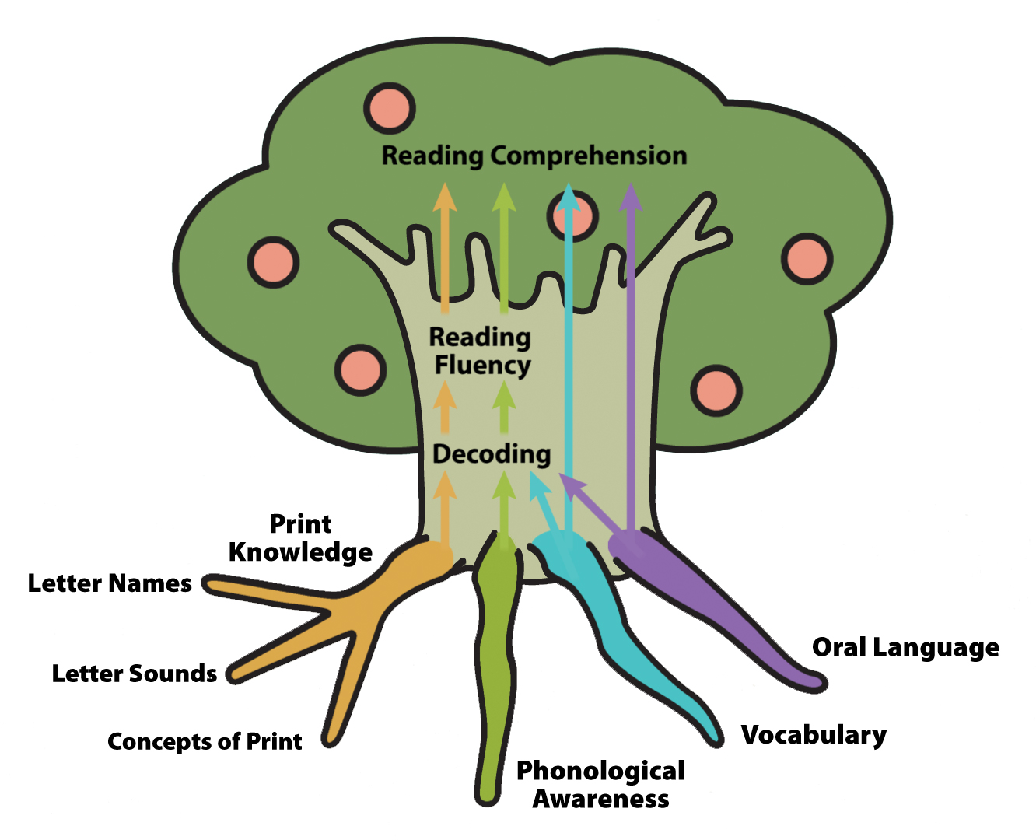
Video 1: The Literacy Tree-
A Representation of Foundational Literacy Skills
Notes:
NOTES This animation shows the connection between children’s’ phonological awareness (and other literacy components) and their ability to decode, and to, ultimately, comprehend text.
SAY Turn to page 7 in the Participant Guide for an image of the Literacy Tree. Let’s watch Video 1: The Literacy Tree (https://youtu.be/dTzdfHqKh00). This animation shows the connections between phonological awareness, decoding, fluency, and reading comprehension. It also shows the other literacy components included in this PLC—print knowledge, vocabulary, and oral language and their relation to reading comprehension. As you watch the animation, think about the importance of what you do every day in your classroom to contribute to each child’s literacy development. Show the video.
Discussion Questions
What do we teach in preschool to prepare children for reading instruction in kindergarten and later grades? (Print knowledge, phonological awareness, vocabulary, oral language)
Participants may say listening comprehension or other components of oral language. Point out that all of these fall under the oral language component.
What might occur if a child does not have well developed phonological awareness? (Without a strong foundation in phonological awareness, a child is unlikely to develop the word reading skills needed to understand text, which is the goal of reading.)
Key Points About the Video
Emphasize the following information if the participants do not.
Phonological awareness is a foundational skill that children will need when, in later grades, formal reading instruction begins.
Children who have good print knowledge skills and well developed phonological awareness can quickly understand the connection between the phonemes (the sounds) and the graphemes (the letters). This will help them benefit from phonics instruction in later grades.
Decoding skills support the development of reading fluency, and reading fluency is a bridge to reading comprehension.
Strong oral language skills and vocabulary knowledge support reading comprehension. Hearing a lot of words and knowing the meanings of words will make children more likely understand what they you read in later grades.

Slide 18
Phonological Awareness is Included in
State Standards
Look at our state’s standards and notice how phonological awareness is included as a key learning goal.
Highlight key words related to phonological awareness.
Notes:
NOTES
Allow 5 minutes.
Locate online and print a copy of your state’s emergent reading standards for each participant. The emergent literacy state standards are typically embedded in early learning standards for each state. Search your state department of education website. Share with participants where to locate the standards. If your state separates standards for 3 and 4-year-olds, print out the one (or both) that matches the level participants teach.
Provide highlighters for marking the state standards.
In some states, phonological awareness standards are limited and provide only a very brief description of a single skill such as rhyming. If participants comment on this, remind them that is important to understand the entire phonological awareness continuum in order to differentiate instruction according to each child’s instructional need.
SAY Standards are what a child should know and be able to do by the end of the school year. Each state addresses standards related to phonological awareness within its early learning standards.
Look at our state’s standards and notice phonological awareness is prioritized as a key learning goal for children.
Highlight key words related to phonological awareness that we have discussed.
Allow 3 minutes for this activity. Verify that participants have highlighted words related to phonological awareness (For example: spoken words/phrases, compound word, syllables, onset-rime, deletes, combines).

Slide 19
Video 2: Phonological Awareness Continuum
Notes:
NOTES This animation describes the four levels of phonological awareness and how children move through the levels. After you show the video, play a thumbs up or thumbs down game. You’ll say a statement and participants determine whether it is true (thumbs up) or not (thumbs down). After each statement, the answer is provided in italicized text in parentheses.
SAY Turn to page 4 in the Participant Guide to see an image of the phonological awareness continuum. Let’s watch Video 2: Phonological Awareness Continuum (https://youtu.be/k0IDVed9dUU). This animation describes the four levels of phonological awareness and how children move through the levels. You read about the four levels in the Self-Study Reading, and we briefly introduced them earlier in this session. The levels are word, syllable, onset-rime, and phoneme. As you watch the video, notice how phonological awareness begins with larger units of language and moves toward smaller ones. Show the video.
Think about the phonological awareness continuum. After each statement I make, hold your thumb up for “yes” or down for “no”.
Phonological awareness is an overarching term that is used to explain several levels of the sound structure of language. (Thumbs up. That’s right. There are four levels on the phonological awareness continuum: word, syllable, onset-rime, phoneme)
Children will enter preschool with the same developmental levels of phonological awareness. (Thumbs down. That is an incorrect statement. Children will enter preschool with diverse levels of phonological awareness.)
The entire phonological awareness continuum does not need to be taught in preschool. (Thumbs up. That’s correct. The goal is for children to progress along the phonological awareness continuum throughout preschool. The phoneme level is typically not developed in preschool.)
It doesn’t matter where each child is on the phonological awareness continuum, just begin teaching phonological awareness at the word level for every child. (Thumbs down. That is an incorrect statement. It is important to determine where each child is on the phonological awareness continuum and explicitly teach each children at their current level in small groups to help them make progress along the continuum).
Phonological awareness is not sequential, where children must master one level before moving to the next level. (Thumbs up. That’s correct. Children do not need to master one level on the phonological awareness continuum before moving to the next level.)

Slide 20

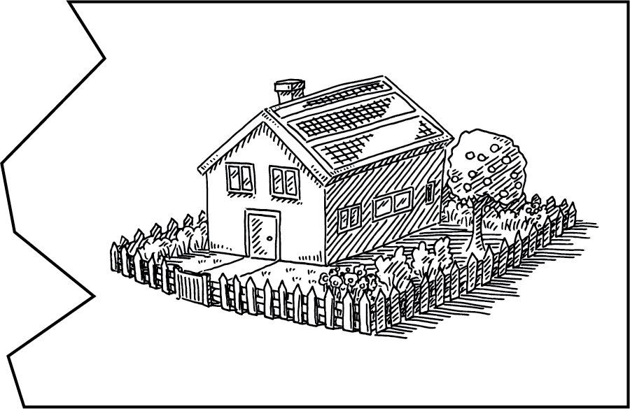

Collaborate and Practice
Word Level
Phoneme Level
Module 2 | Session 4 | 20
Notes:
NOTES
Allow 5 minutes for this activity.
Step 4 of each session is collaborate and practice, where we practice applying what we have discussed so far.
The objective of this activity is for teachers to understand the four levels of phonological awareness. You will need four pieces of paper to label each corner of the room with one level: word level, syllable level, onset-rime level, phoneme level. Point out each corner of the room and state the level for the teachers. After you describe/model a phonological awareness task, participants will walk to the appropriate corner (level). Instead of walking, participants could point to the associated label.
After each task, click the mouse for the answer to appear.
SAY Let’s use the information from the animation of the phonological awareness continuum to sort phonological awareness tasks. Each corner of the room represents a level on the phonological awareness continuum. I’ll demonstrate a task, you respond to the task as a group, and then determine which level of phonological awareness it is. You will walk (or point) to that corner or designated area of the room.
I’m going to say a word in two parts and you will put the two parts together. Dog (pause and click the mouse) house (click the mouse). Participants answer: doghouse. Click the mouse to show the picture puzzle pieces coming together. Great job of putting together dog (pause) house and saying doghouse. Walk/point to the level this task represents on the phonological awareness continuum. Participants walk or point to designated area: word level. Click the mouse to show the title, Word Level. Nice job of recognizing the word level on the phonological awareness continuum!
I’ll say each sound in a word, and you tell me the word. /s/ /ŭ/ /n/. Participant answer: Sun. Click the mouse to show the picture of the sun. Yes! Each sound in the word sun is /s/ ŭ/ /n/. Walk/point to which level this task represents on the phonological awareness continuum. Participants walk or point to designated area: phoneme level Phoneme Level. Click the mouse to show the title, Phoneme Level. This is a phonemic awareness task because I said each phoneme, or individual sound, in the word. Then, you put the sounds together to say the whole word. Even though the phoneme level is not typically taught in preschool, some children may be ready for it, and therefore the phoneme level should be taught to those children.

Slide 21


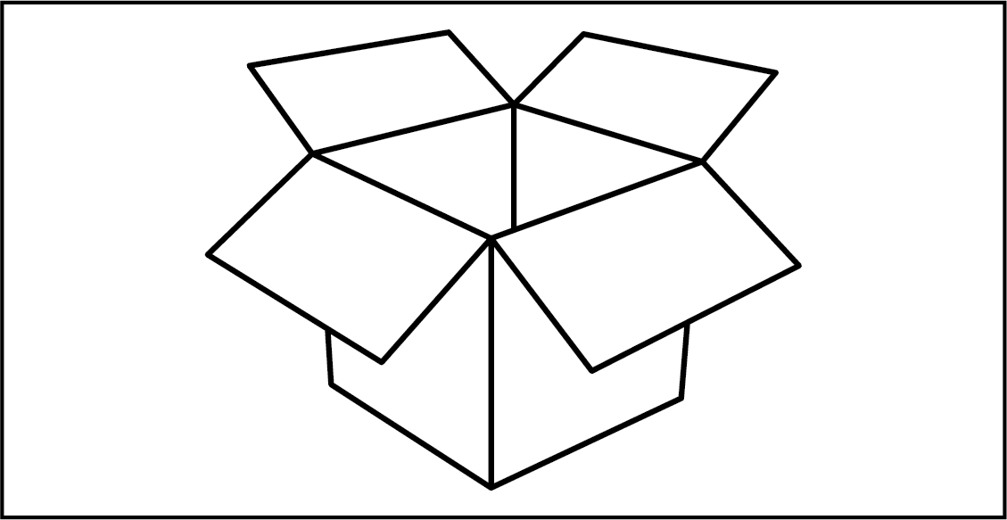
Collaborate and Practice
Syllable Level
Onset-Rime Level
Module 2 | Session 4 | 21
Notes:
NOTES
This is a continuation of the activity from Slide 20.
SAY
What is this a picture of? Participants respond: hamburger. Hop as you say each part you hear in “hamburger.” Participants hop three times and say each syllable for each hop: ham-bur-ger. Great job of saying and hopping for each part in hamburger (model answer). Walk or point to the level this task represents on the phonological awareness continuum. Participants walk or point to designated area: syllable level. Click the mouse to show the title, Syllable Level.
Do these words rhyme: fox, box? Participants answer: Yes. Correct! Fox and box rhyme because they sound the same in the middle and at the end. Walk/point to the level this task represents on the phonological awareness continuum. Participants walk or point to designated area: onset-rime level. Click the mouse to show the title, Onset-Rime Level.
When first learning about rhymes, some children benefit from first identifying the word that is different (does not rhyme) using a longer list of rhyming words and a word that is very different in sounds. For example: cat, pat, mat, round, sat.

Slide 22
Collaborate and Practice
Syllable Level
Phoneme Level
Module 2 | Session 4 | 22
Notes:
NOTES
This is a continuation of the activity from Slide 20.
SAY
Say your first name. Now, clap for each part you hear in your first name. Participants clap for each syllable as they say their first name. Great job of clapping for each part you hear in your name. Use your name and others to model (e.g., Beth: 1 syllable, Kar-li: 2 syllables, Tim-o-thy: 3 syllables). Walk or point to the level this task represents on the phonological awareness continuum. Participants walk or point to designated area: syllable level. Click the mouse to show the title, Syllable Level.
I’m going to say a word one sound at a time, and you tell me the word. /b/ /oa/ /t/. What word? Participants answer: Boat. Great job of putting individual sounds together to say a word. /b/ /oa/ /t/ is boat. Click the mouse to show the picture of a boat. Walk or point to the level this task represents on the phonological awareness continuum. Participants walk or point to designated area: phoneme level. Click the mouse to show the title, Phoneme Level. This level is referred to as phonemic awareness because the task was to listen to each sound, or phoneme, in a word and then say the word. Even though the phoneme level is not typically taught in preschool, some children may be ready for it, and therefore the phoneme level should be taught to those children.

Slide 23
Collaborate and Practice
Word Level
Onset-Rime Level
Module 2 | Session 4 | 23
Notes:
NOTES
This is a continuation of the activity from Slide 20.
SAY
Say “basketball.” Participants repeat, basketball. Click to show the graphic. Now say “basketball” and take away “basket.” Participant answer: ball. Click to show the graphic of a ball. Great job! You took off “basket” from “basketball” and were left with “ball.” This is called deletion. Walk or point to the level this task represents on the phonological awareness continuum. Participants walk or point to designated area: word level. Click the mouse to show the title, Word Level.
What word do these sounds make: /f/ / an/? Participant answer: Fan. Yes, the sounds /f/ / an/ make the word “fan.” Click to show the picture of a fan. Walk or point to the level this task represents on the phonological awareness continuum. Participants walk or point to designated area: onset-rime. Click the mouse to show the title, Onset-Rime Level.
Before engaging in onset-rime activities, children need to understand “first” or “beginning” in order to understand the task. So, when you ask what the first sound is, they will know what “first” means. Also, carefully consider the words you select to use. Select words with very different initial sounds when first teaching this. Using words that are made in a similar way (for example, /b/ and /p/) will be more difficult to distinguish because there the two sounds are made in similar way and there is no visual cue.

Slide 24
Reflect, Plan, and Implement
Think-Pair-Share
What did you learn during this session
that confirmed what you already knew about why
phonological awareness is important?
What did you learn that contradicted what you already
knew about why phonological awareness is important?
Notes:
NOTES Allow 2 minutes for this activity.
SAY Step 5, Reflect, Plan, Implement is the final step of each session. Let’s first reflect on the information we covered today by doing a Think-Pair-Share. Take a moment to think about these two questions:
What did you learn during this session that confirmed what you already knew about why phonological awareness is important?
What did you learn that contradicted what you already knew about why phonological awareness is important?
Then, pair with your shoulder partner and share your thinking.
Allow 1 minute for this activity. Then ask volunteers to share their ideas.

Slide 25
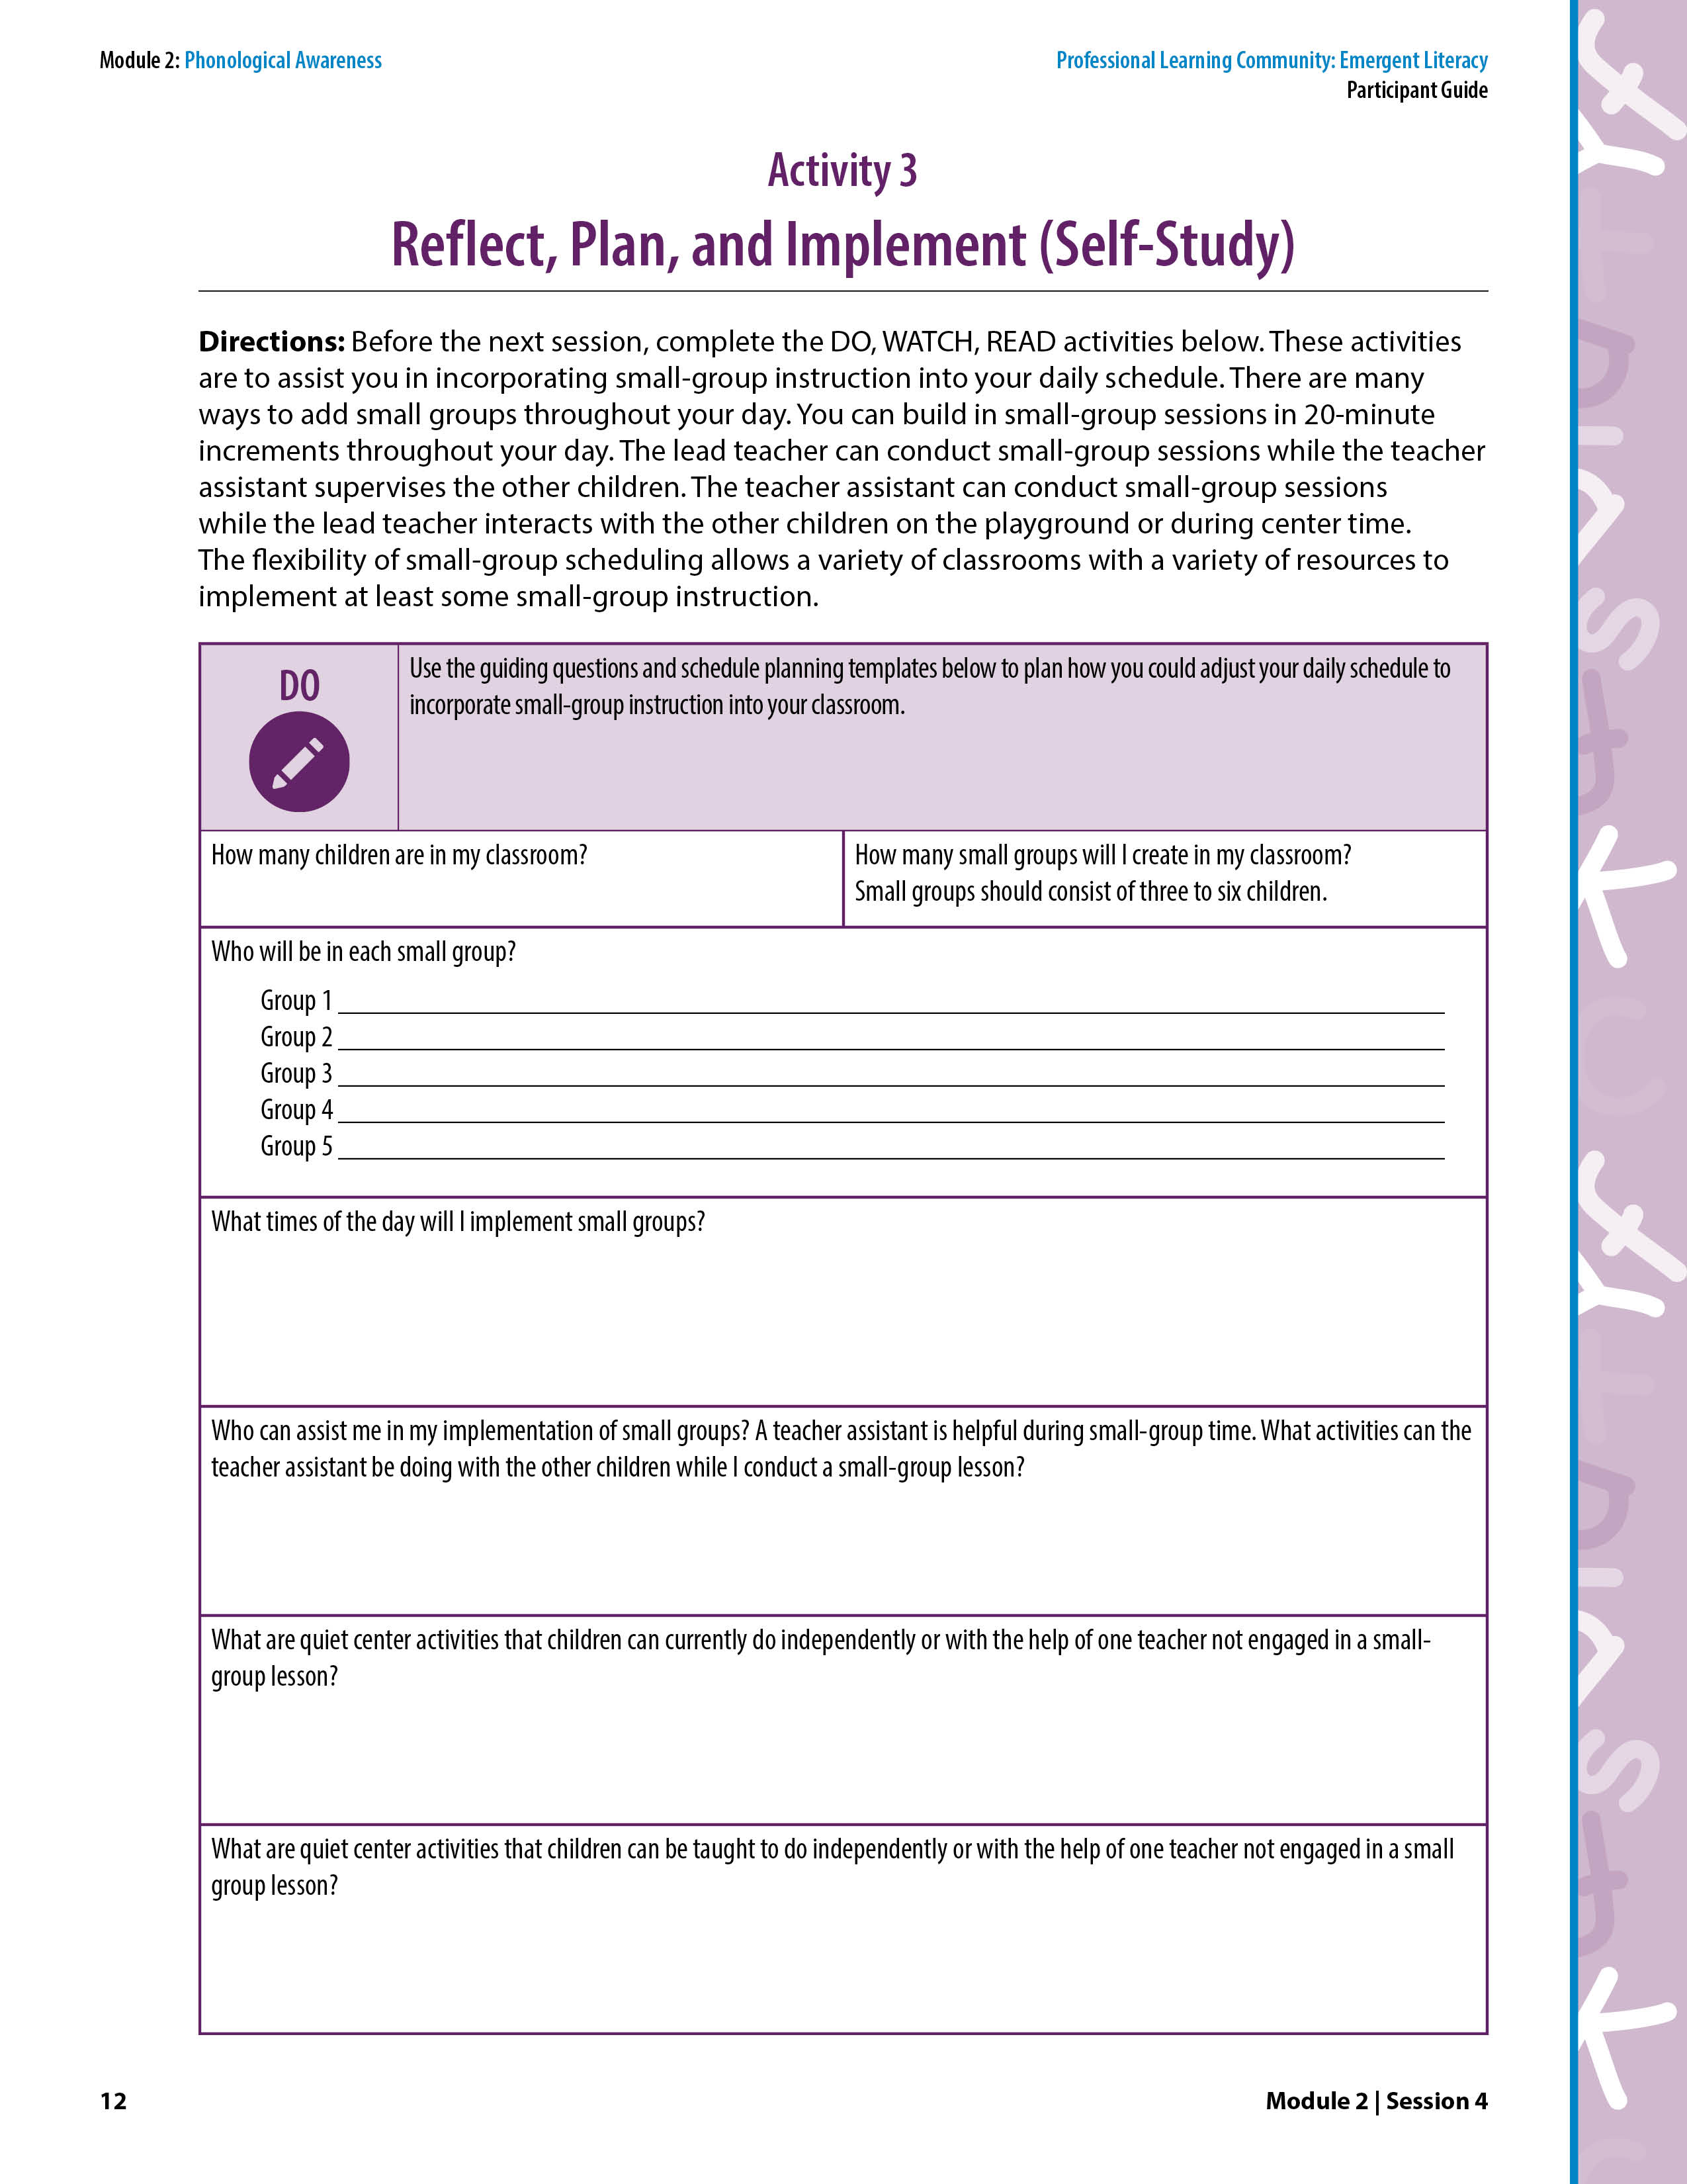
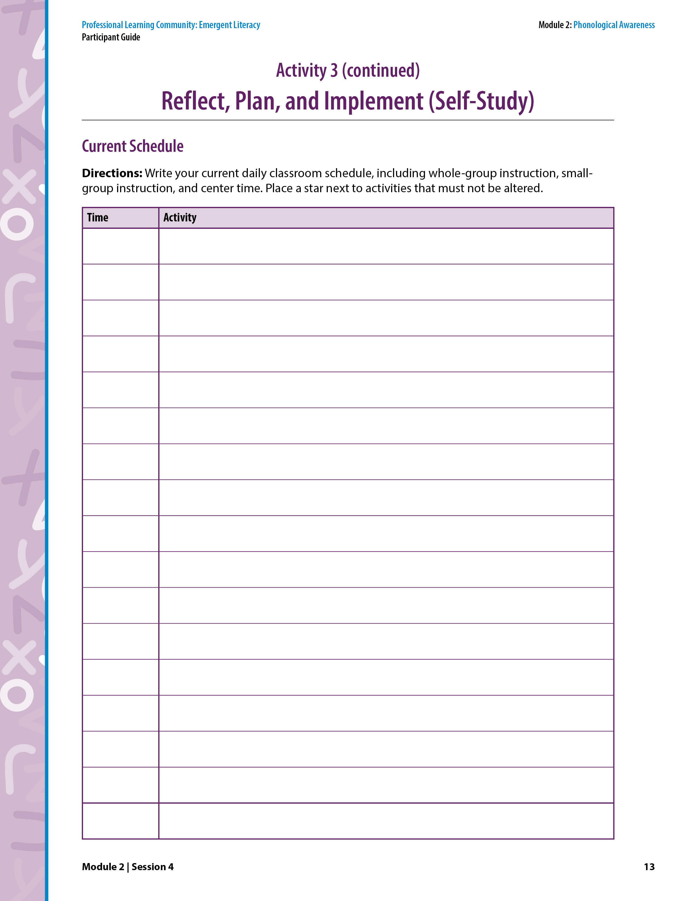
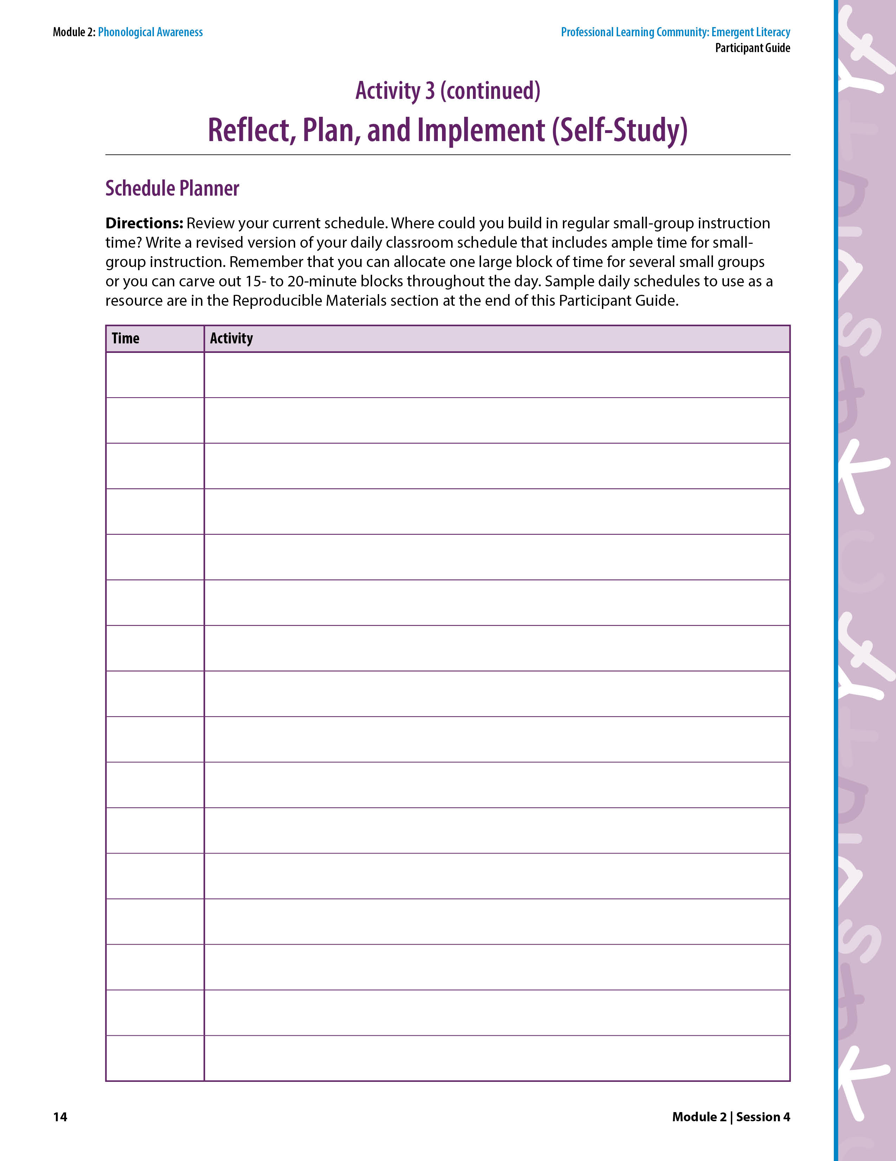
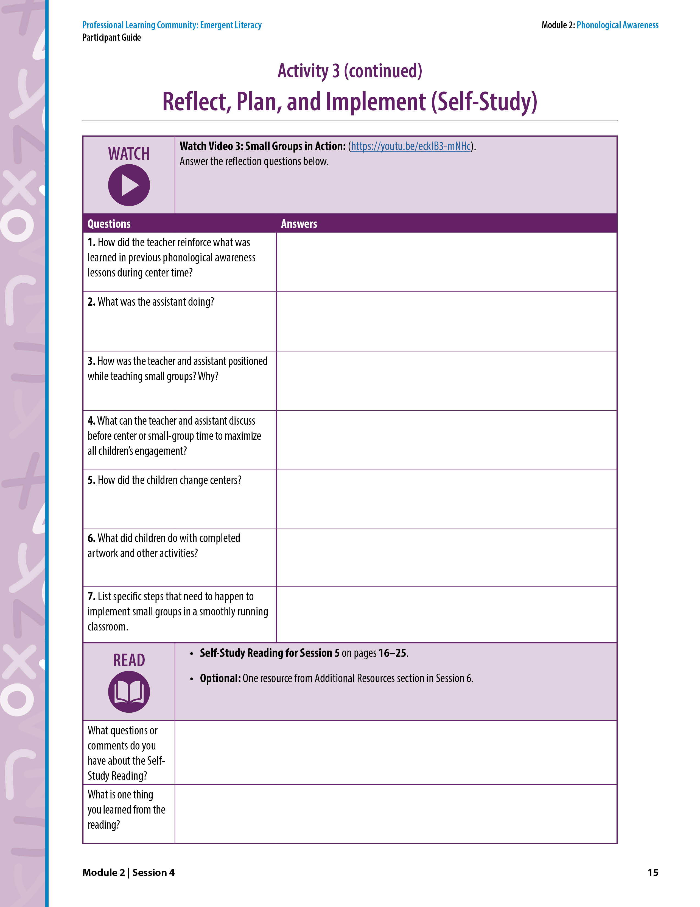
Reflect, Plan, and Implement
Activity 3: Reflect, Plan, and Implement
(Self-Study)
  Answer the guiding questions on page 12.
  Video 3: Small Groups in Action
  Answer the reflection questions on page 15.
  Self-Study Reading for Session 5 on pages 16–25.
  Optional: One resource from the Additional Resources section on pages 44-46.
Notes:
NOTES
Allow 5 minutes to complete this activity.
Explain the DO, WATCH, READ activities.
Announce the date and time of the next PLC session. Ask participants to note it on page v in the Participant Guide.
Follow up with an email so participants will note it in their calendars.
SAY At the end of each session, we will review what you should DO, WATCH, and READ before the next session. These Self-Study activities will take 30–60 minutes. Now, let’s look at Activity 3: Reflect, Plan, and Implement on pages 12–15 in the Participant Guide so we can make a plan to implement.
DO Use the guiding questions and schedule planning templates to plan how you could adjust your daily schedule to incorporate small-group instruction into your classroom. Review the guiding questions.
WATCH Video 3: Small Groups in Action (https://youtu.be/YXaF5qjnSLQ).
Answer the reflection questions.
READ Self-Study Reading for Session 5 on pages 16–25.
Optional: Select and read one resource from the Additional Resources section on pages 44–46.

Slide 26
We have completed
Session 4
Notes:
SAY We have now completed Session 4! Thank you for your collaboration and a great PLC session on phonological awareness!

Slide 27
Professional Learning Community
EMERGENT LITERACY
Module 2: Phonological Awareness
Session 5
Levels of Phonological Awareness
Features and Examples of Effective
Phonological Awareness Instruction
Notes:
NOTES
Session 5 will take approximately 90 minutes.
Prior to Session 5, participants will have read pages 16–25 in the Participant Guide:
Levels of Phonological Awareness
Features of Effective Phonological Awareness Instruction
Examples of Effective Phonological Awareness Instruction
Under “SAY” in these speaker notes:
Regular text indicates what you should say.
Italicized text indicates something you and/or the participants should do.
SAY Welcome and thank you for continuing to participate in our Professional Learning Community on Emergent Literacy! Today, we will meet for 90 minutes to continue Module 2: Phonological Awareness. This is Session 5.
Briefly introduce yourself and facilitate introductions of participants, if needed.

Slide 28
Purpose of Our
Professional Learning Community (PLC)
To engage in collaborative learning experiences to support preschool teachers in applying evidence-based language and literacy strategies.
Notes:
SAY As a quick reminder, the purpose of our PLC is to engage in collaborative learning experiences to support preschool teachers in applying evidence-based language and literacy strategies in their instruction. I look forward to continuing to learn together!

Slide 29
Norms For Our PLC
Presume
positive intentions
Cell phones on silent
Pay attention to self and others
Notes:
NOTES Consider your group to determine how much detail about the norms will be helpful to review.
SAY Let’s quickly review the norms, or ground rules, for our PLC that we agreed to during our first session. We remind ourselves of these norms for PLCs in order to be productive.
Cell phones on silent will help us have an uninterrupted session.
Pay attention to self and others: This means to contribute, listen, and be aware of how you and others are responding to each other. Be sure to give everyone a chance to talk and encourage others who seem reluctant to join in. Sometimes people who are reluctant to talk are thinking. They may not be comfortable jumping in, but they may have something important to say.
Presume positive intentions: This means to pause before responding. Usually when people contribute to a conversation, they intend to be constructive. So, always respond positively to keep the discussions productive.

Slide 30
Debrief
  Answer the guiding questions about your classroom schedule on page 12.
  Video 3: Small Groups in Action
  Answer the reflection questions on page 15.
  Self-Study Reading for Session 5 on pages 16–25.
  Optional self-selected reading from the Additional Resources section on pages 44-46.
Notes:
NOTES
Allow about 15 minutes for this debrief.
If you have a small group, ask for volunteers to share with the whole group. If you have a large group, consider having triads discuss and then ask for a volunteer from each triad to share with the large group.
SAY Let’s dive back into phonological awareness! Before coming to this session, you completed Activity 3: Reflect, Plan, and Implement in the Participant Guide. These self-study activities included something to DO, something to WATCH, and something to READ. Please turn to this activity on page 12 so we can debrief and share our reflections.
DO Review the guiding questions from Activity 3: Reflect, Plan, and Implement on pages 12–15 in the Participant Guide. Have participants work in triads to discuss their planning and implementation of small-group instruction using their planning sheets from Activity 3. Ask triads to share their ideas and ways in which they overcome challenges to implementing small-group instruction. Ask for volunteers to share out one thing they learned from their discussion.
WATCH Now, let’s turn our attention to the video you watched, Video 3: Small Groups in Action (https://youtu.be/YXaF5qjnSLQ). Ask for volunteers to share their responses to the reflection questions. Emphasize the following information if the participants do not.
Key Points About the Video
Note that numbers below match question numbers on page 15.
During center time, the teacher reinforced what was learned in previous phonological awareness lessons by providing a syllable puzzle piece activity at an independent center and by practicing syllables during discussions at the kitchen center.
The assistant was consistently engaged with the children. She taught a small group of children and engaged in conversations with them.
While teaching in small groups, the teacher/assistant always faced the other children in the classroom. The children she was working with faced her with their backs to the rest of the activity in the classroom. This allowed the teacher/assistant to be aware of what was happening in the classroom and allowed the children in the small group to focus on the instruction led by that teacher.
The teacher and assistant can discuss their classroom observations and observations during small-group instruction to determine how to maximize child engagement during center time.
Children changed centers by moving their picture to the center of their choice on the class center board. Centers were labeled by pictures with Velcro on the back.
Children placed completed artwork and other activities in a hanging file folder on the wall next to the center board.
To implement small groups in a smoothly run classroom, teachers must explicitly teach expectations and routines and provide many opportunities for children to practice the routines. During the days (or weeks) of practicing classroom routines, instead of teaching a small group, the teacher provides specific feedback to children as they work in small groups, pairs, and independently. Once children can engage in center time productively, then the teacher starts to teach small groups during center time.
READ You were asked to read the Self-Study Reading for Session 5 on pages 16–25 in the Participant Guide and an optional self-selected resource from the Additional Resources section. What were some of the comments or questions you noted about your readings? We will discuss this content during today’s session.

Slide 31
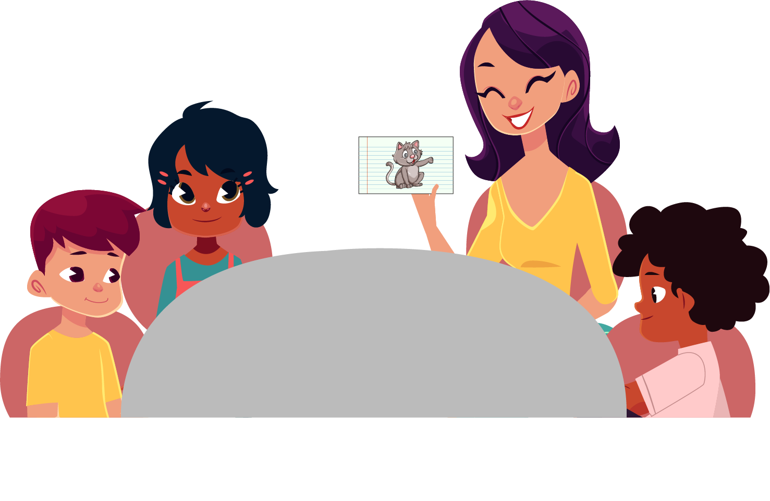
Define and Discuss
Session Goals and Content
Review main ideas from Session 4
Understand how to explicitly teach phonological awareness in small groups
Notes:
SAY During Session 4, we learned:
Phonological awareness is the understanding that speech can be broken down into parts and the ability to manipulate those parts.
Children who have well developed phonological awareness can quickly understand the connection between the phonemes (the sounds) and the graphemes (the letters) when phonics instruction is introduced in later grades.
The four levels of the phonological awareness continuum are word, syllable, onset-rime, and phoneme. Children are not expected to reach the phoneme level in preschool.
Children do not need to master one level of the phonological awareness continuum before moving to the next. Children move through the continuum at different rates.
The goal for Session 5 is to understand how to explicitly teach phonological awareness in small groups using the features of effective instruction. We will learn about specific tasks and instructional activities for each level of the phonological awareness continuum to implement during small-group instruction.
To do this, we will have discussions, watch and reflect on videos, practice instructional strategies, make instructional plans, and implement and reflect on those plans.

Slide 32
Small-Group Explicit Instruction of Phonological Awareness
Implement daily, interactive sessions (10–15 minutes)
Use evidence-based instructional methods
Integrate into a curriculum that simultaneously supports the development of children’s language, math, social, and motor skills and their general knowledge and interests
Notes:
SAY Explicit, small-group instruction is an effective instructional practice for teaching children phonological awareness. Small-group, phonological awareness instruction is a small part of each day in the life of a preschooler. Review the slide.

Slide 33
Video 2: Phonological Awareness Continuum
Notes:
NOTES This animation describes the four levels of phonological awareness and how children move through the levels. It was shown in Session 4.
SAY We are going to watch Video 2: Phonological Awareness Continuum (https://youtu.be/k0IDVed9dUU) again. This animation describes the four levels of phonological awareness and how children move through the levels. You read about the four levels in the Self-Study Reading, and we briefly introduced them earlier in this session. The levels are word, syllable, onset-rime, and phoneme. I wanted to review this with you before the next activity. Show the video.

Slide 34
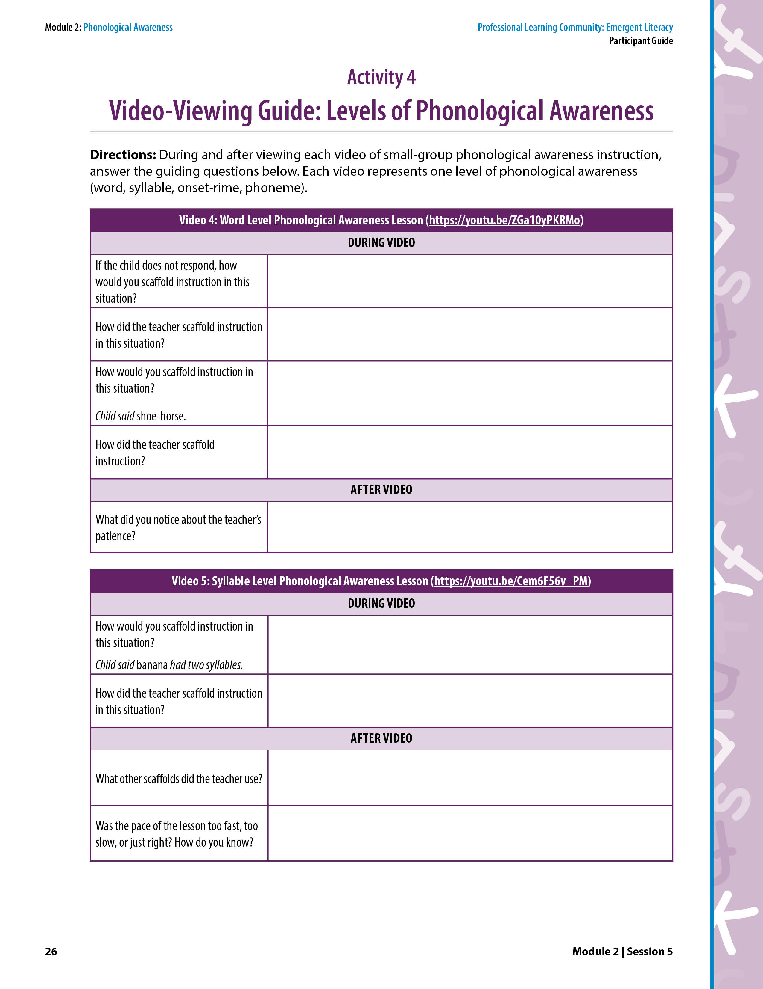
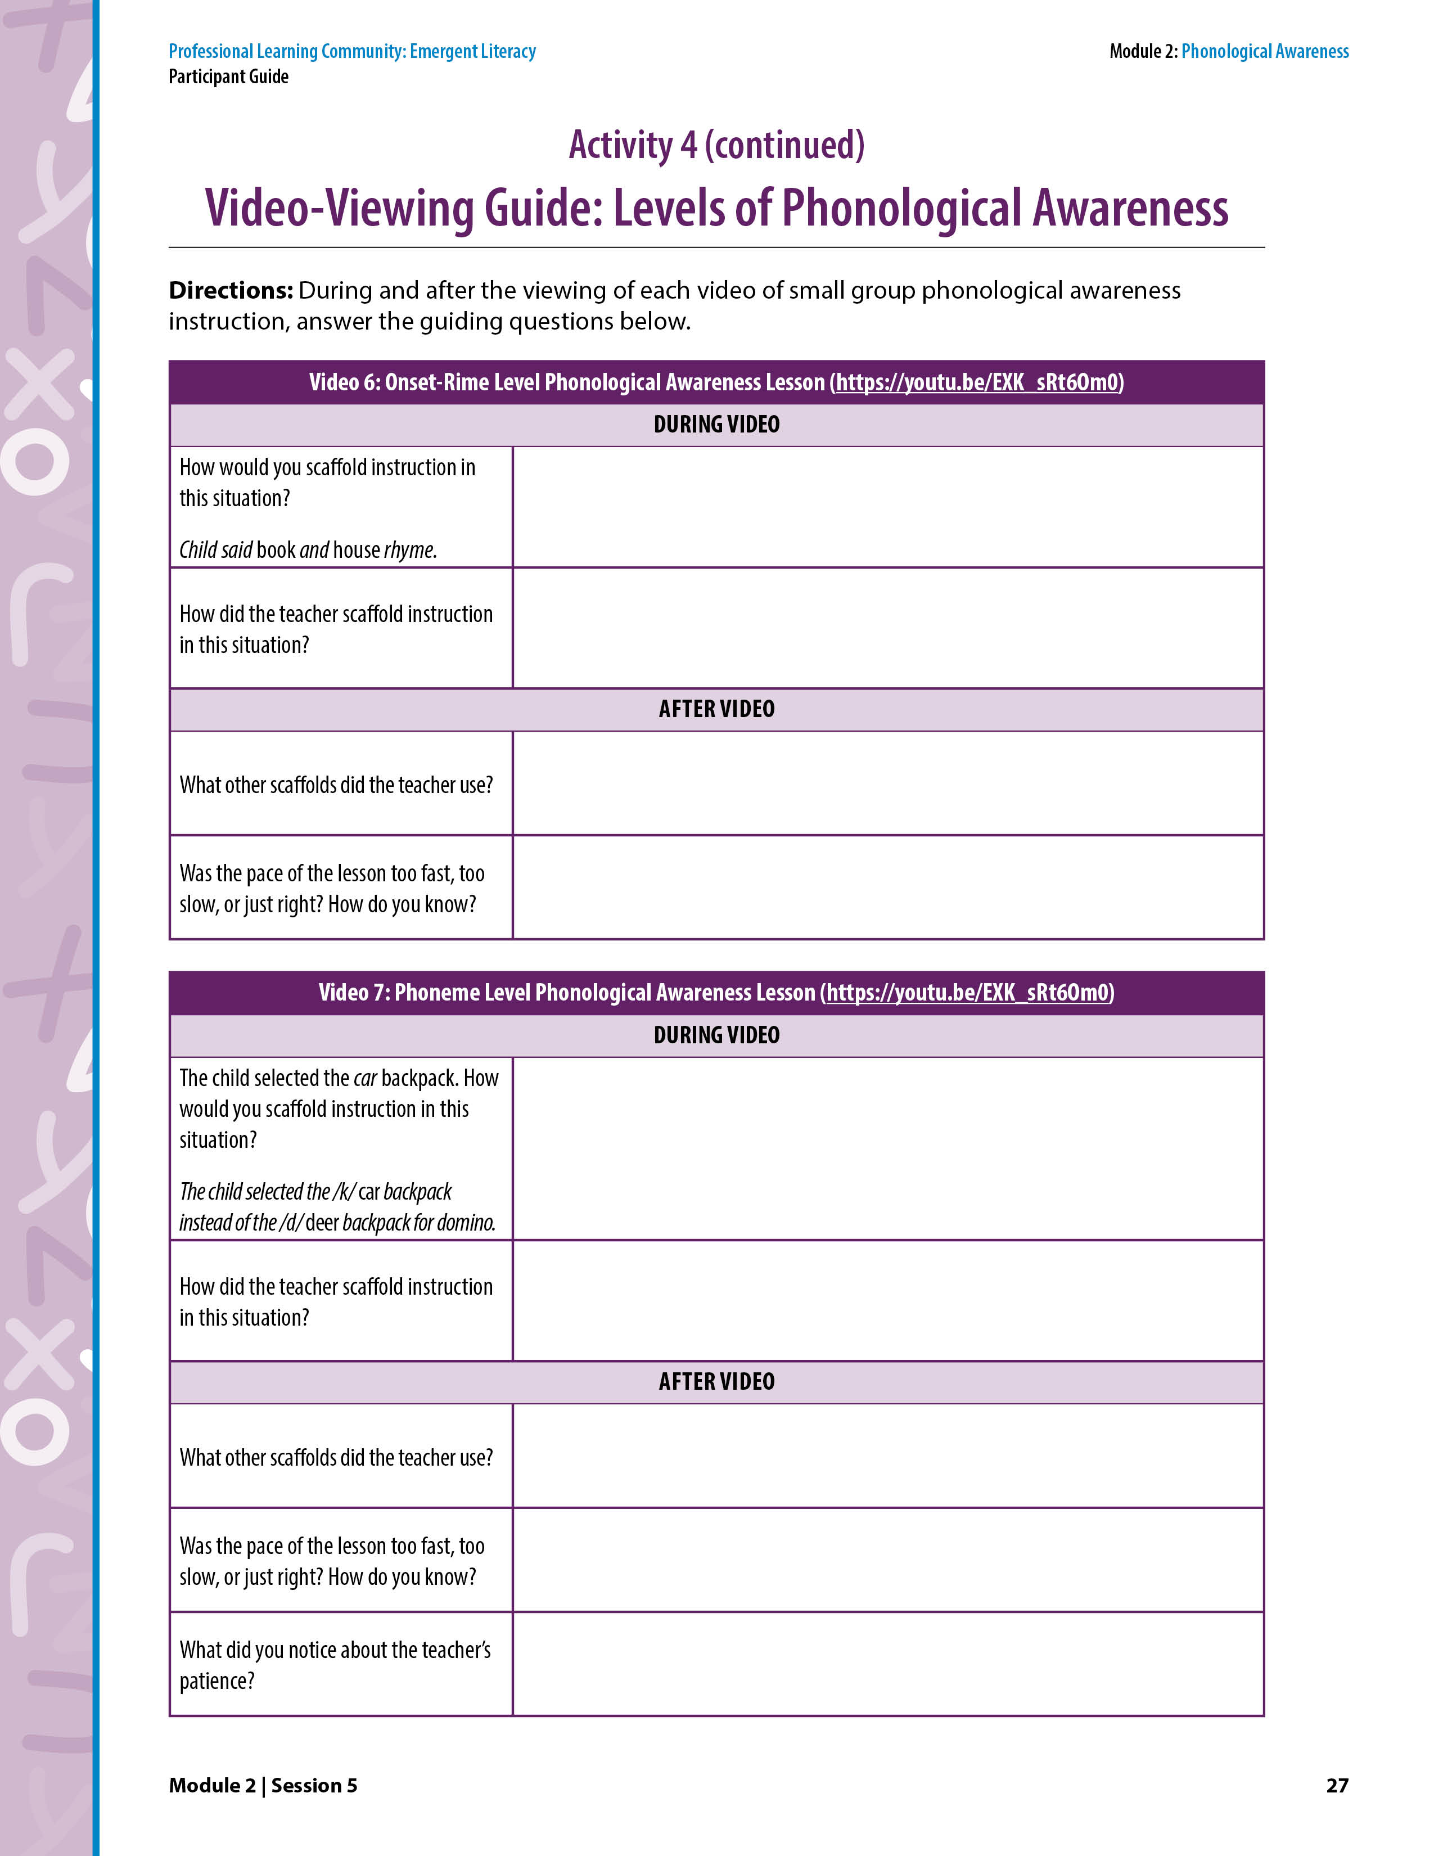
Learn and Confirm
Activity 4: Video-Viewing Guide: Levels of Phonological Awareness
Video 4: Word Level Phonological Awareness Lesson
Notes:
NOTES
Allow about 30 minutes for this activity.
Each of the following four slides include a video that represents one level of phonological awareness instruction in small groups.
Participants answer the guiding questions on Activity 4 as they view each video. Note that many of the questions appear on the video and in the activity guide.
Each video pauses for a few seconds in one or two places for participants to answer a question shown on the video. Stop the video if participants need more time to record their answers.
Discuss participants’ answers to reflections questions about each video before moving to the next video
SAY Step 3 of the collaborative learning cycle is Learn and Confirm. Turn to Activity 4: Video-Viewing Guide: Levels of Phonological Awareness on pages 26–27 in the Participant Guide. We are going to watch four videos—one at each level of the phonological awareness continuum that we just reviewed. Activity 4 includes questions specific to each video. We will discuss your answers to the questions before watching the next video. The goals for this activity are to understand the four levels of phonological awareness and identify effective ways to scaffold phonological awareness instruction.
Video 4 (https://youtu.be/LSF1AZjTAqc) shows small-group phonological awareness instruction at the word level. Review the questions in the first table. You will record your reflections during and after the video. Show the video. Allow time for participants to record their answers. Ask for volunteers to share their answers.
Key Points About the Video
Emphasize the following information if the participants do not. Review sections of the video as needed.
Scaffold question 1: The teacher held each picture up one at a time as she prompted the child to say each word. Then, the teacher put the pictures together and modeled how to say the words together. Finally, the teacher monitored as she provided the child an independent turn.
Scaffold question 2: The teacher separated the two pictures and prompted the child to say each picture’s name. Then the teacher brought the pictures together and modeled how to say the two words together. She had the child repeat the word.
The teacher was very patient and allowed children ample time to respond.

Slide 35
Activity 4: Video-Viewing Guide: Levels of Phonological Awareness
Video 5: Syllable Level Phonological Awareness Lesson
Notes:
NOTES
This is a continuation of Activity 4 from slide 34.
Video 5: Syllable Level Phonological Awareness Lesson
SAY Video 5 (https://youtu.be/CmwMYcQmRGo) shows small-group phonological awareness instruction at the syllable level. Review the questions in the second table on Activity 4 on page 26. You will record your reflections during and after the video. Show the video. Allow time for participants to record their answers. Ask for volunteers to share their answers.
It is important to note that when first introducing this activity, you should only use one and two syllable words. Once children are proficient at one and two syllable words, you can introduce three syllable words.
Key Points About the Video
Emphasize the following information if the participants do not. Review sections of the video as needed.
Scaffold question 1: When the child said there were two syllables in banana, the teacher asked her to try again and tapped the syllables with her.
Other scaffolds:
When the child called the octopus a squid, the teacher told her the name of the picture (octopus). Then, tapped and had the child identify the number of syllables in octopus and the number of syllables in squid.
The teacher used encouraging and specific words when providing feedback.
When the children could not remember the word syllable, the teacher cued them by saying, /s/.
The teacher was enthusiastic and warm.
The teacher smiled and laughed with the children.
The pace of the lesson was just right because the children were actively engaged in the activity and on task throughout the lesson.

Slide 36
Activity 4: Video-Viewing Guide: Levels of Phonological Awareness
Video 6: Onset-Rime Level Phonological Awareness Lesson
Notes:
NOTES
This is a continuation of Activity 4 from slide 34.
Video 6: Onset-Rime Level Phonological Awareness Lesson
SAY Video 6 (https://youtu.be/FHxs4YiB0ZI) shows small-group phonological awareness instruction at the onset-rime level. Review the questions in the third table on Activity 4 on page 27. You will record your reflections during and after the video. Show the video. Allow time for participants to record their answers. Ask for volunteers to share their answers.
Key Points About the Video Emphasize the following information if the participants do not. Review sections of the video as needed.
Scaffold question 1: When the child said that book and house rhyme, the teacher said the onset and rime for each word separately for the child to hear that the middle and end of the words do not rhyme. She said, “/b/ /ook/, /h/ /ouse/. They don’t rhyme because they don’t sound the same in the middle and the end, book, house.”
Other scaffolds: This may have been the first time the children did this task. The teacher did a lot of modeling and explaining, which these children needed. She was also enthusiastic and gave specific and encouraging feedback.
The pace of the lesson was just right because the children were actively engaged in the activity and on task throughout the lesson.

Slide 37
Activity 4: Video-Viewing Guide: Levels of Phonological Awareness
Video 7: Phoneme Level Phonological Awareness Lesson
Notes:
NOTES
This is a continuation of Activity 4 from slide 34.
Video 7: Phoneme Level Phonological Awareness Lesson
SAY Video 7 (https://youtu.be/GJQkPrhspbU) shows small-group phonological awareness instruction at the phoneme level. Specifically, the children are identifying the first sound in a word. Review the questions in the fourth table on Activity 4 on page 27. You will record your reflections during and after the video. Show the video. Allow time for participants to record their answers. Ask for volunteers to share their answers.
Key Points About the Video
Emphasize the following information if the participants do not. Review sections of the video as needed.
Scaffold question 1: When the child was going to place the domino in the car backpack, the teacher pointed as she said, “This is car and it starts with a /k/ sound and deer starts with /d/.” The child immediately corrected herself by placing the domino in the deer backpack.
Other scaffolds:
When the child said, “d” the teacher responded, “That’s the letter, what’s the sound?”
When the child called the comb a hairbrush, the teacher said a hairbrush has a handle.
“I like how you thought about the first sound in comb and matched it to the first sound in car.”
The teacher used encouraging and specific words when providing feedback.
The teacher gave high-fives to children.
The pace of the lesson was just right because the children were actively engaged in the activity and on task throughout the lesson.
The teacher was very patient and allowed children ample time to respond.

Slide 38
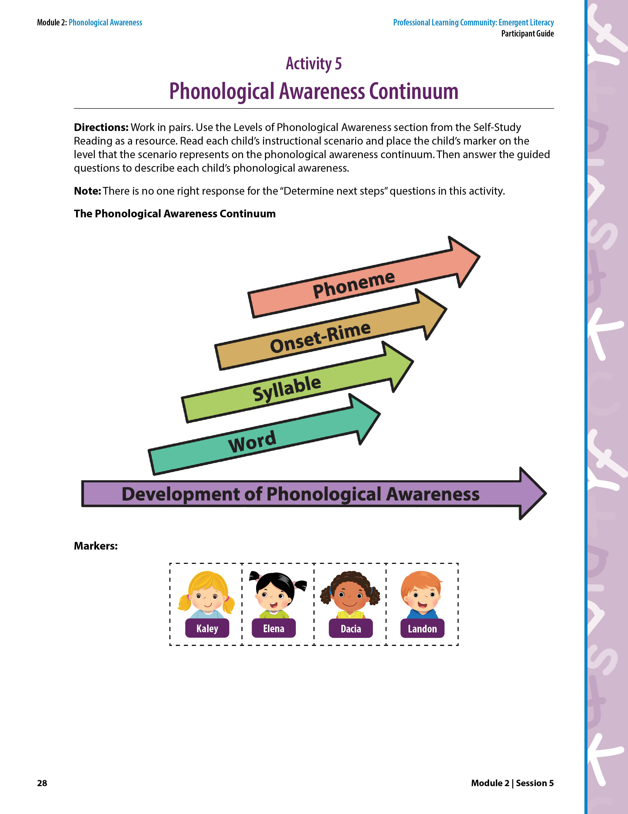
Activity 5: Phonological Awareness Continuum
Read each child’s instructional scenario and place the child’s marker on the level that represents the scenario on the phonological awareness continuum.
Answer the guided questions to describe each child’s phonological awareness.
Notes:
NOTES
Allow about 20 minutes for this activity.
If time permits, cut out each marker so participants can place the marker on the phonological awareness continuum. Each participant will have four markers. Each marker represents one child. Otherwise, participants can write each child’s name on the phonological awareness continuum.
Each of the following four slides represents an answer to one of the instructional scenarios.
SAY Turn to Activity 5: Phonological Awareness Continuum on page 28 in the Participant Guide. Here you have the phonological awareness continuum and four markers. Each marker represents a child: Kaley, Landon, Elena, Dacia. There are also four instructional scenarios on the following pages.
Work in pairs for this activity. Use the Levels of Phonological Awareness section from the Self-Study Reading on pages 16–19 as a resource.
Read each child’s instructional scenario and place the child’s marker on the level that represents the scenario on the phonological awareness continuum.
Answer the guided questions to describe each child’s phonological awareness.
We will discuss each instructional scenario before moving to the next scenario.

Slide 39

Activity 5: Phonological Awareness Continuum
Kaley
Syllable level.
Blending and segmenting tasks.
Kaley put two syllables of a spoken word together and broke a spoken word into syllables.
Deletion task at the syllable level.
Notes:
NOTES This is a continuation of Activity 5 from slide 38.
SAY Let’s talk about Kaley’s instructional scenario. Where did you place Kaley’s marker (or write her name) on the phonological awareness continuum? Participants should respond, “Syllable level.” Click to show the phonological awareness continuum with Kaley’s marker on the syllable level.
One at a time, review the four items participants responded to about Kaley’s instructional scenario. After a volunteer reads his or her response, click to reveal the answer on the slide.
Which phonological awareness level does this scenario represent (word, syllable, onset-rime, or phoneme)?
Which phonological awareness task(s) does this scenario represent?
What did the child do that helped you determine the level and task?
Would you stay at the same phonological awareness level in your next lesson? If not, what would be your next phonological awareness level? Which tasks, within that level, would you have this child complete next?
Keep in mind that there is no one right response for the next steps for instruction (#4) for each of these scenarios.
The goal is to continually move children forward on the continuum without jumping ahead too quickly.

Slide 40

Activity 5: Phonological Awareness Continuum
Landon
Phoneme level.
Segmenting task.
Landon said individual sounds of a spoken word.
Deletion task at the phoneme level.
Notes:
NOTES
This is a continuation of Activity 5 from slide 38.
SAY Review Landon’s instructional scenario. Provide time for participants to complete in pairs.
Where did you place Landon’s marker (or write his name) on the phonological awareness continuum? Participants should respond, “Phoneme level.” Click to show the phonological awareness continuum with Landon’s marker on the phoneme level.
One at a time, review the four items participants responded to about Landon’s instructional scenario. After a volunteer reads his or her response, click to reveal the answer on the slide.
Which phonological awareness level does this scenario represent (word, syllable, onset-rime, or phoneme)?
It’s important to note that it may be rare, but not impossible, for children in preschool to reach the phoneme level.
Which phonological awareness task(s) does this scenario represent?
What did the child do that helped you determine the level and task?
Would you stay at the same phonological awareness level in your next lesson? If not, what would be your next phonological awareness level? Which tasks, within that level, would you have this child complete next?
Keep in mind that there is no one right response for the next steps for instruction (#4) for each of these scenarios.
The goal is to continually move children forward on the continuum without jumping ahead too quickly.

Slide 41

Activity 5: Phonological Awareness Continuum
Elena
Word level.
Deletion task.
Elena deleted a word from a spoken compound word.
Blending and/or counting tasks at the syllable level.
Notes:
NOTES
This is a continuation of Activity 5 from slide 38.
SAY Review Elena’s instructional scenario. Provide time for participants to complete in pairs.
Where did you place Elena’s marker (or write her name) on the phonological awareness continuum? Participants should respond, “Word level.” Click to show the phonological awareness continuum with Elena’s marker on the word level.
One at a time, review the three items participants responded to about Elena’s instructional scenario. After a volunteer reads his or her response, click to reveal the answer on the slide.
Which phonological awareness level does this scenario represent (word, syllable, onset-rime, or phoneme)?
Which phonological awareness task(s) does this scenario represent?
What did the child do that helped you determine the level and task?
Would you stay at the same phonological awareness level in your next lesson? If not, what would be your next phonological awareness level? Which tasks, within that level, would you have this child complete next?
Keep in mind that there is no one right response for the next steps for instruction (#4) for each of these scenarios.
The goal is to continually move children forward on the continuum without jumping ahead too quickly.

Slide 42

Activity 5: Phonological Awareness Continuum
Dacia
Onset-rime level.
Onset identity (beginning sound) task.
Dacia identified the first sound of a spoken word.
Segmenting task at the onset-rime level.
Notes:
NOTES
This is a continuation of Activity 5 from slide 38.
SAY Review Dacia’s instructional scenario. Provide time for participants to complete in pairs.
Where did you place Dacia’s marker (or write her name) on the phonological awareness continuum? Participants should respond, “Onset-rime level.” Click to show the phonological awareness continuum with Dacia’s marker on the onset-rime level.
One at a time, review the three items participants responded to about Dacia’s instructional scenario. After a volunteer reads his or her response, click to reveal the answer on the slide.
Which phonological awareness level does this scenario represent? (word, syllable, onset-rime, or phoneme)?
Which phonological awareness task(s) does this scenario represent?
What did the child do that helped you determine the level and task?
Would you stay at the same phonological awareness level in your next lesson? If not, what would be your next phonological awareness level? Which tasks, within that level, would you have this child complete next?
Keep in mind that there is no one right response for the next steps for instruction (#4) for each of these scenarios.
The goal is to continually move children forward on the continuum without jumping ahead too quickly.

Slide 43
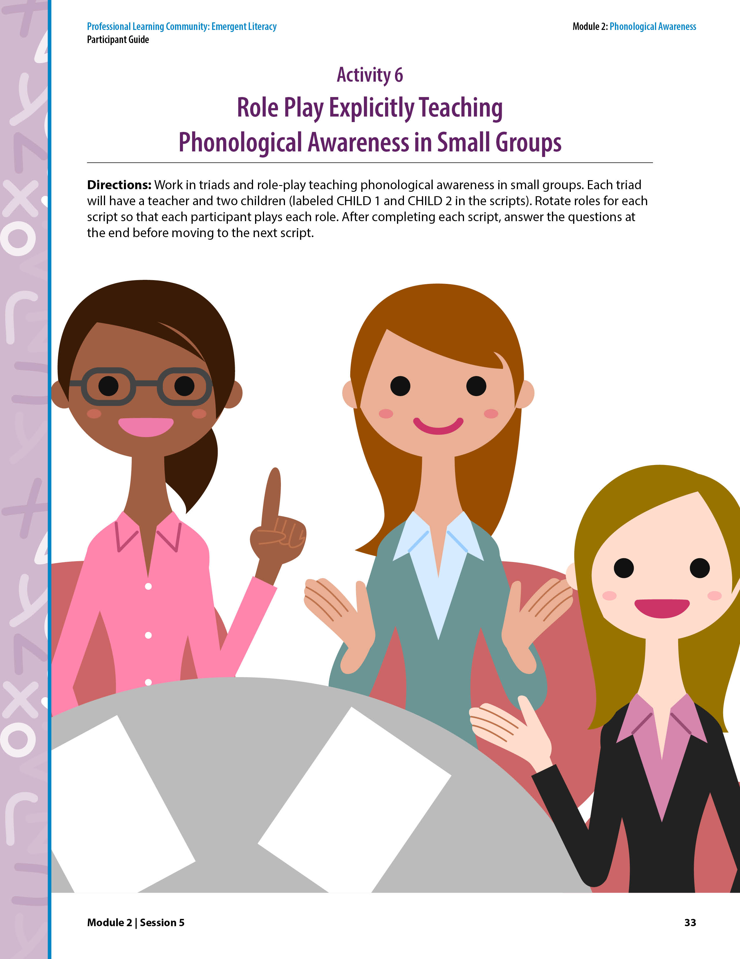
Collaborate and Practice
Activity 6: Role Play Explicitly Teaching Phonological Awareness in Small Groups
Role play in triads and look for scaffolding opportunities.
Each triad has a Teacher, Child 1, and Child 2.
Rotate roles with each new lesson script.
Answer questions in the table at the end of this activity before moving to the next lesson script.
Notes:
NOTES
Allow about 20 minutes for this activity.
Prepare materials for each triad before the session. See the Reproducible Materials at the back of the Participant Guide.
Lesson Script #2: Rime picture header card (cat) and rime picture cards. Chart paper or whiteboard to display picture header card and rime picture cards (or just place on table).
Lesson Script #3: Picture cards.
SAY Step 4 of each of each session includes collaboratively applying what we have discussed. Turn to Activity 6: Role Play Explicitly Teaching Phonological Awareness in Small Groups on page 33 in the Participant Guide. For this activity, we will work in triads and role play teaching phonological awareness in small groups. Each triad will have a teacher and two children (labeled CHILD 1 and CHILD 2). Rotate roles for each lesson script so that each participant plays each role. When you play a child role, make an error so the teacher can practice providing instructional scaffolds.
After completing each script, answer the questions in the table at the end of this Activity on page 37 before moving to the next script.

Slide 44
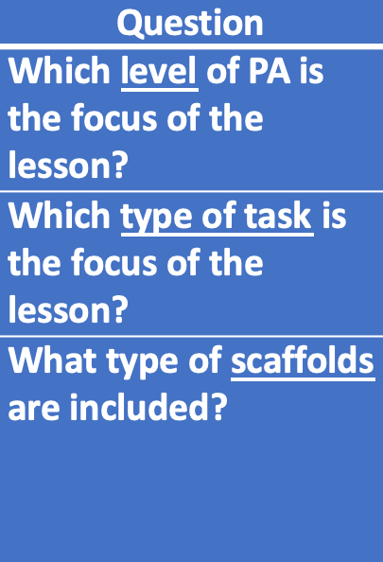
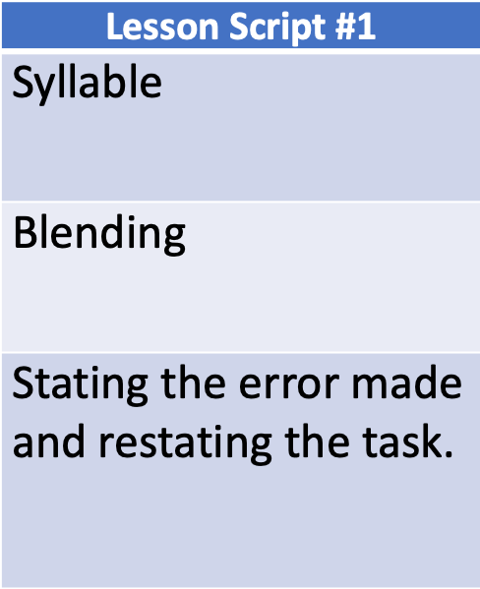
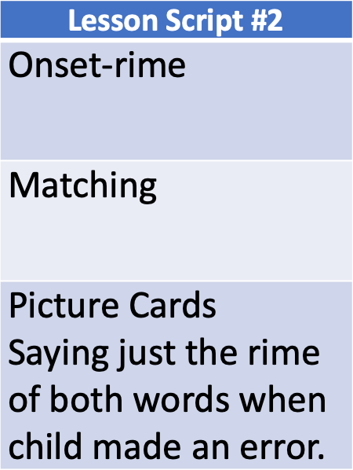
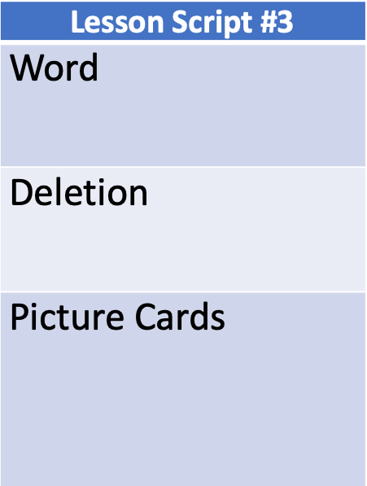
Activity 6: Role Play Explicitly Teaching Phonological Awareness in Small Groups
Notes:
NOTES
This is a continuation of Activity 6 from slide 43.
SAY: Let’s discuss the table you completed at the end of Activity 6. Who would like to share their responses to the questions for Lesson Script #1?
Which level of phonological awareness is the focus of the lesson?
Which type of task is the focus of the lesson?
What type of scaffolds are included in the lesson?
After a volunteer shares, click the mouse to reveal the answers in the first column. Follow this same process for Lesson Scripts #2 and #3.

Slide 45
Activity 6: Role Play Explicitly Teaching Phonological Awareness in Small Groups
Similarities of Lessons
Explicit (I Do, We Do, You Do)
Focused on one level of phonological awareness
Included instructional scaffolds
Differences of Lessons
Phonological awareness level (syllable level, onset-rime level, word level)
Unit size (syllable, rime, word)
Type of task (blending, matching, deletion)
Types of scaffolds
Notes:
NOTES
This is a continuation of Activity 6 from slide 43.
SAY What was similar across all three lessons? Call on volunteers to share and facilitate a discussion. Click to show answers.
What was different among the three lessons? Call on volunteers to share and facilitate a discussion. Click to show answers.

Slide 46
Reflect, Plan, and Implement
Think-Pair-Share
What did you learn during this session
that confirmed what you already knew about
teaching phonological awareness in small groups?
What did you learn that contradicted what you already knew about teaching phonological awareness in small groups?
Notes:
NOTES Allow 2 minutes for this activity.
SAY Step 5, Reflect, Plan, and Implement is the final step of each session. Let’s first reflect on the information we covered today by doing a Think-Pair-Share. Take a moment to think about the questions:
What did you learn during this session that confirmed what you already knew about teaching phonological awareness in small groups?
What did you learn that contradicted what you already knew about teaching phonological awareness in small groups?
Then, pair with your shoulder partner and share your thinking.
Allow 1 minute for this activity. Then ask volunteers to share their ideas.

Slide 47
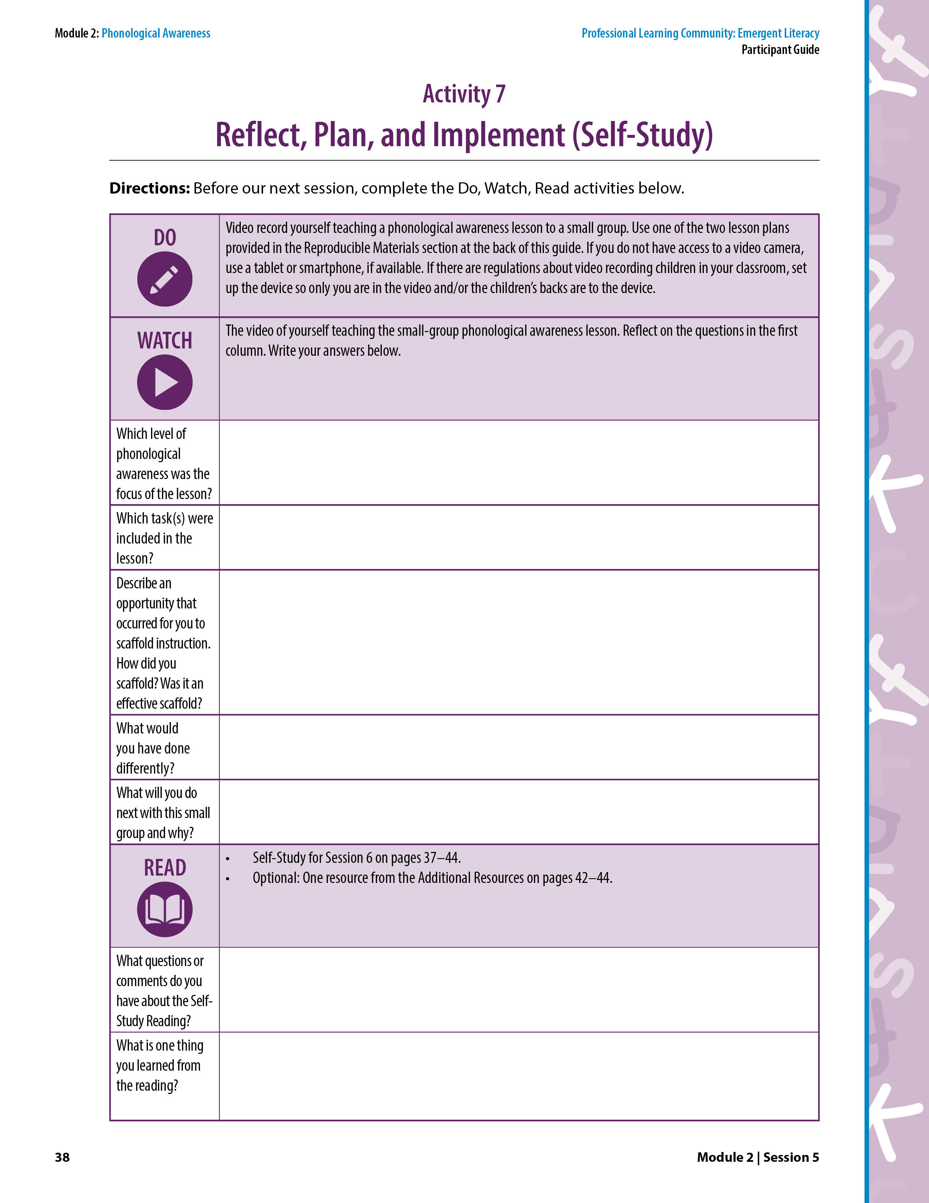
Reflect, Plan, and Implement
Activity 7: Reflect, Plan, and Implement (Self-Study)
  Videotape yourself teaching a small-group explicit lesson on phonological awareness. See the Reproducible Materials at the back of the Participant Guide for lesson plans.
  The video of yourself teaching a small-group lesson on phonological awareness.
  Answer the reflection questions.
  Self-Study Reading for Session 6 on pages 39–46.
  Optional: One resource from the Additional Resources section.
Notes:
NOTES
Allow about 5 minutes for this activity.
Explain the DO, WATCH, READ activities.
Announce the date and time of the next PLC session. Ask participants to note it on page v of the Participant Guide.
Follow up with an email so participants will note it in their calendars.
SAY Now, let’s look at Activity 7: Reflect, Plan, and Implement (Self-Study) on page 38 in the Participant Guide to review what you will DO, WATCH, and READ before the next PLC session. These activities will take 30–60 minutes.
DO Videotape yourself teaching a small-group phonological awareness lesson. Use one of the two lesson plans provided in the Reproducible Materials section at the back of the Participant Guide. If you do not have access to a video camera, you can use a tablet or smartphone, if available. If there are regulations about videotaping children in your classroom, set up the camera so only you are in the video and/or the children’s backs are to the camera.
WATCH Your videotape and answer the reflection questions.
READ
Self-Study Reading for Session 6 on pages 39–46 in the Participant Guide.
If you’d like to, select and read at least one resource from the Additional Resources section on pages 44–46. Note any questions you have about the reading in the Participant Guide. Also note one thing you learned from your selected reading.

Slide 48
We have completed
Session 5
Notes:
SAY We have now completed Session 5! Thank you for your teamwork during our phonological awareness PLC session!

Slide 49
Professional Learning Community
EMERGENT LITERACY
Module 2: Phonological Awareness
Session 6
Phonological Awareness in Action
Considerations for English Learner Students and Students With Disabilities
Additional Resources
Notes:
NOTES
Session 6 will take approximately 60 minutes.
Prior to Session 6, participants will have read content in the Participant Guide on pages 39–46:
Phonological Awareness in Action: Ms. Warner’s Classroom
Considerations for English Learner Students and Students With Disabilities
A participant-selected resource from the Additional Resources section
Under “SAY” in these speaker notes:
Regular text indicates what you should say.
Italicized text indicates something you and/or the participants should do.
SAY Welcome and thank you for continuing to participate in our Professional Learning Community on Emergent Literacy! Today, we will meet for 60 minutes to conclude Module 2: Phonological Awareness. Briefly introduce yourself and facilitate introductions of participants, if needed.

Slide 50
Purpose of Our
Professional Learning Community (PLC)
To engage in collaborative learning experiences to support preschool teachers in applying evidence-based language and literacy strategies.
Notes:
SAY As a quick reminder, the purpose of our PLC is to engage in collaborative learning experiences to support preschool teachers in applying evidence-based language and literacy strategies in their instruction. I look forward to continuing to learn together!

Slide 51
Norms For Our PLC
Presume
positive intentions
Cell phones on silent
Pay attention to self and others
Notes:
NOTES Consider your group to determine how much detail about the norms need a review.
SAY PLCs, like this one, encourage educators to learn from one another. Therefore, sharing, discussing, and participating are important components.
Let’s quickly review the norms, or ground rules, for our PLC that we agreed to during the first session. We remind ourselves of these norms for PLCs in order to be productive.
Cell phones on silent will help us have an uninterrupted session.
Pay attention to self and others: This means to contribute, listen, and be aware of how you and others are responding to each other. Be sure to give everyone a chance to talk and encourage others who seem reluctant to join in. Sometimes people who are reluctant to talk are thinking. They may not be comfortable jumping in but may have something important to say.
Presume positive intentions: This means to pause before responding. Usually when people contribute to a conversation, they intend to be constructive. So, always respond positively to keep the discussions productive.

Slide 52
Debrief
  Video record yourself teaching a small-group explicit lesson on phonological awareness. See the Reproducible Materials at the back of the Participant Guide for lesson plans.
  The video of yourself teaching a small-group lesson on
  phonological awareness.
  Answer the reflection questions.
  Self-Study Reading for Session 6 on pages 39–46.
  Optional self-selected reading from the Additional Resources section.
Notes:
NOTES
Allow up to 10 minutes for this debrief.
If you have a small group, ask for volunteers to share with the whole group. If you have a large group, consider having triads discuss and then ask a volunteer from each small group to share with the large group.
SAY At the end of Session 5, you were asked to complete Activity 7: Reflect, Plan, and Implement (Self-Study) on page 38 in the Participant Guide. Please turn to this activity so we can debrief and share our reflections.
DO See the slide. Ask for volunteers to share their experience of videotaping themselves.
WATCH Review the reflection questions and ask for volunteers to share their answers.
READ You were asked to read pages 39–46 in the Participant Guide and, as an option, select and read a resource from the Additional Resources section. What were some of the comments or questions you noted about your reading? Would anyone like to share which resource they selected to read and one thing they took away from reading it?

Slide 53
Define and Discuss
Session Goals and Content
Review main ideas from Sessions 4 and 5.
Understand how to effectively scaffold phonological awareness instruction.
Considerations for English learner students and students with disabilities
Notes:
SAY During Session 4, we learned what phonological awareness is and why it is important. We also learned about the four levels of phonological awareness: word level, syllable level, onset-rime level, and phoneme level. The phonological awareness continuum can help us identify where children are in their phonological awareness development, which will help us plan instruction.
In session 5, we learned how to explicitly teach phonological awareness in small groups using the features of effective instruction. We also learned about specific tasks and instructional activities for each level of the phonological awareness continuum to implement during small-group instruction.
For this session, 6, we will dive deeper into how to effectively scaffold instruction, a feature of effective instruction. We will also discuss instructional considerations for English learner students and students with disabilities.
To do this we will have discussions, engage in collaborative activities, and watch and reflect on preschool classroom videos.

Slide 54
Learn and Confirm
Phonological Awareness Throughout the Day
How do you embed phonological awareness throughout the day? Provide a specific example of the phonological awareness activity and the setting.
Notes:
NOTES Allow about 5 minutes for this activity.
SAY During step 3 of the collaborative learning cycle, we will learn about embedding phonological awareness throughout the day. The goal for step 3 is to learn something new as well as confirm some things that we already know. Phonological awareness tasks don’t always need to be completed in a small-group setting. In fact, including phonological awareness tasks throughout the day is a great way for children to practice what you taught during small-group instruction. It can also be a lot of fun!
Let’s talk about embedding phonological awareness throughout the day using a Think-Pair-Share. I’ll pose a question and you think about a response, share it with a colleague, and then we’ll have volunteers share responses. Here is the question: How do you embed phonological awareness throughout the day? Provide a specific example of the phonological awareness activity and the setting.
Allow 2 minutes for participants to share responses with a colleague and then ask for volunteers to share their ideas.

Slide 55
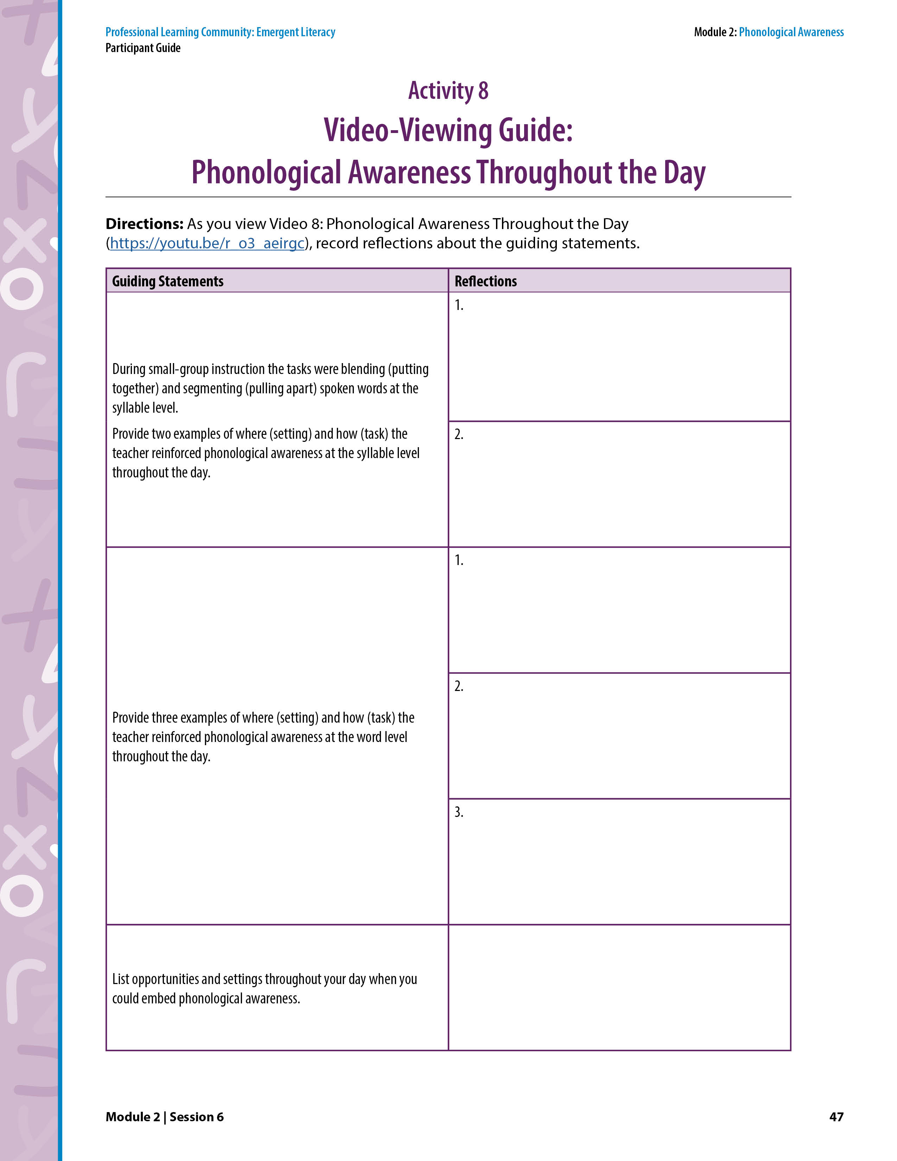
Activity 8: Video Viewing Guide: Phonological Awareness Throughout the Day
Video 8: Phonological Awareness Throughout the Day
Notes:
NOTES
Allow about 15 minutes for this activity.
If needed, pause and rewind the video and review aspects of it.
SAY Turn to Activity 8: Video Viewing Guide: Phonological Awareness Throughout the Day on page 47 in the Participant Guide. Review the video-viewing guiding statements. Allow 1 minute. As you watch the video of a preschool teacher implementing phonological awareness throughout the day, record reflections about the statements.
Show Video 8: Phonological Awareness Throughout the Day (https://youtu.be/5jicN0F12t0). After the video, ask participants to share reflections.
Key Points About the Video
Emphasize the following information if the participants do not.
During small-group instruction, the tasks were blending (putting together) and segmenting (pulling apart) spoken words at the syllable level. Describe two examples of where (setting) and how (task) the teacher reinforced phonological awareness at the syllable level throughout the day.
During read-aloud, the children segmented syllables in words from the story (sweeper, beeper, limousine).
While waiting in line, the children segmented syllables in animal words (horse, alligator, gorilla).
Describe three examples of where (setting) and how (task) the teacher reinforced phonological awareness at the word level throughout the day.
During the read-aloud, children blended and deleted the compound word, everybody.
During lunch, the children blended and deleted compound words (corndog, popcorn).
During recess, the children blended and deleted compound words (football, sidewalk, motorcycle).
List times and settings throughout your day when you could embed phonological awareness.
Every minute counts: transitions, dismissal/arrival time, snack time, while walking in line.

Slide 56
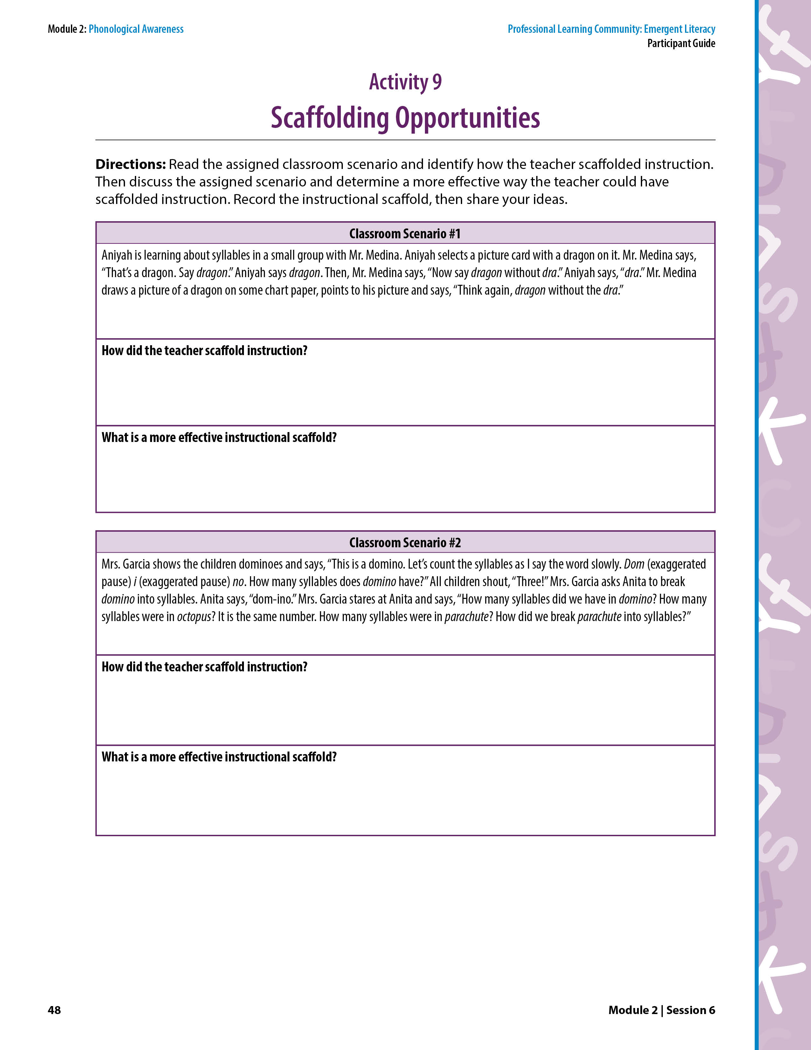
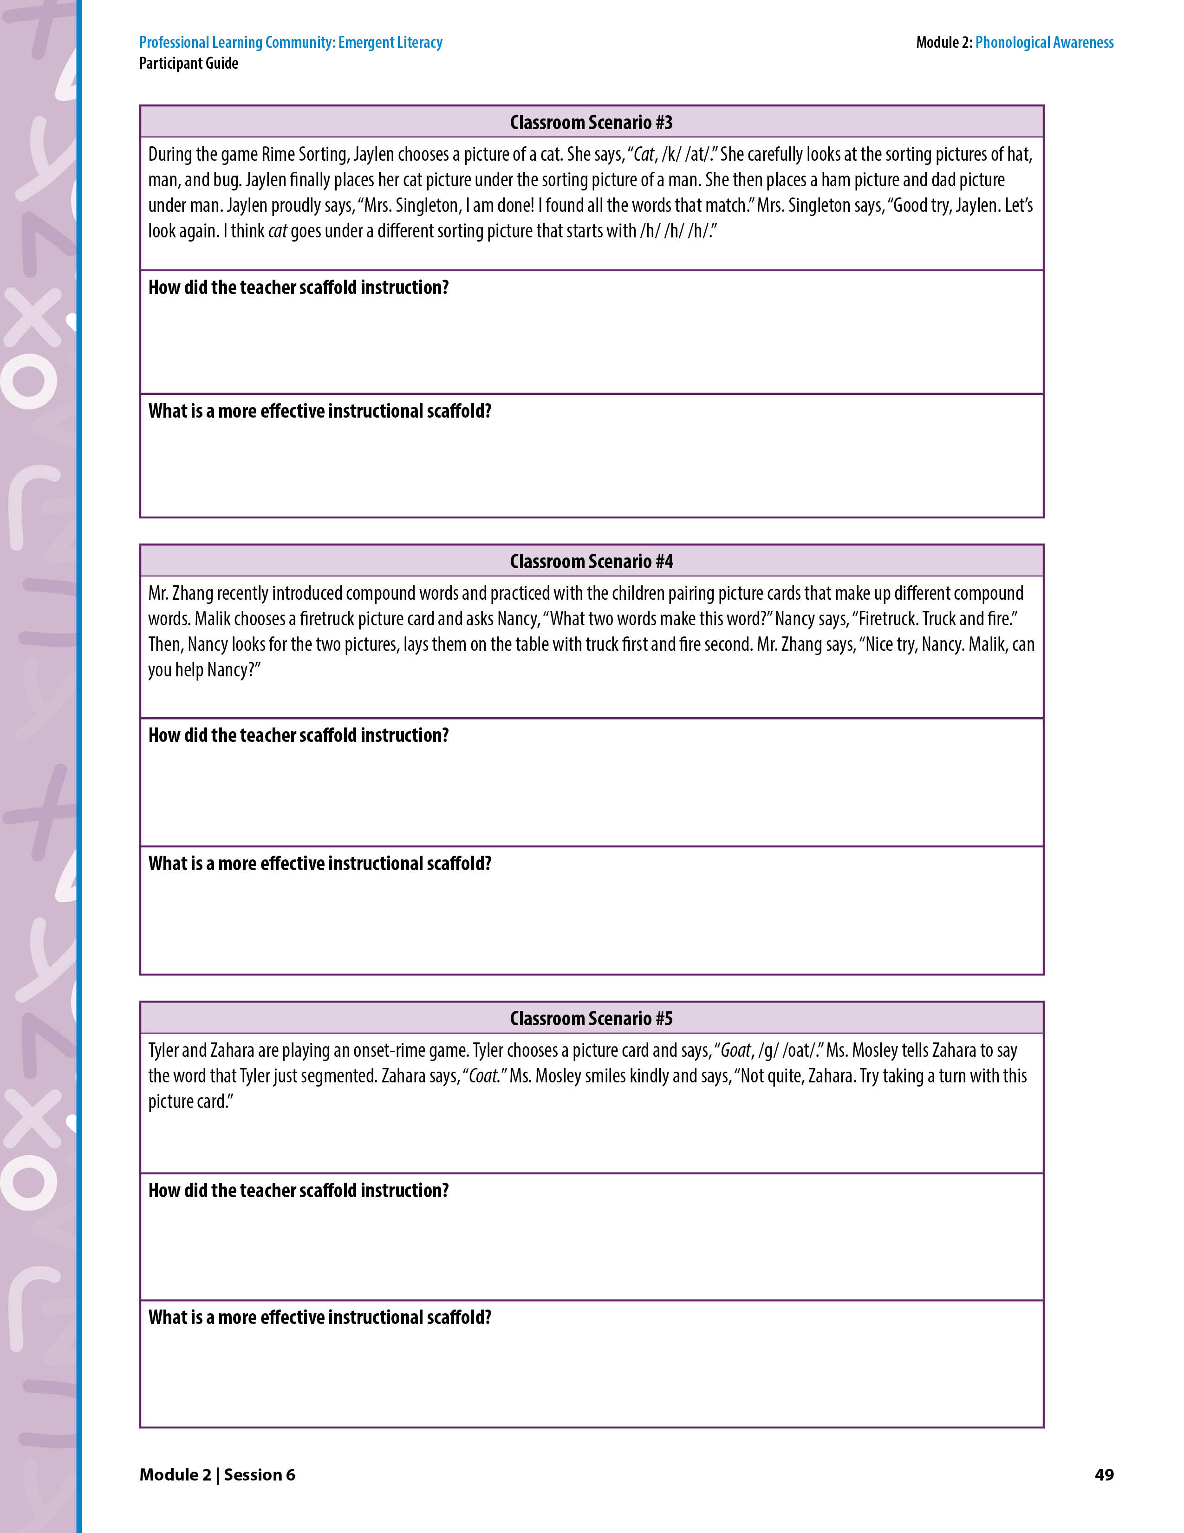
Collaborate and Practice
Activity 9: Scaffolding Opportunities
Read the assigned classroom scenario.
Identify and record how the teacher scaffolded instruction.
Discuss and record a more effective way the teacher could have scaffolded instruction.
Notes:
NOTES
Allow 10 minutes for this activity.
If time permits, assign each pair two classroom scenarios. Otherwise, assign each pair one scenario.
During activities, try to ensure that participants collaborate with a variety of pairs or triads.
SAY Step 4 of each session is to collaborate and practice. Turn to the Activity 9: Scaffolding Opportunities on page 48 in the Participant Guide. You’ll see five classroom scenarios. Each classroom scenario includes an example of an instructional scaffold. Read your assigned scenario(s). Work in pairs to identify and record how the teacher scaffolded instruction. Then, determine and record a more effective way the teacher could have scaffolded instruction.
Allow 5 minutes for participants to complete their assigned scenario(s). Then, use the next five slides to facilitate a discussion about one scenario at a time.

Slide 57
Collaborate and Practice
Activity 9: Scaffolding Opportunities
Classroom Scenario #1
How did the teacher scaffold instruction?
What is a more effective instructional scaffold?
  “There are two syllables in dragon, drag-on. Say each syllable in dragon.”
Notes:
NOTES This is a continuation of Activity 9 from slide 56.
SAY As we review each classroom scenario, take notes on the scenarios that were not assigned to you. Keep in mind that there is more than one right answer for a more effective way to scaffold instruction. The goal of scaffolding instruction is to provide support so the child can develop the necessary skills to complete the task.
Who would like to read classroom scenario #1 and share their thoughts about it? Call on a pair of participants who volunteer. Ask one participant to read the scenario out loud and the other participant to answer the two questions on the slide.
Emphasize the following information if the participants do not.
The teacher scaffolded instruction by providing picture support, which is typically an effective scaffold. However, Aniyah already had a picture card of a dragon so there was no reason for the teacher to draw it again. The teacher asked the child to “Think again,” which is not an instructional scaffold.
The teacher asked the child to complete a deletion task at the syllable level. The child needs to be able to segment syllables in a word before being asked to delete a syllable in a word. Here is one effective instructional scaffold for this scenario. Click for the example scaffold to appear.

Slide 58
Activity 9: Scaffolding Opportunities
Classroom Scenario #2
How did the teacher scaffold instruction?
What is a more effective instructional scaffold?
  Ask one relevant clarification question, “How many syllables did we have in dom-i-no?”
  If the child says three, then the teacher can say, “Right! You only broke the word into two parts. Let’s see if you can break domino into THREE parts.”
  If the child doesn’t say three, then the teacher can say, “Listen as I say the word again – dom-i-no.” The teacher hold up one finger as she says each syllable.
Notes:
NOTES This is a continuation of Activity 9 from slide 56.
SAY As we review each classroom scenario, continue to take notes on the scenarios that were not assigned to you. Keep in mind that there is more than one right answer for a more effective way to scaffold instruction.
Who would like to read classroom scenario #2 and share their thoughts about it? Call on a pair of participants who volunteer. Ask one participant to read the scenario out loud and the other participant to answer the two questions on the slide.
Emphasize the following information if the participants do not.
This is an example of the teacher asking more and more questions when the child could not successfully answer the first question. Asking more questions doesn’t necessarily help clarify for the child or even guide them to the correct answer.
The child needs to first understand that there are three syllables in domino. The teacher needs to determine if the child didn’t understand the question or didn’t understand the concept of breaking a word into syllables. Here is a series of possible effective instructional scaffolds for this scenario. Click and read the slide one bullet at a time to show an example of more effective scaffold(s).

Slide 59
Activity 9: Scaffolding Opportunities
Classroom Scenario #3
How did the teacher scaffold instruction?
What is a more effective instructional scaffold?
  Focus child’s attention on the ending sounds to identify the rime by saying, “Look at the cat picture. Listen. Cat, /k/ /at/. What sound do you hear at the end of /k/ /at/?”
  If the child says /at/, then the teacher can say, “Right! Now let’s listen for the /at/ sound at the end of these three words – hat, man, bug.”
Notes:
NOTES This is a continuation of Activity 9 from slide 56.
SAY As we review each classroom scenario, continue to take notes on the scenarios that were not assigned to you.
Who would like to read classroom scenario #3 and share their thoughts about it? Call on a pair of participants who volunteer. Ask one participant to read the scenario out loud and the other participant to answer the two questions on the slide.
Emphasize the following information if the participants do not.
The teacher provided the beginning sound /h/ in an attempt to help the child sort the word cat under a word that rhymes with it, hat. This is an example of the teacher not targeting the proper skill. The activity requires the child to look at the rime for each word /at/, /an/, /ug/. The teacher provides a hint for the child, but the hint draws her attention to the beginning sound of the word, /h/, not the ending sound, /at/.
The teacher should focus the child’s attention on the ending sounds to identify the rime. Click and read the slide one bullet at a time to show an example of more effective scaffold(s).

Slide 60
Activity 9: Scaffolding Opportunities
Classroom Scenario #4
How did the teacher scaffold instruction?
What is a more effective instructional scaffold?
  Teacher revisits child after the peer support and says, “Do you see how Malik put the fire picture first and the truck picture after that? Listen. (While pointing to the pictures) Fire (exaggerated pause) truck. Fire comes first. Now you try again. Put these pictures in the right order to make firetruck.”
Notes:
NOTES This is a continuation of Activity 9 from slide 56.
SAY As we review each classroom scenario, continue to take notes on the scenarios that were not assigned to you.
Who would like to read classroom scenario #4 and share their thoughts about it? Call on a pair of participants who volunteer. Ask one participant to read the scenario out loud and the other participant to answer the two questions on the slide.
Emphasize the following information if the participants do not.
The scaffold the teacher provided was to ask for peer assistance without following up to make sure the child understood the mistake.
The child needs to understand their error. Teacher should gently correct and have the child repeat. Click and read the bullet to show an example of a more effective scaffold.

Slide 61
Activity 9: Scaffolding Opportunities
Classroom Scenario #5
How did the teacher scaffold instruction?
What is a more effective instructional scaffold?
  Stay on the goat picture card and say, “Listen to the beginning sound of goat. /g/ /g/ /g/ /oat/. What word?”
Notes:
NOTES This is a continuation of Activity 9 from slide 56.
SAY As we review each classroom scenario, continue to take notes on the scenarios that were not assigned to you.
Who would like to read classroom scenario #5 and share their thoughts about it? Call on a pair of participants who volunteer. Ask one participant to read the scenario out loud and the other participant to answer the two questions on the slide.
Emphasize the following information if the participants do not.
This is an example of the teacher telling the child that her answer is incorrect but not providing an instructional scaffold to help the child fix the mistake and be successful with the initial task.
The child should be given support to fix her mistake. Click and read the bullet to show an example of a more effective scaffold.

Slide 62
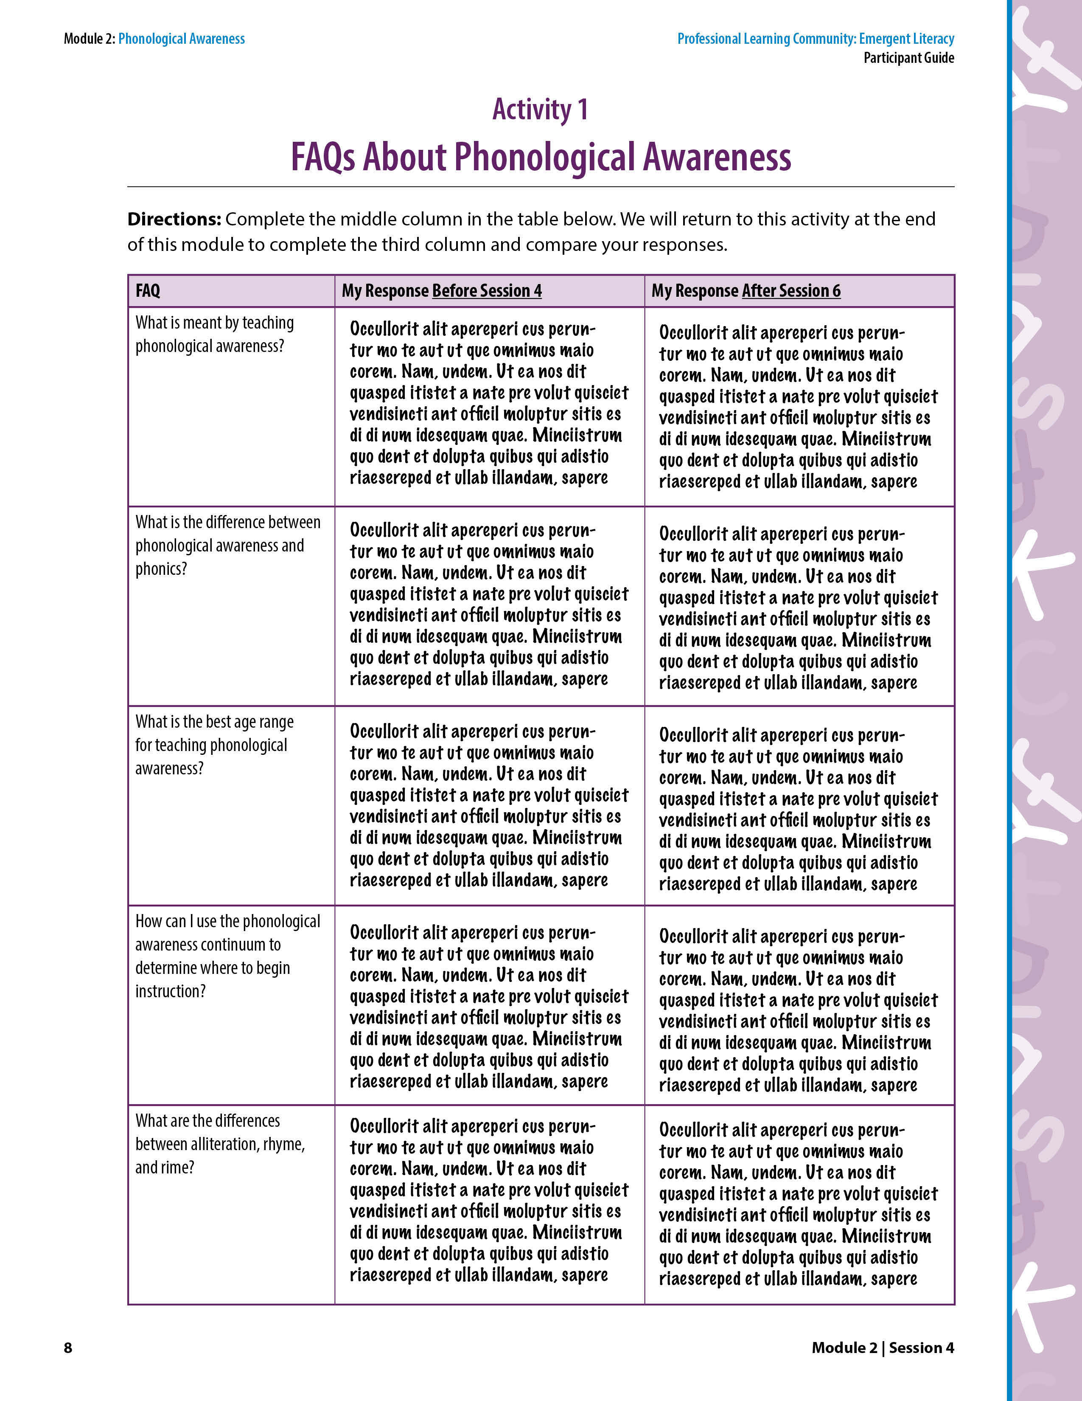
Activity 1: FAQs About Phonological Awareness
Revisit Questions
From Session 4
Record your responses in the third column.
How did your responses change from Session 4?
Notes:
NOTES Allow about 5 minutes for this activity.
SAY Locate Activity 1: FAQ’s About Phonological Awareness on page 8 in the Participant Guide. Remember these FAQs about phonological awareness from the beginning of Session 4? Please take 5 minutes to read each frequently asked question and record a response in the third column. Then, compare your responses from Session 4. How did your responses change from Session 4?
Participants work independently for 5 minutes to answer the FAQs. Ask for volunteers to share their responses.

Slide 63
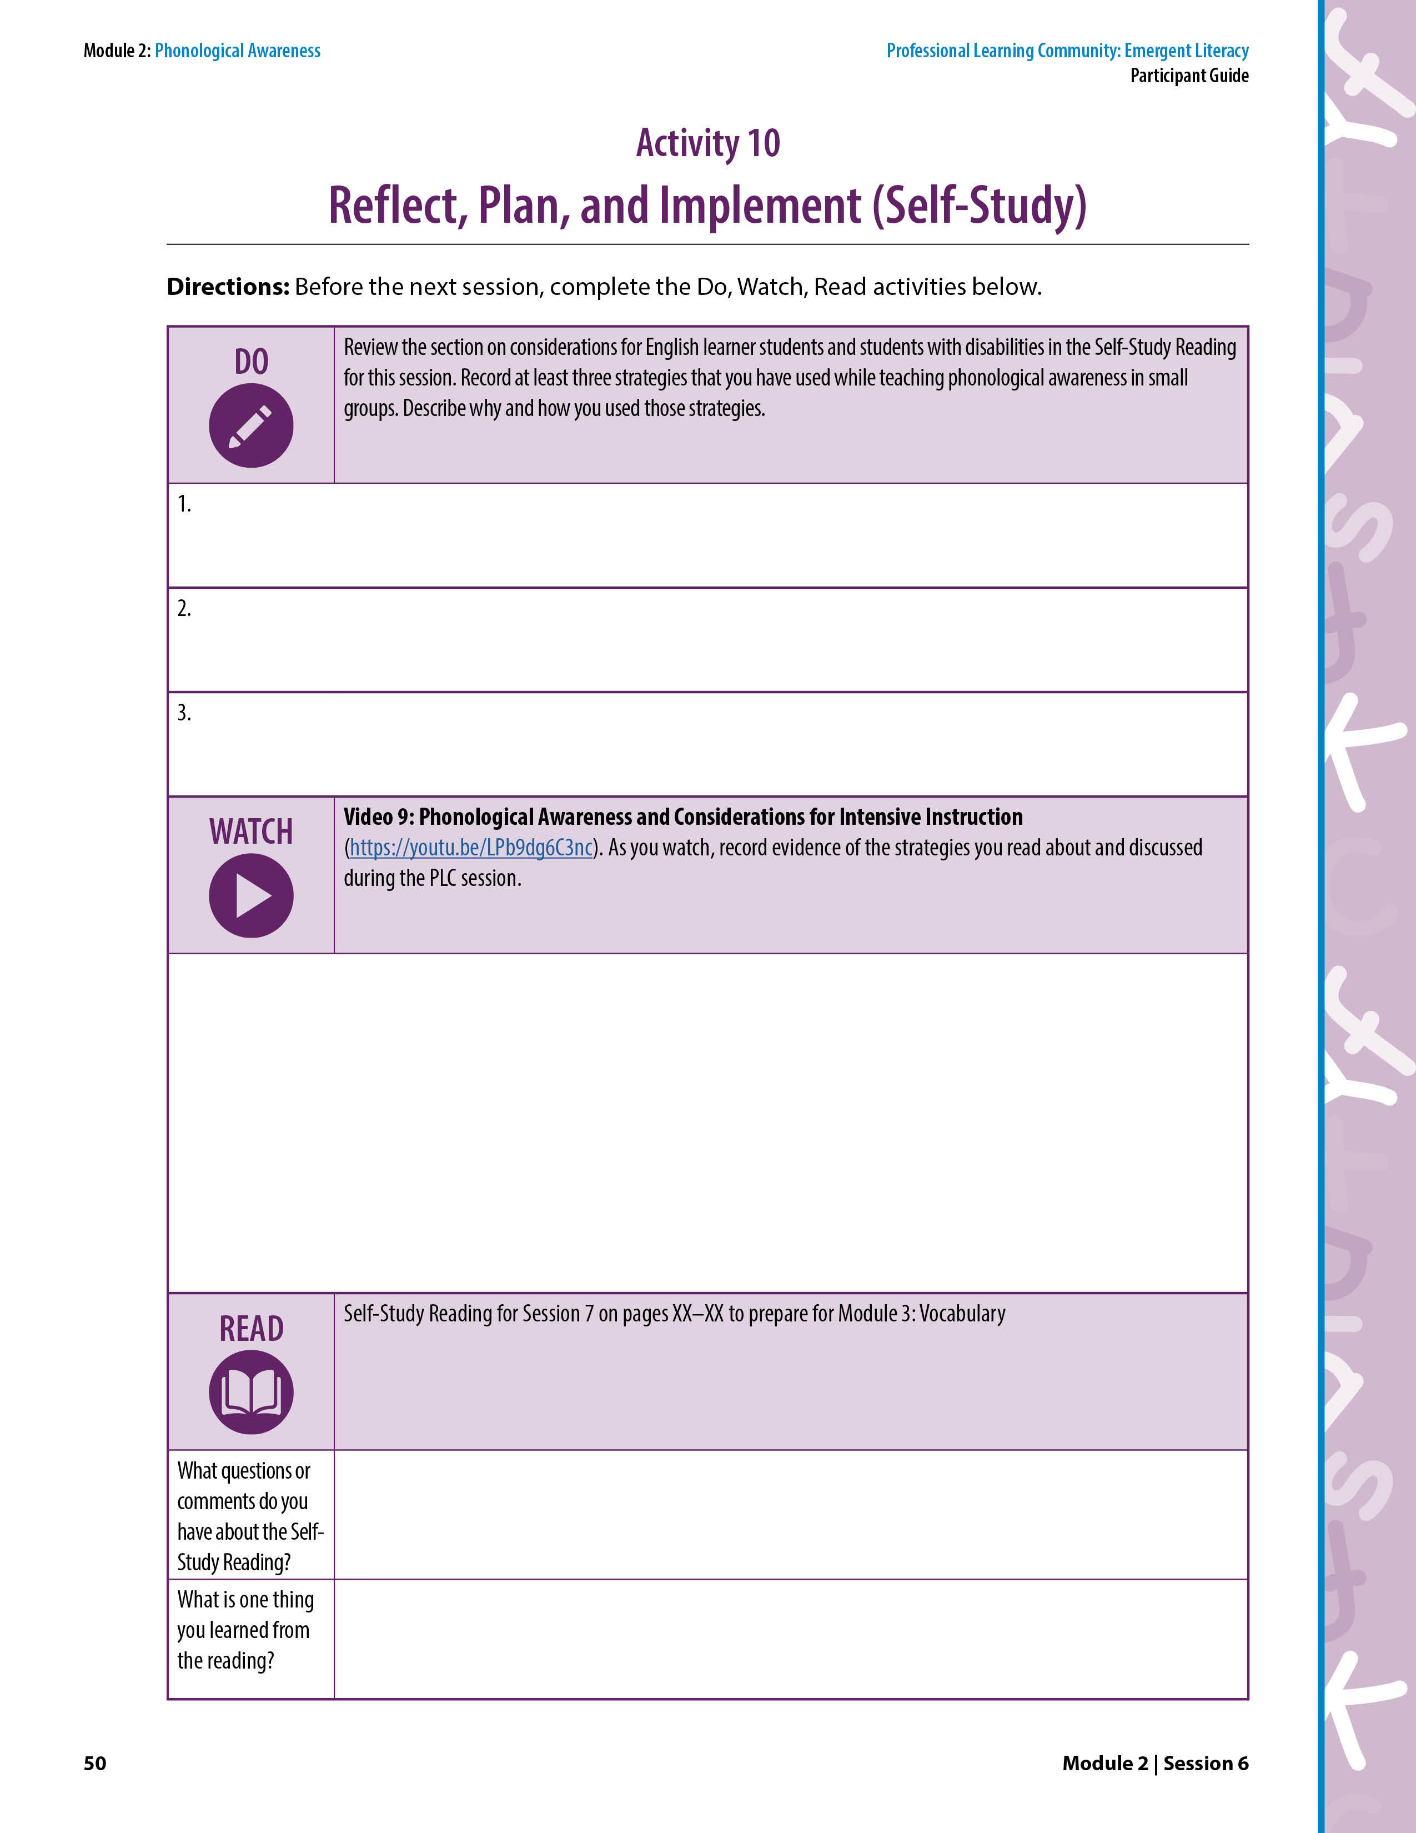
Reflect, Plan, and Implement
Activity 10: Reflect, Plan, and Implement
(Self-Study)
  Review Considerations for English Learner Students and Students With Disabilities. Record three strategies you have used.
  Video 9: Phonological Awareness and Considerations for Intensive Instruction and record evidence of effective strategies.
  Self-Study Reading for Session 7 located in the Participant Guide for Module 3: Vocabulary (Sessions 7–9).
Notes:
NOTES
Allow about 5 minutes for this activity.
Explain the DO, WATCH, READ activities.
Announce the date and time of the next PLC session. Ask participants to note it on page v of the Participant Guide.
Follow up with an email so participants will note it in their calendars.
Ask participants to bring expository (informational) texts about weather and seasons, if available, to the next session (Module 3, Session 7).
SAY Now, let’s look at Activity 10: Reflect, Plan, and Implement (Self-Study) on page 50 in the Participant Guide to review what you will DO, WATCH, and READ before the next PLC session. These activities will take 30–60 minutes.
DO Review Considerations for English Learner Students and Students With Disabilities in the Self-Study Reading for this session. Record at least three strategies that you have used while teaching phonological awareness in small groups. Describe why and how you used those strategies.
Bring expository (informational) texts about weather and seasons, if available, to the next session (Module 3, Session 7).
WATCH Video 9: Phonological Awareness and Considerations for Intensive Instruction (https://youtu.be/YiZMBP9ap50). As you watch the video, record evidence of effective strategies you read about and that we discussed.
READ Self-Study Reading for Session 7 on pages XX–XX in the Participant Guide for Module 3: Vocabulary. Note any questions you have about the reading and one thing you learned from your reading.

Slide 64
We have completed
Session 6
Notes:
SAY We have now completed Session 6, the final session in Module 2, Phonological Awareness! Thank you for sharing your knowledge and working as a team in our emergent literacy PLC!

