Slide 1
IES Contract Number
This presentation was prepared for the Institute of Education Sciences (IES) under Contract ED-IES-17-C-0004 by the Regional Educational Laboratory (REL) Appalachia administered by SRI International. The content of the presentation does not necessarily reflect the views or policies of IES or the U.S. Department of Education nor does mention of trade names, commercial products, or organizations imply endorsement by the U.S. Government.
The original version of the presentation can be found on the REL Appalachia website here: https://ies.ed.gov/ncee/edlabs/regions/appalachia/events/materials/03-16-21_counselors-postsecondary-resources_deck-B-slides_acc.pdf
If you plan to use these slides to facilitate a training or professional development session, please retain this disclaimer at the beginning of the presentation, even if you choose to add your organization’s logo or make revisions to the slides to meet the needs of your audience. In the occurrence that changes are made, please add a note that: Amendments to the original slides have been made as necessary in order to specifically address the purpose of this presentation.

Slide 2
Supporting Students with the Nuts and Bolts of Postsecondary Transitions Paving the Pathway to College and Careers Training Series
Notes:
Talking points
Welcome to “Supporting Students with the Nuts and Bolts of Postsecondary Transitions,” session two in the Paving the Pathway to College and Careers virtual training series.
Introductions if a group.

Slide 3
Paving the pathway to college and careers
Laying the foundation for postsecondary success
Supporting students with the nuts and bolts of postsecondary transitions
Building a postsecondary mindset
Notes:
Talking Points:
Goal of series: to build understanding and encourage the use of evidence-based postsecondary success interventions that improve transition to postsecondary education and training programs.
https://stock.adobe.com/search?filters%5Bcontent_type%3Aphoto%5D=1&filters%5Bcontent_type%3Aillustration%5D=1&filters%5Bcontent_type%3Azip_vector%5D=1&filters%5Bcontent_type%3Avideo%5D=1&filters%5Bcontent_type%3Atemplate%5D=1&filters%5Bcontent_type%3A3d%5D=1&filters%5Bcontent_type%3Aimage%5D=1&filters%5Binclude_stock_enterprise%5D=0&filters%5Bis_editorial%5D=0&k=construction+teacher&order=relevance&safe_search=1&search_page=1&search_type=usertyped&acp=&aco=construction+teacher&limit=100&get_facets=0&asset_id=265329933

Slide 4
Agenda
Welcome and overview
Selection supports
Application and assessment supports
Financial supports
Wrap-up and next steps
Notes:
Talking points:
Here is our agenda. We'll provide an overview and then dive into three topics: postsecondary selection; application and assessment; and finally, financial aid.

Slide 5
Meeting goals
Provide an overview of research-based strategies related to the nuts and bolts of the postsecondary transition: selection, application and assessment, and financial supports.
Walk away with at least one strategy to try.
Notes:
Talking points:
These are our goals for today. We will cover evidence-based strategies for several steps in the college enrollment process.
You should look for at least one strategy to try.

Slide 6
What kinds of nuts and bolts supports are needed?
Application & Assessment
Financial
Selection
Notes:
Talking Points:
Consider that young people have a tendency to think in the here and now and are less likely to see and/or value the delayed benefits of a degree that is several years down the road. It's not surprising that they might lose momentum with the many steps, requirements, and deadlines associated with the application process.
And unfortunately, throughout the process from college consideration to enrollment, research tells us that low-income students fall behind their better-off peers in completing these steps. For example, an estimated 30 percent of students in the bottom income quartile take the SAT, while 70 percent of students in the top income quartile do so (Goodman 2013, quoted from Page, et al). So there's significant support needed, all along the way, to address this inequity in access.
In this training, we are focused on the non-academic nuts and bolts of postsecondary transitions. Rather than the kinds of academic supports that students need, today we’re focused on the supports we can provide to help students take the steps they must take to successfully transition. Specifically, we focus on three areas: Selection, Application (which includes completing the appropriate entrance exams and assessments) and Financial supports.
This slides shows the topics as somewhat discrete, but they are overlapping—considering where to apply, and applying are all wrapped up in the financials, but we will cover each of these topics separately.

Slide 7
Selection supports
Notes:
Talking points:
The process of selecting a college is not only complex but it is overwhelming for students and their families.
In a research study, student satisfaction with the institution of their choice had a greater impact on academic performance than academic performance had on student satisfaction (Bean & Bradley, 1986).
A weak, inaccurate search increases the risk of choosing the wrong institution to attend, becoming dissatisfied with the institution, and withdrawing before graduation. (Hossler, 1984; Villella & Hu, 1990).
Even students with a wide range of resources at their fingertips often do not know how to navigate this process effectively.
Rather than make active informed choices resulting in applications to colleges that fit their personal needs and skills, they may apply to postsecondary programs that they’re familiar with or that have the easiest application process.
Research-based strategies that support students through this complicated process will be presented in upcoming slides.
References:
Bean, J. P., & Bradley, R. K. (1986). Untangling the satisfaction-performance relationship for college students. Journal of Higher Education, 57, 393–412.
Hossler, D. (1984). Enrollment management: An integrated approach. College Board Publications.
Villella, E. F., & Hu, M. (1990). College choice as a linking variable between recruitment and retention. Journal of Marketing for Higher Education, 3(1), 79–88.

Slide 8
What do you think?
How do your students make decisions about where to apply to school?
Notes:
Talking points:
Before reviewing these research-based strategies, let's consider the students you know.
How do they make decisions about where to apply for postsecondary training?
How do they go about the process of selecting a school or program?
Facilitator notes:
If you are working with a group, discuss. As people share comments (either through sharing ideas in person, writing on a board, or in a chat box for virtual meetings), read ideas out loud and reflect on common themes emerging. Relate back to those ideas when presenting the next few slides.

Slide 9
Why do fit and match matter?
Low-income, college-ready students are less likely to enroll in an institution that is a good match with their needs and interests.
Students are more likely to persist in college if the institution is a good match, fitting their social, academic, and financial needs.
(Bowen et al., 2009; Light & Strayer, 2000)
Notes:
Talking points:
Students are more likely to enroll and persist if they choose an institution that is a good match.
Low-income students are less likely to have access to information to help make these choices and are less likely to find a school that is a good match.
References:
Bowen, W., Chingos, M., & McPherson, M. (2009). Crossing the finish line: Completing college at America’s public universities. Princeton University Press.
Light, A., & Strayer, W. (2000). Determinants of college completion: School quality or student ability? Journal of Human Resources, 299–332.

Slide 10
Supports for school selection
Assist students in their college search by:
Helping students identify postsecondary programs that match their qualifications, interests, and goals.
Encouraging students to apply to a range of programs: safety, match, reach.
Sharing information on net vs. sticker price.
(Page & Scott-Clayton, 2016; Tierney, et al., 2009)
Notes:
Talking points:
Supporting students to make intentional and informed choices in selecting postsecondary institutions first starts by helping students identify postsecondary programs that match their qualifications, interests, and goals. While this seems intuitive, students might not fully understand the matching process or why some institutions might be a better fit.
For example, academically successful, low-income students “undermatching” or attending an institution that is not as academically rigorous as they could because it is familiar or nearby is a common phenomenon. This is particularly important for college completion, as some research shows that students who undermatch are less likely to persist to graduation. However, students may have compelling reasons to stay local (such as a need to care for family); so engage students and help to understand their particular context and concerns.
Once students identify a set of matching programs, encourage students to apply to a range of options given their qualifications. This includes a set of safety schools that students will almost certainly get into, ones that match the students’ qualifications, and ones a student might wish to attend but would be considered a reach given the student’s qualifications. Applying to more colleges increases chances of students getting in and ending up in a good fit.
Sharing information on the net costs – what the student might pay after financial aid versus the advertised sticker price of college can potentially help students see college as an option and a broader range of schools as an option.
References:
Page, L. C., & Scott-Clayton, J. (2016). Improving college access in the United States: Barriers and policy responses. Economics of Education Review, 51, 4–22.
Tierney, W. G., Bailey, T., Constantine, J., Finkelstein, N., & Hurd, N. F. (2009). Helping students navigate the path to college: What high schools can do: A practice guide (NCEE #2009-4066). U.S. Department of Education, Institute of Education Sciences, National Center for Education Evaluation and Regional Assistance.

Slide 11
Application and assessment supports
Notes:
Talking points:
Once students have identified an appropriate and varied set of options, students benefit from supports in completing all the requirements of the application.

Slide 12
What do you think?
The biggest barrier to students completing their postsecondary applications is _____________.
Notes:
Talking points:
Before looking at the research-based strategies, consider your experiences: What do you see as the biggest barrier to students completing their postsecondary applications?
Facilitator notes:
If working in a group, discuss. As people share comments (either posting in person or through discussion or in a chat box for virtual meetings), read ideas out loud and reflect on common themes emerging. Relate back to those ideas when presenting the next few slides.

Slide 13
How can application and assessment supports encourage postsecondary enrollment?
57 percent of high-achieving, low-income students reported that the application process was somewhat of a challenge, and 10 percent said it was a major challenge.
90 percent of economically disadvantaged students do not enter college the first semester after high school, in part due to missing application deadlines.
(Corrigan; 2003; Giancola & Kahlenberg, 2016)
Notes:
Talking points:
We know that supporting students to complete the complex paperwork, navigate deadlines, and make decisions is an important role for school counselors and other support providers.
Recent survey data also show that this is particularly important for high-achieving, low-incomes students. Many reported that it is a challenge for them.
References:
Giancola, J., & Kahlenberg, R. D. (2016). True merit: Ensuring our brightest students have access to our best colleges and universities. The Jack Kent Cooke Foundation.
Corrigan, M. E. (2003). Beyond access: Persistence challenges and the diversity of low-income students. New Directions for Higher Education, 121, 25-34.

Slide 14
Student-level supports for college applications
Help students create an email account for the application process.
Create clear timelines for the process and communicate deadlines.
Seek application fee waivers.
Support students with essays.
Support requests for letters of recommendation.
Assign staff to ensure student applications are complete and of sufficient quality.
(Page & Scott-Clayton, 2016; Tierney et al., 2009)
Notes:
Talking Points:
Students can benefit from comprehensive supports through the entire application. This includes supports such as:
Creating an email to track their applications. Often students don't use email much anymore but having and checking an email is an important part of the application process and teachers or counselors can help students to set up an email for that purpose.
Creating timelines and communicating deadlines can be invaluable in the process. Provide students with a timeline to follow and help them keep track of deadlines.
Seeking application and testing fee waivers to remove that barrier to applying.
Supporting students in the essay writing process.
Supporting students in asking for letters of recommendations in a timely way.
Assigning or allocating staff to review students' applications to ensure they are complete and ready for submission.
References:
Page, L. C., & Scott-Clayton, J. (2016). Improving college access in the United States: Barriers and policy responses. Economics of Education Review, 51, 4–22.
Tierney, W. G., Bailey, T., Constantine, J., Finkelstein, N., & Hurd, N. F. (2009). Helping students navigate the path to college: What high schools can do: A practice guide (NCEE #2009-4066). U.S. Department of Education, Institute of Education Sciences, National Center for Education Evaluation and Regional Assistance.

Slide 15
System-level supports for college applications
Integrate application steps into course requirements (e.g., English classes to write essays; advisory to set a timeline).
Hold postsecondary application weeks.
Partner with college access organizations and/or postsecondary institutions.
(Page & Scott-Clayton, 2016; Tierney et al., 2009)
Notes:
Talking Points:
It can be challenging to provide all supports for each individual student, but a few concrete ways to provide them using your existing system are:
Integrating these steps in the application process into courses, such as using English classes to draft college essays or an advisory period to set a timeline or to review applications.
A school might also hold postsecondary application weeks, whereby several classes or activities may focus on completing applications. (Note: In Virginia, the state has a college application week designated for this purpose)
Knowing that caseloads for counselors at high schools are high—it may be difficult to provide the comprehensive supports described here to navigate the application process, so consider partnering with a college access or postsecondary institution that may help bring those resources to some or all of your students.
References:
Page, L. C., & Scott-Clayton, J. (2016). Improving college access in the United States: Barriers and policy responses. Economics of Education Review, 51, 4–22. https://doi.org/10.1016/j.econedurev.2016.02.009
Tierney, W. G., Bailey, T., Constantine, J., Finkelstein, N., & Hurd, N. F. (2009). Helping students navigate the path to college: What high schools can do: A practice guide (NCEE #2009-4066). U.S. Department of Education, Institute of Education Sciences, National Center for Education Evaluation and Regional Assistance. https://ies.ed.gov/ncee/wwc/Docs/PracticeGuide/higher_ed_pg_091509.pdf

Slide 16
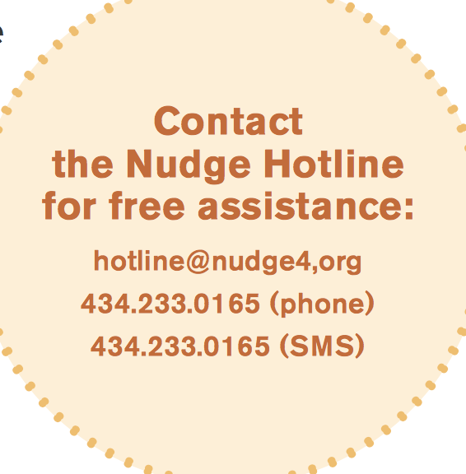
Supports for assessment preparation and completion
Implement universal school-day testing policy.
Offer assistance with testing fee waivers.
Establish a testing center on your high school campus.
Communicate testing schedule and timeline through:
Emails and phone blasts.
Information tables at athletic events.
Help students prepare with:
Training on test-taking.
Exam preparation or workshops (including direct tutoring, ordering practice tests, or using training software).
(Page & Scott-Clayton, 2016; Tierney et al., 2009; Klasik, 2013)
Notes:
Talking points:
There are ways to help ensure students take the test:
Implement universal school-day test taking. That is, all students take the test during a designated school day. These testing policies can impact whether and where students enroll in college. One study reported significant impacts of universal testing on college enrollment in Illinois and positive although insignificant effects in Colorado and Maine (Klasik, 2013).
Helping students apply for testing fee waivers eliminates the financial barrier. This might be done as part of an advisory period or "application week" as described on the prior slide.
Ease the process and reduce anxiety for students by establishing a testing center on your high school campus. Students come to the high school for the test rather than having to travel to an unfamiliar location.
Provide a clear testing schedule and timeline and remind students with email and phone blasts to ensure they don’t miss important dates.
Have an information table at events students and families attend, such as sporting events. These tables can provide all necessary the information, so students and families get the information.
You can also help students prepare to take the exams:
Offer training on test taking strategies during class time.
Offer exam preparation classes or workshops, either directly through the school or by partnering with college access programs. Test preparation can include providing direct tutoring, ordering practice tests, or using training software.
References:
Klasik, D. (2013). The ACT of enrollment: The college enrollment effects of state-required college entrance exam testing. Educational Researcher, 42(3), 151–160.
Page, L. C., & Scott-Clayton, J. (2016). Improving college access in the United States: Barriers and policy responses. Economics of Education Review, 51, 4–22. https://doi.org/10.1016/j.econedurev.2016.02.009
Tierney, W. G., Bailey, T., Constantine, J., Finkelstein, N., & Hurd, N. F. (2009). Helping students navigate the path to college: What high schools can do: A practice guide (NCEE #2009-4066). U.S. Department of Education, Institute of Education Sciences, National Center for Education Evaluation and Regional Assistance. https://ies.ed.gov/ncee/wwc/Docs/PracticeGuide/higher_ed_pg_091509.pdf

Slide 17
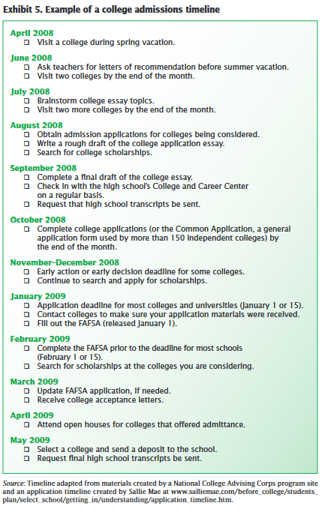
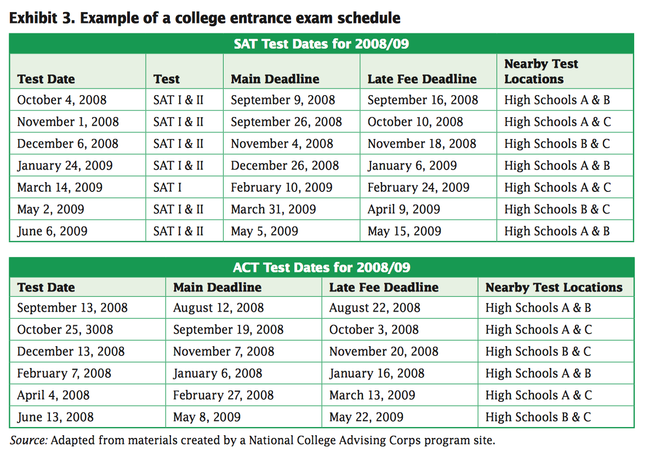
Sample schedules
Notes:
Talking Points:
This is an example timeline and schedule to support students in completing the application and assessment requirements.
References:
These example timelines are from the IES practice guide: https://ies.ed.gov/ncee/wwc/Docs/PracticeGuide/higher_ed_pg_091509.pdf

Slide 18
Financial supports
Notes:
Talking points:
Research shows that completion rates for high school seniors have risen over time, and that a significantly larger percentage of students who complete the FAFSA ultimately enroll in college compared to those who do not.
Reference
National College Attainment Network. (2019). National FAFSA completion rates for high school seniors.
https://www.ncan.org/page/NationalFAFSACompletionRatesforHighSchoolSeniorsandGraduates

Slide 19
FAFSA completion matters
Completion rates for graduating seniors have risen from 57.2 percent in the class of 2015 to 61.2 percent for the graduating class of 2019.
91.5 percent of students who complete the FAFSA enroll in college in the fall, compared to only 49.7 percent of students who do not complete the FAFSA.
Many students who do not complete the FAFSA would have qualified for federal Pell Grants. Estimates suggest students are missing out on up to $2.6 billion in college funding, with each student leaving behind an average of $4,000.
(Helhoski, 2018; NCAN, 2019)
Notes:
Talking points:
Completion rates for high school seniors has gone up slightly in last four years.
Research shows that completing the FAFSA is related to enrolling in college, and many students who do not complete it would have qualified for aid. These students are missing out on an average of $4000. (Note: Another study calculated missed funding at over $9,000 when including Pell plus other funding sources. https://papers.ssrn.com/sol3/papers.cfm?abstract_id=2353846).
Funds left behind are calculated annually by nerd wallet. Data presented are 2018/19 school year. https://www.nerdwallet.com/blog/2018-fafsa-study/
References:
National College Attainment Network. (2019). National FAFSA completion rates for high school seniors. https://www.ncan.org/page/NationalFAFSACompletionRatesforHighSchoolSeniorsandGraduates
Helhoski, A. (2018). Students missed out on $2.6 billion in free college money. Nerd Wallet. https://www.nerdwallet.com/blog/2018-fafsa-study/

Slide 20
What do you think?
The biggest barrier to students completing their FAFSA application is _____________.
Notes:
Talking points:
Before we look at research-based strategies, let's consider: What is the biggest barrier to students completing the FAFSA application?
Facilitator notes:
If you are working in a group, as people share comments (either posting in person or through discussion or in a chat box for virtual meetings), read ideas out loud and reflect on common themes emerging. Relate back to those ideas when presenting the next few slides.

Slide 21
Why don’t students complete the FAFSA?
Don’t know about it.
It’s too long and too complicated.
Fear of the cost of college and student debt.
Believe they don’t qualify for funds.
Missed deadlines.
Unwillingness to share personal information with the government.
(Davidson, 2013; Hodara, 2017)
Notes:
Talking Points:
Research tells us some of the reasons students don’t complete the FAFSA:
They might not know it exists, or it seems too long and complicated.
They may be afraid of the cost of college and fear student debt.
They may think they wouldn’t qualify anyway.
They may miss deadlines.
They may not want to share personal information.
References:
Hodara, M. (2017, January 17). What does the research say about barriers to FAFSA completion and strategies to boost completion? Education Northwest.
Davidson, J. C. (2013). Increasing FAFSA completion rates: Research, policies and practices. Journal of Student Financial Aid, 43(1).

Slide 22
Families need information and personalized assistance with FAFSA
Compared with participants who received no information, or received only information without additional supports, participants who received information and personalized assistance had significant increases in FAFSA completion and college enrollment.
Early and accurate information has shown some evidence for improving FAFSA completion rates.
(Bettinger et al., 2012; George-Jackson & Gast, 2016)
Notes:
Talking points:
Research that has examined the value of supporting families in completing the FAFSA has shown that personalized assistance in completing the FAFSA has increased the number of completed FAFSAs for low- and moderate-income families.
Researchers placed participants, who had come to a well-known accounting firm for tax assistance, into three randomly-assigned groups:
No information and no assistance with FAFSA
Information only
Information and completion assistance
The researchers found that those participants who received information and additional personal support had significant increases in FAFSA completion compared to those who just had information but no extra help.
Other research (a literature review of financial aid research published between 2000 and 2013, George-Jackson, 2015) has shown some evidence that providing students and families the information about FAFSA early, in other words -- during middle school and early high school instead of waiting until senior year – can give families more accurate information and is linked to increased applications for financial aid.
References:
Bettinger, E. P., Long, B. T., Oreopoulos, P., & Sanbonmatsu, L. (2012). The role of application assistance and information in college decisions: Results from the H&R Block FAFSA experiment. The Quarterly Journal of Economics, 127(3), 1205–1242.
George-Jackson, C., & Gast, M. J. (2016). Addressing information gaps: Disparities in financial awareness and preparedness on the road to college. Journal of Financial Aid, 44(3). https://ir.library.louisville.edu/jsfa/vol44/iss3/3

Slide 23
School-based activities to support FAFSA completion
Provide detailed timelines for students and families.
Implement in-class interventions.
Build a school-based FAFSA team.
Host FAFSA completion nights.
Partner with local postsecondary institutions.
Test small before going big.
(Black, 2016; Scholarship America, 2020)
Notes:
Talking points:
There are several activities that can support students to complete their FAFSAs.
Implement school-based supports, such as preparing detailed timelines for students
Implement FAFSA-completion as a classroom assignment, perhaps for social studies or economics.
Building a school-based team familiar with the FAFSA.
Track data about student completion can help ensure students get it done.
Host a FAFSA-completion night to give students and families some devoted time and support on hand to complete the requirements and get their questions answered in the moment.
Partner with local institutions where financial aid experts can help students with the FAFSA and answer questions.
Consider starting with a focus on a certain group of students, to pilot these strategies and see what's most effective.
References:
Scholarship America. (2020, June). You can boost FAFSA completion in your Community. Here’s how. https://scholarshipamerica.org/blog/you-can-boost-fafsa-completion-in-your-community-heres-how/
Black, H. (2016). 10 effective strategies to increase FAFSA completion in your community. StriveTogether. https://www.strivetogether.org/library/strategies-increase-fafsa-completion/

Slide 24
Using data to track and encourage FAFSA completion
Use student and school-level data to know who’s completed.
Frequently monitor data.
Track progress and impact of your interventions with data visuals (for example, charts).
(Black, 2016)
Notes:
Talking points:
Using data can help support FAFSA completion
-FAFSA data can help school-based practitioners target their support.
-Accessing and regularly monitoring these data on who has completed the FAFSA has become more available and these data can be useful in focusing on the students who need the support.
-And, keeping track of who is completing the FAFSA, and what supports they had, can help you to determine the interventions that are the most effective.
References:
Black, H. (2016). 10 effective strategies to increase FAFSA completion in your community. StriveTogether.
https://www.strivetogether.org/library/strategies-increase-fafsa-completion/

Slide 25
FAFSA tracking resources
U.S. Department of Education’s Federal Student Aid website
Provides current state and school-level data about FAFSA submissions and completions, updated regularly.
Schools can obtain student-level data on completion status, but must first enter into a data sharing agreement.
Form your Future, sponsored by the National College Access Network
Provides data displays that track change over time at the state, district, and city level.
https://studentaid.ed.gov/sa/about/data-center/student/application-volume/fafsa-completion-high-school
https://formyourfuture.org/
Notes:
Talking points:
There are several resources to support the use of FAFSA data. The US Department of Education has several resources, including access to data that is up to date, timelines, and other resources. The link is provided in this slide.
NCAN provides a range of additional resources, such as data displays that track FAFSA completion in your state or district. The link to “Form Your Future” offers various data displays created by NCAN as well as a FAFSA tracker and tips for encouraging students to complete the FAFSA.

Slide 26
Wrap-up and next steps
Notes:
Facilitator notes:
Transition slide

Slide 27
Question and answer
Notes:
Facilitator notes:
Pause to take any questions if working with a group.

Slide 28
Continuing this journey How can you use what we discussed today?
Develop an action plan
In which area do you want to improve?
What specific strategies or considerations from today’s presentation do you want to employ?
Refer to the Strategies and Possible Applications section of the resource compilation for more ideas.
What’s your plan?
Identify next steps.
Assign responsible parties and due dates.
Track progress.
Notes:
Talking Points
Now it's time to continue the journey.
The resource includes a template for action planning. The action-planning template provides a table for action steps and some guiding questions. A sample is also provided.
In addition, the student scenarios are also available for review and consideration in light of the content of this deck.
Facilitator's Note
• If working as a group, a discussion here can help the participants to move to action. Ask participants to share which area they may focus on and some of the ideas they are most interested in pursuing.
• Also consider engaging the group in a discussion of the student scenarios (see Supplemental materials). The student scenarios can help to concretize and deepen the discussion.

