Slide 1
U.S. Department of Education Office of Inspector General (ED OIG) Small Business Innovation Research (SBIR) Fraud Awareness
Robinette Brown, Special Agent
Mid-Atlantic Region
Washington Field Office

Slide 2
ED OIG
Mission
Promote the efficiency, effectiveness, and integrity of U.S. Department of Education programs and operations
What We Do
Identify and prevent fraud, waste, and abuse involving Department funds, programs, and operations

Slide 3
ED OIG Authority
Inspector General Act of 1978
OIGs are independent and objective
Direct/unrestricted access to agency records and information
Subpoena Authority - Obtain information and records outside the agency
Statutory law enforcement authority
Execute arrest and search warrants
Semiannual Report to Congress

Slide 4
ED OIG Components
Immediate Office
IG, Deputy IG, Quality & Integrity Group, Counsel/Public Affairs
Audit Services
Management Services
Investigation Services
IT Audits and Computer Crime Investigations

Slide 5
ED OIG Organizational Chart

Slide 6
Investigation Services
Who do we investigate?
Any entity or person that receives ED funds or participates in ED programs
e.g. – grant recipients, contractors, school officials, teachers, students, and ED employees
What do we do?
Conduct investigations of fraud, corruption and misconduct.
Criminal
Civil
Administrative

Slide 7
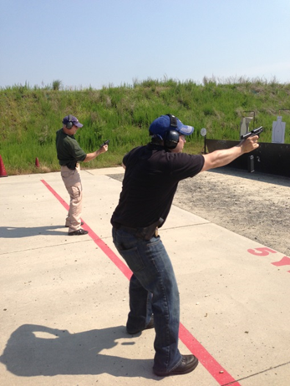
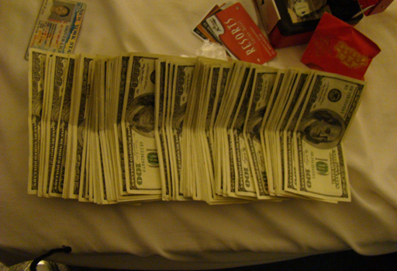
ED OIG Federal Agents:
Conduct Investigations
Execute Arrest and Search Warrants
Serve Grand Jury and IG Subpoenas
Carry Firearms

Slide 8
Legal Elements of Fraud
Must be proved by showing that the defendant’s actions involved five separate elements:
A false statement of a material fact
Knowledge that the statement is untrue
Intent to deceive the alleged victim
Justifiable reliance by the alleged victim on the statement
Injury to the alleged victim as a result

Slide 9
Fraud (continued)
So what does that really mean?
Fraud can also be defined as:
Using dishonest methods to take something of value from another
Deceit, trickery, misrepresentation
Lying, cheating, stealing
“There is no kind of dishonesty into which otherwise good people more easily and frequently fall than that of defrauding the government.” - Benjamin Franklin

Slide 10
Why should you care about fraud?
You are a steward of federal funds
Ethical and legal responsibility to safeguard the funds
SBIR award must be used for its intended purpose
Misuse or theft of funds is a crime
You may be subject to criminal and/or civil prosecution

Slide 11
Sources of Investigations
Anonymous – OIG Hotline
ED Program Offices
School Administrators & Employees
Other Law Enforcement Agencies
U.S. Attorney’s Offices
Guaranty Agencies
Grantees
Contractors & Subcontractors
Students, Citizens

Slide 12
ED SBIR Program
Overview
The SBIR program was established in 1982 under the Small Business Innovation Development Act
11partipating Federal Agencies
Competitive awards (funded as grants or contracts)
$2.5 billion awarded annually government-wide through grants or contracts to for-profit small business firms and their partners
ED has one of the smaller SBIR programs
Awards $7.5 million annually through the Institute of Education Sciences
Provides up to $1,050,000 for research & development of commercially viable education technology products

Slide 13
Examples of SBIR Fraud
Falsification of Eligibility
Company must be U.S. owned / U.S. based
Must be a small business (fewer than 500 employees)
Must be at least 51% owned by one or more individuals
Duplicate Funding
Cannot receive SBIR funding from other Federal agencies for equivalent work
Principle Investigator (PI)
Cannot be employed full-time elsewhere unless granted waiver
PI cannot be different than PI listed in the application unless granted waiver

Slide 14
Examples of SBIR Fraud (cont.)
Grantee not performing substantial portion of research
Phase I – requires 2/3 of research
Phase II – requires ½ of research
False statements and claims:
Includes info furnished by grantee leading to grant award or grant performance.
Includes false certifications
Lying to obtain SBIR Grant/Contract (18 USC § 1001)

Slide 15
Criminal Offenses
If you lie to obtain SBIR funds or lie about how the funds were used:
False Statements(18 USC §1001)
Theft of Federal Funds (18 USC §641)
Wire Fraud (18 USC §1343)
If you use SBIR funds for personal use:
Criminal Conversion (18 USC §641)
And, if you don’t report if on your Federal tax return
Tax Evasion, 26 USC §7201

Slide 16
Criminal Offenses (cont.)
If you lie to OIG, destroy evidence or fabricate evidence:
Obstruction of Justice (18 USC §1505)
False Statements (18 USC §1001)
Falsification of Records Involving Federal Investigations
(18 USC §1519)
You can go to prison for all of these offenses, and be required to pay restitution and fines

Slide 17
Civil Issues
The False Claims Act 31 USC §3729
Causing a false claim for payment
May include false information in SBIR proposal, false current costs or pricing data, false certifications, false progress reports, etc.
Government does not need to prove specific intent to defraud
Actual knowledge, reckless disregard for the truth, or deliberate ignorance
Penalties of treble damages plus $5,500 to $11,000 per each false claim

Slide 18
Administrative Remedies
Suspension
A temporary exclusion from new awards pending an ongoing investigation or administrative action
Debarment
Action taken at the completion of proceedings that renders an entity/person ineligible from receiving awards for a specific period of time – usually three years

Slide 19
Results of Investigations
Incarceration, Restitution, Forfeiture
Administrative & Civil Penalties – False Claims Act
Suspension & Debarment
Grant/Contract Termination

Slide 20
SBIR Fraud Case Examples
AQUASENT and several of its officials and employees entered into a civil settlement to pay $400,000 to resolve allegations they violated the False Claims Act. AQUASENT received approximately $924,618 under NSF’s SBIR program. It was alleged that AQUASENT made false certifications relating to the PI’s primary employment; the scope and size of AQUASENT’s facilities; submission of false timesheets, etc.
June 2, 2016

Slide 21
SBIR Fraud Case Examples
A Florida federal jury found two scientists guilty of conspiracy to commit wire fraud, wire fraud, aggravated identity theft, and falsification of records involving a federal investigation. Mahmoud Aldissi, owner of Fractal Systems Inc., and Anastassia Bogomolova, owner of Smart Polymers Research Corp., were convicted of submitting proposals for SBIR contracts between 2004 and 2014 using stolen identities in order to create false endorsements for their proposed contracts. Aldissi and Bogomolova fraudulently obtained approximately $10.5 million in government research grants from the U.S. Department of Defense and other agencies. March 23, 2015

Slide 22
OIG Role in SBIR Fraud , Waste & Abuse Prevention
Establish fraud detection indicators
Review regulations and operating procedures of the Federal agency
Coordinate information sharing between Federal agencies
Improve the education, training, and outreach to:
Administrators of SBIR program
Applicants to the SBIR program
Recipients of awards under the SBIR program

Slide 23
Reporting Suspected Fraud
Anyone who suspects fraud should report it
Don’t “tip off” subjects of actual or pending investigation
Suspected fraud can be reported to:
ED OIG Regional Offices http://www2.ed.gov/about/offices/list/oig/misused/index.html
ED OIG Hotline http://www2.ed.gov/about/offices/list/oig/hotline.html
1-800 MIS-USED
Fax: 202-245-7047
Notes:
What should you do if you suspect fraud?

Slide 24
Bottom Line
Make sure you understand and comply with SBIR requirements
If you have questions, you should reach out to the ED SBIR program officer, Ed Metz
Do not lie or cheat to obtain SBIR funds
This is fraud
Do not steal SBIR funds
This is fraud
If you commit fraud
Investigations, convictions, incarceration, fines
Report fraud, waste or abuse

Slide 25
Questions?
Robinette Brown
Special Agent
202-245-6500
Robinette.Brown@ed.gov

